Slide 1


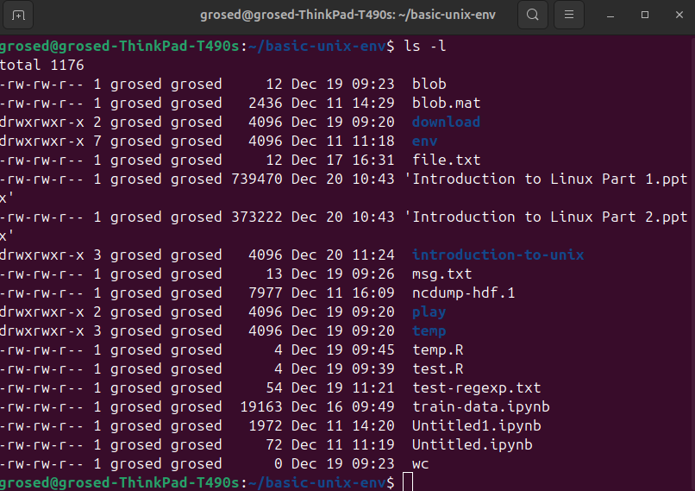

stdout
command
stdin

Slide 2
keyboard
display
stdin
stdout
command

Slide 3
keyboard
display
stdin
stdout
command

Slide 4
keyboard
display
stdin
stdout
command

Slide 5
keyboard
display
stdin
stdout
command

Slide 6
temporary
file
stdin
command 1
command 2
stdout
temporary
file
stdin
command 1
command 2
stdout

