Slide 1
Team Fitbit
JHU DaSH
Final Presentation

Slide 2
Problem
Scrape our own fitbit sleep and step data and create a shiny app to examine patterns of activity at different day of the week, times of the day, and hours of the day.
Examine how sleep relates to total number of daily steps.

Slide 3
Data
Sleep data was at daily level and step data was at 15 min. intervals and merging the two across the time scales and individuals was a challenge.
We computed total daily steps for each person within each day.
N = 5 and length of time of available data varies
No sleep data for one person.
One person is a marathon runner (2 marathons last year).
One person only started using the device about 2 weeks ago.
One person’s device broke in mid-July and was not replace until Sept.
One person can’t keep track of his charger.
Removed days with zero steps.

Slide 4
Results
For these data, it does not appear that steps and sleep duration or quality are related.
Remember: N=4 for sleep data

Slide 5
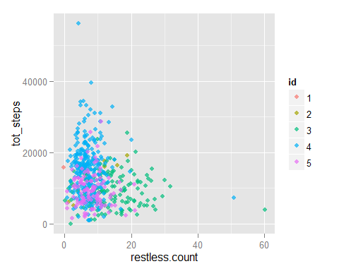

Slide 6
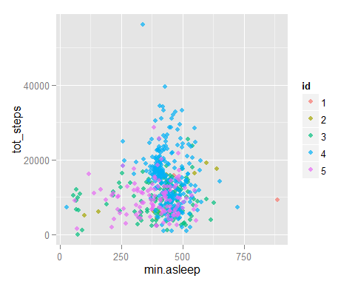

Slide 7
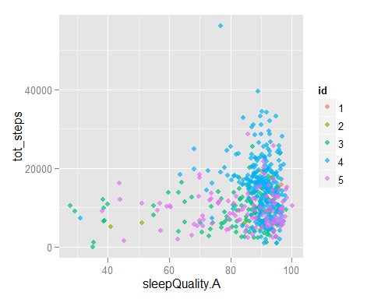

Slide 8
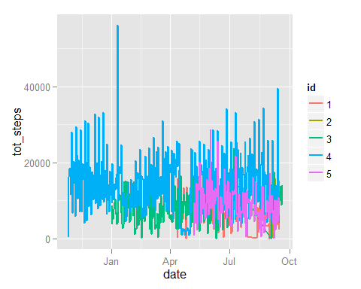

Slide 9
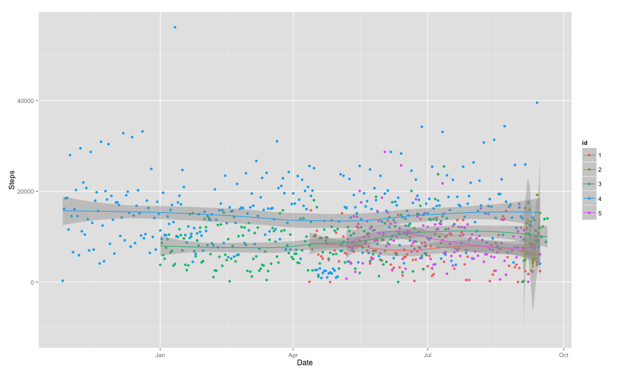

Slide 10
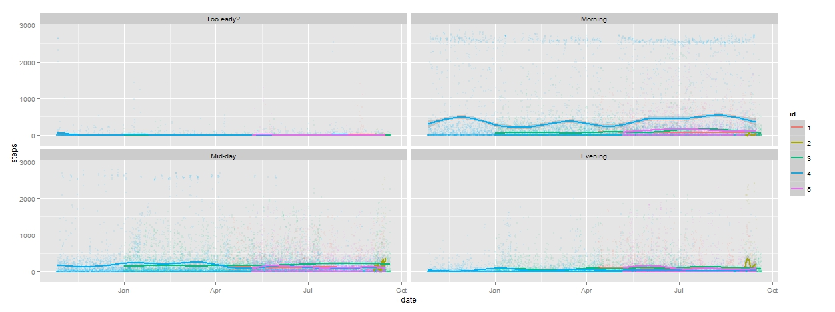

Slide 11
Shiny & Github
https://abbynoyce.shinyapps.io/shiny_day_time_viz
https://github.com/grosenf1/Fitbit_analysis_JHUDash

