Slide 1


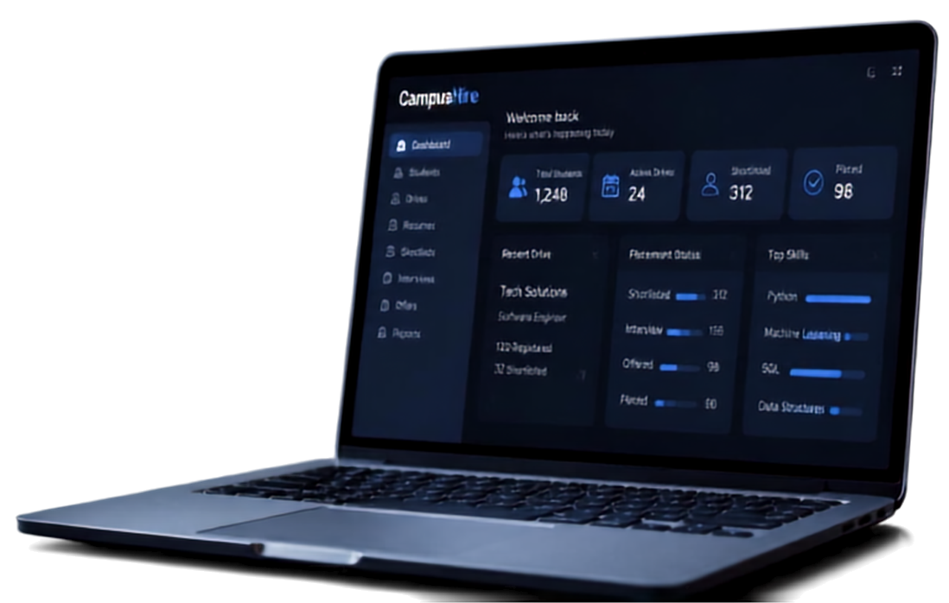



CAMPUSHIRE
Placement Management Platform
A smart digital platform for
student placement management
PRESENTED BY:
Garswel Roshan A.M.
B.Tech – AI & Machine Learning

Slide 2



Introduction & Problem Statement
Campushire is a web-based platform that streamlines the placement process and centralizes every student detail.
THE CHALLENGE
Manual placement data management
Scattered student information
Outdated and hard-to-maintain resumes
Lack of personalized placement guidance
Time-consuming candidate shortlisting

Slide 3


Objectives
Build a centralized placement management platform
Maintain complete student profiles
Manage skills, projects, certifications and resumes
Leverage AI to analyze resumes and identify skill gaps
Enhance placement readiness and streamline recruitment

Slide 4

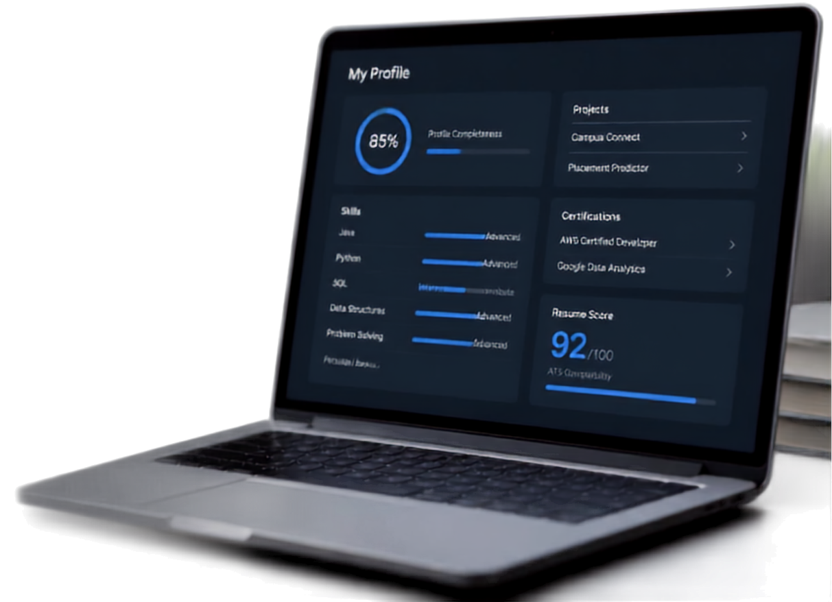
Key Features
Everything students need to showcase, improve, and get placed.
My Profile
Projects
85%
Profile Completeness
Campus Connect
Placement Predictor
STUDENT PROFILE
RESUME MANAGEMENT
Certifications
Complete and up-to-date profiles
Skills and proficiency insights
Projects and academic work
Certifications and achievements
GitHub and LinkedIn integration
Portfolio that stands out
Upload and manage resumes
AI-powered resume analysis
ATS compatibility score
Missing skills identification
Personalized improvement tips
AWS Certified Developer
Google Data Analytics
Resume Score
92
/100
ATS Competibility

Slide 5















Technology & System Workflow
TECHNOLOGY STACK
React.js – Frontend
JavaScript / TypeScript – Application logic
HTML5 – Structure
CSS / Tailwind CSS – UI Design
AI / NLP – Resume Analysis
Netlify – Deployment
SYSTEM WORKFLOW
Student
Profile
Skills & Projects
Resume Upload
Analysis
Improvement
Placement Ready

Slide 6


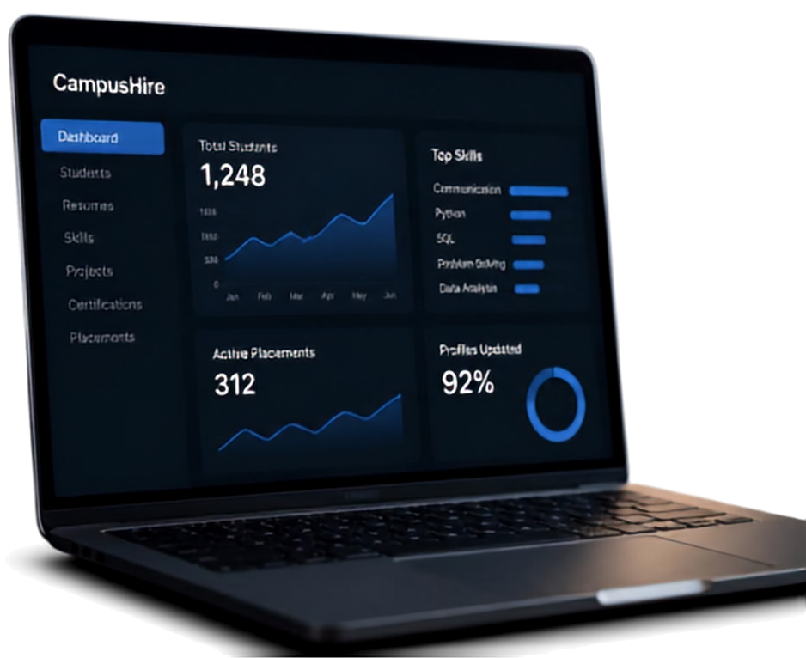

Advantages &
Future Scope
WHY CAMPUSHIRE GIVES YOU AN EDGE
Campushire
All student data in one place
Simple and efficient profile management
Less manual work, more time saved
Higher-quality, recruiter-ready resumes
Spot skill gaps early
Stronger placement readiness
1,248
Total Students
Students
Resumes
Skills
Projects
Certifications
placements
Active Placements
Profiles Updated
312
92%
BUILT FOR WHAT’S NEXT
AI-powered job recommendations
Smarter student-job matching
Interview preparation chatbot
Skill gaps analysis
Recruiter dashboard
Automated candidate shortlisting

Slide 7



CONCLUSION
CampusHire
Prepare • Improve • Get Hiring
A centralized platform for smarter placements
Unifies profiles, skills, projects, certifications, and AI-powered resume analysis
Empowering students to become placement-ready
THANK YOU

