Slide 1
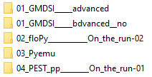
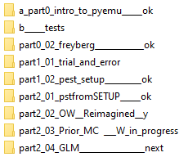
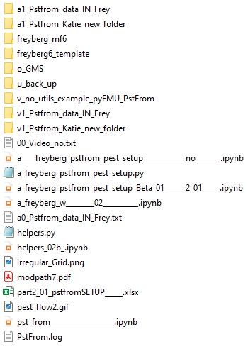
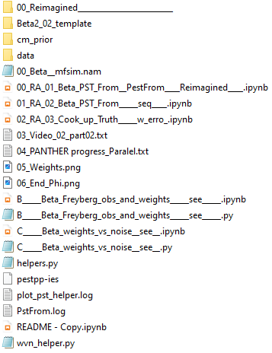
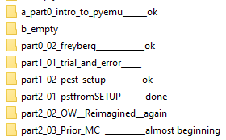
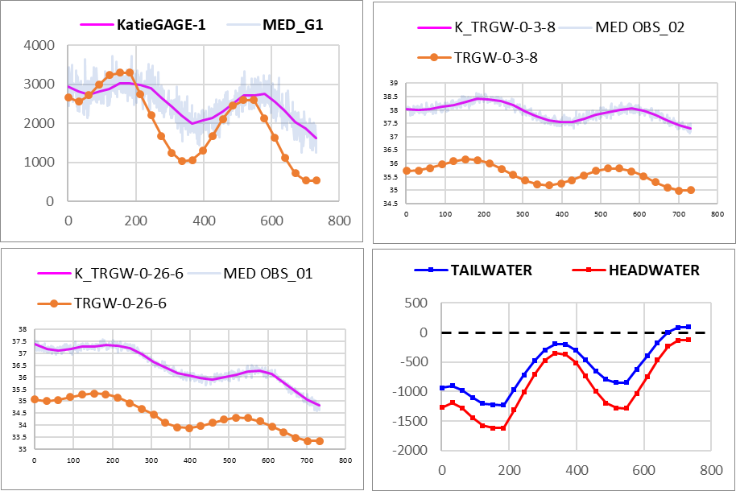
2_01
2_02
S2 sequence
0_02
2_01
S1
2_02
Last one:
Move on …
simplified
OBS
0_02
+ time series
2024 - www.betami.com.br
Beta μ

Slide 2
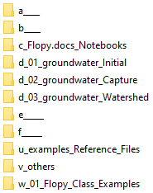
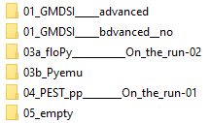

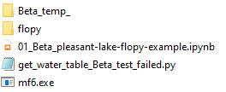
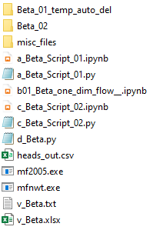
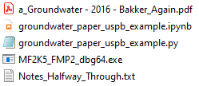
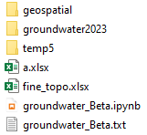
0
0
02
03
03
04
+50
0
02
03.1
06 phases
04
+10
03.2
multi_threads err
Last one:
Move on …
Streamflow
Postprocessing errs
03.3
s
2024 - www.betami.com.br
Beta μ

Slide 3

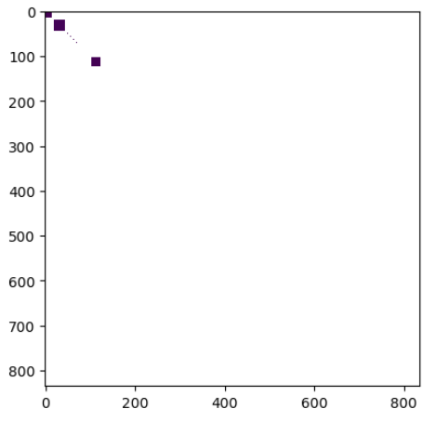
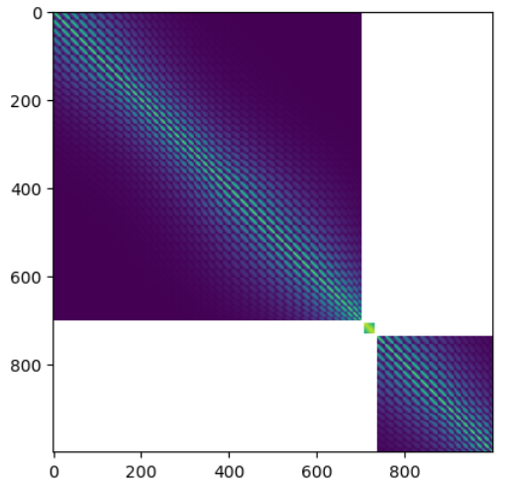
2_01 pstfromSETUP
01__OBS(a)
02__PAR(a)
03__BC & PAR(b)
04_IC
05__2º___OBS(b)
06__Writing___RUN
07__Prior_Ensemble_
08__Run_again_FW
09__Graphics...

Slide 4
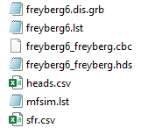

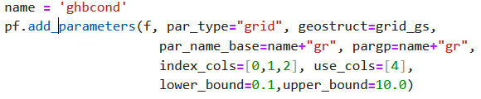
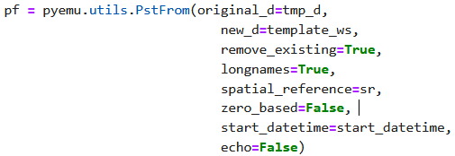

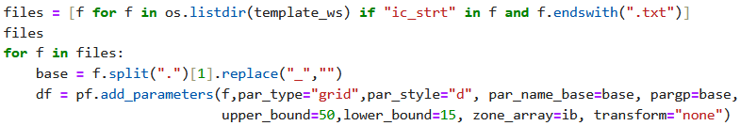

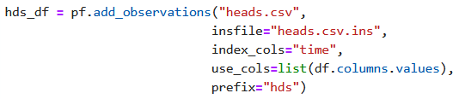


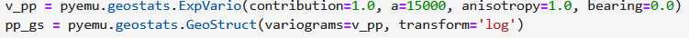
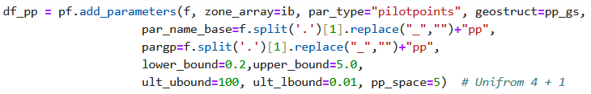

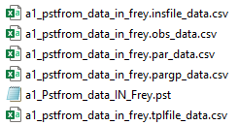

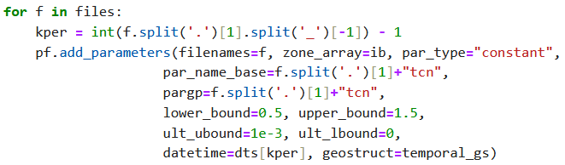
01 - 04
Housekeeping(2) + Flopy(1), … till the 1º run
Boundary conditions
2_01 pstfromSETUP
Pyemu, Pstfrom
ok
05 *.ins
12
IC
06
OBS
heads.csv → heads.csv.ins
13
14
15 – Helpers, Heads and Mass Balance
PST_03
Again
at 16
17,18,19 ______
PST_04
“Tag”
20 pst.write ___ external files
REC
07
Geostat. PAR
21
PST_05
08
RCH
Then, … ensemble ….

Slide 5
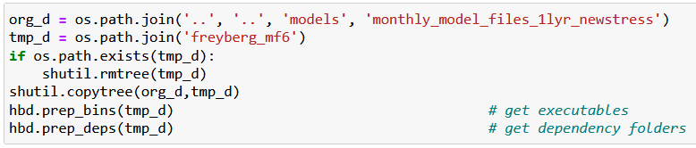

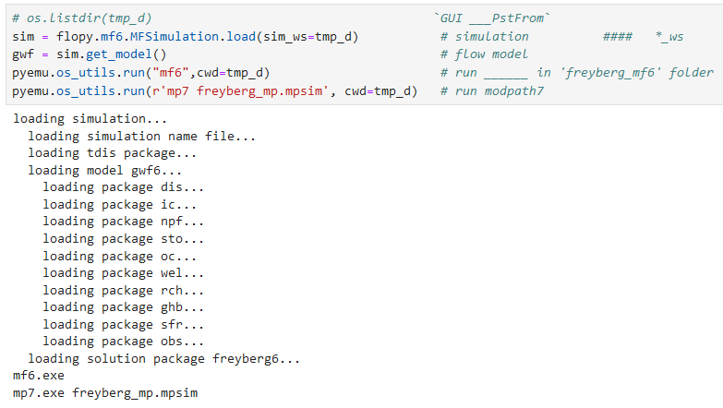

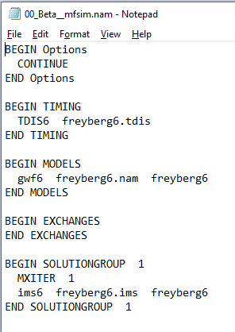
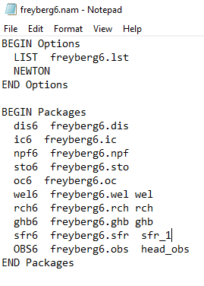
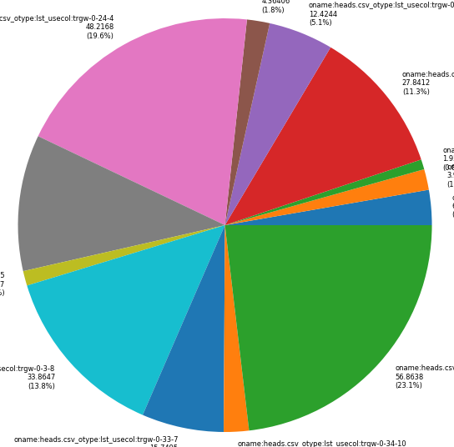
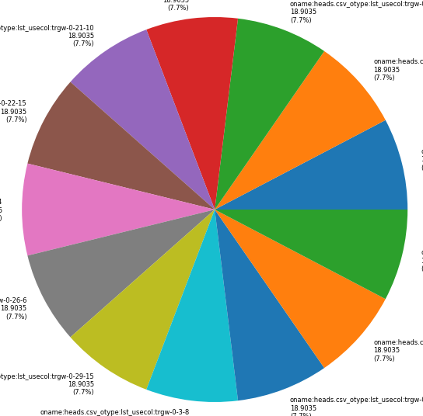
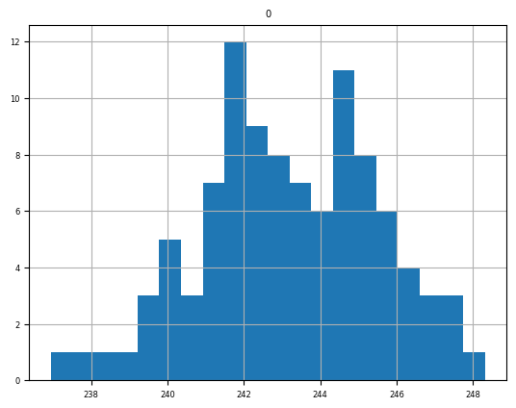

01
New folder
Just reference
workspace
New folder,
working
directory
FloPy
Freyberg
comparison
part2_01_
PEST SETUP
Workspace *.nam1,2,+*.exe
part2_02_
pstfrom Reimagined
… then Katie 2_02
pestpp-swp
Sweep
pyemu.os_utils.run('mf6',cwd=model_ws)
New folder
pyEMU

Slide 6
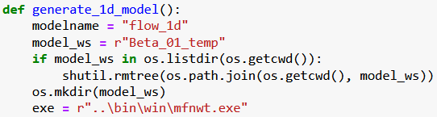


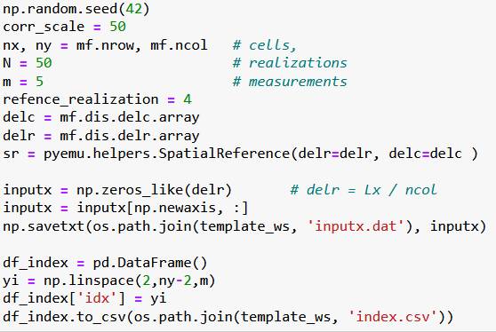
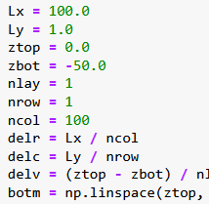
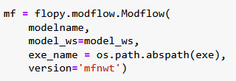
04
Beta_01
02
03
. . .
PEST_pp \ Benchmarks \ 1D
Mf5 _1d ___ SETUP
http://localhost:8888/notebooks/05_PEST_pp________On_the_run-01/benchmarks/01_one_dim_flow/02_Beta_model_SETUP___01__.ipynb
Stopped at:
# `Beta ____ multi_threads=false ____ error`

Slide 7

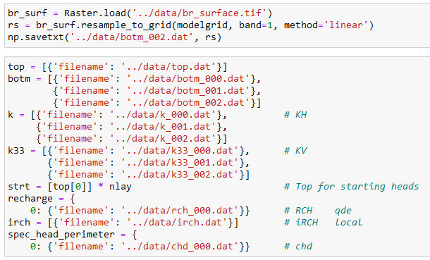
### `Stoped at ____: Postrocessing : Get_water_table()__Module` __________ err __ 2x
## ` Streamflow err... intersects` ____________` err_01 `
## Postrocessing : Get_water_table()__Module ____` err_02 `
02
03a_floPy_01_Pleasant-lake-flopy-example

Slide 8


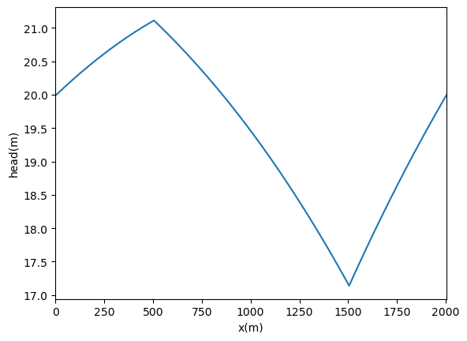
1 - 1, 201
10, 1
20
-30
How to insert a H line?
03.1 Part 01 - Capture

Slide 9
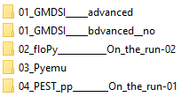
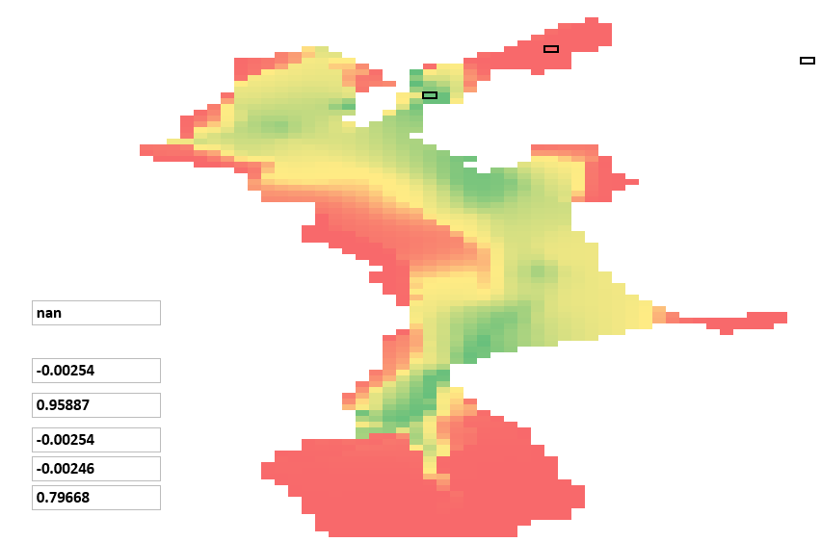
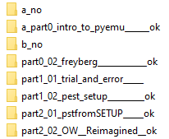
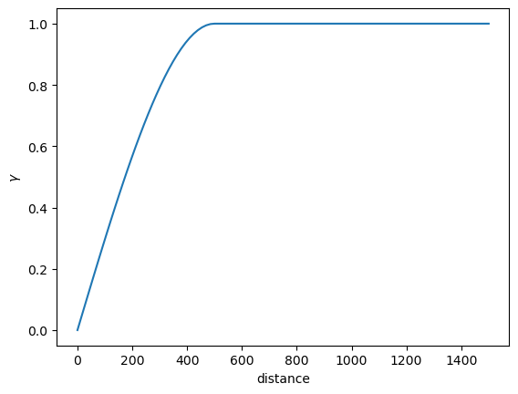
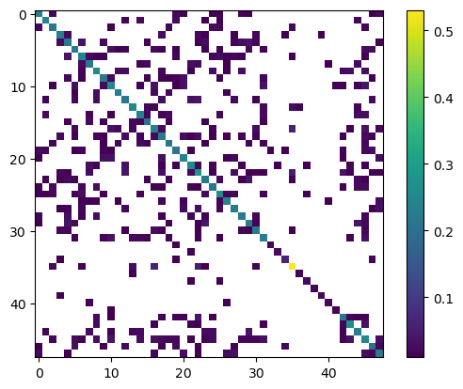
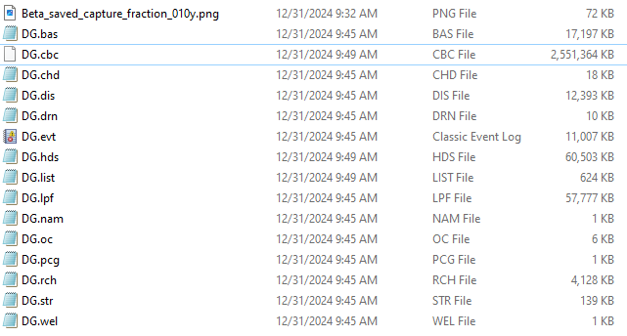
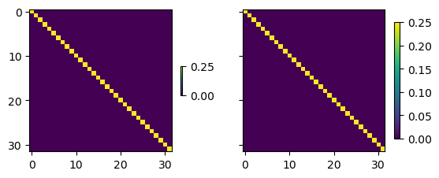
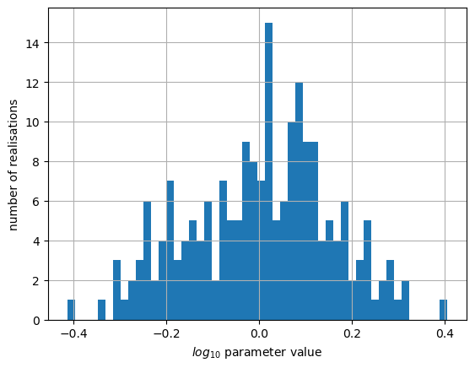
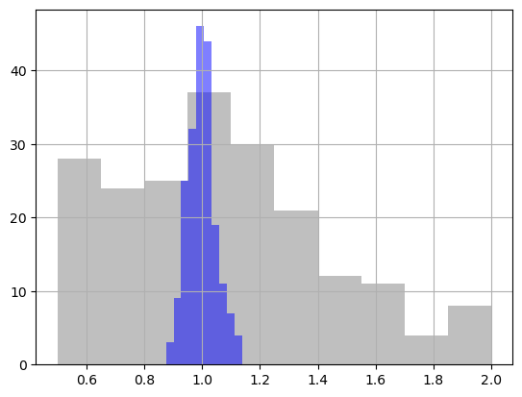
1.3 intro pyEMU
http://localhost:8888/notebooks/01_GMDSI_____advanced/01_Tutorials___AGAIN___/a_part0_intro_to_pyemu______ok/intro_to_pyemu________.ipynb#Geostatistics-=-PPCOV
Flopy
construction ?
## `First Order, Second Moment (FOSM)`_ Linear Analysis + forecasts _<font color='red'> Recording __*.cov </font>
# Previous Ensemble <font color='red'> possible issue </font> shutil.rmtree(t_d)
03.2 Part 02 - Capture

