Slide 1
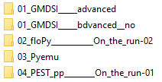
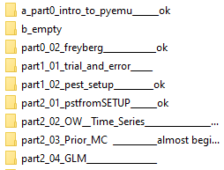
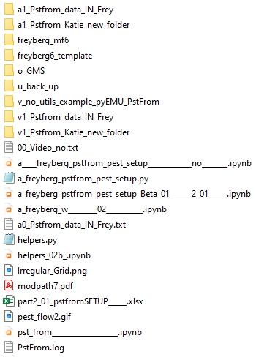
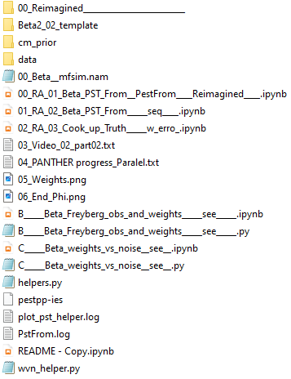
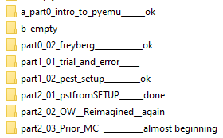
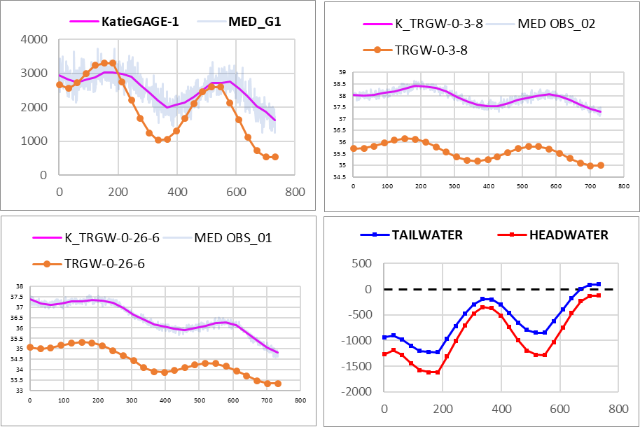
2_01
2_02
04
S2 sequence
FREYBERG
0_02
Original version
2_01
S1
2_02
simplified
Last one:
Move on …
OBS
0_02
+ time series
2024 - www.betami.com.br
Beta μ

Slide 2
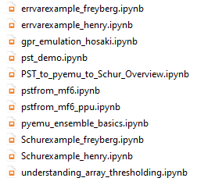

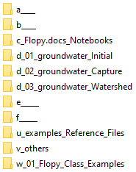

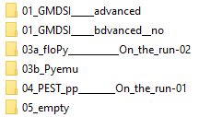

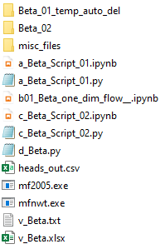

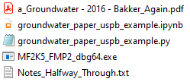
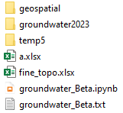
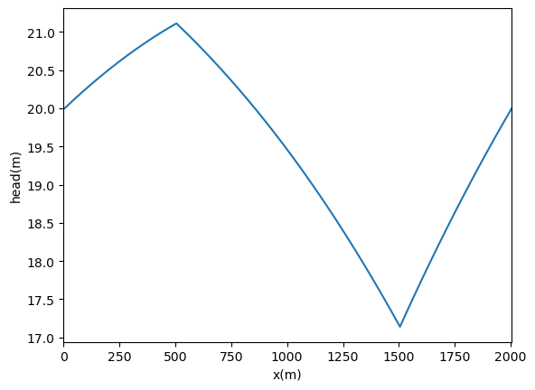
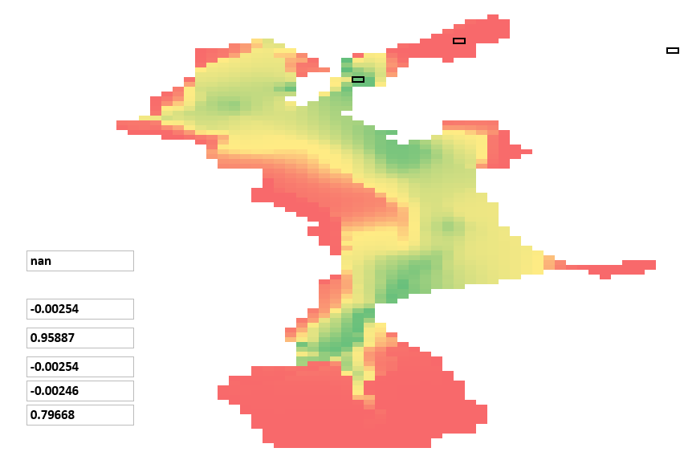
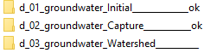
0
0
03
06
02
03
04
0
02
No
local
Temp.
ok
2
06 phases
04
Sfrmaker err
+10
Folders
swap
2
01
Sfrmaker & New folder err
Change TEMP folder
04
05
06
07
08
...
Last one:
Move on …
03
02
multi_threads
=
false
error
2
s
05
2024 - www.betami.com.br
Beta μ

Slide 3
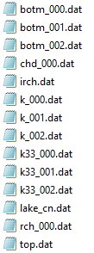

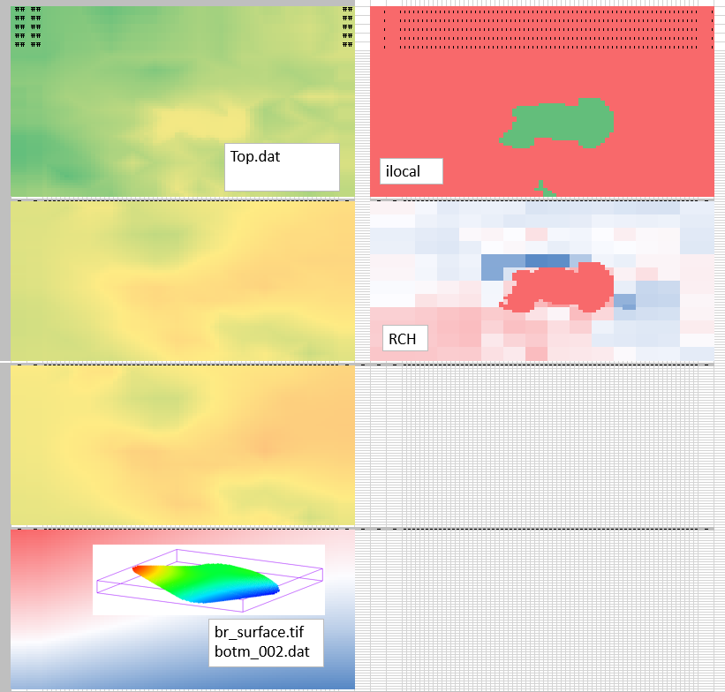
02

Slide 4
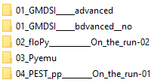
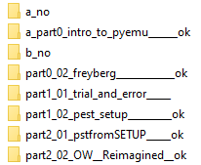
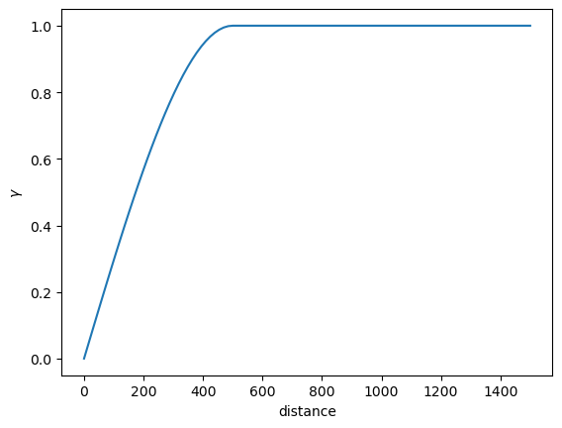
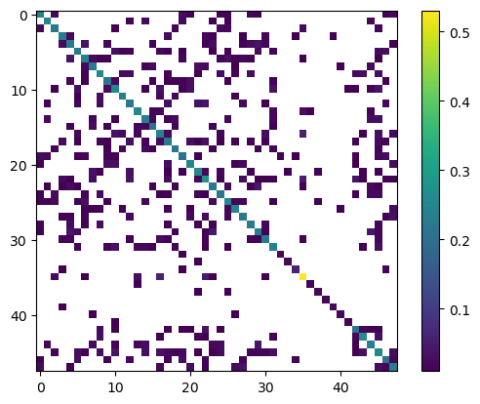
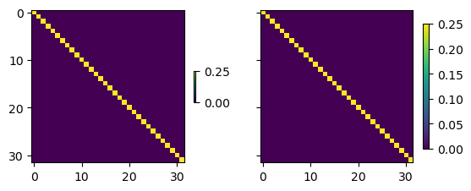
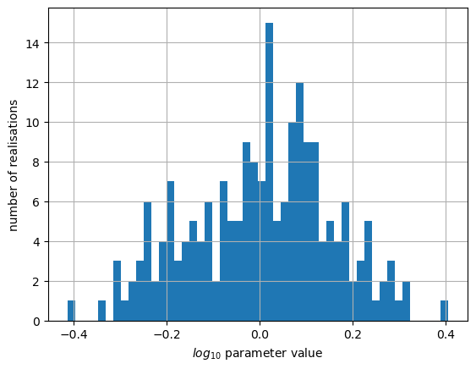
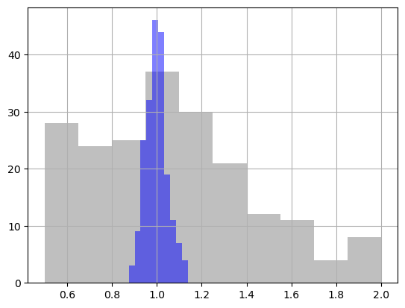
1.3 intro pyEMU

Slide 5

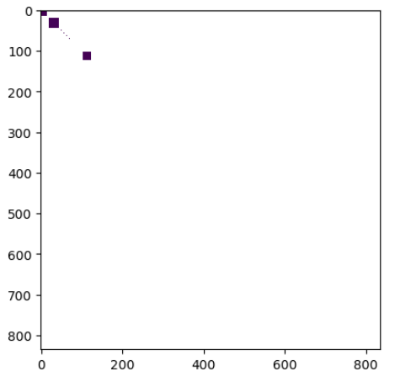
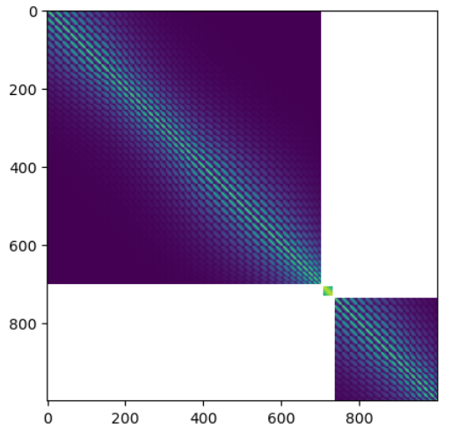
2_01 pstfromSETUP
Simples
Flopy ... Freyberg
2_01
01__OBS(a)
02__PAR(a)
03__BC & PAR(b)
04_IC
05__2º___OBS(b)
06__Writing___RUN
07__Prior_Ensemble_
08__Run_again_FW
09__Graphics...

Slide 6
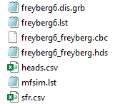

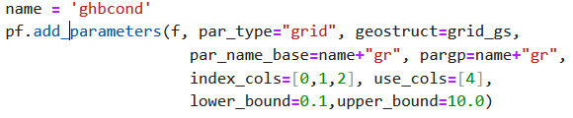
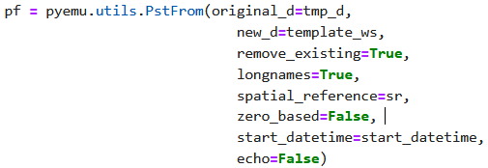

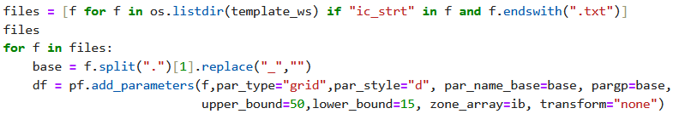

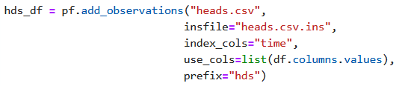


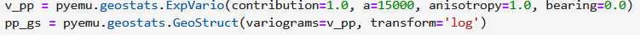
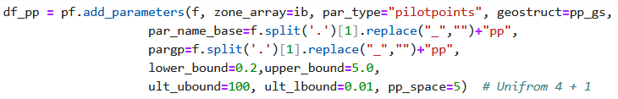

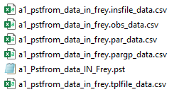

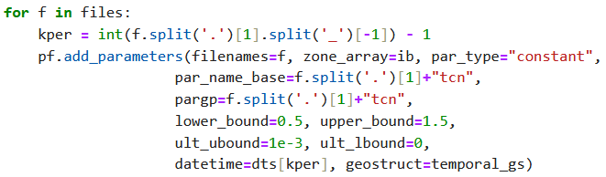
01 - 04
Housekeeping(2) + Flopy(1), … till the 1º run
Boundary conditions
2_01 pstfromSETUP
Pyemu, Pstfrom
ok
05 *.ins
12
IC
06
OBS
heads.csv → heads.csv.ins
13
14
15 – Helpers, Heads and Mass Balance
PST_03
Again
at 16
17,18,19 ______
PST_04
“Tag”
20 pst.write ___ external files
REC
07
Geostat. PAR
21
PST_05
08
RCH
Then, … ensemble ….

Slide 7
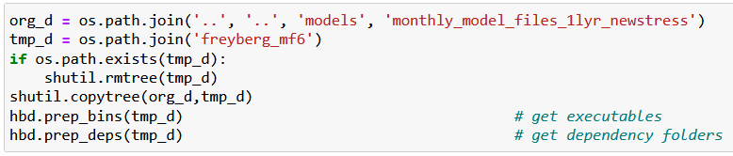

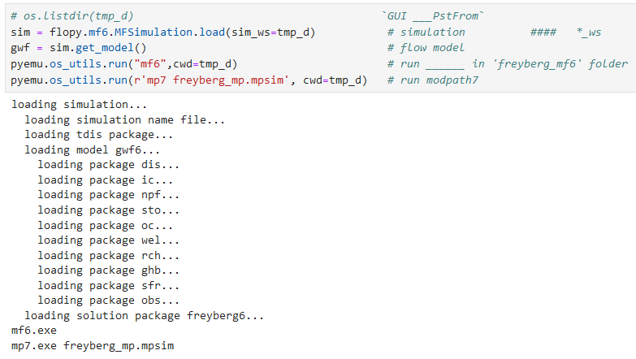

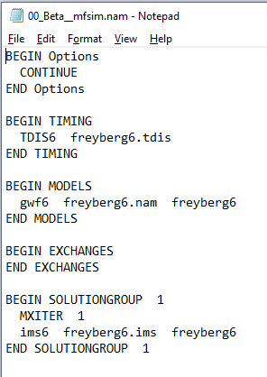
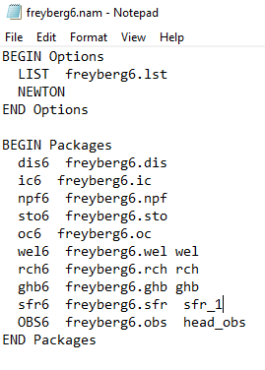
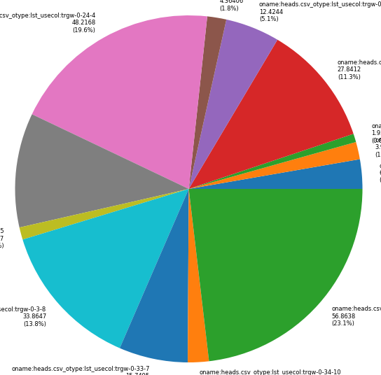
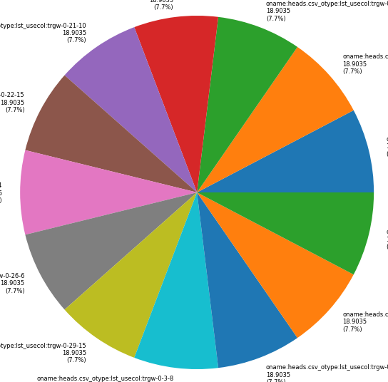
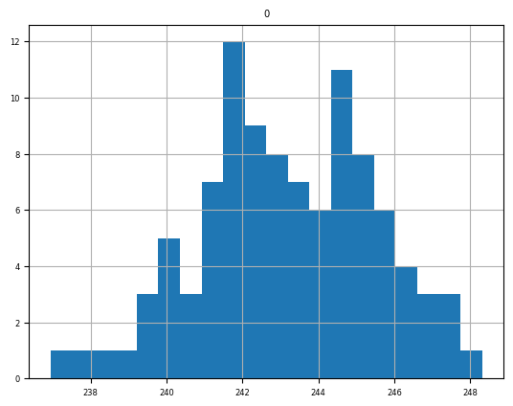

01
New folder
Just reference
workspace
New folder,
working
directory
FloPy
Freyberg
comparison
part2_01_
PEST SETUP
Workspace *.nam1,2,+*.exe
part2_02_
pstfrom Reimagined
… then Katie 2_02
pestpp-swp
Sweep
pyemu.os_utils.run('mf6',cwd=model_ws)
New folder
pyEMU

Slide 9


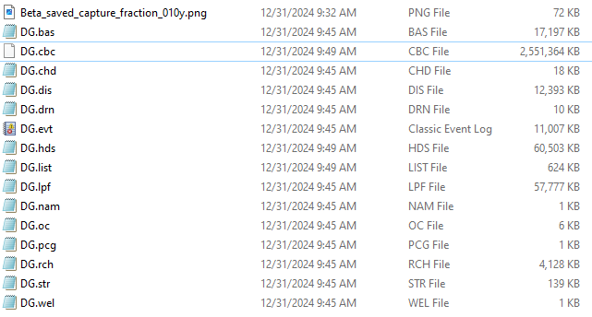
1 - 1, 201
10, 1
20
-30
insert line ..
Flopy construction ?
pyEMU - 03
Part 01 – 1D
Part 02 – Capture

Slide 10
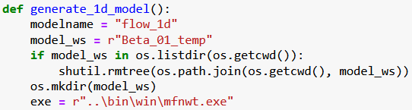


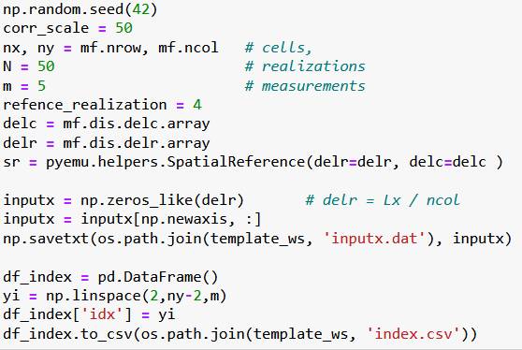
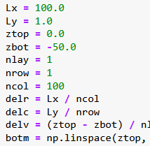
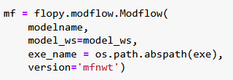
. . .
PEST_pp \ Benchmarks \ 1D
Mf5 _1d ___ SETUP
http://localhost:8888/notebooks/05_PEST_pp________On_the_run-01/benchmarks/01_one_dim_flow/02_Beta_model_SETUP___01__.ipynb
04
Stopped at:
# `Beta ____ multi_threads=false ____ error`

Slide 11

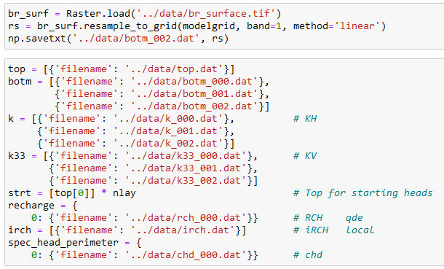
### `Stoped at ____: Postrocessing : Get_water_table()__Module` __________ err __ 2x
## ` Streamflow err... intersects` ____________` err_01 `
## Postrocessing : Get_water_table()__Module ____` err_02 `
02
03a_floPy_01_Pleasant-lake-flopy-example

