Slide 1

Transport
$$Beta μ$$

Slide 2



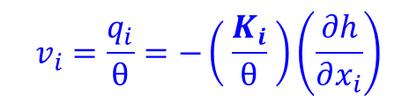







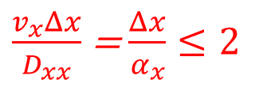




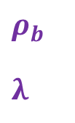

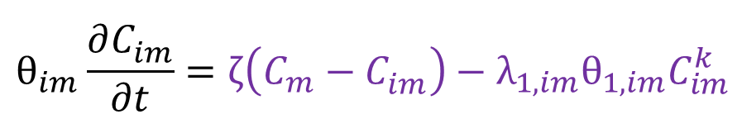
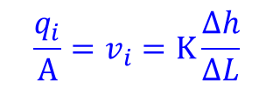



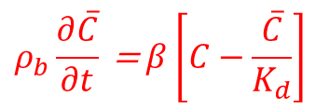
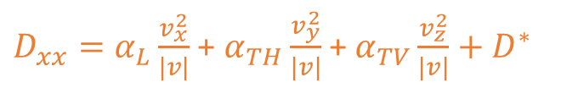
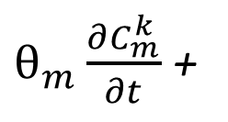

Transport
Reactions
Diffusion
Advection
Storage
Sorption
de Sorption
$$θ\frac{∂C^{k}}{∂t} + ρ_{b} \frac{∂{\overline{C}}^{k}}{∂t} = \frac{∂}{∂x_{i}}\left[θD_{ij}\left(\frac{∂C^{k}}{∂x_{j}}\right)\right] − \frac{∂}{∂x_{i}}θv_{i}C^{k} + q_{s}C_{s} − q_{s}^{′}C^{k} − λ_{1}θC^{k} − λ_{2}ρ_{b}{\overline{C}}^{k}$$
intern
Retardation
mobile
Sorption (MATRIX)
Retardation
Hyperbole x Parabola
$$\frac{\text{∆}\text{ [} \text{C} \text{]}}{\text{∆}\text{ [} \text{t} \text{]}}$$
$$\vec{j}=−D∇C$$
Darcy
Flux
$$n_{E} | θ$$
$λ=$(ln 2) / $t_{1/2}$
sorbed
(solid)
phase
$$\frac{q_{i}}{A}=v_{i}=K\frac{Δh}{ΔL}$$
$$Rθ\frac{∂C^{k}}{∂t}$$
[LEA] …
Fick Law (3D)
porosity
dissolved
phase
$$R=1+\frac{ρ_{b}}{θ}\frac{∂\overline{C}}{∂C}$$
Tortuosity
$$τ={\left(\frac{L}{L_{e}}\right)}^{2}$$
$$v_{i}=\frac{q_{i}}{θ}=−\left( \frac{K_{i}}{θ} \right)\left(\frac{∂h}{∂x_{i}}\right)$$
$\overline{C}=K_{d}$C
Kd (L³M⁻¹) distribution coefficient
$$ρ_{b}$$
$$λ$$
bulk density
1º order reaction rate
Linear
$D^{∗}=η_{e}τ$D
$S_{s}\frac{∂h}{∂t} = \frac{∂}{∂x_{i}}\left[K_{i}\frac{∂h}{∂x_{i}}\right]+$ $q_{s}$
Isotermas
Freundlich
$$\overline{C}=K_{f}C^{a}$$
$$λ_{2}$$
mechanical
Molecular diffusion driven by concentration gradients.
$$\overline{C}=\frac{K_{l} \overline{S}\text{C}}{1+K_{l} \text{C}}$$
S = [C]
Sorbed phase
Dispersion
$$α_{L}$$
$$TRVT$$
$$TRPT$$
$$D^{∗}$$
Langmuir
$D_{xx}=α_{L}\frac{v_{x}^{2}}{|v|}$ + $α_{TH}\frac{v_{y}^{2}}{|v|}$ + $α_{TV}\frac{v_{z}^{2}}{|v|}+D^{∗}$
$\frac{v_{x}Δx}{D_{xx}}$ = $\frac{Δx}{α_{x}}≤2$
no
[LEA]
$$ρ_{b}\frac{∂\overline{C}}{∂t}\text{ =} β\left[C−\frac{\overline{C}}{K_{d}}\right]$$
Peclet nº
longitudinal dispersity + Transverse H | V
Nonequilibrium sorption
Dual-domain
$$λ_{2}ρ_{b}{\overline{C}}^{k}$$
+ Sorption
β: 1º order mass transfer rate between the dissolved and sorbed phases
Mobile e immobile
$θ_{m}\frac{∂C_{m}^{k}}{∂t}$ +
$${θ_{im}\frac{∂C_{im}^{}}{∂t}=ζ\left(C_{m}^{ }−C_{im}^{}\right)−λ}_{1,im}θ_{1,im}C_{im}^{k}$$
$θ\frac{∂C}{∂t}+ρ_{b}\frac{∂\overline{C}}{∂t}$ =L(C)+$λ_{1}θC^{k}−λ_{2}ρ_{b}{\overline{C}}^{k}$

Slide 3
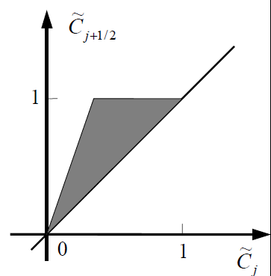
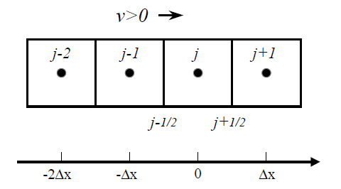

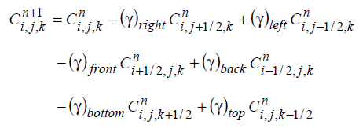




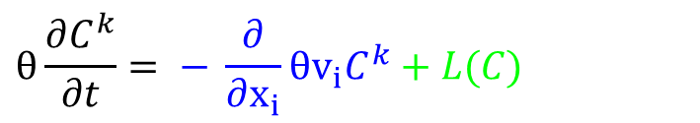






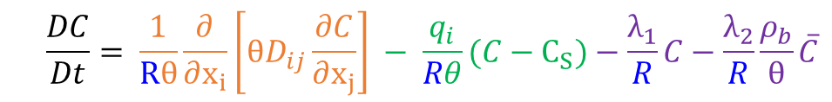






MMOC
HybridHMOC
Advection “weight” (sharp front $∞$ )
x …diffusion
appropriate criterion for controlling the switch
situations where sharp fronts are not present
Characteristics MOC MMOC eliminates numerical dispersion in strongly advection-dominated problems.
Lagrangian | particle tracking
… whether the concentration field has sharp or smooth fronts
$$θ\frac{∂C^{k}}{∂t}= − \frac{∂}{∂x_{i}}θv_{i}C^{k}+L(C)$$
$$Rθ\frac{∂C}{∂t}$$
Standard
upstream weighting
central-in-space weighting
$\frac{v_{x}Δx}{D_{xx}}$ = $\frac{Δx}{α_{x}}≤4$
Advection
strongly converging or diverging flows - Higher order - Runge-Kutta
nº of cells (grid) ?
NPH ... DCCEEL ... NPL
NPMIN
NPMAX
Eulerian | finite-difference
TVD method
advection term is solved independently
Transport step size
distance
Total-Variation-Diminishing
$C_{j}^{n+1}=C\left(0,Δt\right)=C(−v$ $Δt$,0)
Finite difference
Adding 1/R…
${\overline{v}}_{i}$= $v_{i} / R$
Mixed Eulerian-Lagrangian
$$v>0 →$$
$$\frac{DC}{Dt}= \frac{1}{Rθ}\frac{∂}{∂x_{i}}\left[θD_{ij}\frac{∂C}{∂x_{j}}\right] − \frac{q_{i}}{Rθ}(C−C_{S})−\frac{λ_{1}}{R}C−\frac{λ_{2}}{R}\frac{ρ_{b}}{θ}\overline{C}$$
$$C\left(x,0\right)=a+bx+cx^{2}+dx^{3}$$
$$C_{j}^{n+1}=C_{j}^{n}−C_{r}\left(C_{j+1/2}^{n}−C_{j−1/2}^{n}\right)$$
$$\frac{DC}{Dt}= \frac{∂C}{∂t}+\overline{v_{i}}\frac{∂C}{∂x_{i}}$$
$$\frac{DC}{Dt}= \frac{C_{m}^{n+1}−C_{m}^{n^{∗}}}{Δt}$$
Finite difference
third-order TVD scheme
Finite difference
$$C_{r}=v∆t/∆t$$
$$C\left(0,0\right)=C_{j}, at x=0$$
$$C_{j+1/2}={(C}_{j+1}+C_{j})/2−C_{r}{(C}_{j+1}+C_{j})/2−(1−C_{r}^{2}){(C}_{j+1}{−2C}_{j}+{(C}_{j−1})/6$$
$$C_{m}^{n+1}=C_{m}^{n^{∗}}+Δt ×RHS$$
Advection
Dispersion
$$+$$
FINITE DIFFERENCE - GRADIENT – CURVATURE (+) TWIST 3d
Lagrangian
Eulerian

Slide 4

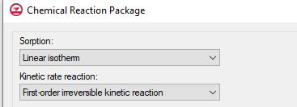
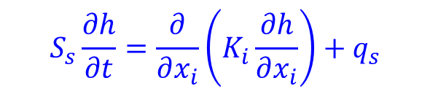
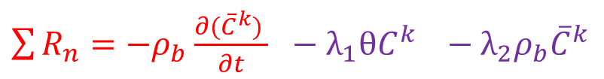
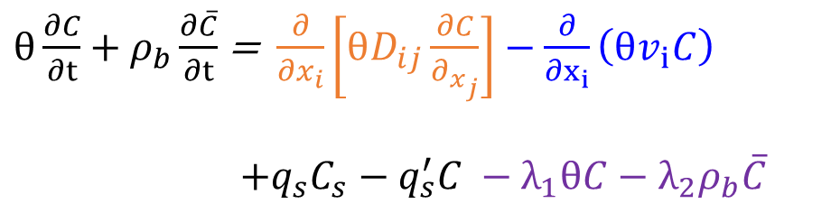
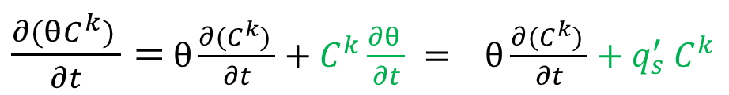
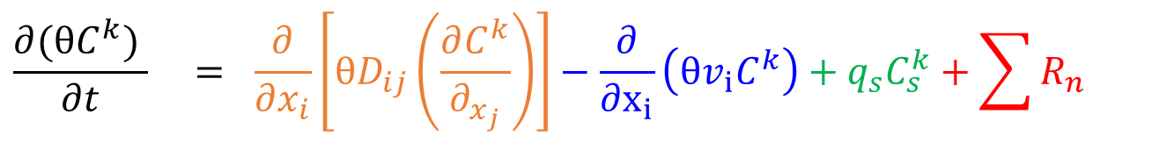

Fluxo
Sorption will retard the movement of the plume
$$S_{s}\frac{∂h}{∂t}=\frac{∂}{∂x_{i}}\left(K_{i}\frac{∂h}{∂x_{i}}\right){+ q}_{s}$$
Decay (due to biodegradation) will reduce the concentration
Transporte
$$\frac{∂(θC^{k}) }{∂t} = \frac{∂}{∂x_{i}}\left[θD_{ij}\left(\frac{∂C^{k}}{∂_{x_{j}}}\right)\right]−\frac{∂}{∂x_{i}}\left(θv_{i}C^{k}\right)+q_{s}C_{s}^{k}+\sum{R_{n}}$$
Dispersão
mecânica
Fluxo
Advecção
Source
Sinks
Reações químicas
$\frac{∂(θC^{k}) }{∂t}=$ $θ\frac{∂(C^{k}) }{∂t}+C^{k}\frac{∂θ }{∂t} = θ\frac{∂(C^{k}) }{∂t}+q_{s}^{′}$ $C^{k}$
storage
$$n_{E}θC^{k}$$
$θ\frac{∂C}{∂t}+ρ_{b}\frac{∂\overline{C}}{∂t}$ = $\frac{∂}{∂x_{i}}\left[θD_{ij}\frac{∂C}{∂_{x_{j}}}\right]−\frac{∂}{∂x_{i}}\left(θv_{i}C\right)$
$$+q_{s}C_{s}−q_{s}^{′}C −λ_{1}θC−λ_{2}ρ_{b}\overline{C}$$
$\sum{R_{n}}=−ρ_{b}$ $\frac{∂({\overline{C}}^{k}) }{∂t}$ $− λ_{1}θC^{k} −λ_{2}ρ_{b}{\overline{C}}^{k}$
Retardação
Fase
desorvida
Fase
sorvida

Slide 5
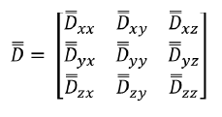

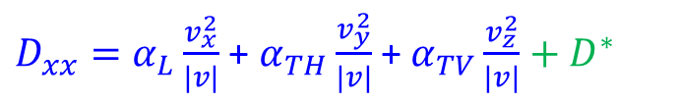

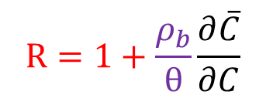


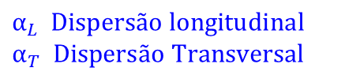




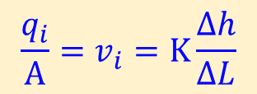


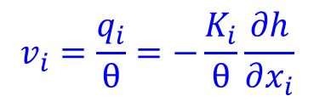





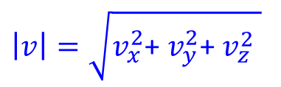

Isotermas
Fonte interna / armazenamento
$$Rθ\frac{∂C}{∂t}=\frac{∂}{∂x_{i}}\left[θD_{ij}\left(\frac{∂C}{∂x_{j}}\right)\right]−\frac{∂}{∂x_{i}}\left(θv_{i}C\right)+q_{s}C_{s}−q_{s}^{′}C−λ_{1}θC−λ_{2}ρ_{b}\overline{C}$$
Fase
sorvida
Fase
desorvida
$\sum{R_{n}}=−ρ_{b}$ $\frac{∂({\overline{C}}^{k}) }{∂t}$ $− λ_{1}θC^{k} −λ_{2}ρ_{b}{\overline{C}}^{k}$
retardation factor
$$R=1+\frac{ρ_{b}}{θ}\frac{∂\overline{C}}{∂C}$$
$C^{∗}=K_{d}$C
$$P_{e}=\frac{|v|L}{D}$$
Dispersão mecânica
& Difusão molecular
Batch Test
Isoterma linear
Massa sorvida / massa sedimentos
$$\frac{q_{i}}{A}=v_{i}=K\frac{Δh}{ΔL}$$
Dispersão
Numérica
Oscilação artificial
$α_{L}$ $Dispersão longitudinal$
$$α_{T} Dispersão Transversal$$
$$v_{i}=\frac{q_{i}}{θ}=−\frac{K_{i}}{θ}\frac{∂h}{∂x_{i}}$$
Coeficiente de difusão
$\frac{∂}{∂x_{i}}\left[K_{i}\frac{∂h}{∂x_{i}}\right]+$ $q_{s}=S_{s}\frac{∂h}{∂t}$
$${\hat{D}}_{ij}={θD}_{ij}$$
TRPT TRPV DMCOEF POETER
$$j_{y}=−D\frac{∂C}{∂y}$$
$$\vec{j}=−D∇C$$
$α_{TV}$ =0.05 $α_{L} (0.025−.01)$
$D_{xx}=α_{L}\frac{v_{x}^{2}}{|v|}$ + $α_{TH}\frac{v_{y}^{2}}{|v|}$ + $α_{TV}\frac{v_{z}^{2}}{|v|}+D^{∗}$
$$\frac{∂C}{∂t}=\frac{∂^{2}C}{{∂y}^{2}}$$
$$τ={\left(\frac{L}{L_{e}}\right)}^{2}$$
$α_{TH}$ =0.1 $α_{L} (.33)$
$D^{∗}=η_{e}τ$D
$D_{xy}=D_{yx}={(α}_{L}$-$α_{T})\frac{v_{x}v_{y}}{|v|}$
$D^{∗}=θτ$D
$$Depende do tamanho da pluma$$
$$\left|v\right|=\sqrt{v_{x}^{2}\text{+} v_{y}^{2}\text{+} v_{z}^{2} }$$
https://www3.epa.gov/ceampubl/learn2model/part-two/onsite/longdisp.html
https://inside.mines.edu/~epoeter/583CSM/Porter

Slide 6

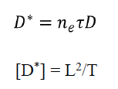










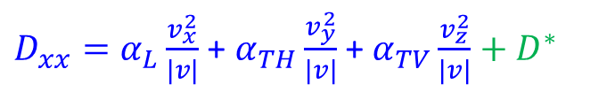
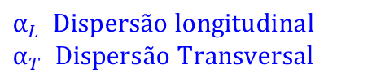




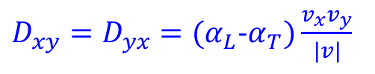



Difusão
$$P_{e}=\frac{|v|L}{D}$$
Dispersão mecânica
& Difusão molecular
Tortuosidade
Dispersão
Numérica
Oscilação artificial
_{Lei de Fick + Bear - Fetter}
$α_{L}$ $Dispersão longitudinal$
$$α_{T} Dispersão Transversal$$
Coeficiente de difusão
$${\hat{D}}_{ij}={θD}_{ij}$$
$D_{xx}=α_{L}\frac{v_{x}^{2}}{|v|}$ + $α_{TH}\frac{v_{y}^{2}}{|v|}$ + $α_{TV}\frac{v_{z}^{2}}{|v|}+D^{∗}$
$D_{xy}=D_{yx}={(α}_{L}$-$α_{T})\frac{v_{x}v_{y}}{|v|}$
TRPT TRPV DMCOEF POETER
$${20..10..=α}_{L}$$
$α_{TH}$ $α_{TV}$
$$TRPT TRVT$$
$$j_{y}=−D\frac{∂C}{∂y}$$
$$\vec{j}=−D∇C$$
$α_{TV}$ =0.05 $α_{L} (0.025−.01)$
$α_{TH}$ =0.1 $α_{L} (.33)$
$$\frac{∂C}{∂t}=\frac{∂^{2}C}{{∂y}^{2}}$$
$$τ={\left(\frac{L}{L_{e}}\right)}^{2}$$
$D^{∗}=η_{e}τ$D
$$Depende do tamanho da pluma$$
$D^{∗}=θ τ$D
$$\left|v\right|=\sqrt{v_{x}^{2}\text{+} v_{y}^{2}\text{+} v_{z}^{2} }$$
https://www3.epa.gov/ceampubl/learn2model/part-two/onsite/longdisp.html

Slide 7
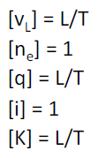
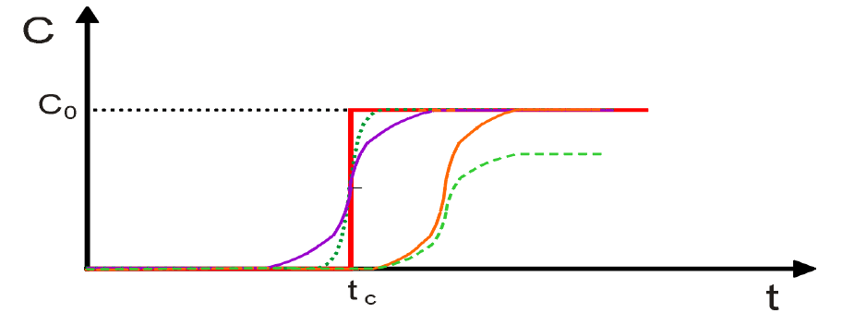
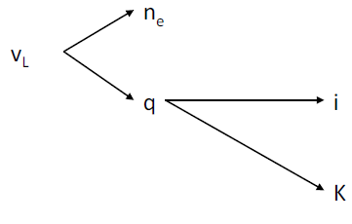

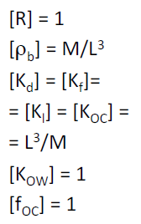







Advecção
Difusão
$$n_{e}=θ$$
Retardação
Dispersão
$α_{TH}$ $α_{TV} α_{L}$
$$\left[α\right]L$$
RESUMO
${P_{e}}_{x}=\frac{\text{|} v_{x} \text{|} L_{x}}{D_{xx}}$
Número de Peclet
Dispersão >> Advecção

Slide 8









ULTIMATE
$Rθ\frac{∂C}{∂t}=−\frac{∂}{∂x}\left[θv_{x}C\right]−\frac{∂}{∂y}\left[θv_{y}C\right]$ $−\frac{∂}{∂z}\left[θv_{z}C\right]$ + L(C)
L(C) nonadvection terms including dispersion/diffusion, fluid sink/source, and chemical reactions.
Concentration values at the cell interfaces
$0$ ${ P}_{e}$ $∞$
upstream weighting scheme
${P_{e}}_{x}=\frac{\text{|} v_{x} \text{|} L_{x}}{D_{xx}}$
Número de Peclet
Dispersão >> Advecção
advection dominated
central-in-space weighting scheme
dispersion dominated
TVD schemes
Mixed Eulerian-Lagrangian Methods
Front-tracking MOC .. Pág. 45
(MOC)
MT3DMS is intended for single-species systems
Add-on reaction package such as RT3D (Clement 1997) or
SEAM3D (Widdowson and Waddill 1997)
must be used to model more sophisticated multispecies reactions

Slide 9









$$Rθ\frac{∂C}{∂t}=\frac{∂}{∂x_{i}}\left[{\hat{D}}_{ij}\frac{∂C}{∂x_{j}}\right]−\frac{∂}{∂x_{i}}\left(θv_{i}C\right)+q_{s}C_{s}−q_{s}^{′}C−λ_{1}θC−λ_{2}ρ_{b}\overline{C}$$
$${\hat{D}}_{ij}={θD}_{ij}$$
Advecção
Dispersão
Many [transport] stress periods as necessary
to accommodate time-varying sink/source concentrations
58-69 Implicit finite-difference formulation
GCG
69- 70 Explicit finite-difference formulation
$Rθ\frac{∂C}{∂t}=−\frac{∂}{∂x}\left[θv_{x}C\right]−\frac{∂}{∂y}\left[θv_{y}C\right]$ $−\frac{∂}{∂z}\left[θv_{z}C\right]$ + L(C)
The actual transport step size used in the simulation is then determined from the maximum step sizes allowed for individual transport components.
$Rθ\frac{∂C}{∂t}={… α}_{L}$ [D] ...
$$Rθ\frac{∂C}{∂t}=$$
Simpson’s
basic, advection, dispersion, sink/source, and chemical reaction
PRECONDITIONER iSOLVE
can be solved with:
the particle-tracking-based Eulerian-Lagrangian methods, MOC MMOC
the standard finite-difference method, or
- GCG, implicit finite-difference method is used, without any stability constraints,
- no GCG, finite-difference method is used instead, subject to the usual stability constraint
the third-order TVD (ULTIMATE) method.
$θ\frac{∂C}{∂t}+ρ_{b}\frac{∂\overline{C}}{∂t}$ = $L(C)$ $−λ_{1}θC−λ_{2}ρ_{b}\overline{C}$
$$ρ_{b}\frac{∂\overline{C}}{∂t}\text{ =} β\left[C−\frac{\overline{C}}{K_{d}}\right]−λ_{2}ρ_{b}\overline{C}$$

Slide 10
70 | 74 - Third-Order TVD Method
(ULTIMATE)
advection term is solved independently
solved either implicitly or explicitly
Special attention must be addressed to the concern that mass balance errors could arise when cell thicknesses in the same model layer vary spatially.
If explicit, thus, the transport step size is subject to a stability constraint
75 - Particle-tracking-based Eulerian-Lagrangian methods, MOC MMOC
Areas of strongly converging or diverging flows - Runge-Kutta
85 - 87 - 88 - Modified method of characteristics (MMOC)
Mass Budget Calculations
sharp front problems - largely advection-dominated
MOC virtually eliminates numerical dispersion;
110 - Input Instructions – Advection, Dispersion – Sink Source – Chemical reactions – GCG
Start of a Simulation Run (143) – Benchmark (145)

