Slide 1
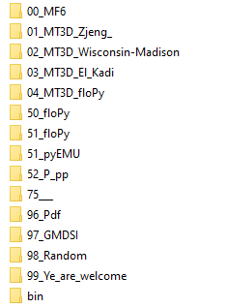
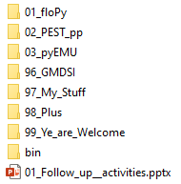
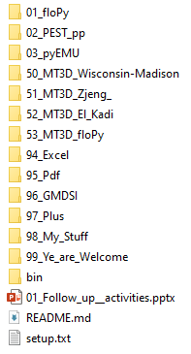
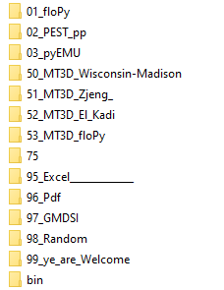
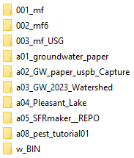

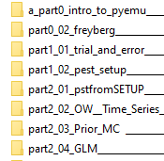

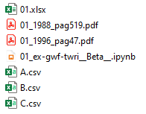
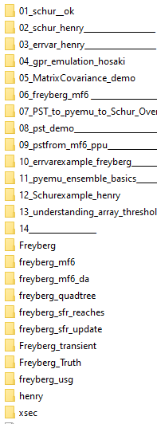
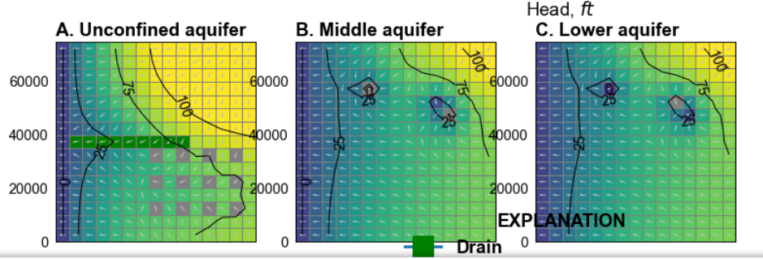
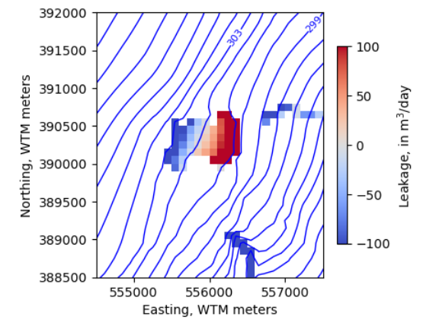


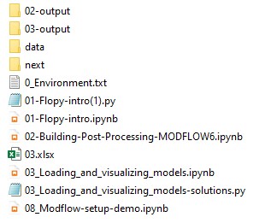
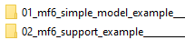
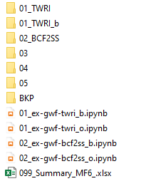
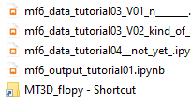
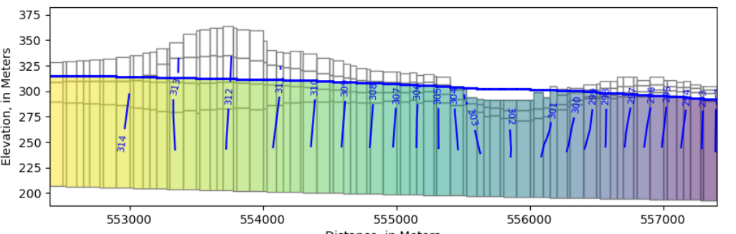
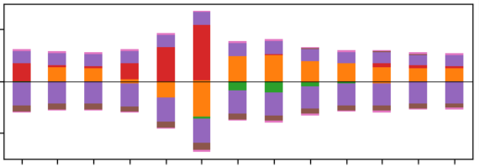
*
pleasant-lake
… ongoing
… extra: neversink _ PEST workflow

Slide 2
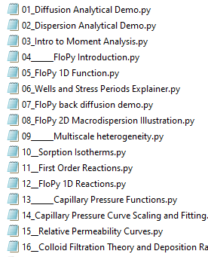
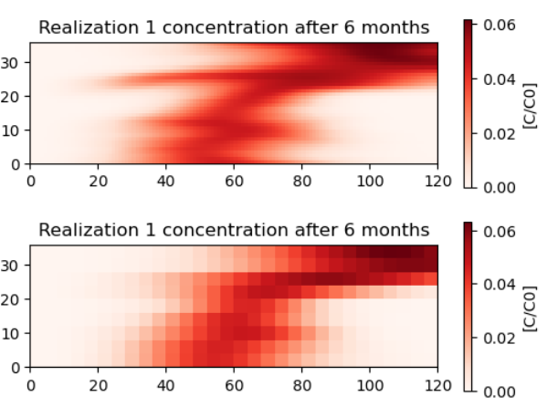
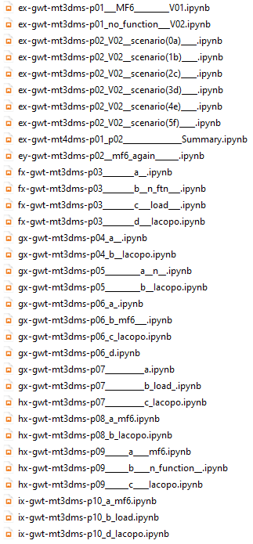
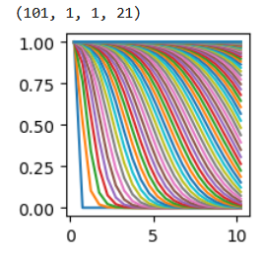
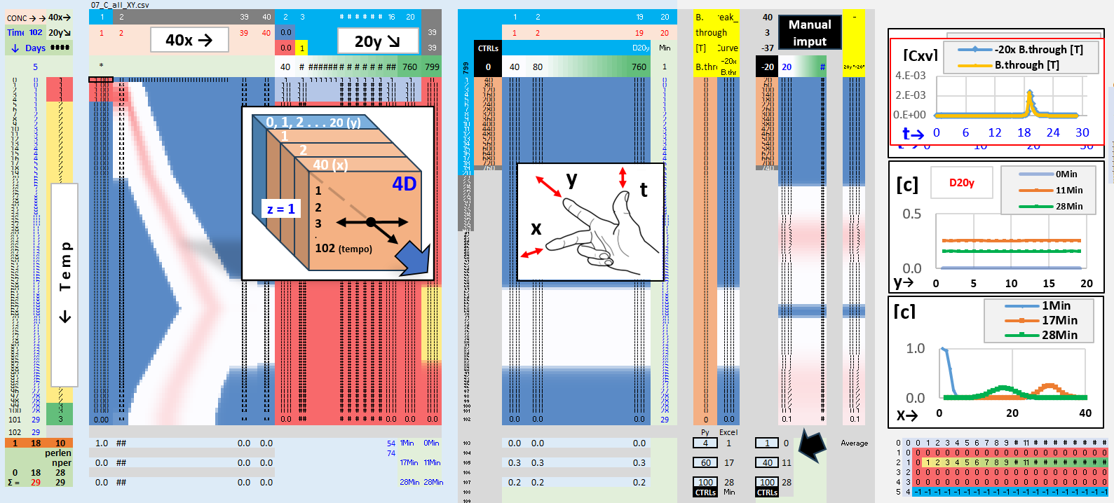
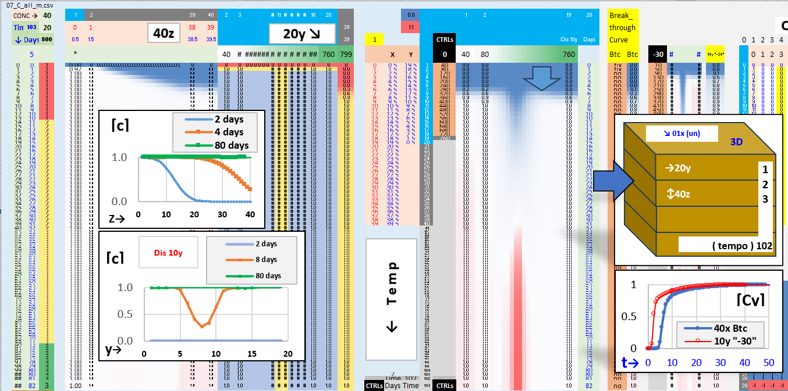
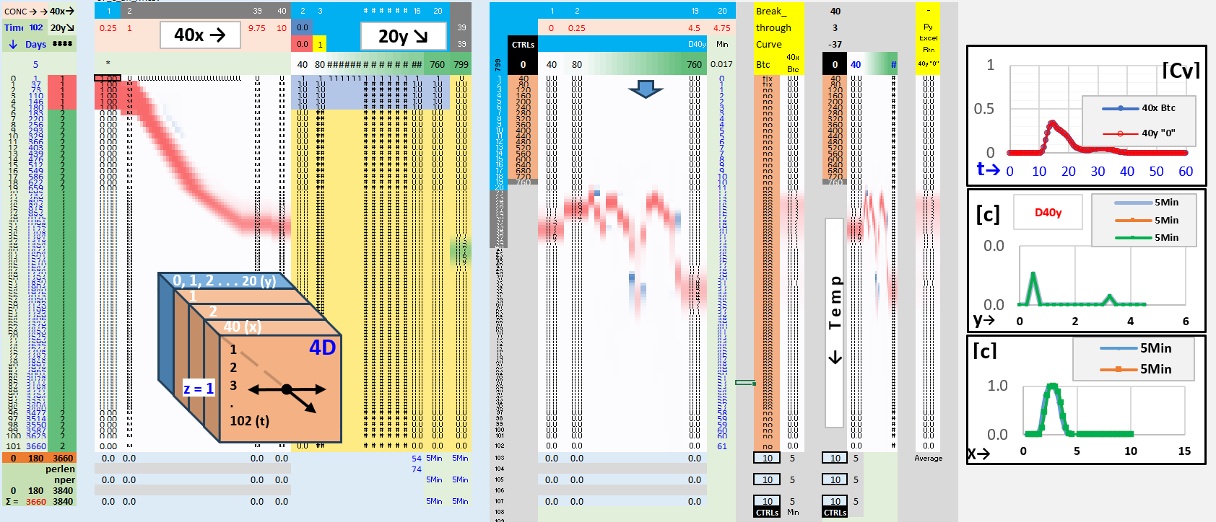
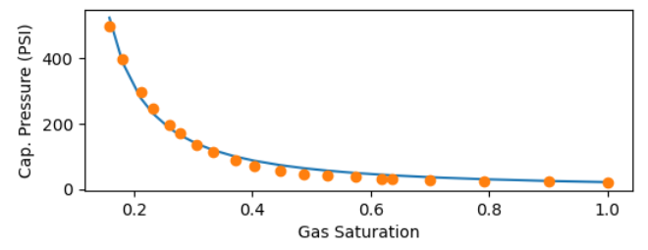
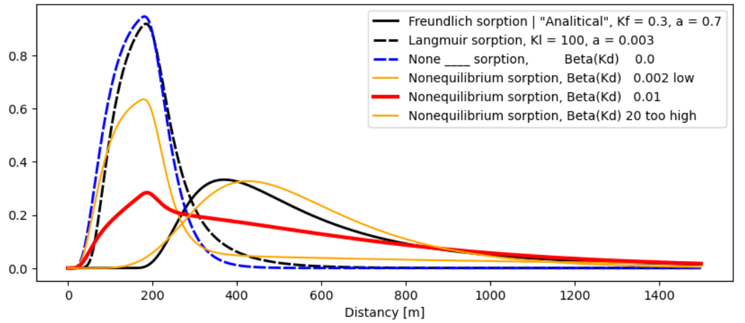
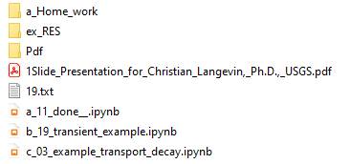
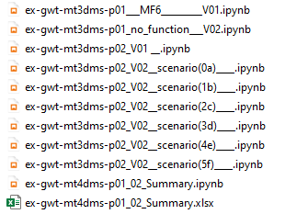
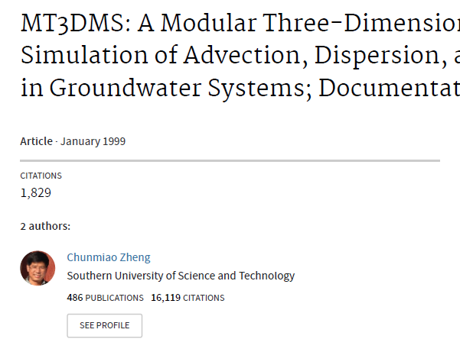

1D
2D
Freundlich, Langmuir, decay, R,
.. Flopy isotherms
van Genuchten,
Brooks Corey
Hydro's
16
Relative Permeability from Capillary Pressure

Slide 4
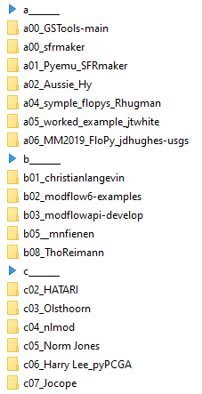
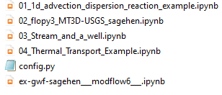
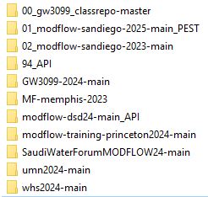
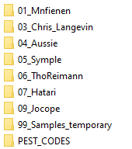
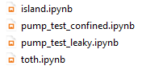
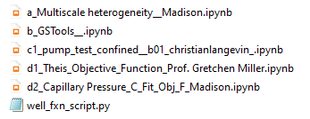
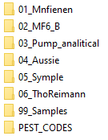

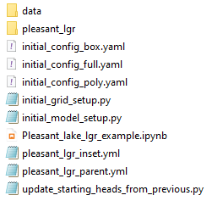
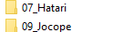
Visible
offscreen
E:\15_REPOS\b01_christianlangevin\00_gw3099_classrepo-master\exercises\MT3DUSGS
E:\15_REPOS\b01_christianlangevin\umn2024-main\notebook
MT3D_Unconfined
E:\15_REPOS\00_BETAMI\98_Random\01_Mnfienen\A_Modflow-Setup\examples
E:\15_REPOS\00_BETAMI\98_Random\06_ThoReimann
E:\15_REPOS\00_BETAMI\98_Random\07_Hatari
E:\15_REPOS\00_BETAMI\98_Random\99_Samples_high_L_temp
git env! mfsetup kernel
https://doi-usgs.github.io/modflow-setup/latest/notebooks/Pleasant_lake_lgr_example.html

Slide 5
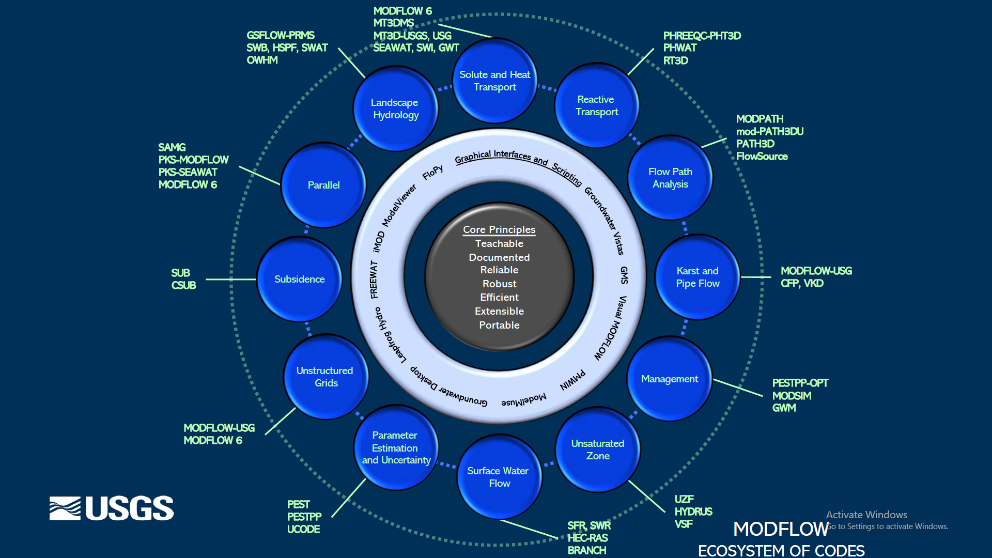

ECOSYSTEM
Core Principles
Teachable
Documented
Reliable
Robust
Efficient
Extensible
Portable
API
SFR
MNW2
MVR packages
christianlangevin

Slide 6
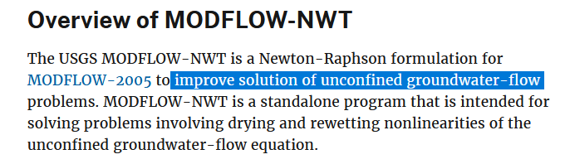
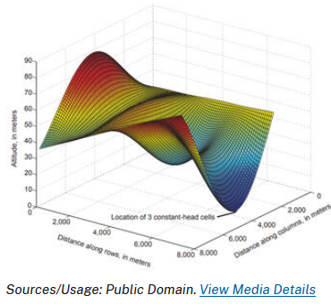
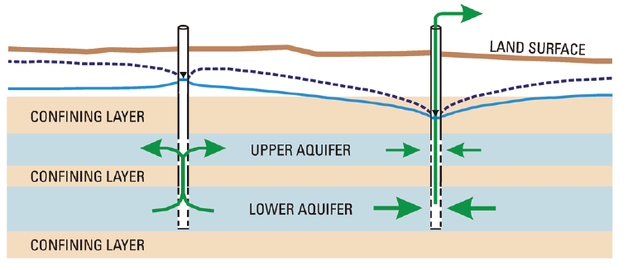
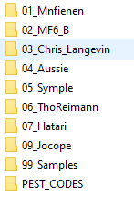
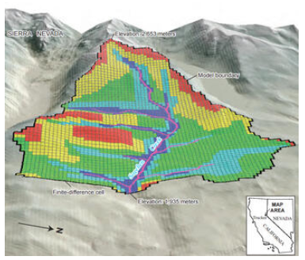
Reilly
Problem
Horizontal MNW2
& MT3D
NWT
01
1d_advection_dispersion_reaction_example.ipynb
02
https://modflow6-examples.readthedocs.io/en/latest/_examples/ex-gwf-maw-p03.html
SFR Package
Multi-Node Well (MNW2) Package
01_MNW2_Reilly_Problem.pdf
GSFLOW: Coupled Groundwater and Surface-Water Flow Model
ArcPy
Application Programming Interface - API
03_UZF1_Sagehen _ unconfined _MF2005.pdf

Slide 7
