Slide 1
Ground-Water Flow and Solute Transport for the PHAST Simulator:
Numerical Considerations

Slide 2
Outline
Numerical implementation
  Numerical oscillation and dispersion
  Operator splitting error
  Negative concentrations
  Automatic time step
  Linear equation solvers
Diagnosis of difficulties

Slide 3
Computational Procedure
Governing partial differential equations
and boundary conditions
Discretization
System of flow and transport algebraic equations
Equation solver
Approximate numerical solution

Slide 4
Computational mathematics is mainly based on two ideas: Taylor series and linear algebra.
--L.N. Trefethen (1998)

Slide 5





Finite Difference Discretization
1D Solute Transport, Steady Flow
Spatial discretization
  terms
    Centered-in-space
      Truncation error:
  terms
    Centered-in-space;
      Truncation error:
      Possible oscillations
    Upstream-in-space
      Truncation error:
      Dispersion

Slide 6



Finite Difference Discretization
1D Solute Transport, Steady Flow
Temporal discretization
  terms
    Centered-in-time
      Truncation error:
      Possible oscillations
    Backward-in-time
      Truncation error:
      Dispersion

Slide 7
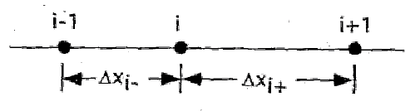

Finite Difference Discretization
Variable grid spacing
  terms
    Centered-in-space
      Truncation error:
  terms
    Centered-in-space
      Truncation error:
  Control error by limiting changes in adjacent Δx to factor of 1.25 to 2

Slide 8
Field-Scale Example
Solute Slug in 1 Dimension
Uniform properties
Steady flow
Hydraulic parameters
  Flow-path length: 100 m
  Porosity: 0.1
  Dispersivity: 0.012 m
  Ground-water velocity
    Interstitial velocity: 1.97 m/d
    Darcy velocity: 0.197 m/d
  Dispersion coefficient: 0.024 m2/d
  Slug duration: 10 d

Slide 9
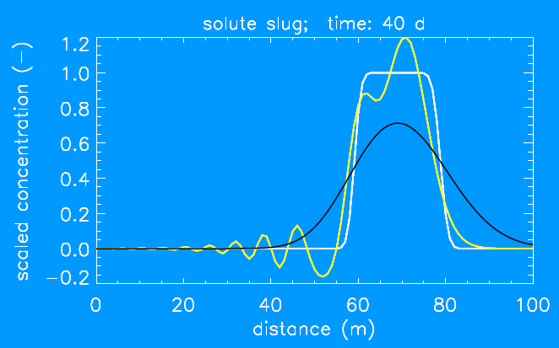
Field-Scale Examples
Concentration Profiles
Analytical and two finite-difference solutions

Slide 10
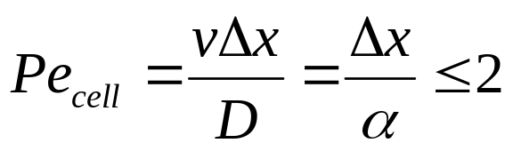
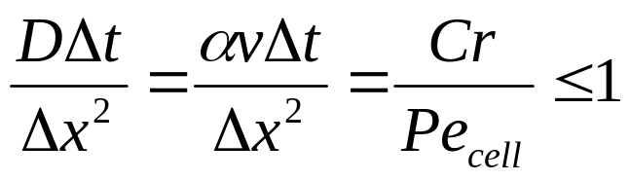
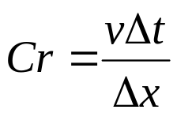
Controlling Numerical Oscillation
Criteria
  Centered-in-space differencing
  Centered-in-time differencing
    where

Slide 11
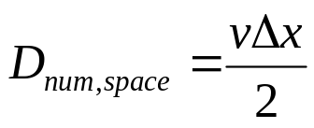
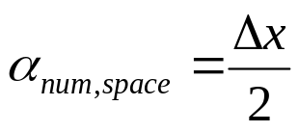
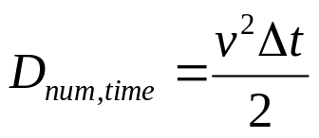
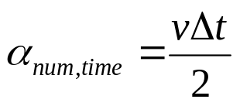


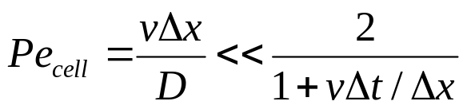
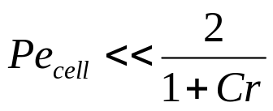
Controlling Numerical Dispersion
Upstream-in-space differencing
  or
Backward-in-time differencing
  or
Accuracy requirement
  or
Dimensionless accuracy requirement
  or

Slide 12


Cross-Flow Dispersion Discretization truncation error
Solute transport equation in 2-dimensions, steady flow at angle φ to coordinates
Backwards-in-time and upstream-in-space differencing
  Truncation error leading terms; numerical dispersion
Numerical dispersion
  Tangential is minimum at φ = π/4; maximum at φ = 0, π/2
  Normal is maximum at φ = π/4; minimum at φ = 0, π/2
Remedies
  Refine grid and reduce time step
  Other remedies not available in PHAST

Slide 13
Field-Scale Example
Solute Slug in 2 Dimensions
Uniform properties
Steady flow
Hydraulic parameters
  Flow-path length: 100 m
  Porosity: 0.1
  Dispersivity: 0.012 m
  Ground-water velocity
    Interstitial velocity: 1.97 m/d
    Darcy velocity: 0.197 m/d
  Dispersion coefficient: 0.024 m2/d
  Slug duration: 10 d

Slide 14
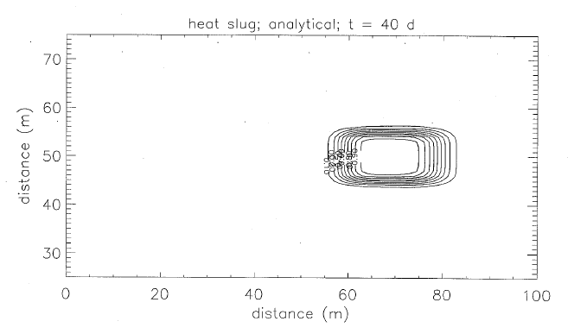
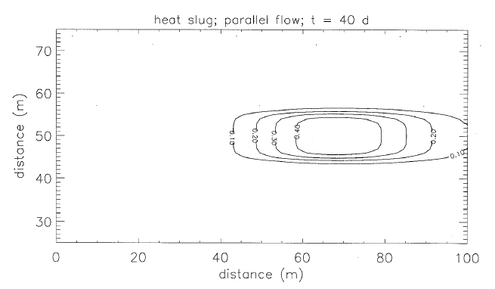
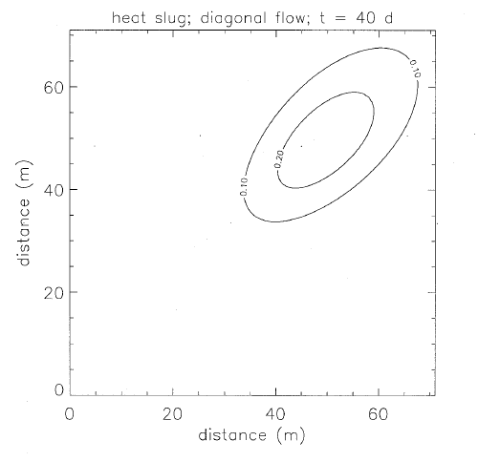
Field-Scale Example

Slide 15
Operator Splitting Error
Order Δt
  Linear equilibrium sorption
  Linear kinetic mass transfer or linear decay
Remedies
  Use small time steps
  Other remedies not available in PHAST

Slide 16
Negative Intermediate Concentrations
Causes:
  Spatial discretization (centered-in-space)
  Temporal discretization (centered-in-time)
  Cross-dispersion terms with strong diagonal flow
  Operator splitting
    e.g.Linear equilibrium sorption chemistry, SNlA method
    where R is the retardation factor, R > 1.
    Overshoot and undershoot may occur with strong sorption, strong partitioning
Effect:
  Failure of the chemical reaction calculation

Slide 17
Negative Intermediate Concentrations
Remedies:
  Small Δx
  Small Δt
  Modify or ignore cross-dispersion terms
  PHAST limits c to positive values
    Gain of mass
  Other remedies not available in PHAST

Slide 18
Automatic Time-Step Algorithm for Steady-State Flow
Controls:
  Maximum change in head over time step; δh
  Time-step limits; Δt_{min}, Δt_{max}
Objective:
  Adjust time step to achieve target δh
Method:
  Start each cycle with Δt_{min}
  Adjust time step as necessary for target
  Reduce time step if solver convergence failure
Possible difficulties:
  Δt_{min} incompatible with δh
  δh incompatible with b.c. and i.c.

Slide 19
Solving the Linear Equation Systems
Ax = b
Sparse; small fraction of non-zero elements
Structured; 7 diagonals
Symmetric for flow equation
Unsymmetric for transport equations

Slide 20
Linear Equation Solvers
Direct Solver
  Based on Gaussian elimination without pivoting
  No user parameters
  Best for smaller problems (few thousand nodes)

Slide 21
Linear Equation Solvers
Iterative solver
  Preconditioned restarted Orthomin method
    Based on adjusting the solution to minimize the residual using a set of conjugate, orthogonal directions
    Preconditioning used to accelerate convergence
  Several user parameters
    Convergence tolerance
    Restart interval
    Iteration count limit
  Needed for larger problems (tens of thousands of nodes)

Slide 22
Iterative Linear Equation Solver
Scaling the equations
  Rows and columns can be scaled
    where R and C are diagonal scaling matrices
Scale factors calculated to make the maximum element in each row and column of A equal to one
Enables a single value of τ to apply to flow and all transport equations
Only row scaling is implemented

Slide 23
Iterative Linear Equation Solver
Setting Orthomin iteration parameters
  Stopping tolerance
    Default: 1x10⁻¹⁰
    Vary τ and observe change in solution
    Want changes to be in insignificant digits
  Maximum number of iterations
    Default: 500
    Increase if necessary; usually indicates another problem
  Restart interval (number of saved search directions)
    Default: 20
    Increase if necessary to avoid non-convergence

