Slide 1
The PHAST 3D Reactive-Transport Simulator
David Parkhurst, Ken Kipp, and Scott Charlton

Slide 2
Agenda
Introduction to PHAST
Review of geochemical reactions
Phast4Windows
  Flow modeling exercise
  Reactive-transport modeling exercise

Slide 3
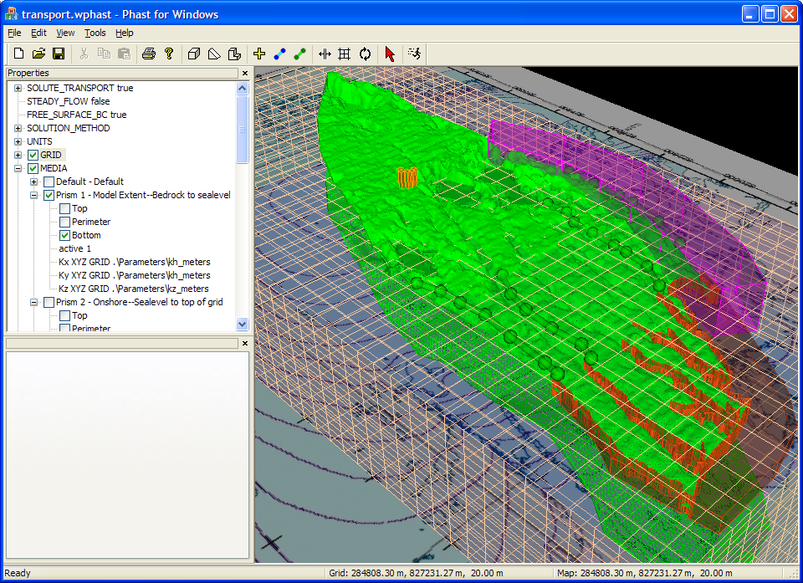

Slide 4
3D Reactive-Transport Modeling
Three simultaneous processes
  Flow
  Transport
  Chemical reaction

Slide 5
PHAST
Flow
HST3D—Flow and transport
PHREEQC—Chemistry
Operator splitting—Sequential Non-Iterative Approach
PHT3D is a 3D reactive transport model built on MODFLOW, MT3DMS, and PHREEQC
Transport
Chemistry
Flow
Transport
Chemistry

Slide 6
Flow and Transport
Constant temperature
Constant density
Single phase
Saturated confined or unconfined flow
Point-distributed finite-difference grid
Boundary conditions
  Specified, leaky, flux, rivers, drains, wells

Slide 7
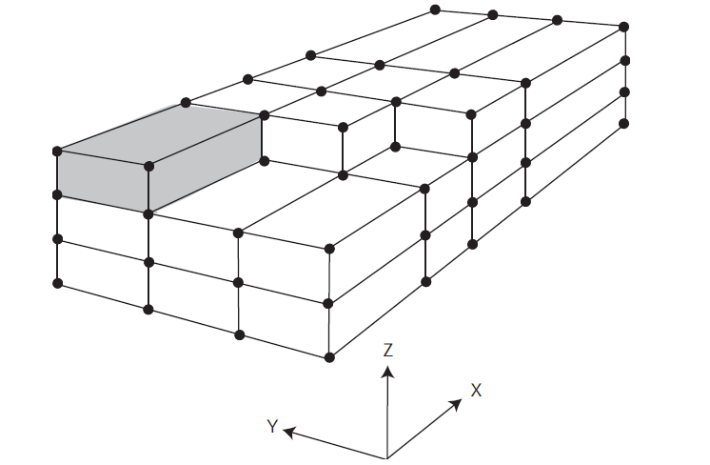
Grid Element

Slide 8
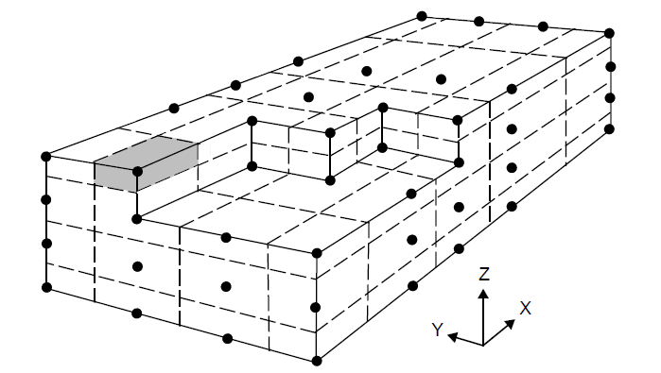
Grid Cell

Slide 9
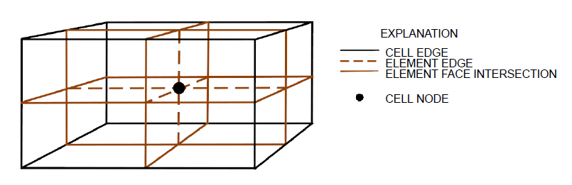
Full Cell Has Parts of 8 Elements
Cell Properties do not change abruptly
  Media properties weighted by volume
  Conductances weighted by facial area

Slide 10
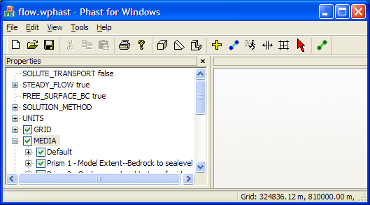
Zones
Box—Rectangular brick
Wedge—Right triangular wedge
Prism
  Perimeter
    Arc shape
    XYZ file
    points
  Top, Bottom
    Arc raster
    Arc shape + attribute
    XYZ file
    Points

Slide 11
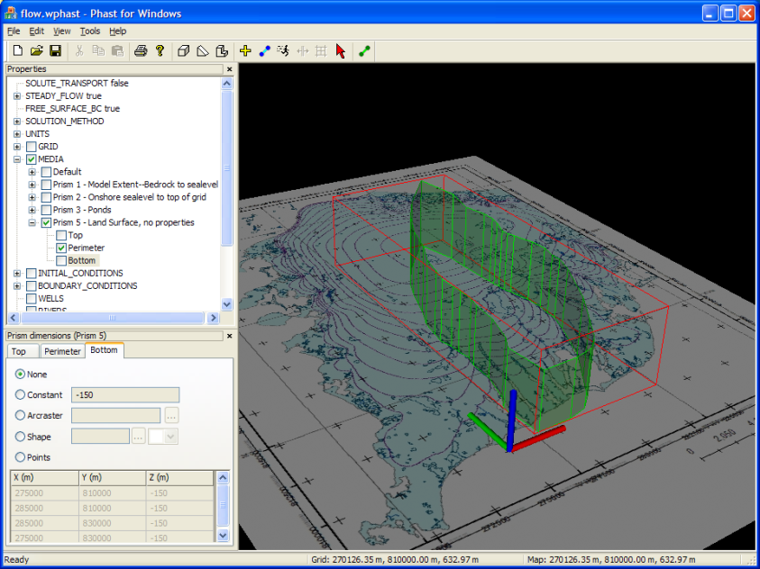
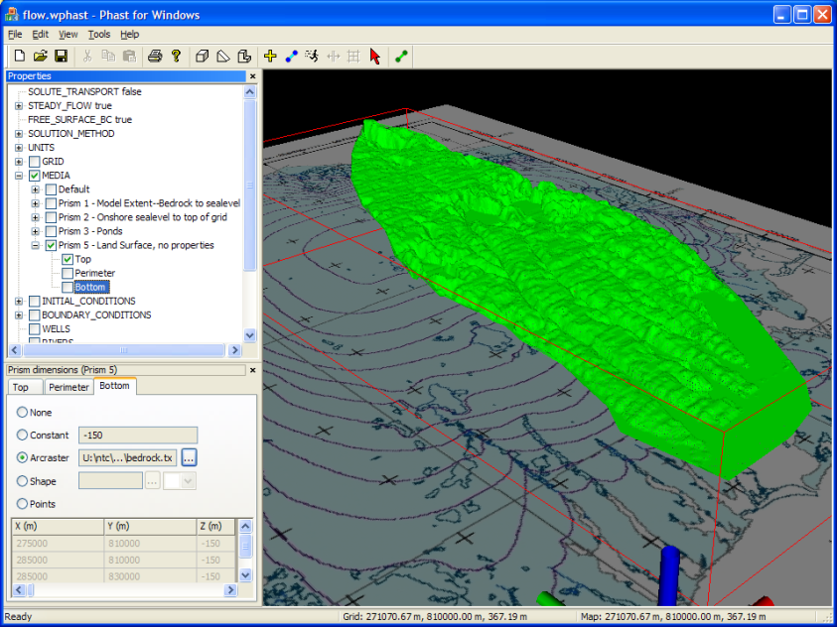
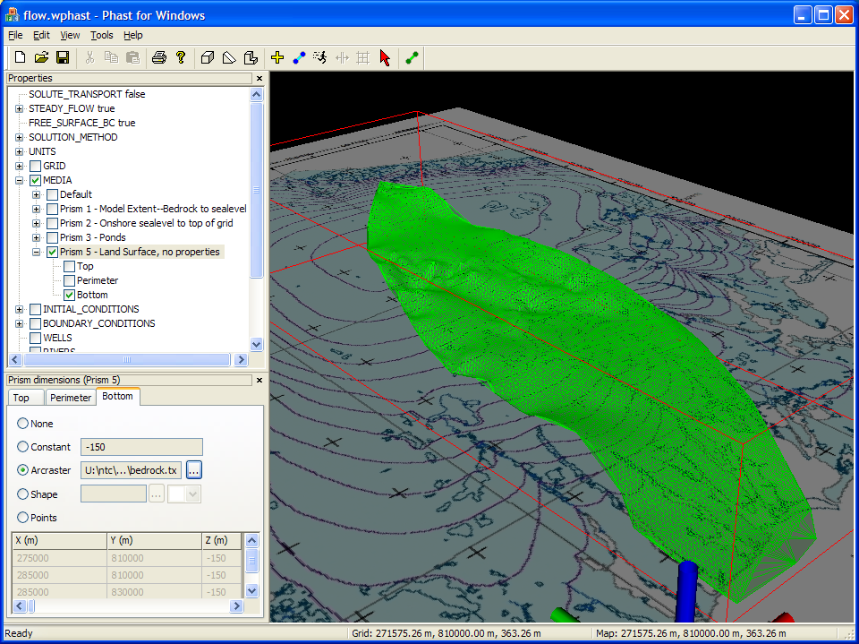
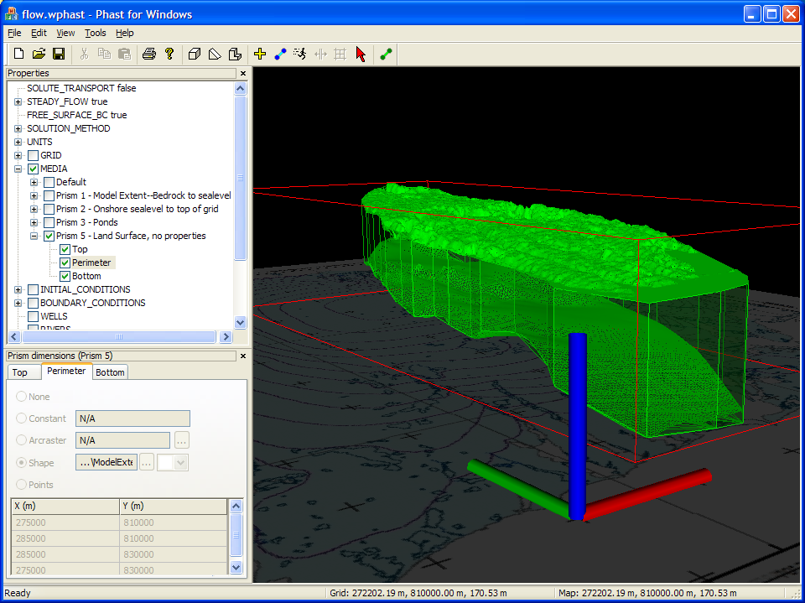
Perimeter
Top
Bottom
Prism

Slide 12
Interpolation for Top and Bottom
XYZ Data are treated as scattered points
Natural neighbor interpolation (NNI) is used if possible
  Defines a continuous surface except at data points
  NNI is not simply the closest neighbor
  Area weights by nearest points
Uses closest neighbor interpolation (CNI) if NNI fails
  Not continuous
  Used outside convex hull

Slide 13
Two Coordinate Systems
Map—State plane, UTM
Grid—Local coordinate system
Not quite finished
Today, map = grid

Slide 14
Assigning Properties to a Zone
Constant
Linear in X, Y, or Z direction
Points—Values at set of X,Y,Z points
XYZ File—Values at set of X,Y,Z points
XYZT File—Boundary conditions only
  X,Y,Z,T,P: property at location and time

Slide 15
3D Interpolation from Points
Properties are assigned from the closest of the set of points
Produces a volume with constant property around each point

Slide 16
Spatially Distributed Properties Are Overlayed in Zone Sequence
Property P defined by green followed by brown zone
Property P defined by brown followed by green zone
P = 10
P = 20
P = 10
P = 20

Slide 17
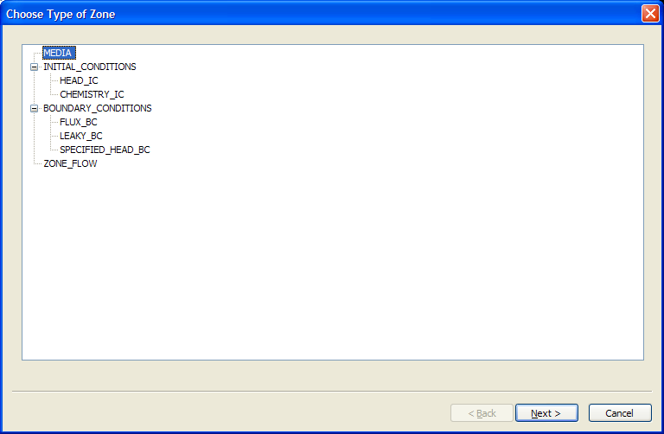
Zones
Media
Initial conditions
Boundary conditions
Zone flows

Slide 18
Media Properties
Active
Kx
Ky
Kz
Porosity
Specific storage
Longitudinal dispersivity
Horizontal component transverse dispersivity
Vertical component transverse dispersivity

Slide 19
Head IC
Define head distribution for zone
  Constant
  Linear in X, Y, or Z
  Points
  XYZ file with points

Slide 20
Specified Head BC
Some grid dependence because a specified head applies to entire cell
Time-dependent values
  Head
  Solution number

Slide 21
Leaky (Head dependent) BC
Applies only over area defined by zone (partial cell faces)
Applies only to exterior faces
Z face—water goes to first active cell or water table
Parameters
  Thickness
  Hydraulic conductivity
Time-dependent values
  Head
  Solution number

Slide 22
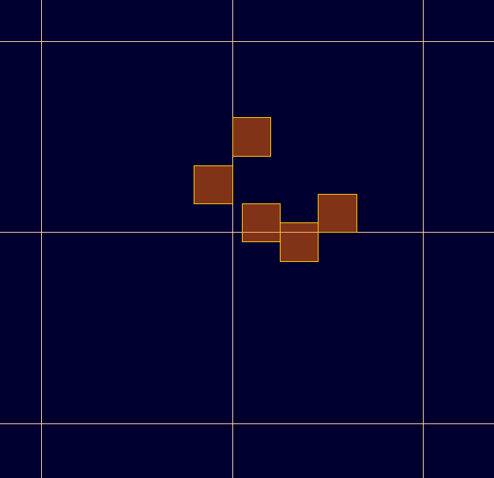
Flux BC
Applies only to area of cell face intersected by the zone
Time-dependent values
  Flux
  Solution

Slide 23
Overlapping BC
Duplicate flux areas are removed
Duplicate leaky areas are removed
Leaky and flux can coexist on a cell face
Neither Leaky nor flux can coexist with specified head
  Last defined takes precedence

Slide 24
Rivers & Drains
Series of X,Y points
Parameters
  Width
  Bed hydraulic conductivity
  Bed thickness
  Elevation of bed
Time-dependent values (Rivers only)
  Head
  Solution
Parameters and time-dependent values
  Must define for first and last point
  If not defined at intermediate points, interpolation by river distance

Slide 25
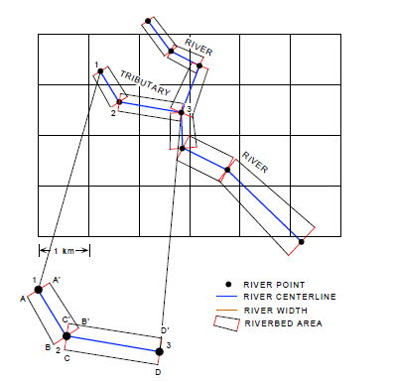
River and Drain User Definition

Slide 26
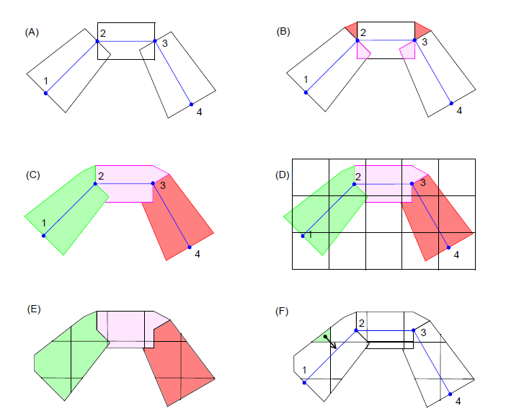
River and Drain Processing

Slide 27
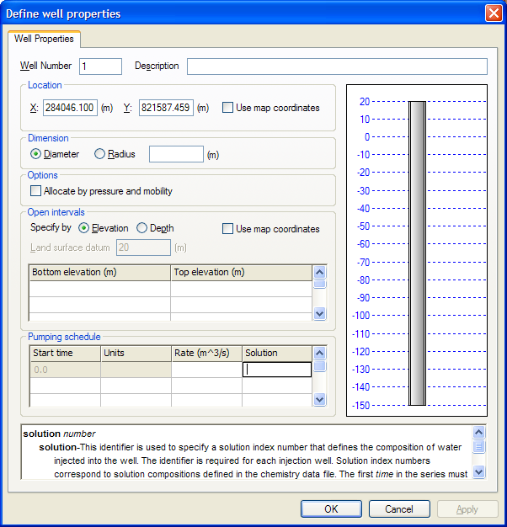
Wells
X, Y location
Parameters
  Diameter
  Allocation
  Open intervals
Time-dependent parameters
  Pumping/injection rate
  Solution number

Slide 28
PHAST (PHREEQC) Chemistry
Aqueous models
  Wateq
  LLNL
  Pitzer
  SIT (Specific ion Interaction Theory)
Reactants
  Mineral equilibrium
  Surface complexation
  Ion exchange
  Solid solutions
  Kinetic reactions

Slide 29
Transport and Chemistry
Flow and transport data file (.trans.dat)
Chemistry data file (.chem.dat)
  Solutions
  Mineral equilibrium
  Surface complexation
  Ion exchange
  Solid solutions
  Kinetic reactions

Slide 30
Mineral Assemblage in .chem.dat
EQUILIBRIUM_PHASES 11
Calcite 0 0.3
Dolomite 0 1.2
Identified by an integer (11)
Apply to a zone

Slide 31
Chemistry-Transport Connections
ID numbers for reactants in .chem.dat
  SOLUTIONS
  EQUILIBRIUM_PHASES—Minerals and gases)
  SURFACE—Surface complexation sites
  EXCHANGE—Ion exchangers
  SOLID_SOLUTIONS—Solid solutions
  KINETICS—Kinetic reactions
Used in .trans.dat file
  CHEMISTRY_IC (all reactants)
  Boundary conditions (solutions only)
    Specified head
    Leaky
    Flux
    River
    Well

Slide 32
Parallelization
Flow
Single processor:
Flow and transport
Multiple processors:
Chemistry
Data passed using MPI
10-30 processors
Up to 500,000? nodes
Hours of CPU
Transport
Chemistry
Cells
Cells
Cells
Cells
Cells
Flow
Transport

Slide 33
New Parallelization
Flow
Single processor:
Flow
Multiple processors:
Transport
Multiple processors:
Chemistry
Transport
Na
Cl
H
O
+/-
Chemistry
Cells
Cells
Cells
Cells
Cells
Flow

Slide 34
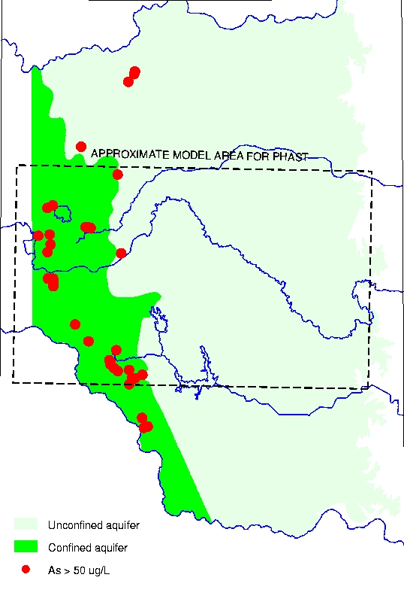
Arsenic in the Central Oklahoma Aquifer
Arsenic mostly in confined part of aquifer
Arsenic associated with high pH
Flow:
  Unconfined
  Confined
  Unconfined

Slide 35
Geochemical Reactions
Brine initially fills the aquifer
Calcite and dolomite equilibrium
Cation exchange
  2NaX + Ca⁺² = CaX₂ + 2Na⁺
  2NaX + Mg⁺² = MgX₂ + 2Na⁺
Surface complexation
  Hfo-HAsO4⁻ + OH⁻ = HfoOH + HAsO4⁻²
  Desorption at pH > 8.5

Slide 36
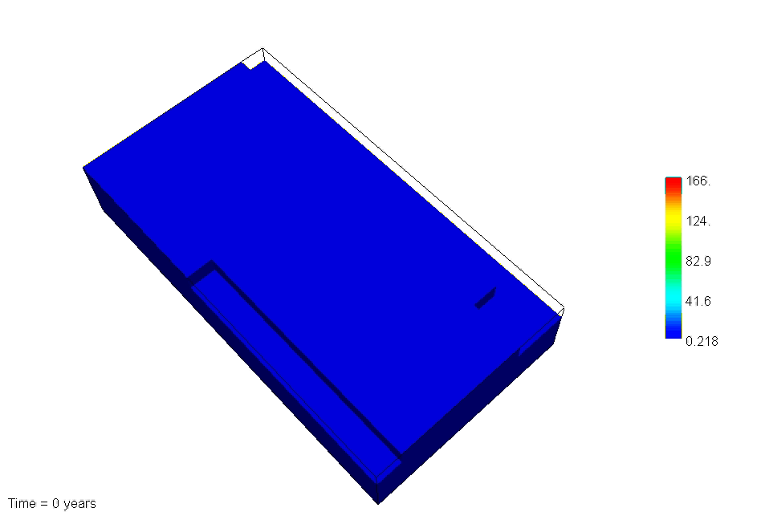
Arsenic Concentrations over Geologic Time

Slide 37
PHAST
PHAST is a 3D reactive-transport model
Field-scale problems with limitations
Data requirements
  Field—Aquifer tests, tracer tests, logging, chemical samples
  Laboratory—column experiments, extractions, mineralogy
Modeling results
  Understanding natural systems
  Designing engineered
  Predicting long-term effects

