Slide 1
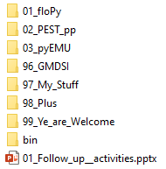
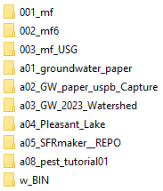


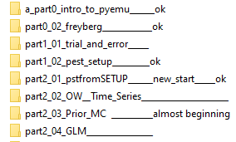


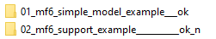
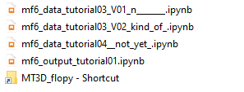

Slide 2
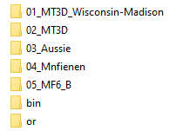
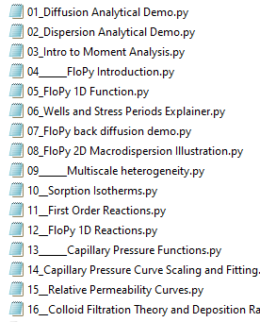
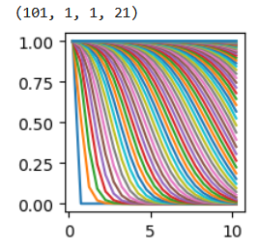
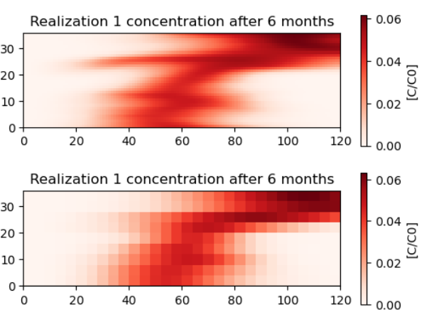
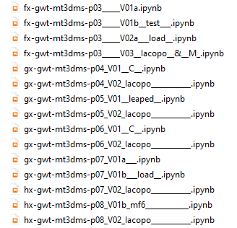
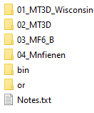
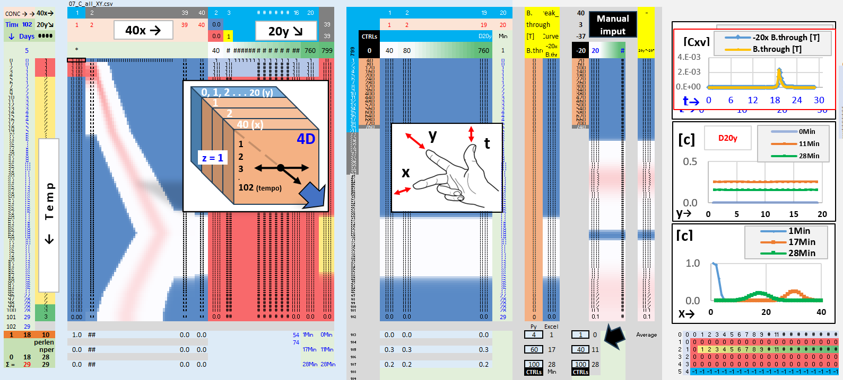

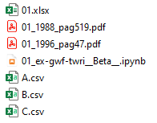
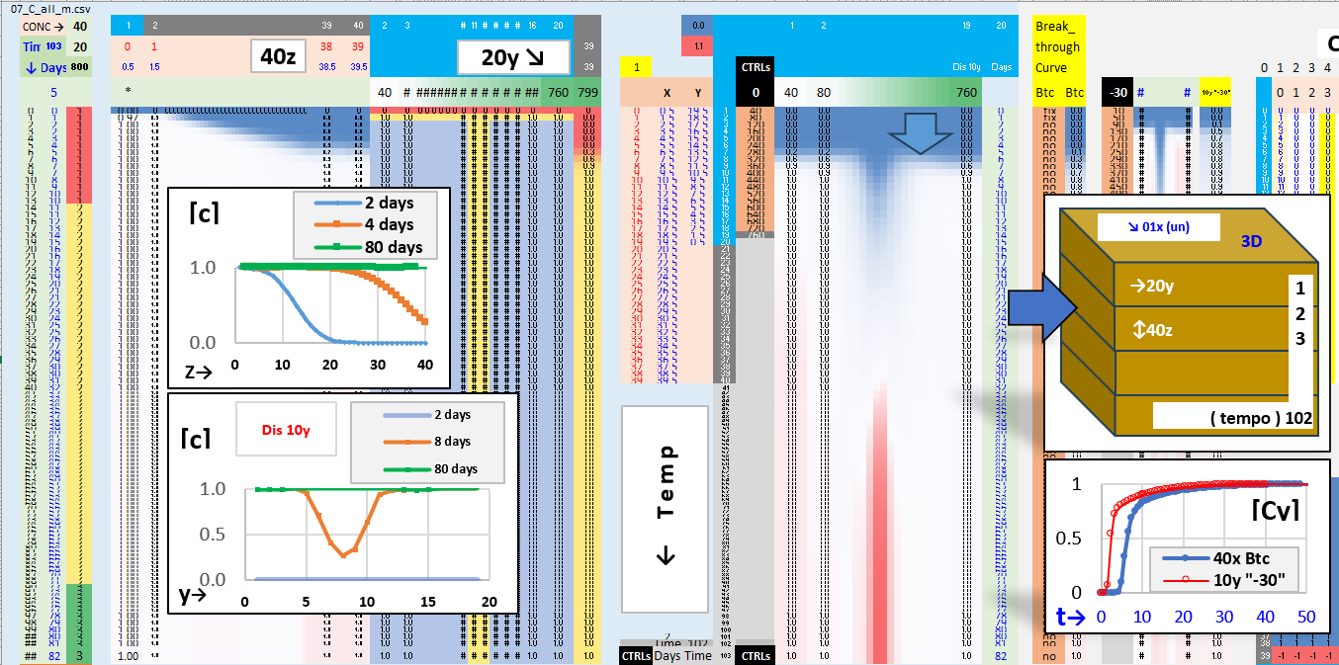
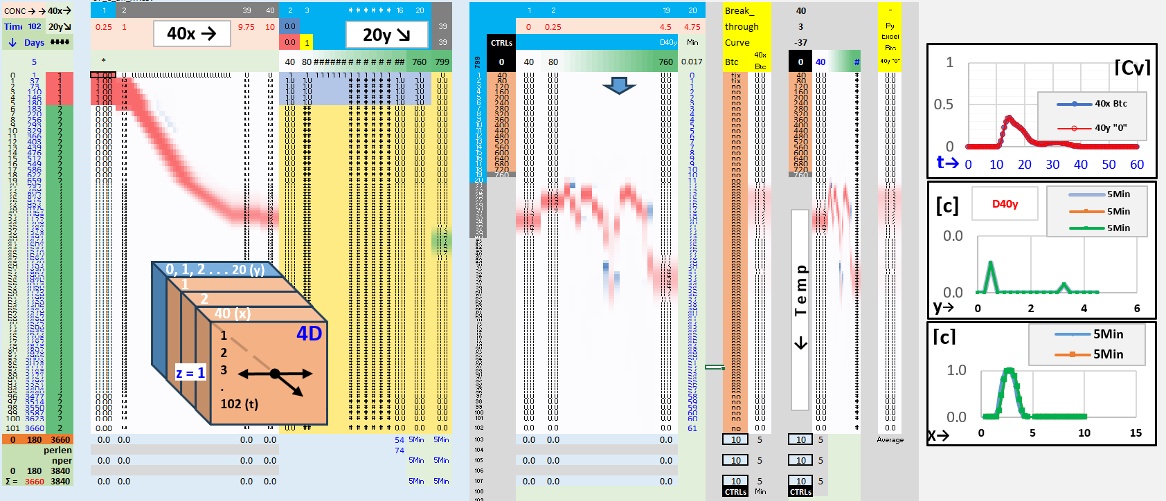
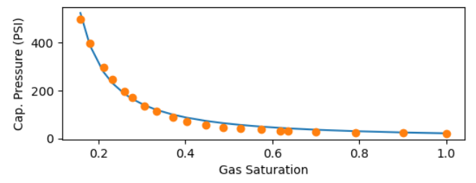
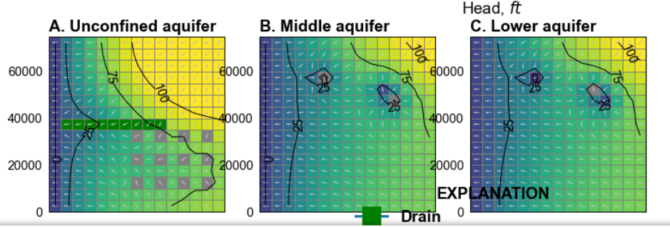
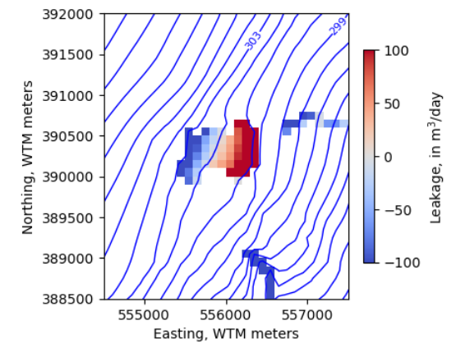
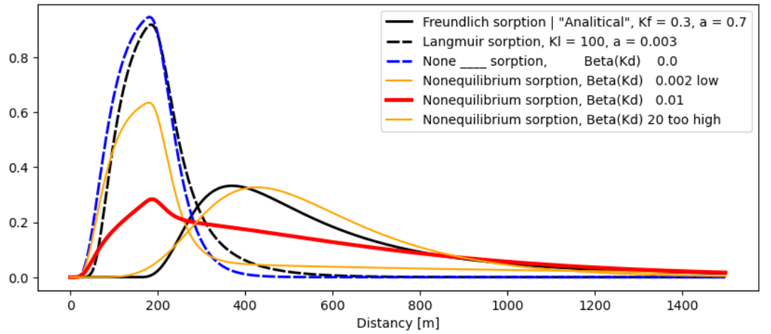

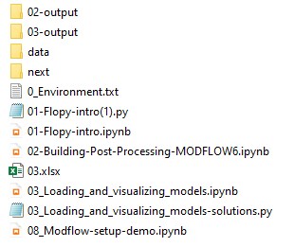
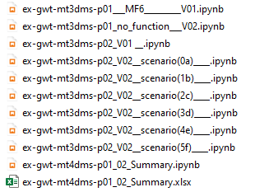
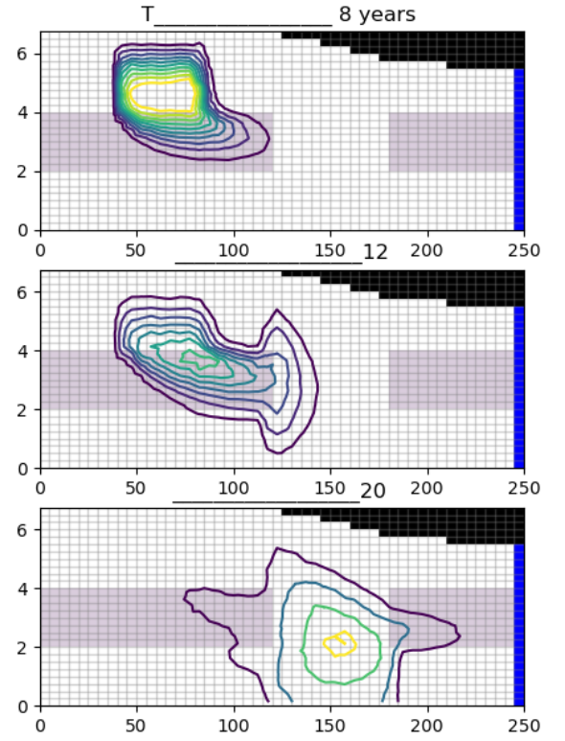
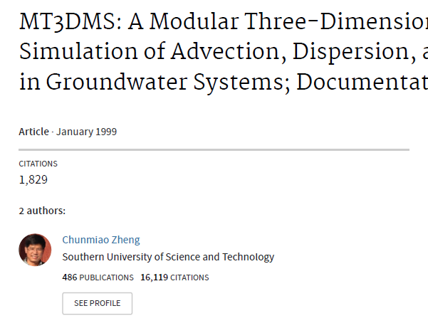
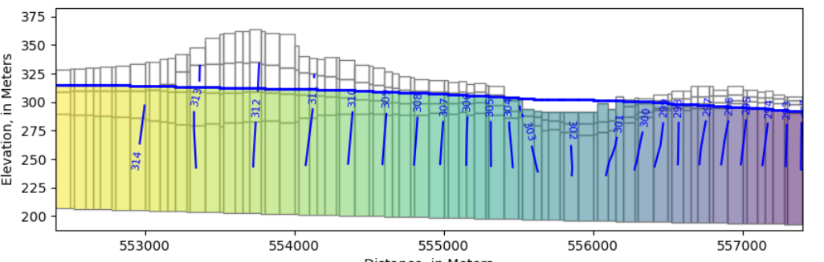
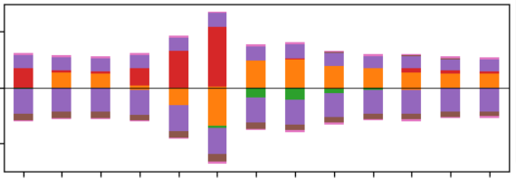
1D
2D
Freundlich, Langmuir, decay, R,
.. Flopy isotherms
van Genuchten,
Brooks Corey
Hydro's
16
Relative Permeability from Capillary Pressure
p03_____V03 __ [C], 1D & M( t )
P04 ____ stress periods distribution ?
P05 ____ steady
P06 ____ C_mf6&M!
P07 ____ V01b ____ load
P08 ____ MF6
pleasant-lake
… ongoing
… extra: neversink _ PEST workflow
Last one

Slide 3
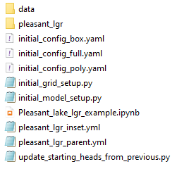
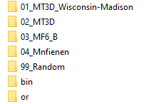

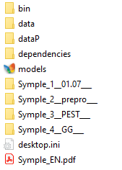
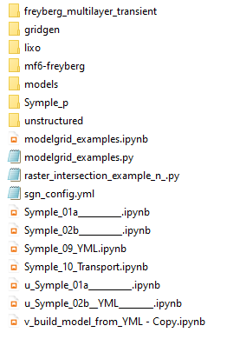

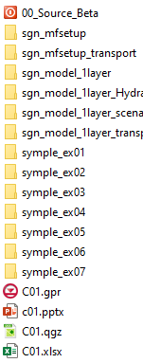
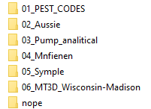
gis env! mfsetup kernel https://doi-usgs.github.io/modflow-setup/latest/notebooks/Pleasant_lake_lgr_example.html
Stopped here

Slide 4
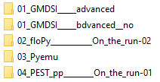
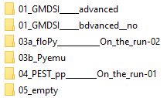

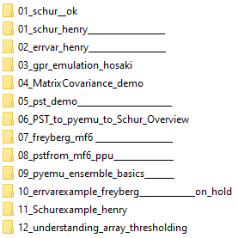

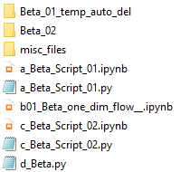
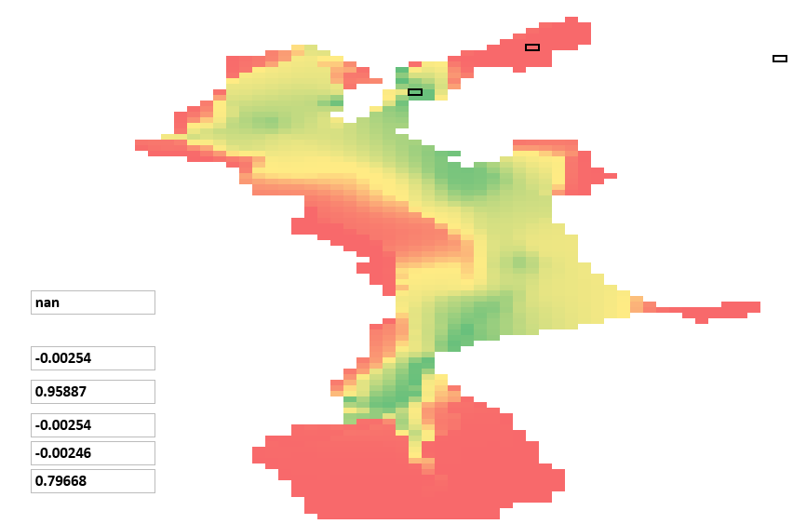

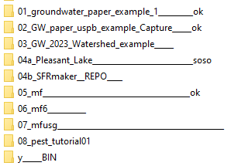
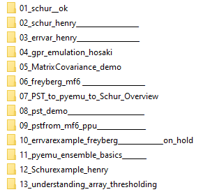
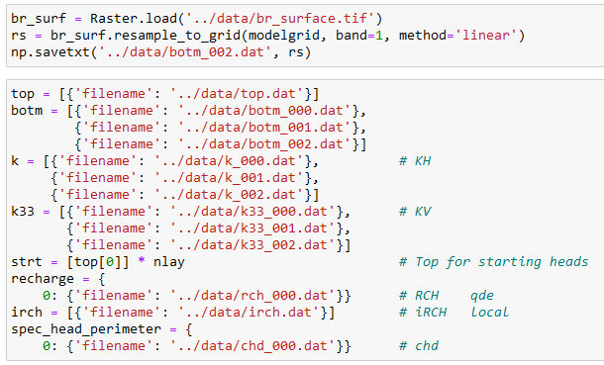
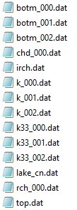

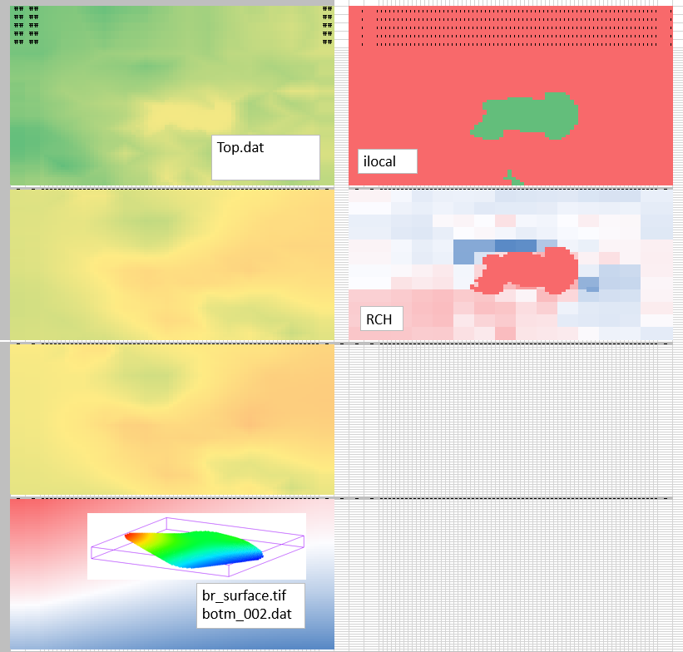
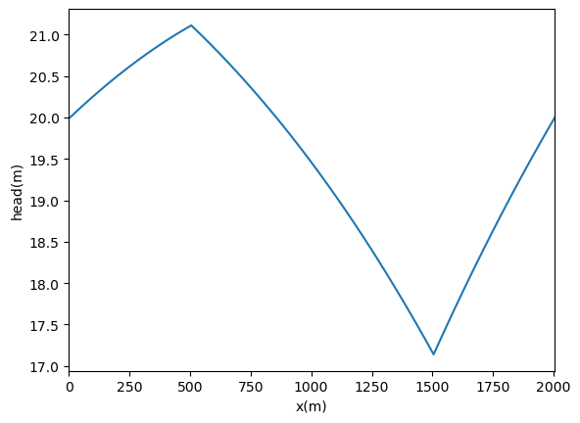

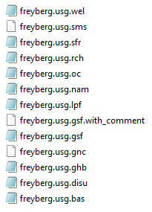
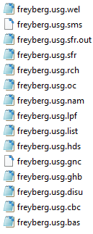

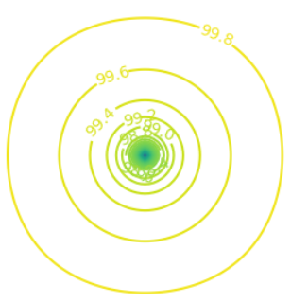
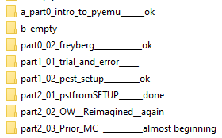
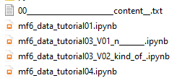
02
03
04
FREYBERG _original
+10
On analysis
Folders
swap
Revise
temporary working directory
Not yet
till GMS
Sfrmaker err
1.1
1.2
1.3
Pleasant lake
Sfrmaker & New folder err
First assumptions
FREYBERG
0_01
&
Local
& Temp.
2025 - www.betami.com.br
Beta μ

Slide 5
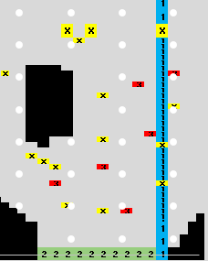
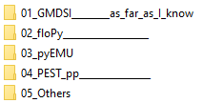
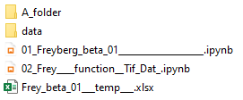











03
FREYBERG _original
Freyberg Flopy not yet
Freyberg GMS – ok – Steady
*
2_01
S1
Last one
Freyberg
*.ins
2_01
S1
…
__ic
__rch
__ne
__sto
*.tpl
*.zone
simplified
d
c
PARVAL
f1
Ensemble
b
85M
Monte Carlo
g
f2
e
a

Slide 6



1 - 1, 201
10, 1
20
-30
Flopy construction?
insert line ..
03 pyEMU __ 01D & Capture

Slide 7





02
FREYBERG
0_01
0_02
time series
2_01
2_02

Slide 8











1.3 intro pyEMU
2_01 pstfromSETUP
Simples
2_01
2_01
01__OBS(a)
02__PAR(a)
03__BC & PAR(b)
04_IC
05__2º___OBS(b)
06__Writing___RUN
07__Prior_Ensemble_
08__Run_again_FW
09__Graphics...
S2 sequence
Original version

Slide 9
















01 - 04
Housekeeping(2) + Flopy(1), … till the 1º run
Boundary conditions
2_01 pstfromSETUP
Pyemu, Pstfrom
ok
05 *.ins
12
IC
06
OBS
heads.csv → heads.csv.ins
13
14
15 – Helpers, Heads and Mass Balance
PST_03
Again
at 16
17,18,19 ______
PST_04
“Tag”
20 pst.write ___ external files
REC
07
Geostat. PAR
21
PST_05
08
RCH
Then, … ensemble ….

Slide 10










01
New folder
Just reference
workspace
New folder,
working
directory
FloPy
Freyberg
comparison
part2_01_
PEST SETUP
Workspace *.nam1,2,+*.exe
part2_02_
pstfrom Reimagined
… then Katie 2_02
pestpp-swp
Sweep
pyemu.os_utils.run('mf6',cwd=model_ws)
New folder
pyEMU

Slide 11






. . .
PEST_pp \ Benchmarks \ 1D
Mf5 _1d ___ SETUP
http://localhost:8888/notebooks/05_PEST_pp________On_the_run-01/benchmarks/01_one_dim_flow/02_Beta_model_SETUP___01__.ipynb
04

