Slide 1




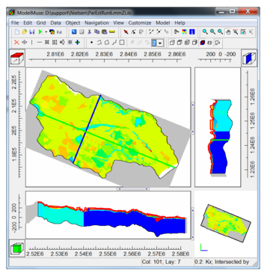
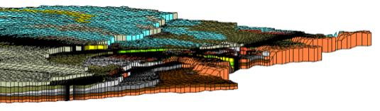
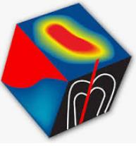





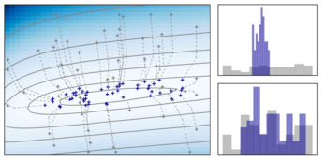

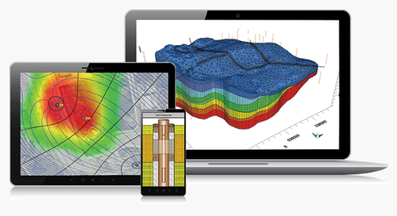




numerical modeling MODFLOW
Commercial Graphical User Interfaces
Model Muse
MODFLOW
https://www.aquaveo.com/software/gms-modflow
https://www.aquanty.com/hydrogeosphere
Open
source
Beta μ
https://www.itascadenver.com/
https://www.usgs.gov/software/modelmuse-graphical-user-interface-groundwater-models
https://www.algocompute.com/
FEflow
https://www.mikepoweredbydhi.com/products/feflow
https://www.groundwatermodels.com/
PEST
PEST: Model-Independent
Parameter Estimation and Uncertainty Analysis
https://www.usgs.gov/software/pest-software-suite-parameter-estimation-uncertainty-analysis-management-optimization-and
https://pesthomepage.org/
Open
source
https://pest.cloud/
Visual MODFLOW Flex
https://www.waterloohydrogeologic.com/products/visual-modflow-flex/
www.betami.com.br
Notes:
Hello AQUAVEO. My name is Rodrigo Grossi. I’m a MSc geology engineer with reasonable background on Sedimentology & Geostatistics.
I’m doing a bit of groundwater modelling at www.betami.com.br
….
It’s a honor to talk with you guys.
Here comes an expedite technical presentation of a solution to bridge what a see as a gap between MODFLOW-PEST Apps.
Or more accurately, to address a better way to just see (understand, manage and criticize) what has already been delivered by (I would say) the impeccable PEST software.

Slide 2


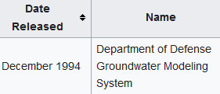

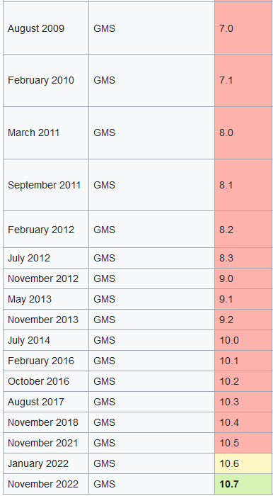

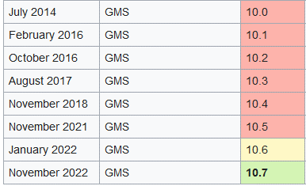


US Army Corps of Engineers
1994
2007
GMS
2014
Engineer Research and Development Center
2022
$$Beta μ$$
Notes:
I know who you are, GMS.
Furthermore, I am also aware of the magnitude of the undertaking I got aim, PEST.
But here’s a thing:
I think all the pangs of my T-Progs mastership theses paid off, thoroughly.
Cause back then I got no choice, and reinforcing what a have just said:
T-Progs became all the needed mathematical push for anyone would dream to understand PEST. Including for myself, being already an engineer.

Slide 3
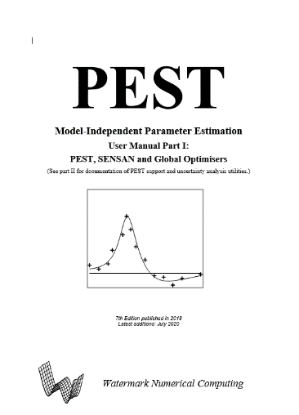
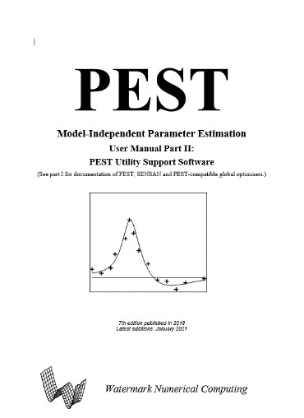
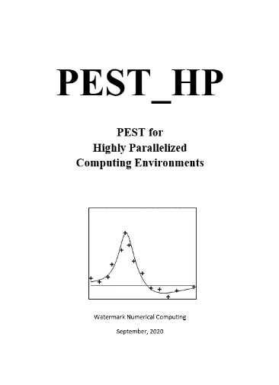
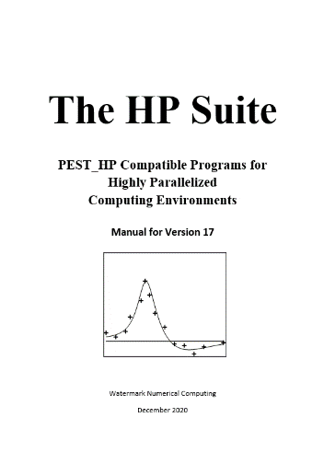
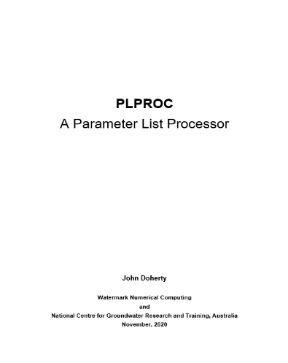
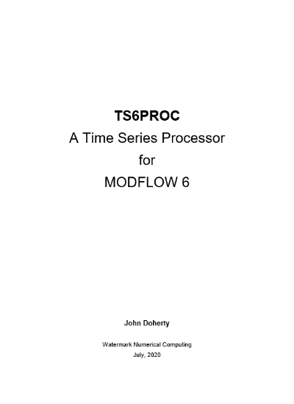

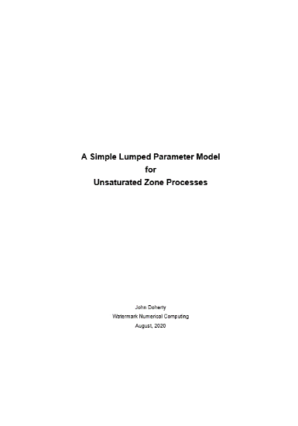
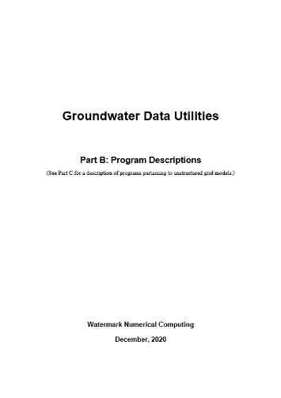
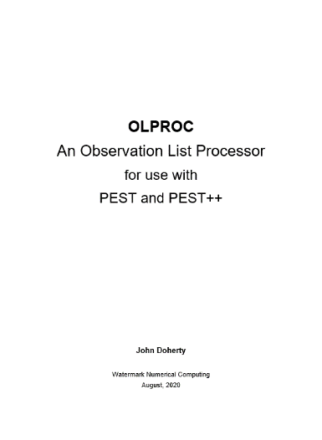


Thousands of pages
From the originals – John Doherty
$$Beta μ$$
Notes:
Nevertheless, no one cares about PEST. “ Its too much(!) ”.
Way too complicated a path to simplify the calibration. Better to attack the problem itself, manually, most of the time. Then deal with the consequences, not to say, all the uncertainties involved afterwords.
But eventually, as the says goes, every problem is an opportunity in disguise.
Thus the Beta µ solution (still in an eternal spreadsheet format) comes to deliver some clarification on of the many phases of the so called mathematical regularization. The calibration challenges in itself.
I think a reached a good solution, a very didactical one. Much better then the plethora of ethereal PEST codes already available.

Slide 4
Hundreds of utilities
PEST
PEST Utilities
CSV2JCB
PEST_HP Suite
RANDPAR
Groundwater
ASSESSPAR
JCB2CSV
PEST
PESTCHEK
ADDREG2
PEST_HP
GENLINPRED
MF62GIS
PPCOV
Parallel PEST
ADDREG1
etc
INSCHEK
MOD2SMP
MANY2ONE
TEMPCHEK
PEST_HP_MKL
OBS2OBS
MKPPSTAT3D
INFSTAT
RANDPAR1
SUBREG1
FAC2REAL
BeoPEST
RANDPAR2
RSI_HP_MKL
SMPCHEK
MKPPSTAT
DSI
SUPCALC
PARREP
JACWRIT
TWOARRAY
PREDVAR1b
CMAES_HP
ARR2BORE
etc
USGBUD2SMP
I64PEST
etc
etc
PREDUNC1
SMP2INFO
PAR2PAR
OBSCOMP
REAL2INT
PPCOV_SVA
PREDUNC2
RSI_HP
SCEUA_P
PREDVAR1
AGENT_HP
DBL2SGL
PPKREG
PESTPREP1
CMAES_P
PREDVAR1a
SSSTAT
GETMULARR
INDENTPAR
USGBIN2TAB_H
SMP2SMP
JACTEST
SCALEPAR
PWHISP_HP
JACTEST_HP
MF62VTK2
SUPOBSPAR
SMP2SMP
MF6DEP2CSV
JCO2JCO
USGMOD2SMP
COMFILNME
MAT2JCO
etc
JCO2MAT
BUD2SMP
ELEVCONC
USG2VTK1
PESTPREP2
MF62VTK1
Others
etc
GENREG
Surface Water Utilities
FIELDGEN
PLPROC
INT2MIF
USGBUD2SMP
LOGARRAY
OLPROC
TS6PROC
MF2VTK1
USGPROP2TAB1
MF62GIS
TSPROC
LUMPREM
LR2SERIES
MF6BIN2TAB_H
From the originals – John Doherty
$$Beta μ$$
Notes:
Not that I'm trying to outdo the originals, far from it. I think the PEST code is irreprochable. And I use it, gladly, through GMS.
My algorithm doesn't do the automated decisions itself. But prepares suitable distributions of parameters and all the needed modeling objectives (observations). As a “back and front end” interposed between PEST and GMS.
Uncertainty analysis, for instance, has not been achieved. Not yet!
I'm only humbly suggesting an alternative to do the basic statistics. So with all due respect Mr. Doherty:
I would like to stick only with all this great theory of yours. The calibration, I can do by myself.
Cause after a while I’m sure, I can prove it. It’s feasible. In Excel. And all knowledge it give the user is a worthwhile endeavour.

Slide 5

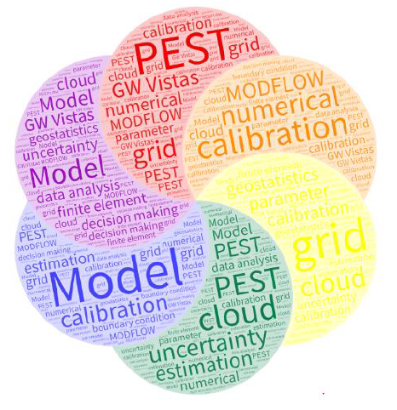

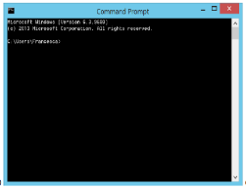




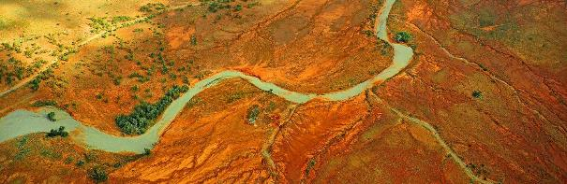

Players
$$Beta μ$$
batch files
https://pesthomepage.org/
$$Beta μ$$
Notes:
So here comes the sources of my study.
…
Seams that the Italian Kataclima institute and PEST were a ancient partnership.
Then it broke apart to evolved separately as Symple and the Australian GMDSI.
Today PEST is a lot more than just a parameter estimation tool:
It is focused now on uncertainty and decision making, related to the modelling design as a whole.

Slide 6


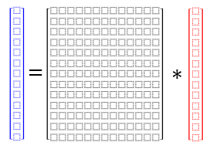
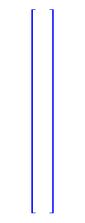











Markov Chains
T-Progs
$$Beta μ$$
https://www.teses.usp.br/teses/disponiveis/44/44138/tde-15032021-105715/
Well
A
B
A
A
A
B
C
C
C
C
B
A
A
C
C
B
B
B
A
C
$$\vec{h}=X∗\vec{p}$$
$$Vetor$$
$$Matrix$$
$$Vetor$$
$$=$$
$$∗$$
Observation window
→ distancy
$$Structure$$
$$Observations$$
$$Parameters$$
Δh = 1 unity
$$Beta μ$$
Notes:
Let’s see what I’m talking about:
First and foremost, it is paramount to understand the cyclical, recurrent meaning, and the consequences, of a matrixial notation.
I’m stressing the value of the more formal covariance matrix. Stop here if you don’t know what I am talking about.
Linear algebra and vectors – SVD decomposition – the unrestricted dimensions of the null space – all this goes with T-Progs.
… You could read mastership thesis to get started on it.
https://www.teses.usp.br/teses/disponiveis/44/44138/tde-15032021-105715/

Slide 7
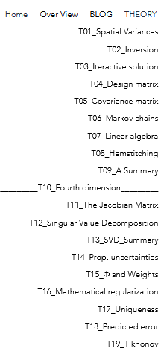
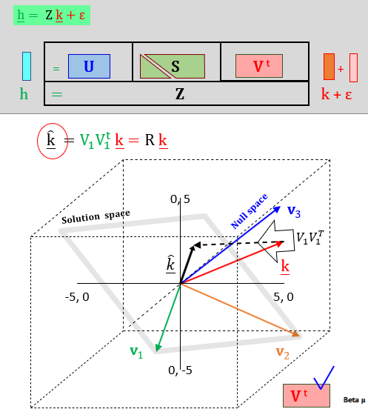


MOFLOW
Beta μ
PEST
https://www.betami.com.br/
$$Beta μ$$
Notes:
Take a look in at some aspects of MODFLOW and PEST theory at my website:
https://www.betami.com.br/home-2

Slide 8
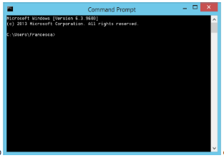

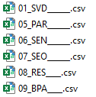
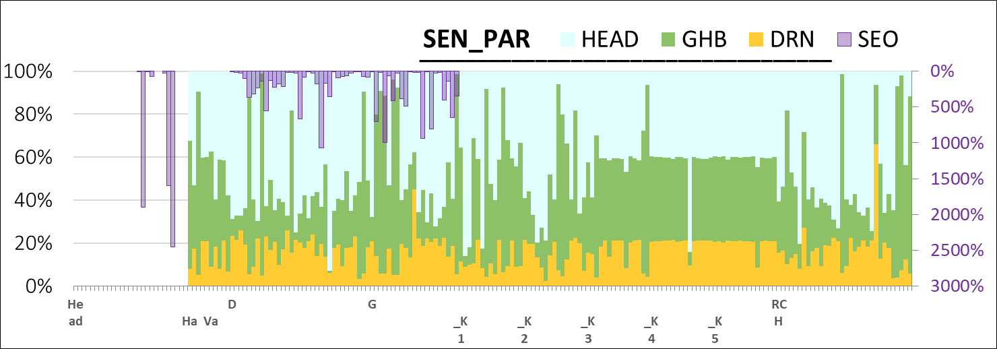
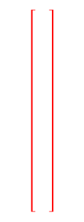


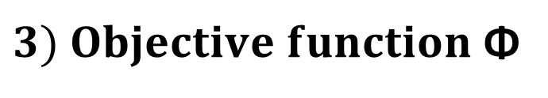










Sum of squared weighted residuals (ie phi) = 4132.2
Contribution to phi from group "head“ = 3995.2
Contribution to phi from group "drain“ = 126.55
Contribution to phi from group "ghb“ = 0.39256
1ST Problem
batch file
2nd Problem
v
$3) Objective function$ Φ
$$1) Ordering$$
3rd Problem
$$2) PEST$$
$$4) SEN x SEO$$
4th Problem
...$the sensibilitie$
$$and susceptibilities$$
$$\vec{h}=X∗\vec{p}$$
$$Vetor$$
$$Matrix$$
$$Vetor$$
$$=$$
$$∗$$
Notes:
Beta µ comes to address four big problems – mainly just to see, clearly, what’s is going on in any PEST realization.
…
1 – The need to [ just ] order inputs and outputs;
2 – The why’s and the how's PEST works, or should not work;
3 – The balance of a composite objective function, … that makes sense;
4 – And the understanding of the covariance matrix sensibility function.

Slide 9

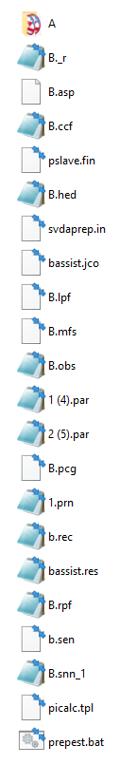
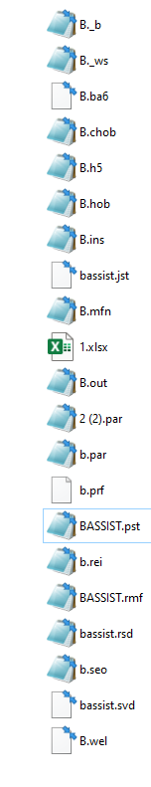
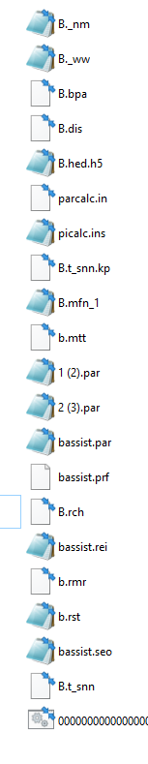
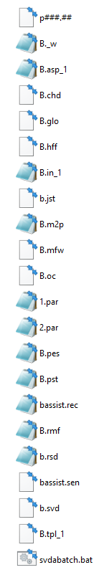
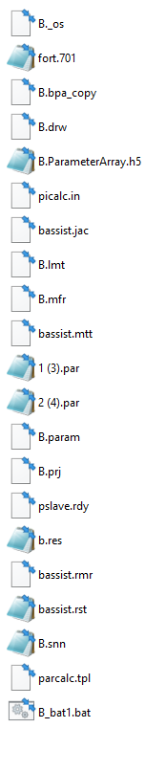


1ST Problem
v
batch file
v
Beta μ
Notes:
PEST attends for Model-Independent Parameter Estimation and Uncertainty Analysis
Aquaveo GMS MODFLOW is a Graphical Interface that process PEST in a great but not indefectible way.
Its biggest advantage, in my point of view, is its solicitude in not become a handicap on what the user can, or cannot do, in its own modelling effort.

Slide 10
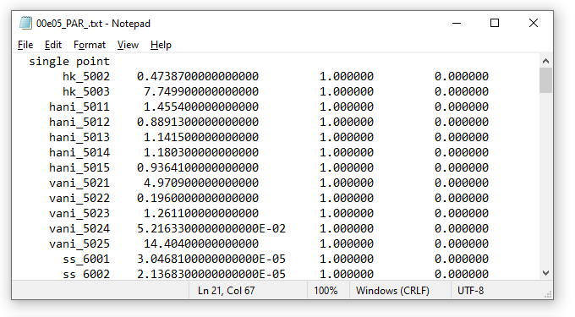
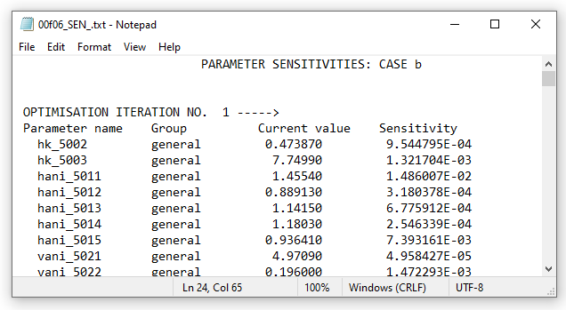
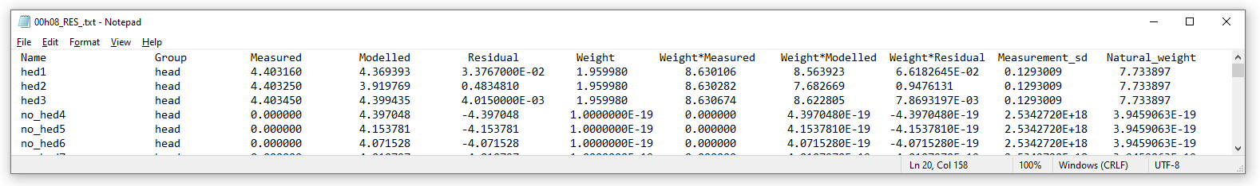
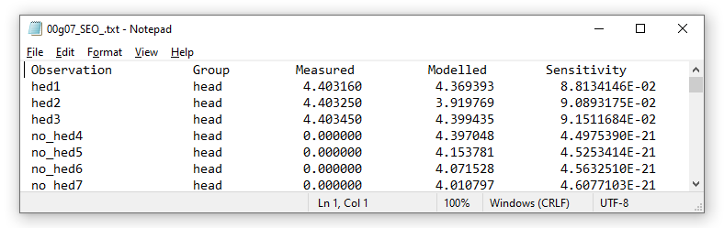
1ST Problem
v
Beta μ
Notes:
This first problem comes as the test files …. PAR – SEN – RES – SEO
We handle this files in two big spreadsheets.

Slide 11
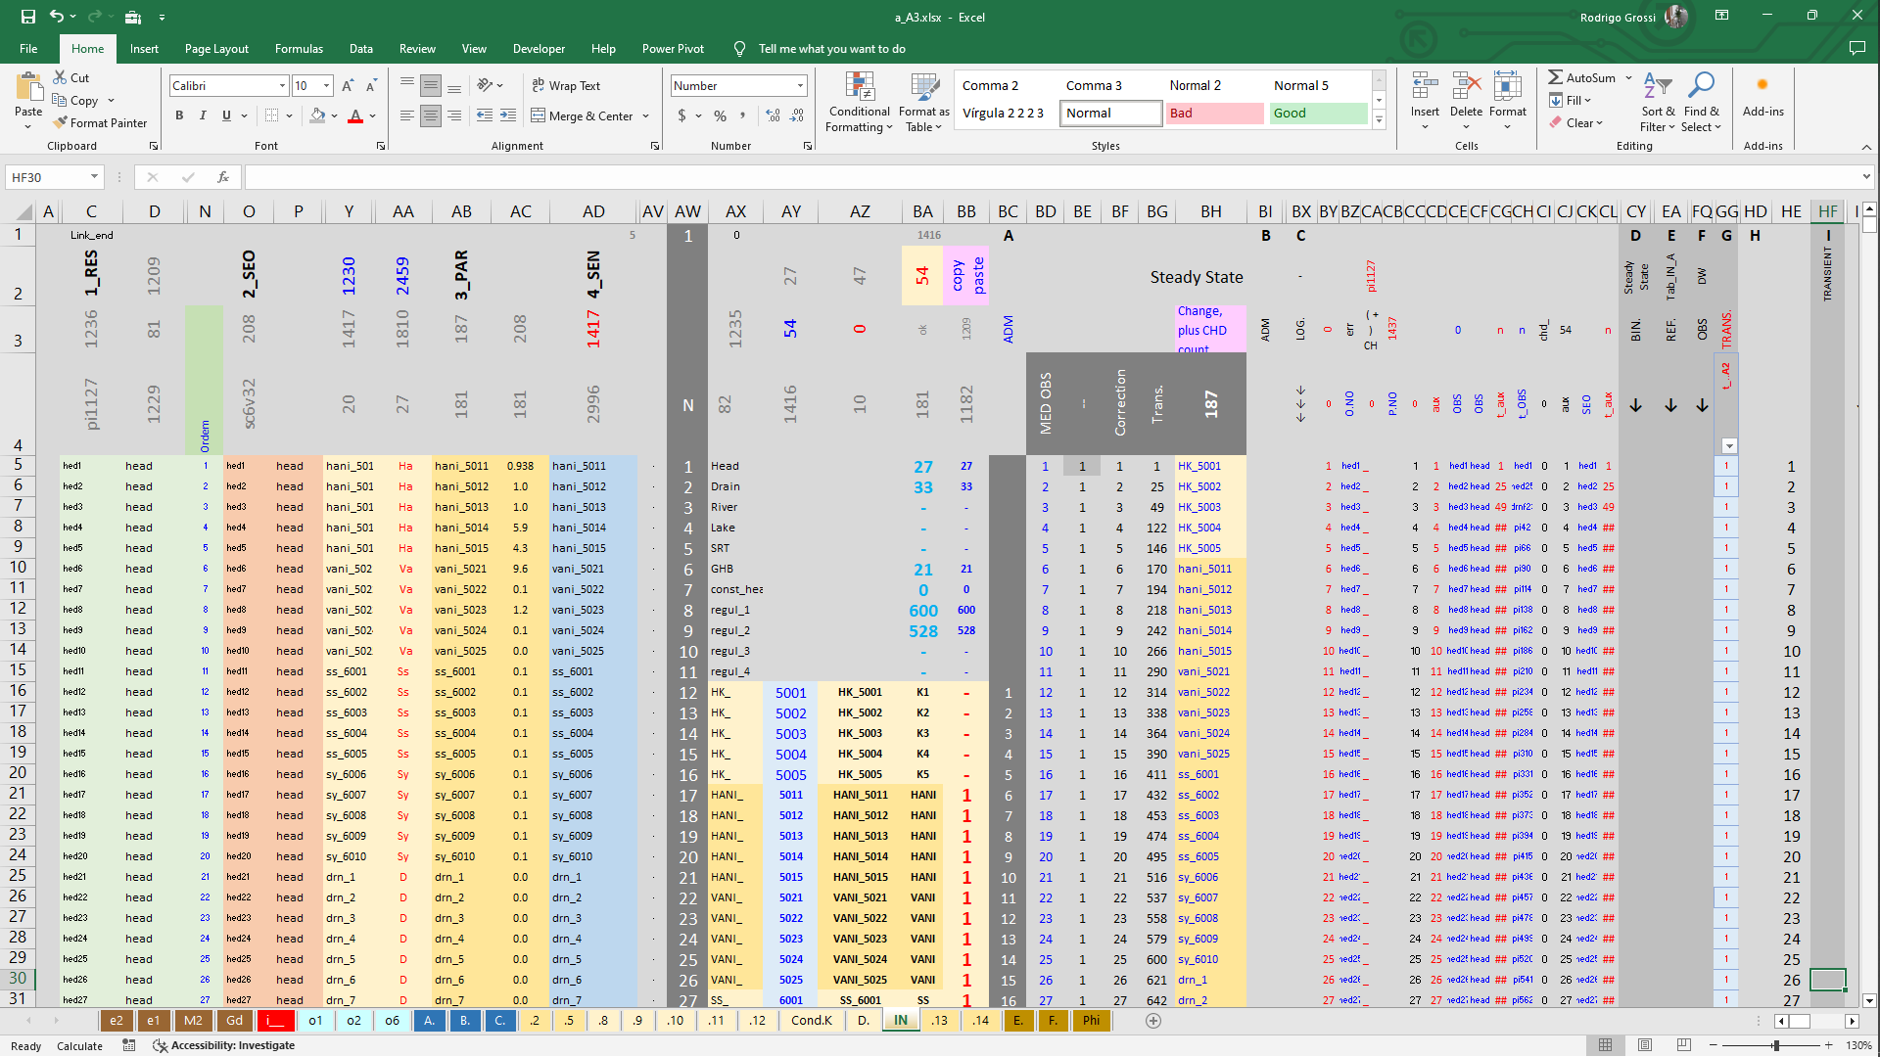
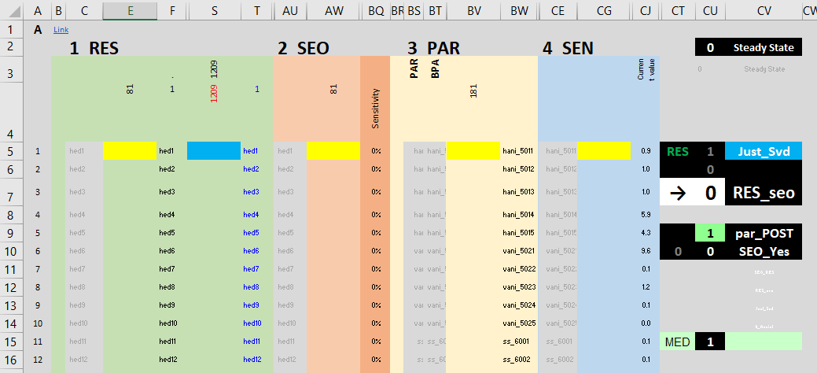
Notes:
At first sight, it seems like a simple assignment. - Just ordering.
But the devil comes in the details.
There is not a few variations of its inner contents, and it varies according to the PEST controls used in a realization.
And we need a unique platform to make room for different conceptual models;
The analysis must come in standard proceedings amicable to the user;
We need chart visualizations, I make a point of it.
And so on..

Slide 12
Observations
EMQN (%)
Por exemplo: A variável SD_22 conecta-se ao valor da diferença MOD-MED, e é utilizada para disciplinar o mecanismo de escolha dos parâmetros.
E na sequência: Pondera-se o peso a ser atribuído aos três conjuntos de observações.
2024 - www.betami.com.br
Beta μ
Notes:
Observations x Parameters
This is a case for Heads, Drains and General Head Boundaries (o1, o2, o6)
against
DRN, GHB, K12345, HANI, VANI and RCH (.2,5 - 8,9,10,11,12 - 13,14).
Then comes the Objective function … Mass Balance and Sensibilities.

Slide 13
Observations
EMQN (%)
O mesmo, para DRN e GHB.
De forma que, junto aos resultados alcançados na calibração (próxima página), entrega-se uma compilação de todas as interligações estabelecidas.
Isto evita resultados tendenciosos.
SEN_PAR
_______________________________
SEN_PAR x SEO _OBS
2024 - www.betami.com.br
Beta μ
Notes:
To be continued, ..
www.betami.com.br
05|21|2024

Slide 14
Parameters
Parâmetros
K
A
B
C
D
E
KH
KV
m/d
K
Pth
10%
K
Pth
90%
Notes:
Thank you!

Slide 15
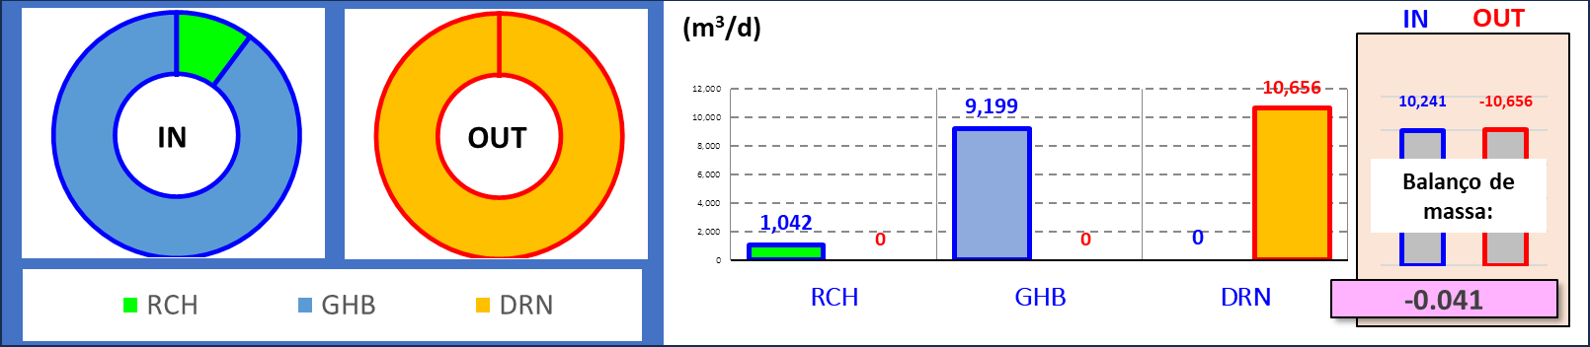
SEN_PAR
_______________________________
Notes:
To be continued, ..
Thank you!
www.betami.com.br
05|21|2024

Slide 16
Thank you!
www.betami.com.br
05|24|2024

