Slide 1
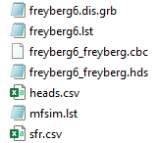

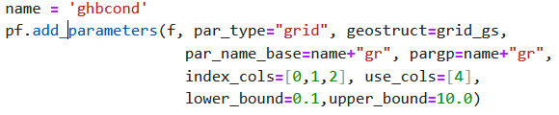
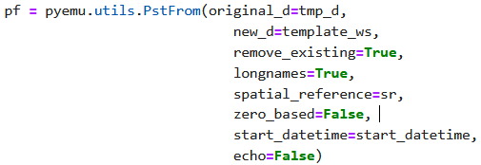

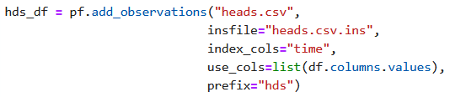
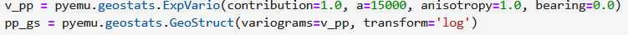
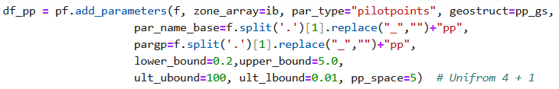
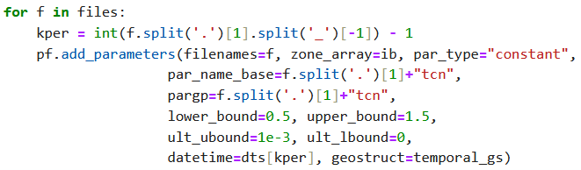
01
Housekeeping(2) ... 1º forward & 2º pm runs.
01 - 04
part2_01_pstfromSETUP
GHB, Well, SFR(river) __Boundary conditions
pyemu
Pstfrom
05
*.ins
ok
06
OBS
heads.csv → heads.csv.ins
“Tag”
07
Geostat. PAR
08
RCH

Slide 2
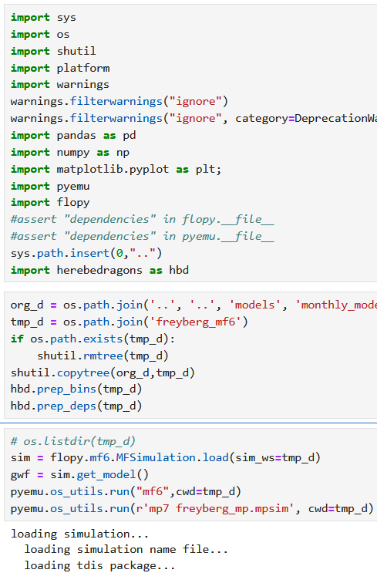

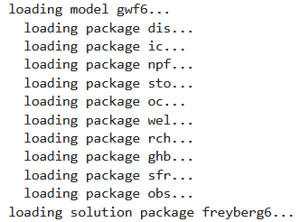
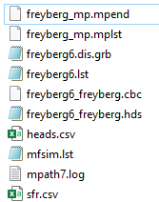
part2_01_pstfromSETUP
01
01
flowPy
shutil.copytree
(org_d,tmp_d)
AUX
PAR
Folder freyberg_mf6
OBS
02
pyEMU
Mf6
Mp7
+
05a
03

Slide 3
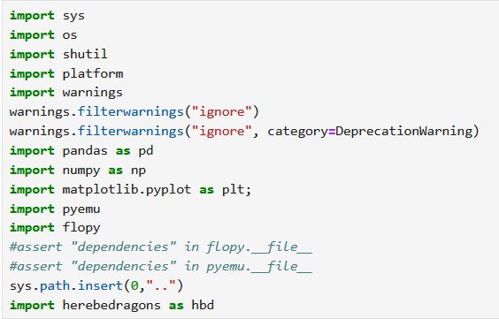

pstfrom
01

Slide 4
Recalling …
Essential model utilities flowPy
01
02
03
04
05
06
fpm.Modflow Dis
fpm.Modflow Bas (model, ibound=ibound, strt=20) fpm.Modflow Lpf (model, hk=10, laytyp=1) fpm.Modflow Wel (model, stress_period_data=lrcQ) fpm.Modflow Pcg (model)
fpm.Modflow Oc (model)
Discretization
# Grid
flowPy
# Layers
# solver
AUX
# output control
PAR
03
initial conditions
OBS
03
pyEMU
+
05a

Slide 5
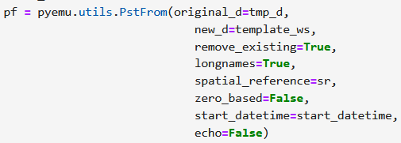

part2_01_pstfromSETUP
++
05b
+
PstFrom
04
helpers
pyEMU
pyEMU
+
05a

Slide 6
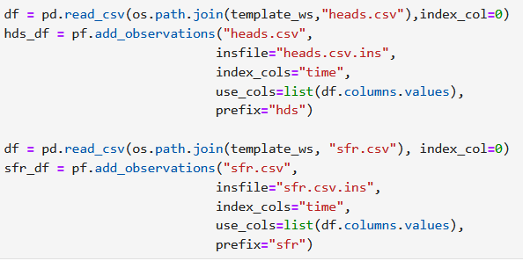



OBS
PAR
PstFrom
PstFrom
PEST interface
++
06
05b
*.ins
Simulation
model
+
Pst PESTfrom
!oname:hds_otype:lst_usecol:trgw-0-2-15_time:3652.5!~,~34.6

Slide 7
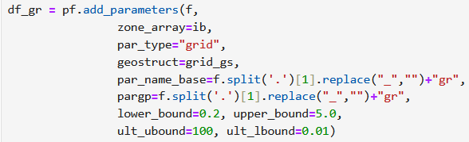
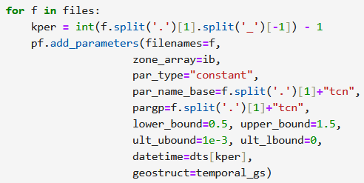





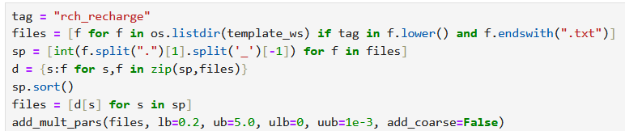

OBS
part2_01_pstfromSETUP
PAR
tag = "npf_k_“
tag = "sto_ss“
tag = "sto_sy“
tag = "ne_"
*.tpl
a,b,c
K
3x
D
07 a,b,c,D
HV
tag = "rch_recharge “
08
a) Space
b) Time
tag = "ghb_stress_period_data"
temp.
09

Slide 8

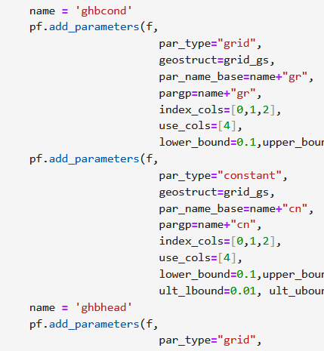
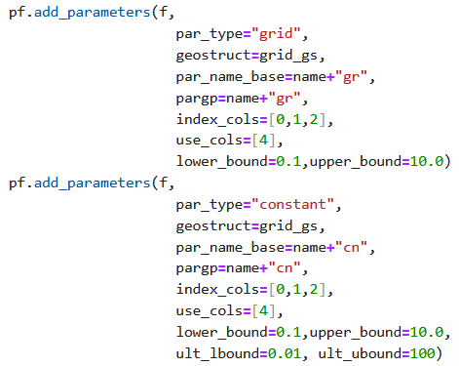

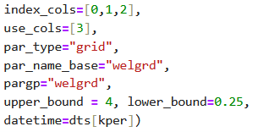
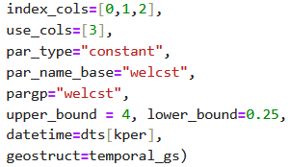
part2_01_pstfromSETUP
tag = "ghb_stress_period_data"
2x2
09
Head
&
Conductance
tag = "wel_stress_period_data"
10
Grid
Stress periods
Cte
two scales
2x
a) Space
b) Time

Slide 9




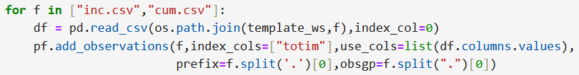


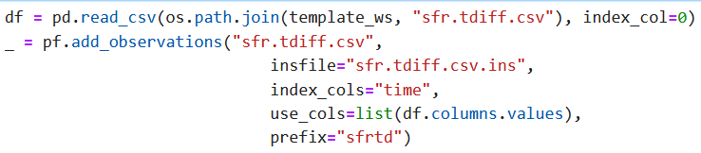



part2_01_pstfromSETUP
Condições iniciais
*.tpl
- Simulation
- Model
tag = K
12
PAR
14 _ SYS
*.cmd
mf6
mp7
14
07
13
Forward & PEST.pst
Pst PESTfrom
15
Pre- post-
processing
temp
tag = R
08
04
05
Spatial Ref.
09
Secondary Observations
16
10
OBS
*.ins
tag = wel
06
11
Pst PESTfrom
*.ins
temp
tag = SFR

Slide 10
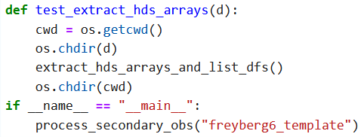
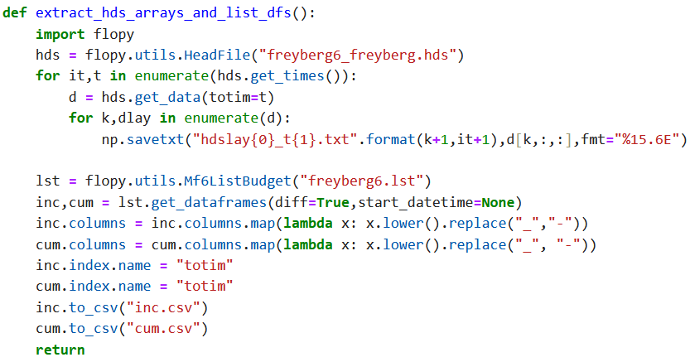
part2_01_pstfromSETUP
15
Pre- post-
processing

Slide 11
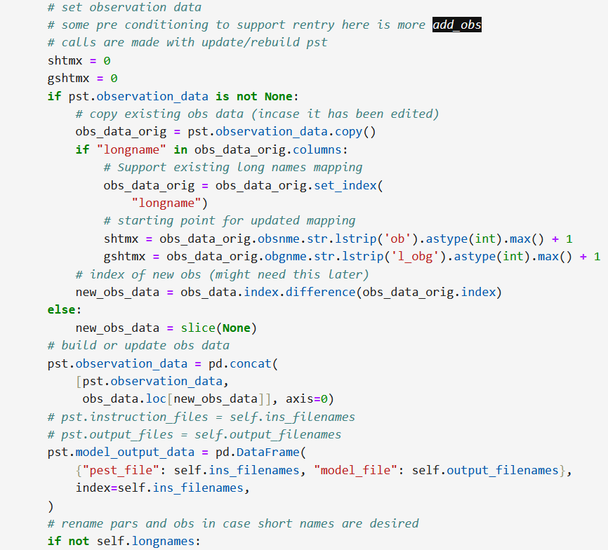
part2_01_pstfromSETUP
17 ____ Weights ...
Secondary Observations
16
Pst PESTfrom
*.ins

Slide 12
part2_01_pstfromSETUP
2º Summary

Slide 13
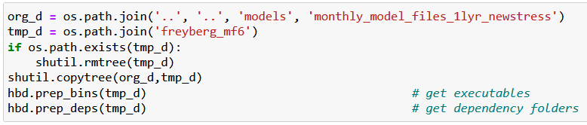

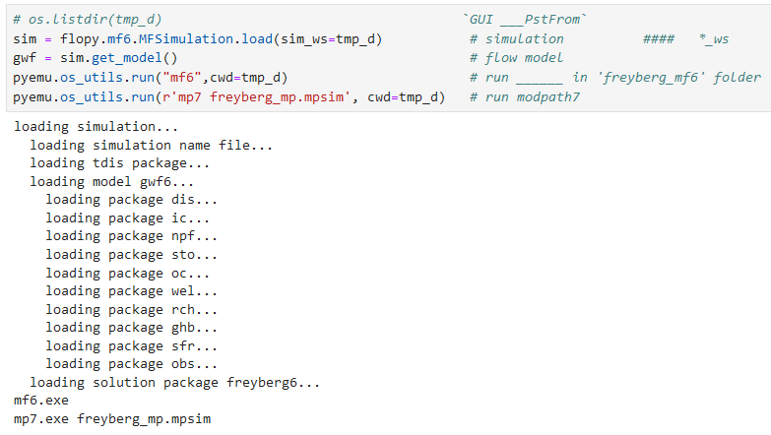

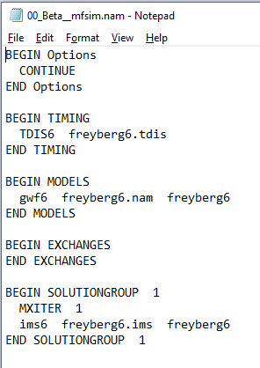
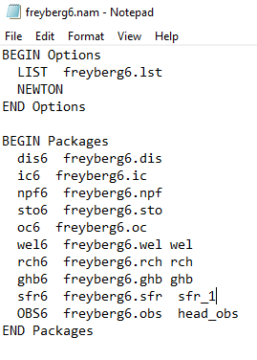
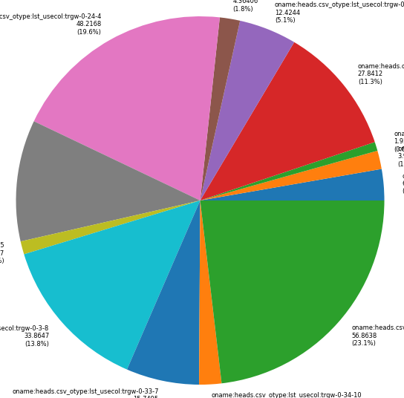
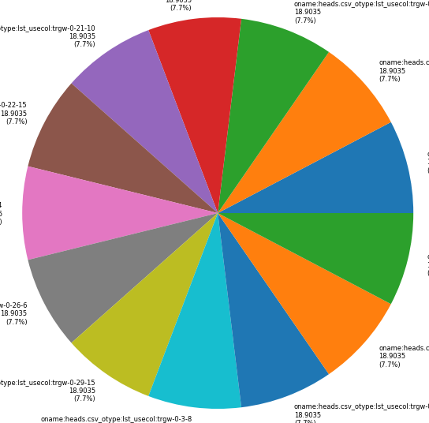
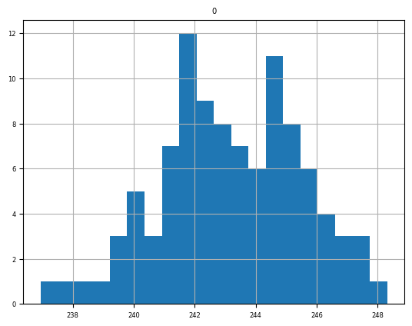

01
New folder
Just reference
workspace
New folder,
working
directory
FloPy
Freyberg
comparison
part2_01_
PEST SETUP
Workspace *.nam1,2,+*.exe
part2_02_
pstfrom Reimagined
… then Katie 2_02
pestpp-swp
Sweep
pyemu.os_utils.run('mf6',cwd=model_ws)
New folder
pyEMU

Slide 14
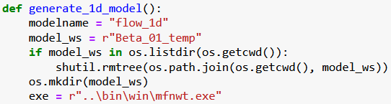


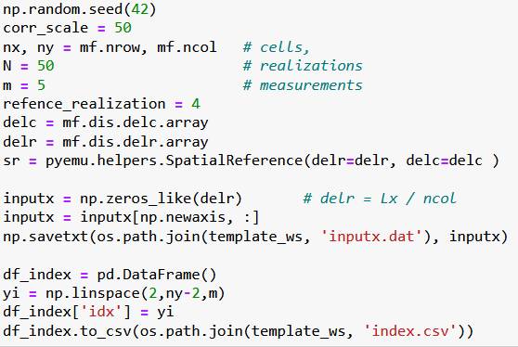
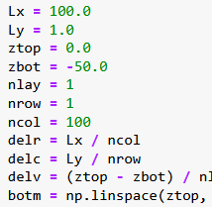
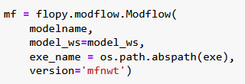
04
Beta_01
02
03
. . .
PEST_pp \ Benchmarks \ 1D
Mf5 _1d ___ SETUP
http://localhost:8888/notebooks/05_PEST_pp________On_the_run-01/benchmarks/01_one_dim_flow/02_Beta_model_SETUP___01__.ipynb
Stopped at:
# `Beta ____ multi_threads=false ____ error`

Slide 15

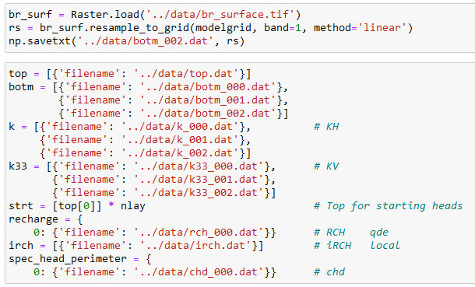
### `Stoped at ____: Postrocessing : Get_water_table()__Module` __________ err __ 2x
## ` Streamflow err... intersects` ____________` err_01 `
## Postrocessing : Get_water_table()__Module ____` err_02 `
02
03a_floPy_01_Pleasant-lake-flopy-example

Slide 16
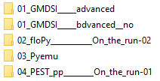
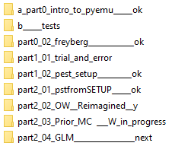
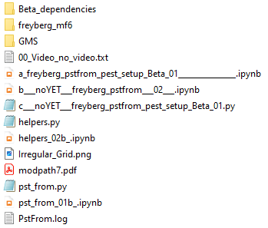
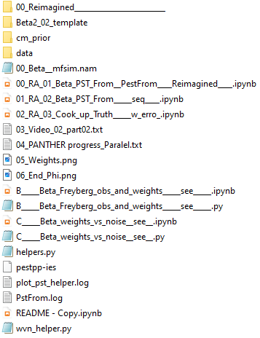
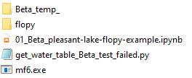
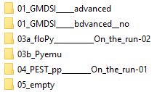
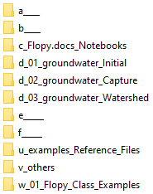
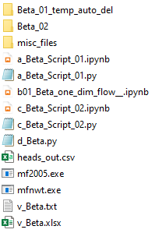

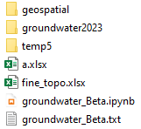
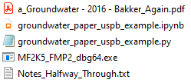
01
02
1.3
Last one:
Move on …
sequence
multi_threads err
s
Again
s
s
10
s
04
03.1
06 phases
50
03.2
Last one:
Move on …
03.3
s
Streamflow
Postprocessing errs
2024 - www.betami.com.br
Beta μ

Slide 17


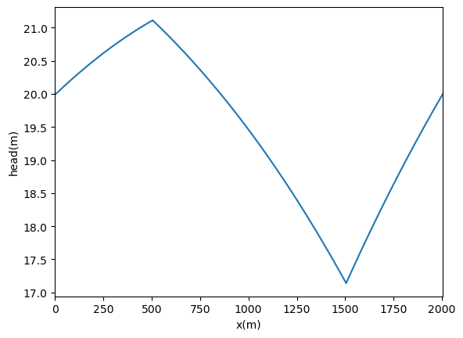
1 - 1, 201
10, 1
20
-30
How to insert a H line?
03.1 Part 01 - Capture

Slide 18
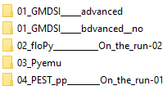
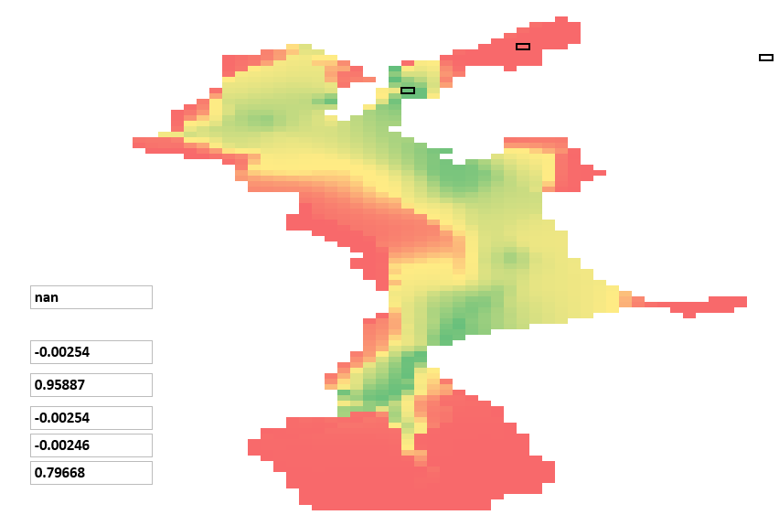







1.3 intro pyEMU
http://localhost:8888/notebooks/01_GMDSI_____advanced/01_Tutorials___AGAIN___/a_part0_intro_to_pyemu______ok/intro_to_pyemu________.ipynb#Geostatistics-=-PPCOV
Flopy
construction ?
## `First Order, Second Moment (FOSM)`_ Linear Analysis + forecasts _<font color='red'> Recording __*.cov </font>
# Previous Ensemble <font color='red'> possible issue </font> shutil.rmtree(t_d)
03.2 Part 02 - Capture

