Slide 1
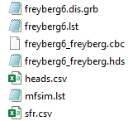

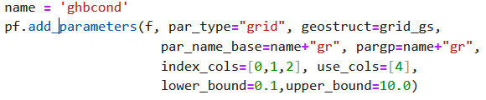
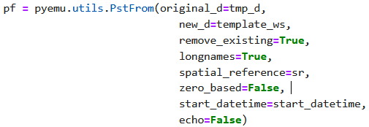

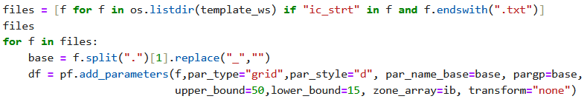

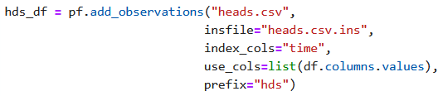


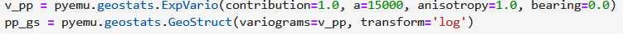
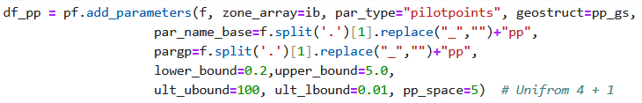

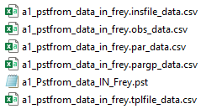

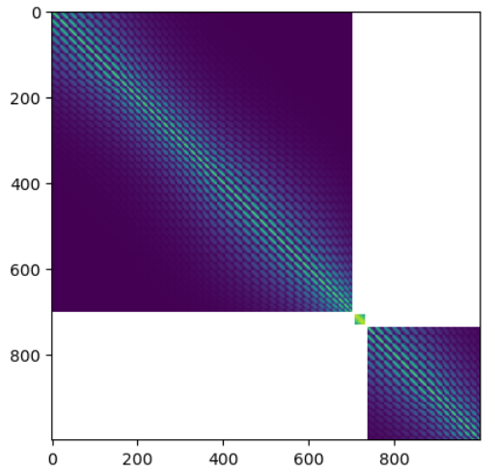
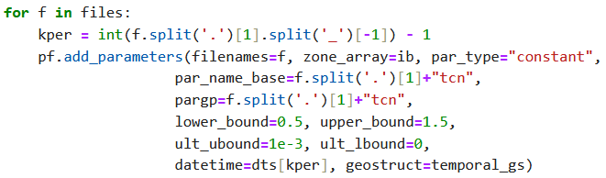
part2_01_pstfromSETUP
01
Housekeeping(2) ... 1º forward & 2º pm runs.
01 - 04
GHB, Well, SFR(river) __Boundary conditions
Pyemu, Pstfrom
05 *.ins
ok
12
IC
06
OBS
heads.csv → heads.csv.ins
13
14
15 – Helpers, Heads and Mass Balance
PST_03
Again
at 16
07
Geostat. PAR
17,18,19 ______
PST_04
“Tag”
20 pst.write ___ external files
REC
21
08
RCH
PST_05
Then, … ensemble ….

Slide 2
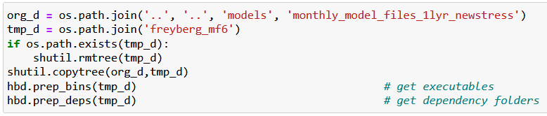

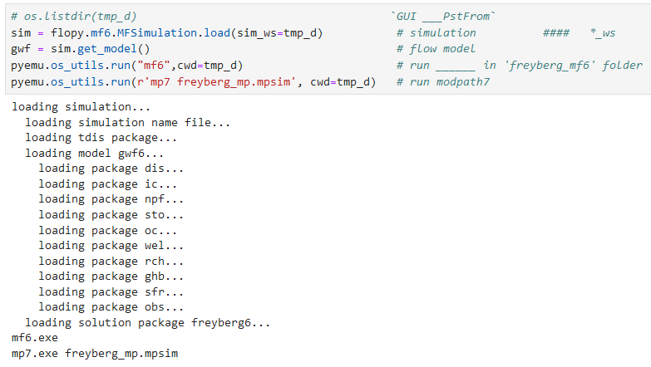

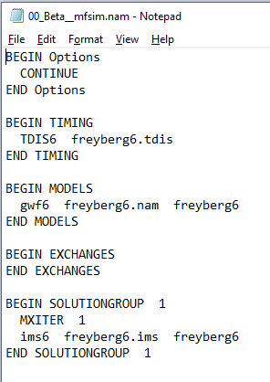
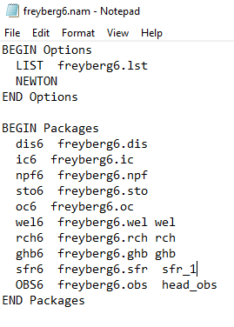
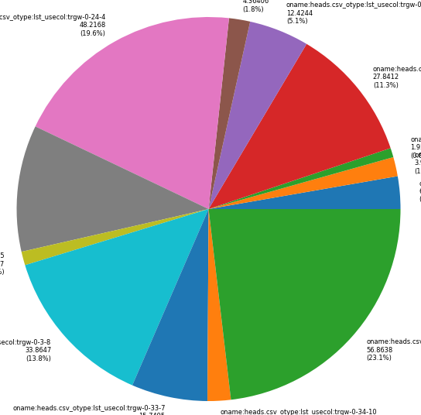
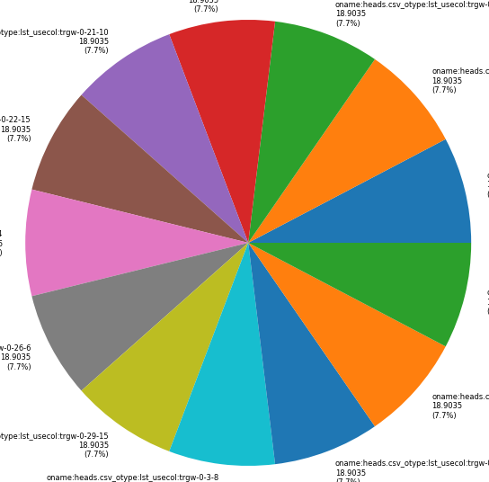
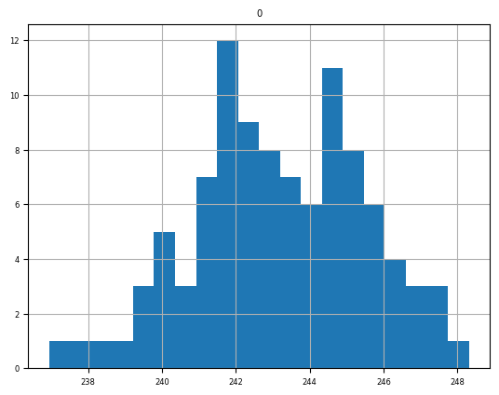

01
New folder
Just reference
workspace
New folder,
working
directory
FloPy
Freyberg
comparison
part2_01_
PEST SETUP
Workspace *.nam1,2,+*.exe
part2_02_
pstfrom Reimagined
… then Katie 2_02
pestpp-swp
Sweep
pyemu.os_utils.run('mf6',cwd=model_ws)
New folder
pyEMU

Slide 3
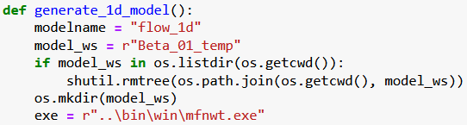


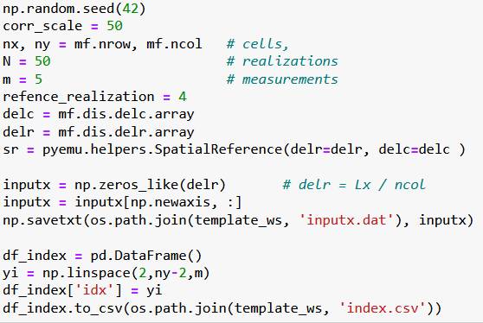
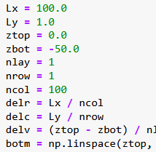
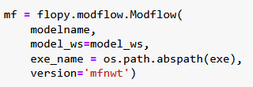
04
Beta_01
02
03
. . .
PEST_pp \ Benchmarks \ 1D
Mf5 _1d ___ SETUP
http://localhost:8888/notebooks/05_PEST_pp________On_the_run-01/benchmarks/01_one_dim_flow/02_Beta_model_SETUP___01__.ipynb
Stopped at:
# `Beta ____ multi_threads=false ____ error`

Slide 4

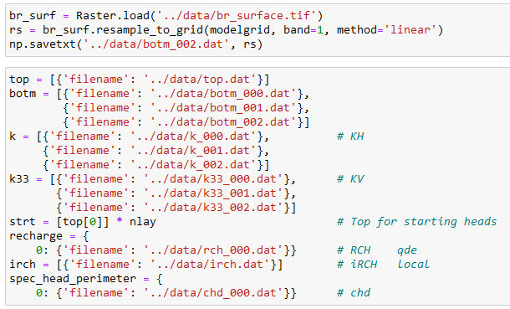
### `Stoped at ____: Postrocessing : Get_water_table()__Module` __________ err __ 2x
## ` Streamflow err... intersects` ____________` err_01 `
## Postrocessing : Get_water_table()__Module ____` err_02 `
02
03a_floPy_01_Pleasant-lake-flopy-example

Slide 5
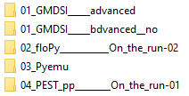
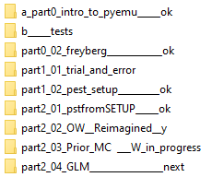
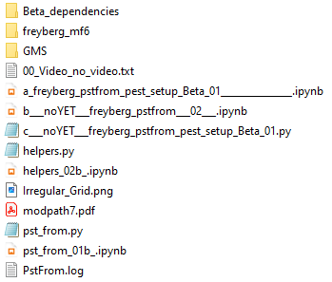
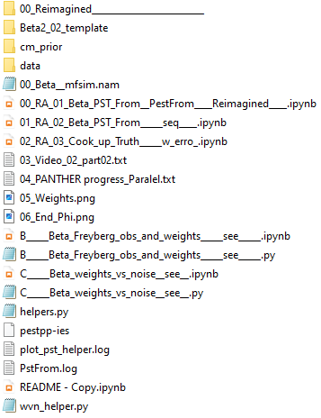
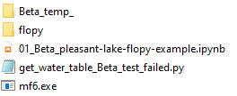
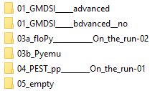
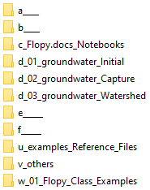
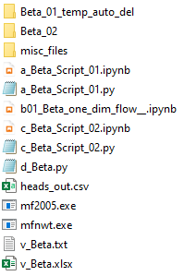

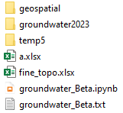
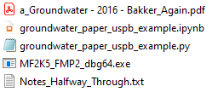
01
02
1.3
Last one:
Move on …
sequence
multi_threads err
s
Again
s
s
10
s
04
03.1
06 phases
50
03.2
Last one:
Move on …
03.3
s
Streamflow
Postprocessing errs
2024 - www.betami.com.br
Beta μ

Slide 6


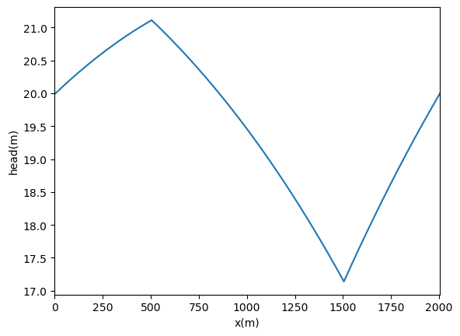
1 - 1, 201
10, 1
20
-30
How to insert a H line?
03.1 Part 01 - Capture

Slide 7
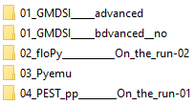
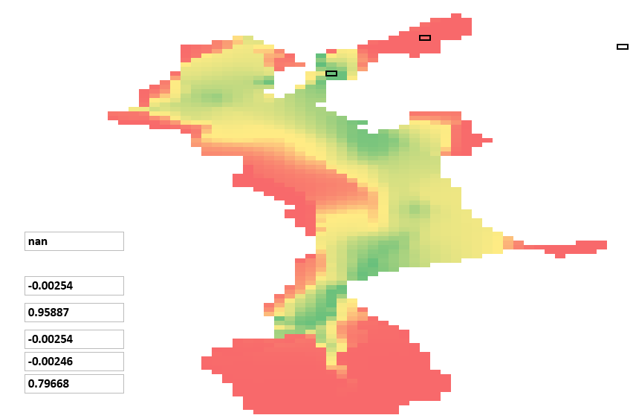
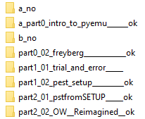
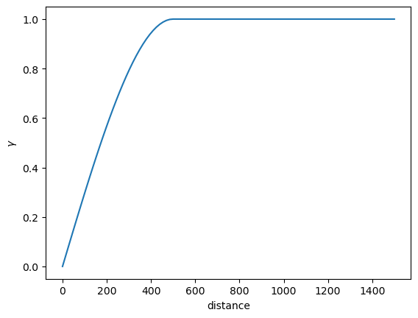
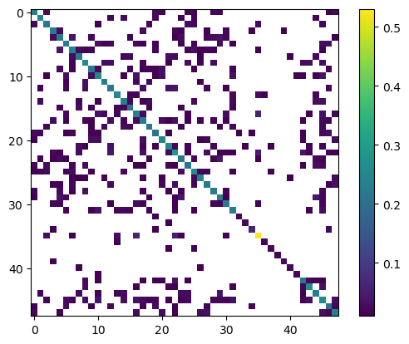
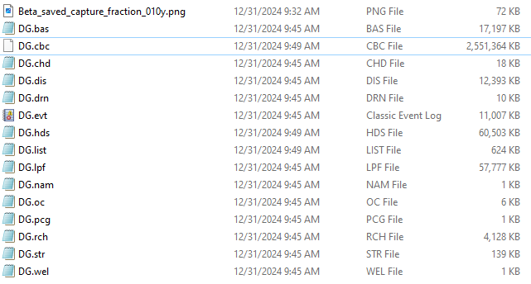
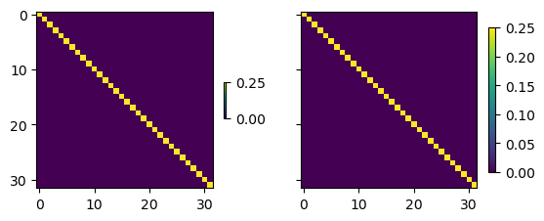
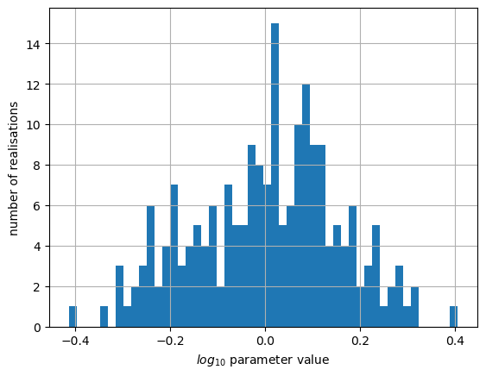
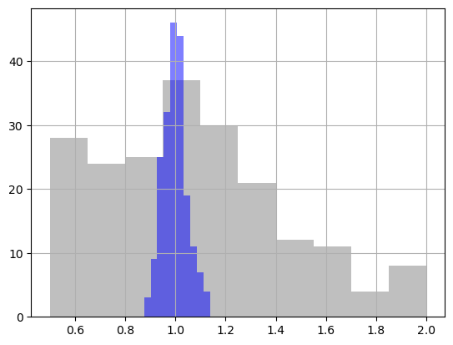
1.3 intro pyEMU
http://localhost:8888/notebooks/01_GMDSI_____advanced/01_Tutorials___AGAIN___/a_part0_intro_to_pyemu______ok/intro_to_pyemu________.ipynb#Geostatistics-=-PPCOV
Flopy
construction ?
## `First Order, Second Moment (FOSM)`_ Linear Analysis + forecasts _<font color='red'> Recording __*.cov </font>
# Previous Ensemble <font color='red'> possible issue </font> shutil.rmtree(t_d)
03.2 Part 02 - Capture

