Slide 1
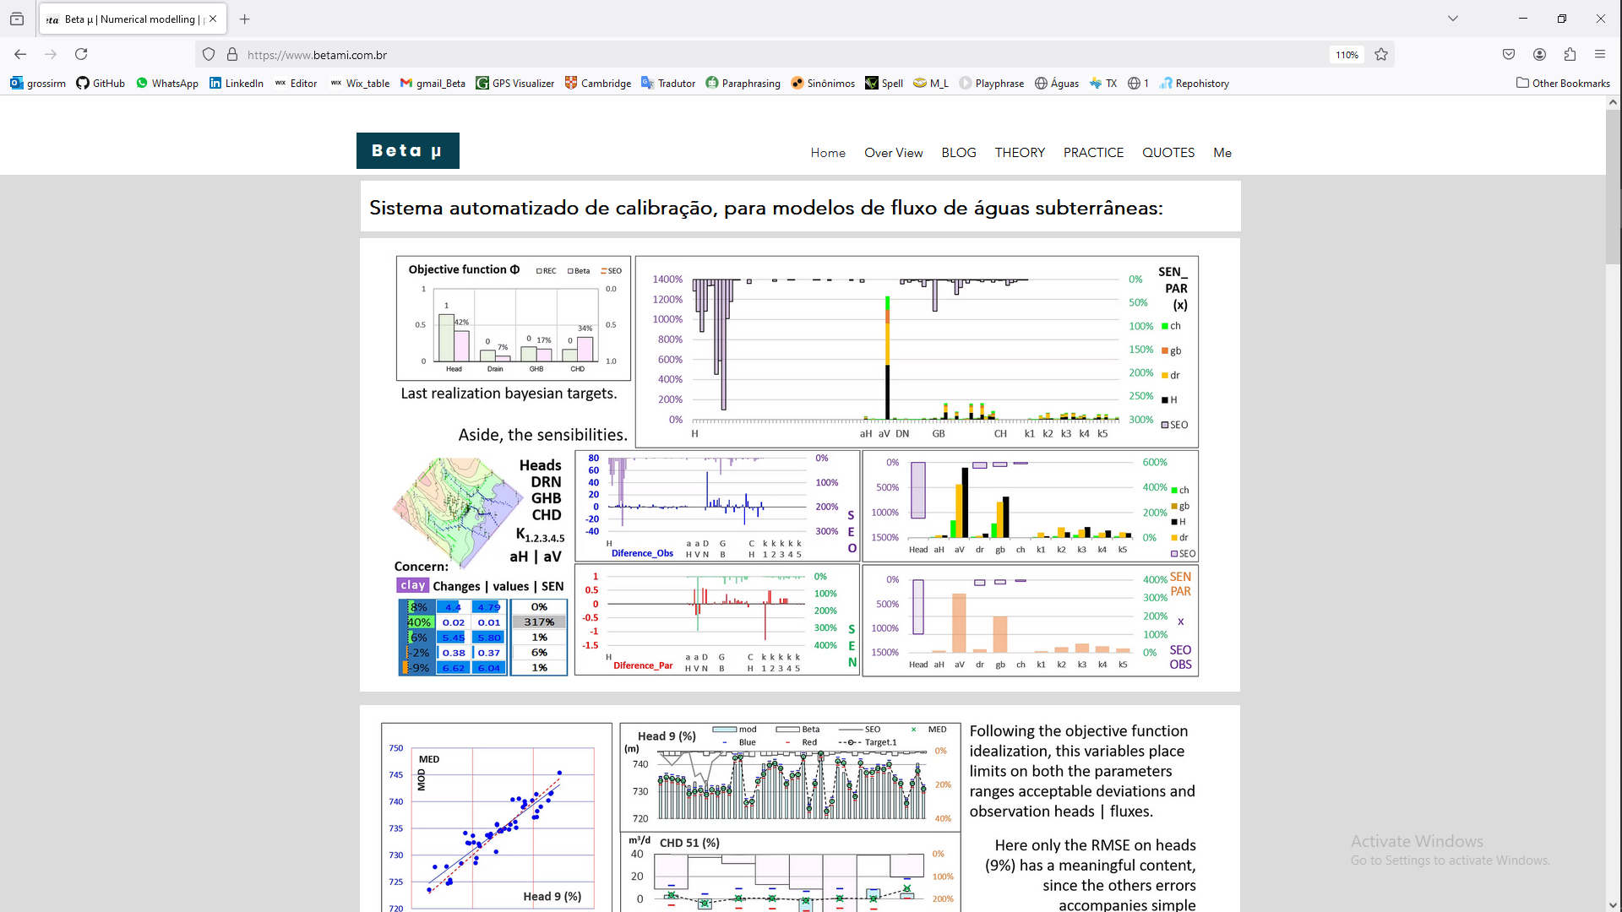
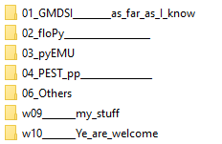
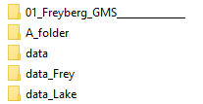
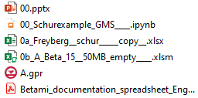
www.betami.com.br
https://github.com/grossiRM/00_Betami
01_Freyberg_GMS______________

Slide 2
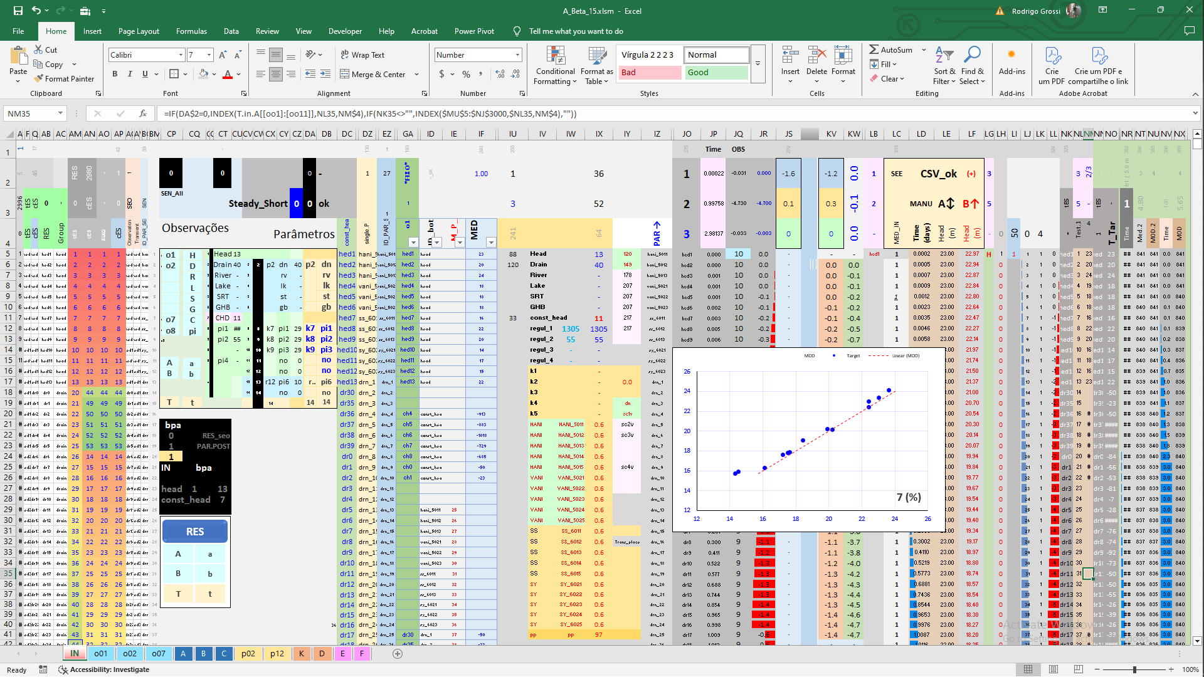
Main
controls
GMS and 0a_Freyberg__schur_____copy__.xlsx __ok
0b_A_Beta_15__request_on_demand.

Slide 3
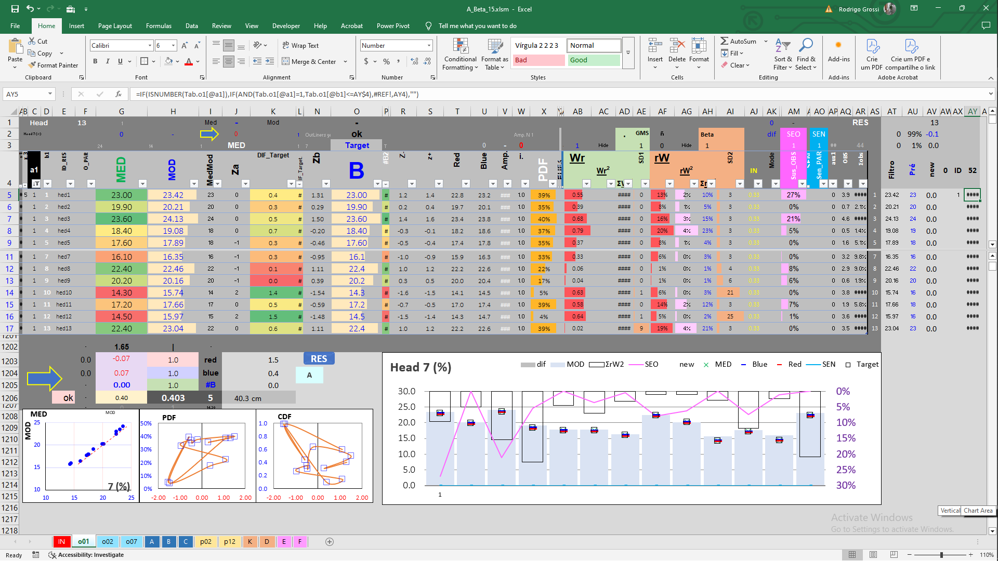
OBS

Slide 4
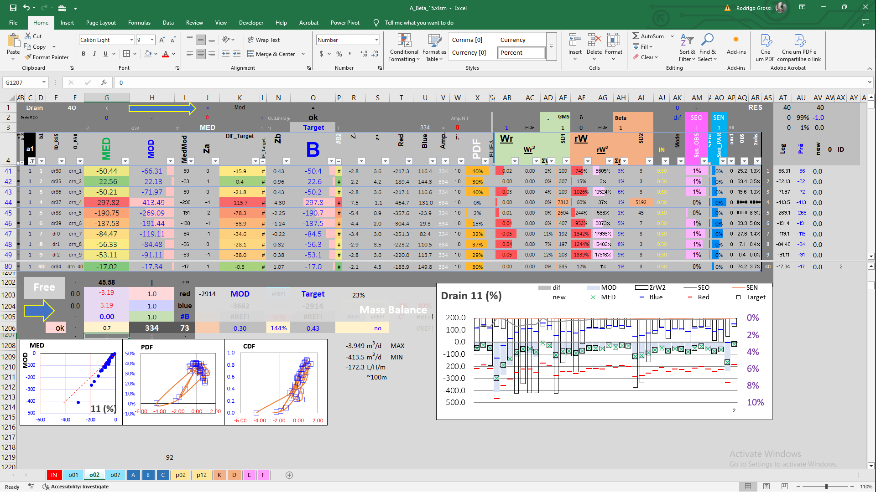
OBS

Slide 5
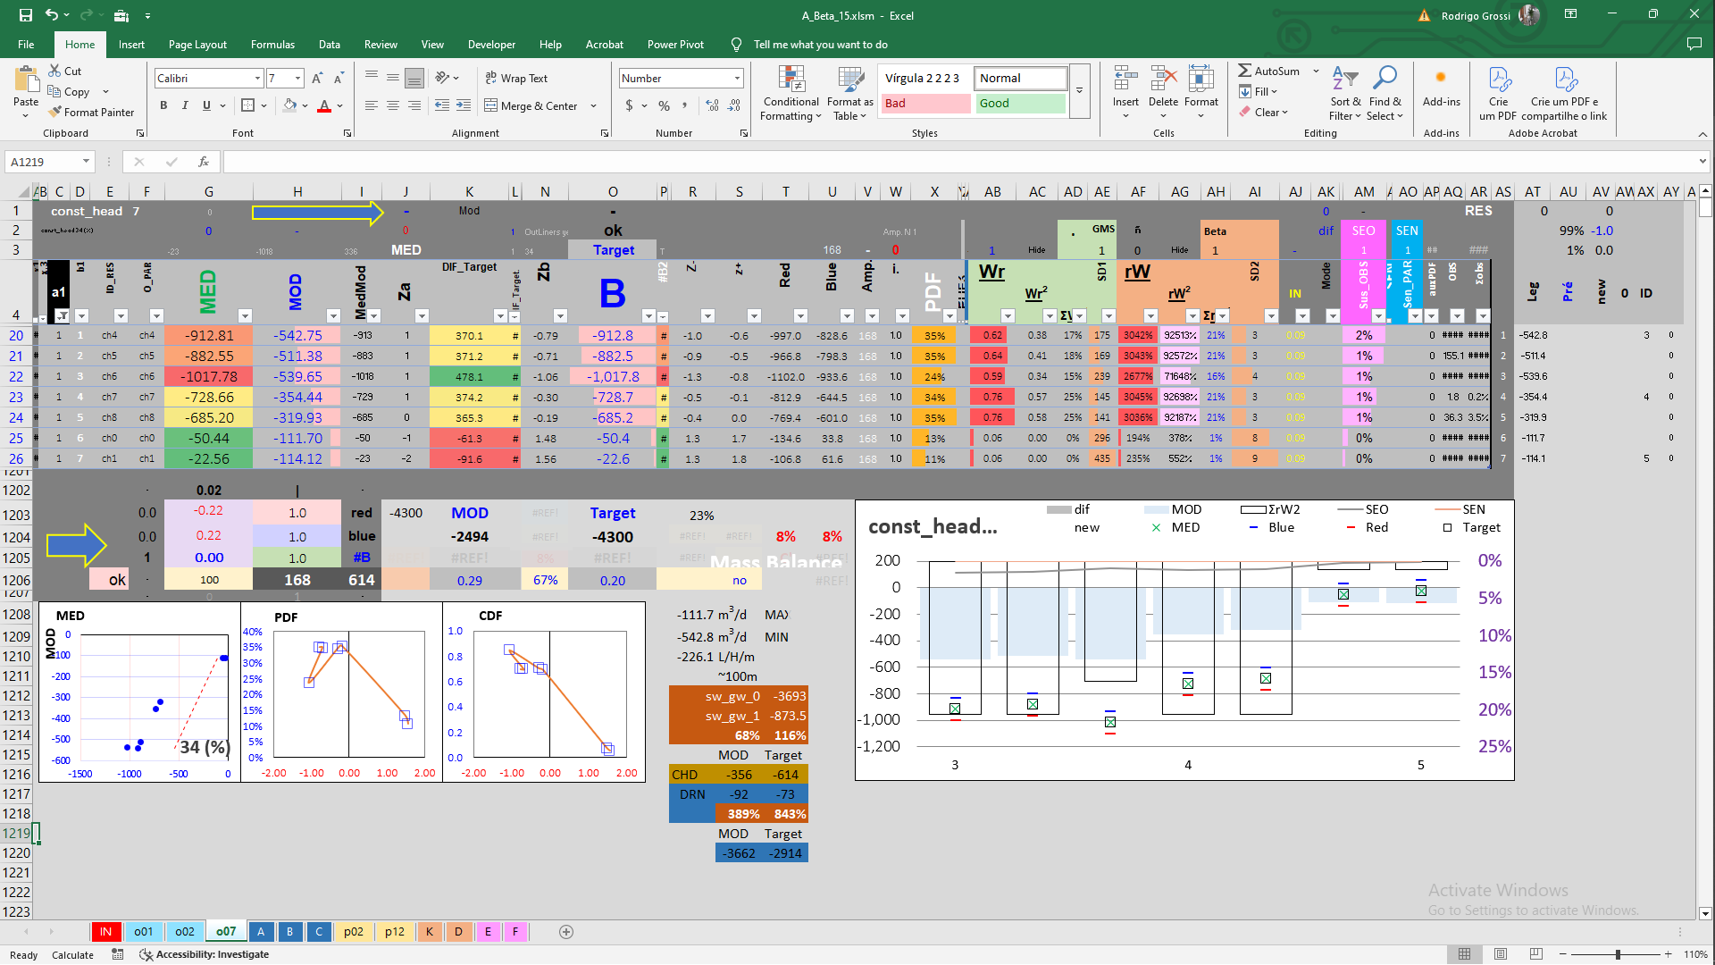
OBS
Good CHD flow balance, given the contribution of DRN as well.

Slide 6
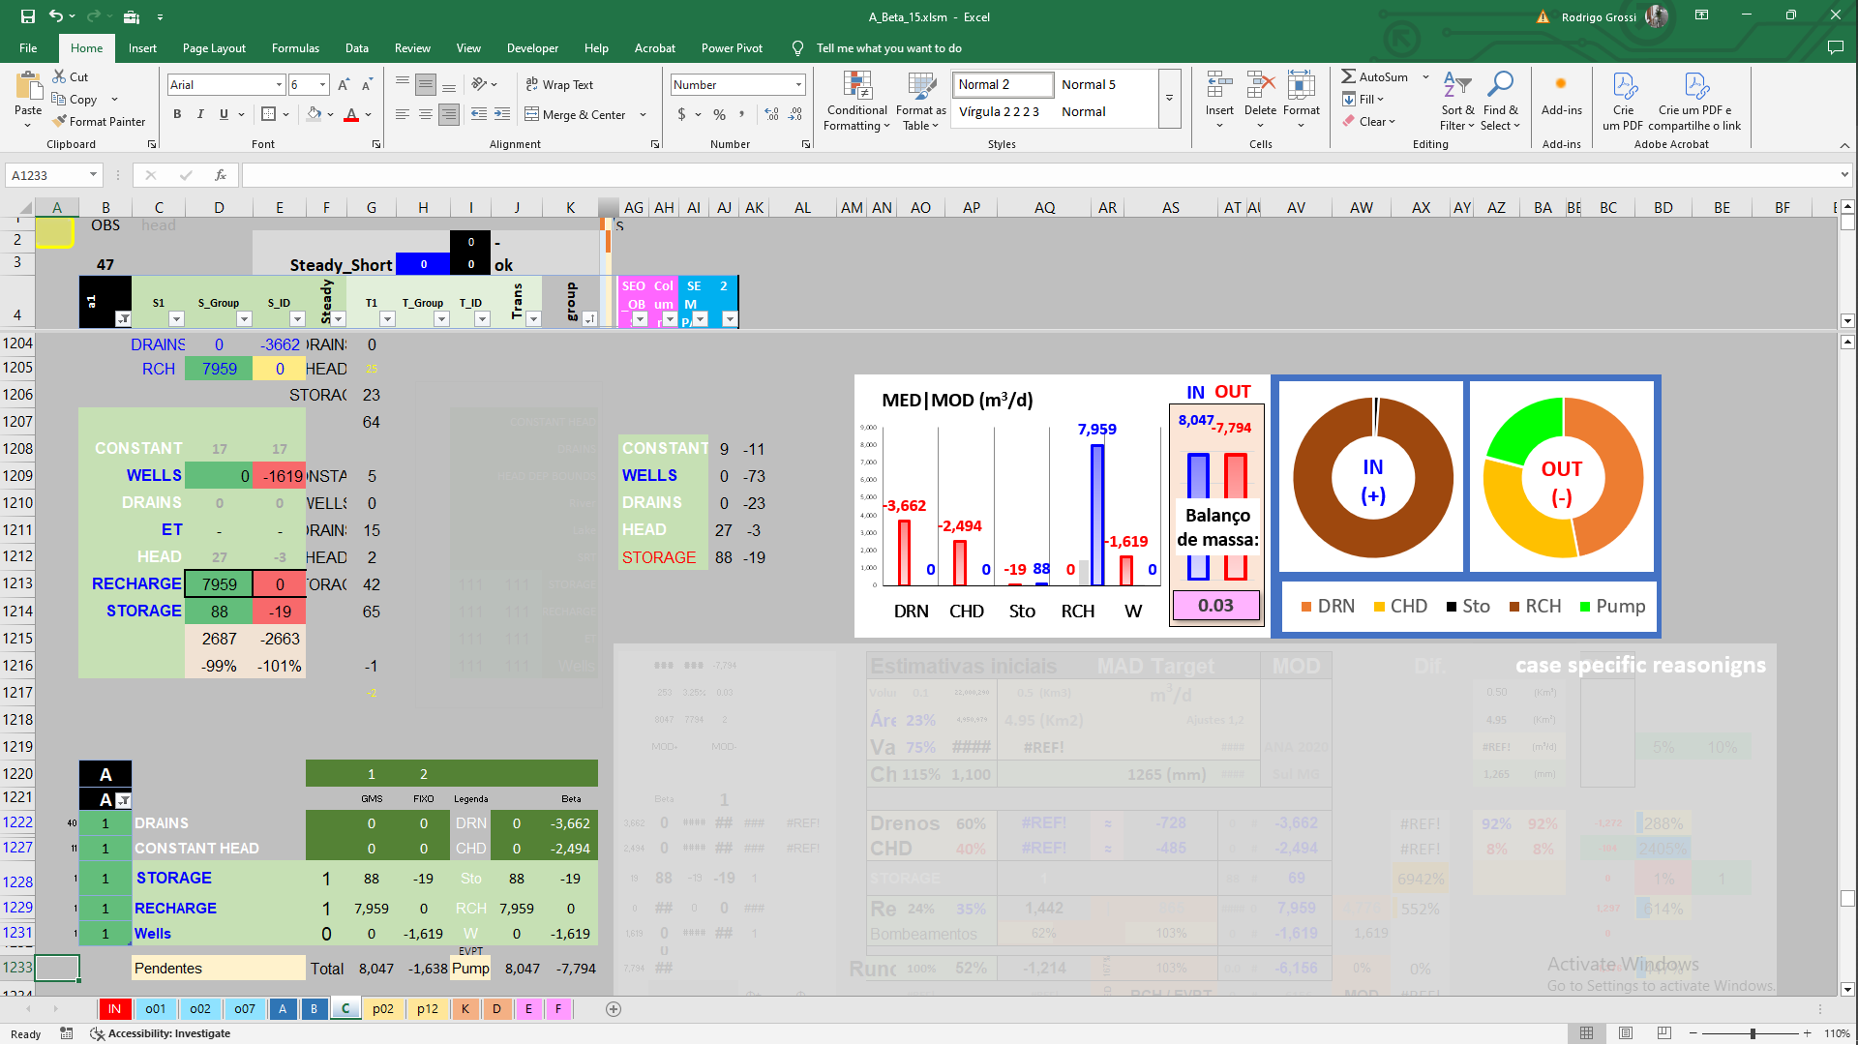
Good CHD flow balance, given the contribution of DRN as well.

Slide 7
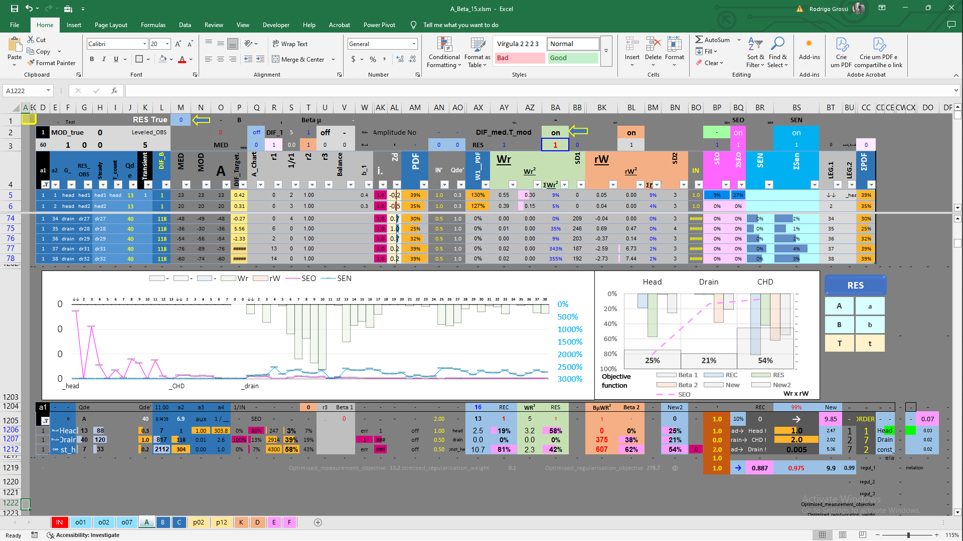
Last objective function θ

Slide 8
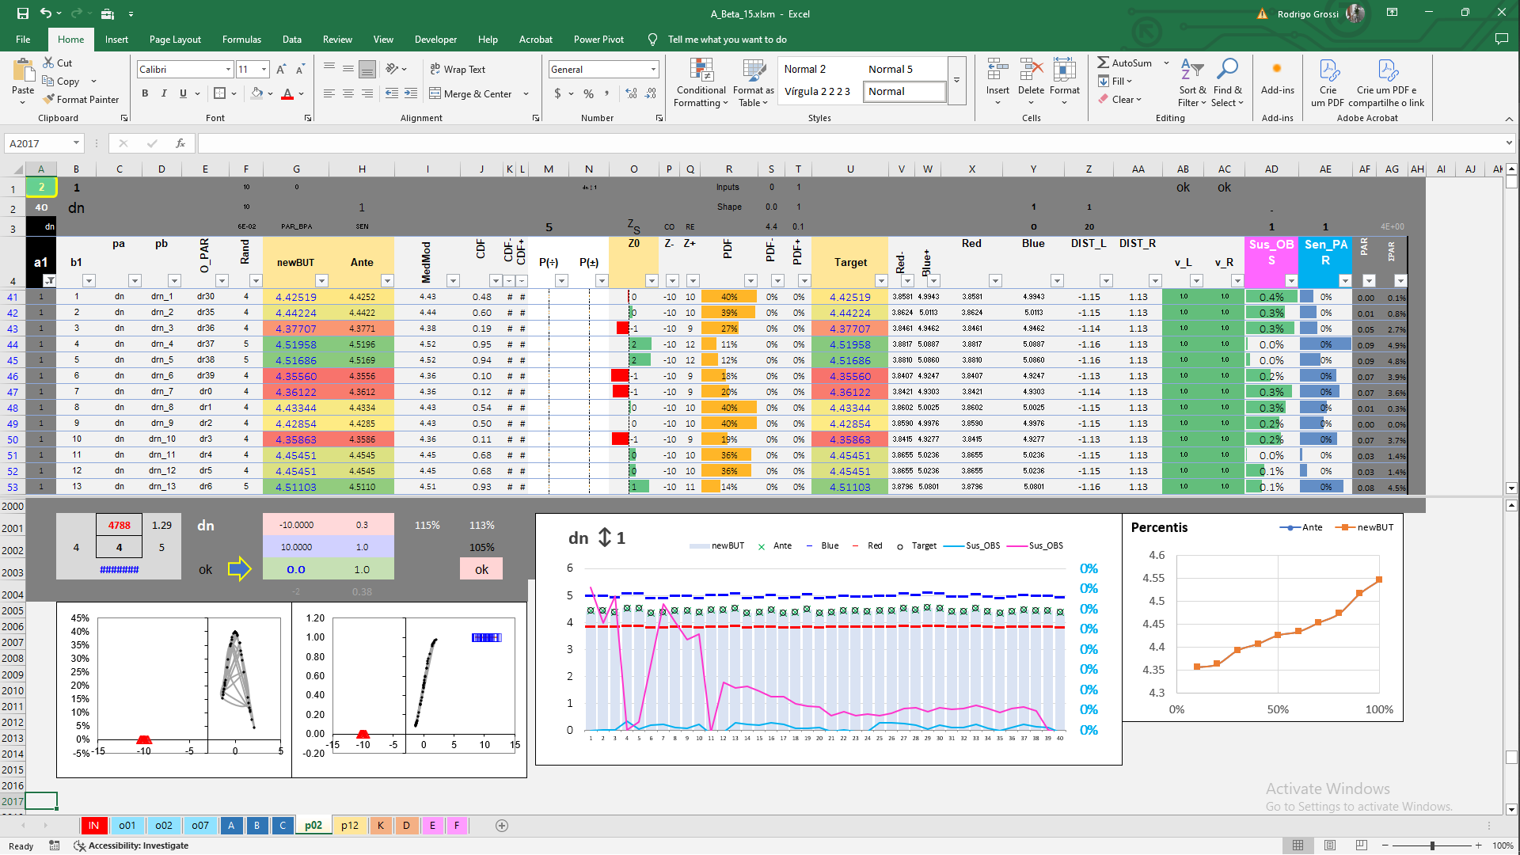
PAR

Slide 9
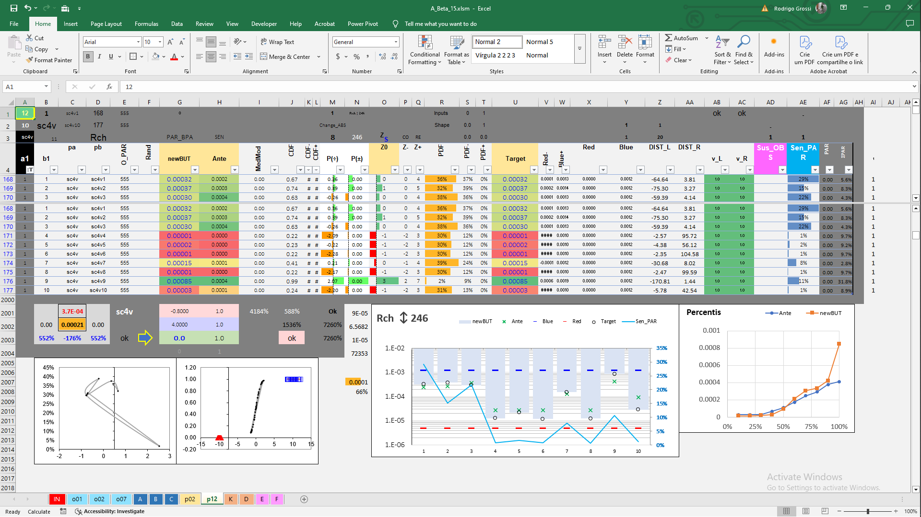
PAR

Slide 10
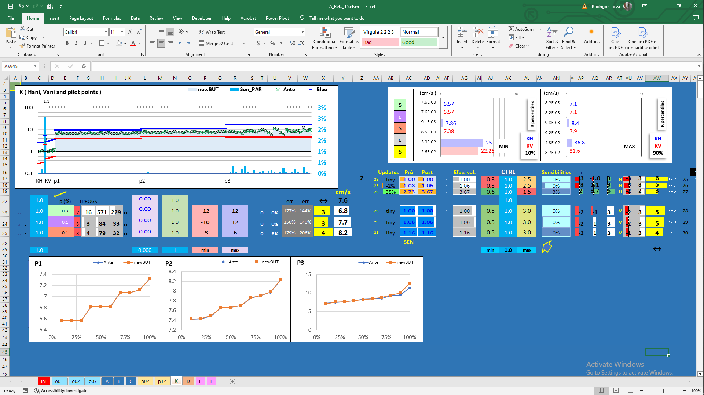
PAR

Slide 11
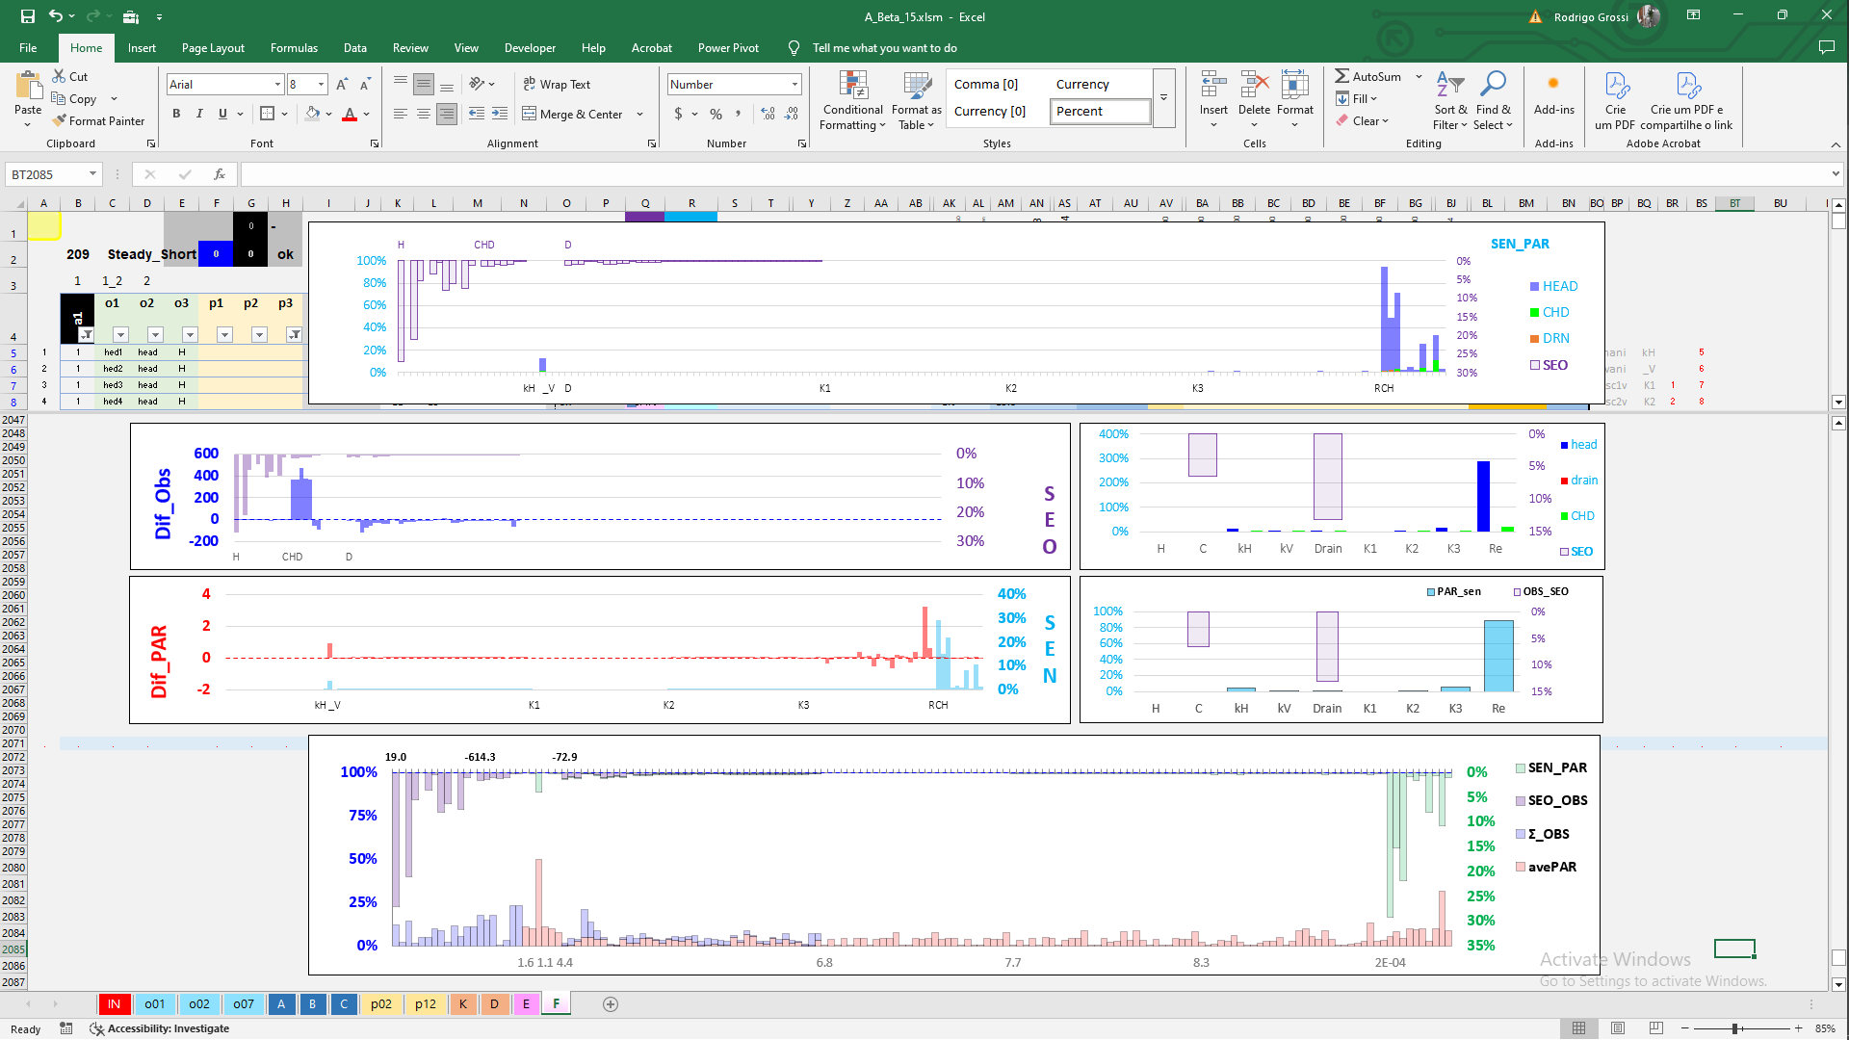
Jacobian matrix diagonal
SEN
SEO

Slide 12
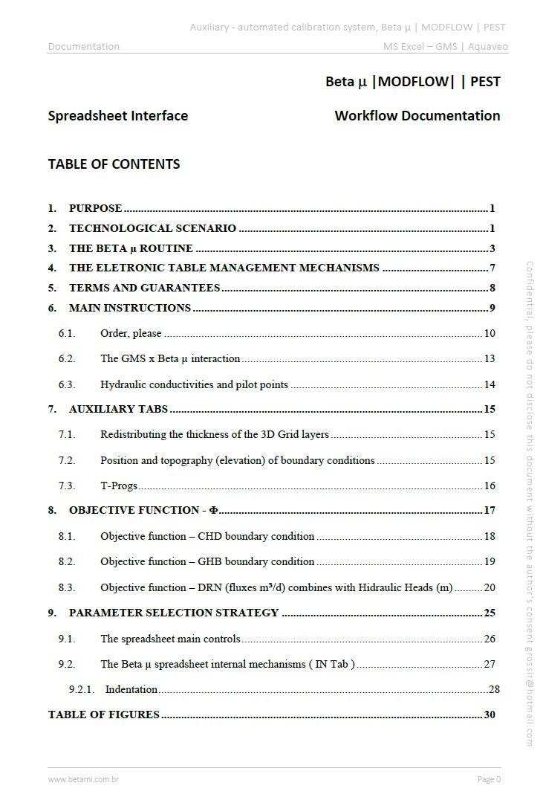
Tks!
Betami_documentation_spreadsheet_English_V_04_signed.pdf

Slide 13
