Slide 1
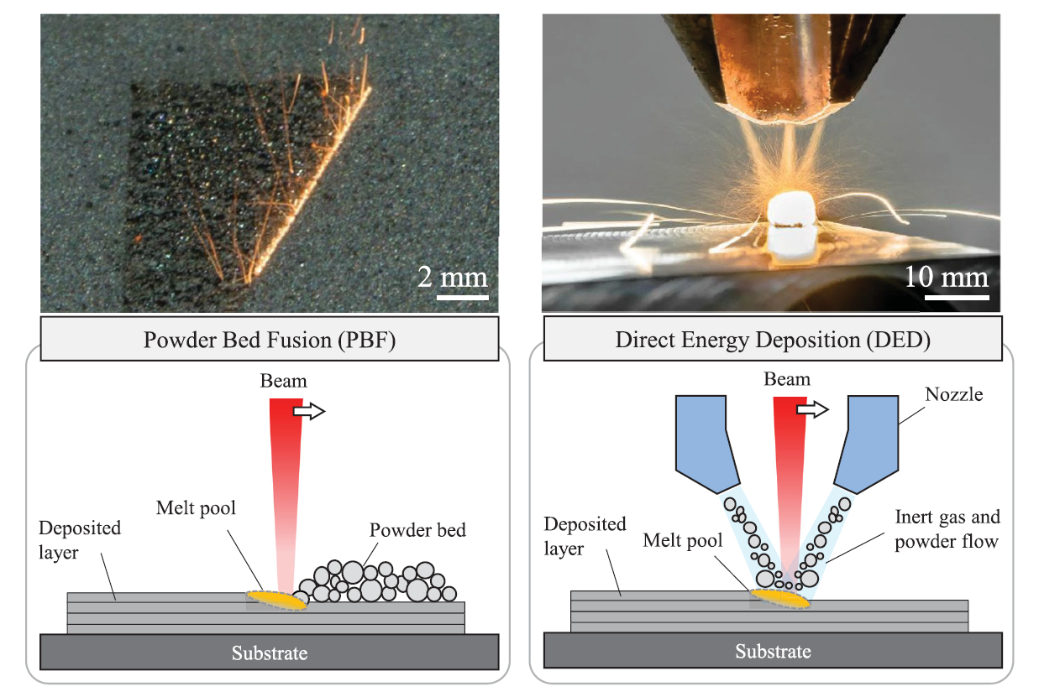
Powder Bed Fusion (PBF)
Directed Energy Deposition (DED)

Slide 2
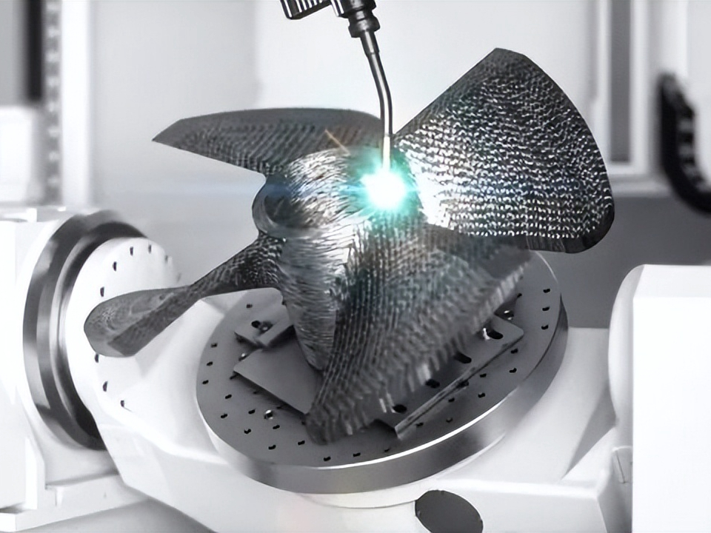
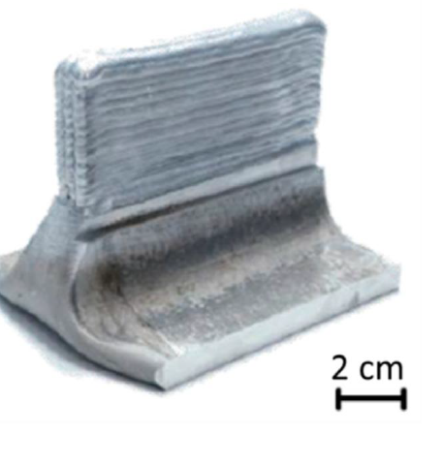
Powder Bed Fusion (PBF)
Directed Energy Deposition (DED - ARC)
- EBM
Electron Beam Melting
Vat Photopolymerization VPP
Binder Jetting (glue) BJ
Material Jetting MJ
Sheet Lamination (cut) SHL
Classificações:
Fonte de energia
Tipo de material
Wire Arc
WAAM
Wire DED
Arco Voltaico
Modelling and simulation of metal additive manufacturing processes with particle methods: A review https://doi.org/10.1080/17452759.2023.2274494

Slide 3
MODELAGEM
Para que modelar?
Racionalizar o problema
Controlar o processo de fabricação
Grande quantidade de variáveis !
PROBLEMAS DE FABRICAÇÂO
1- Orientação – intensidade
2- Descontínuidades (balling)
3- Keyholes (espaços vazios - vapor)
4- Degradação química e oxidação
5- Partículas residuais
6- Trincas
7- Delaminação / Distorção
8- Acabamento superficial
9- Porosidade
Aula 3 - ED_Deposicao_por_energia_direcionada___e___p86__

Slide 4
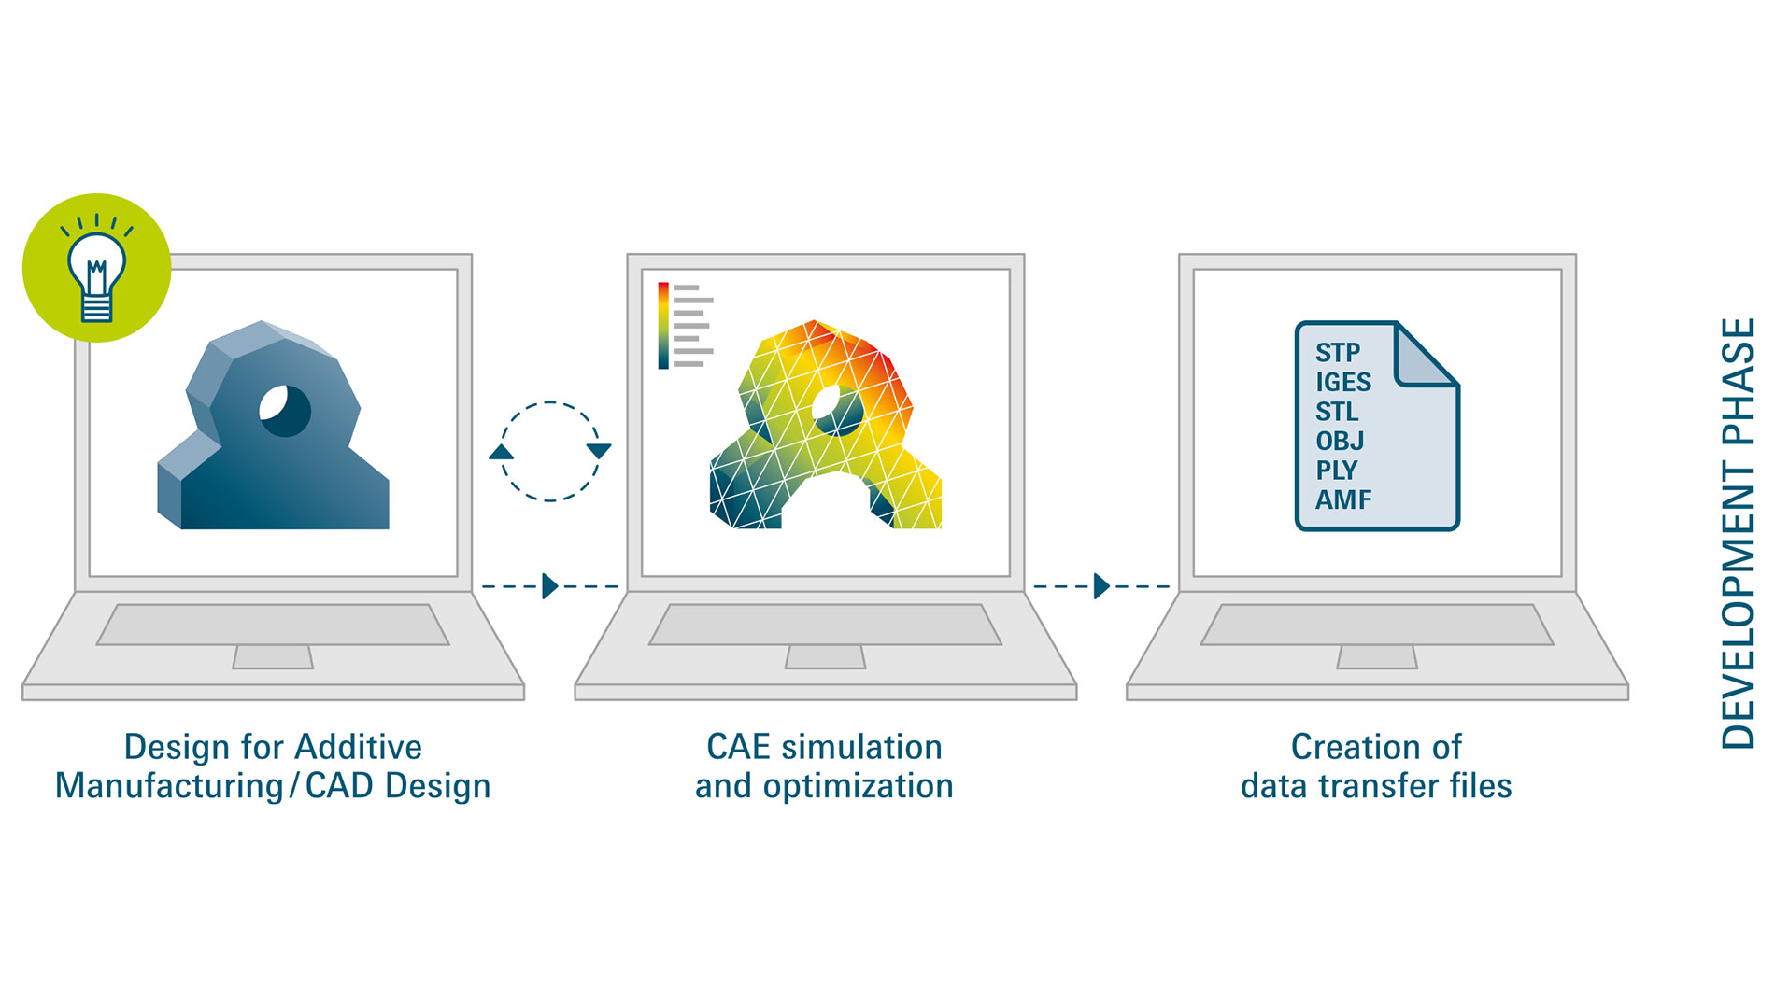
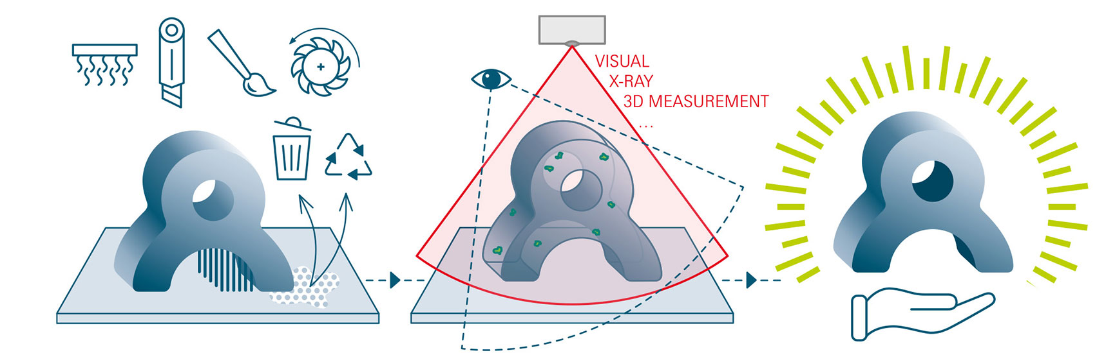
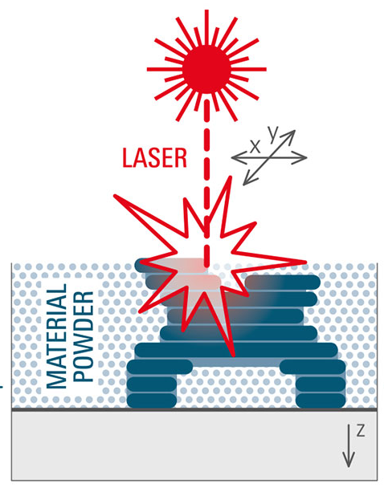
CAD (Computer-Aided Design) shapes - parametric 3D models (length, width, angles + Rules + History Tree)
CAE (Computer-Aided Engineering) – data harvesting - structural stresses, deformations, displacement, and failures – FEA - CFD
CAM
Computer-Aided Manufacturing
Pós Processamento
Testes, Medições
& controle de qualidade
https://formnext.mesago.com/frankfurt/en/industry-insights/am-field-guide/process_in_general.html

Slide 5
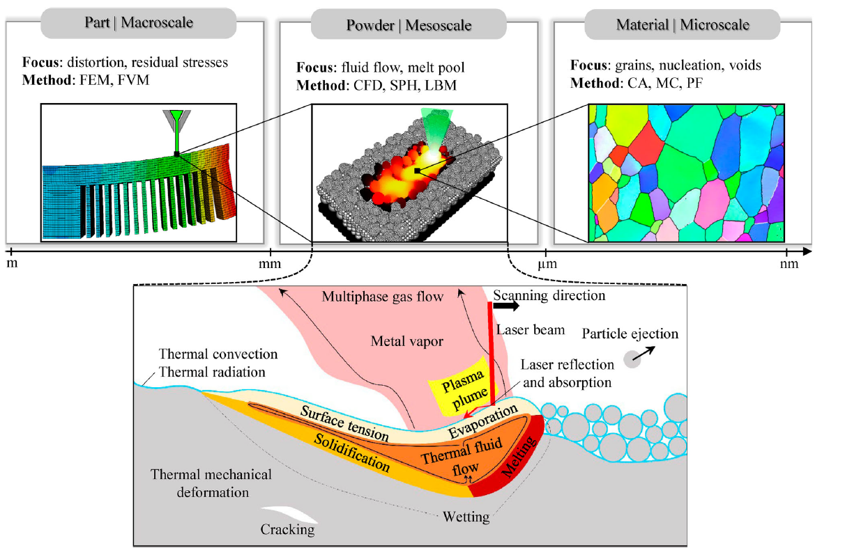
MODELAGEM
Macro-scale models
heat flow and structural (stress) deformation & interlayer bonding,
Meso-scale models
pool geometry, bead formation, and dilution.
Micro-scale phase-field
grain growth, microstructural transitions, solidification kinetics
Foco: Distorção, stress residual
Métodos: FEM, FVM
Foco: Fluxo, poça de fusão
Métodos: CFD, SPH, LBM
Foco: Grãos, nucleação, vazios
Métodos: CA, MC, PF

Slide 6
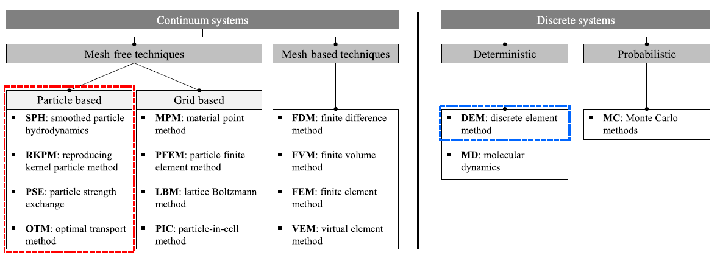
Particle based
MPM
PFEM
ML algorithms
physics-based surrogate model
Massive parallelisation
Macro
simulation-informed closed-loop control feedback
real-time monitoring systems.
Como modelar?
01 - finite element analysis (FEA)
02 - thermal–mechanical simulations
03 - phase-field modeling techniques
Macro
global heat flow, temperature distribution,
and stress evolution during deposition
meshfree
particle-based
| Probabilistic ?
Modelling and simulation of metal additive manufacturing processes with particle methods: A review https://doi.org/10.1080/17452759.2023.2274494

Slide 7
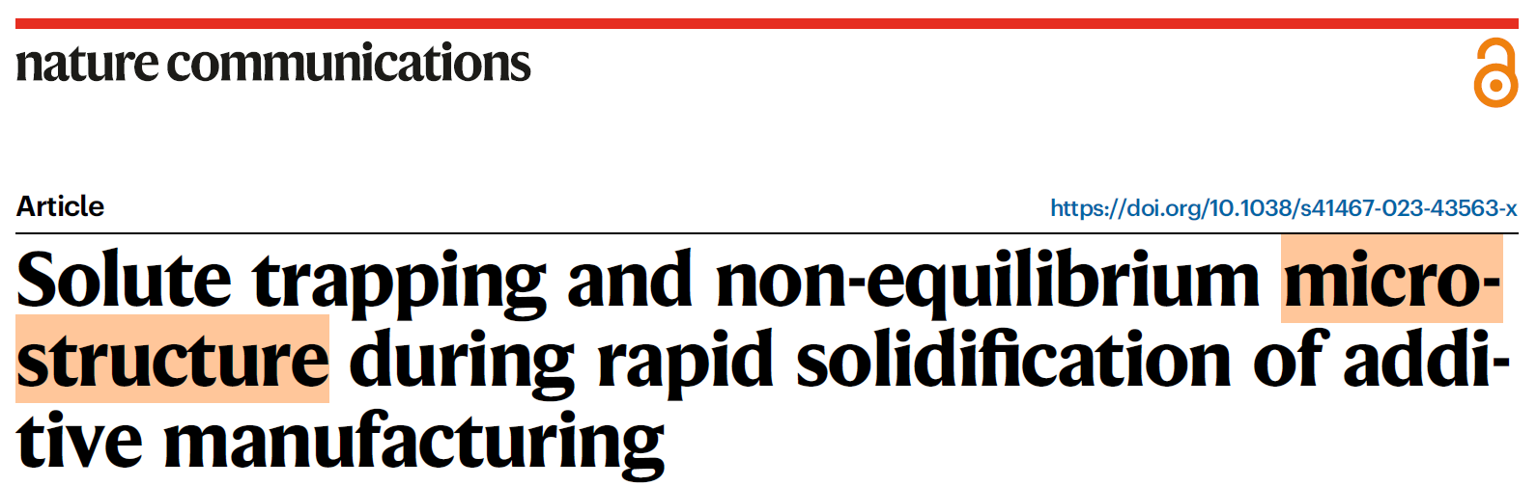
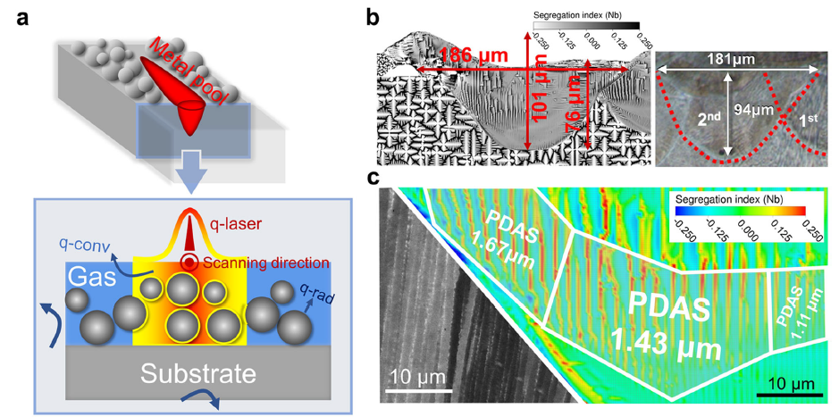
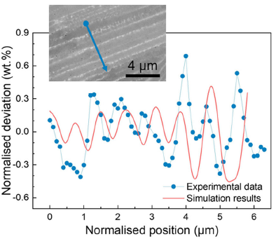
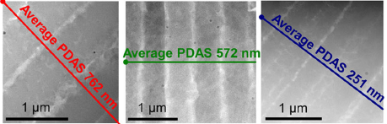
Micro-scale
A.M (3D)
Powder Bed Fusion (PBF)
insight into the solute transport process;
high-fidelity physics-based numerical modelling;
effect of melt convection and solute partition.
Modelo
Temperature, flow velocity, solute concentration, and microstructure
... directly coupled
210 × 400 µm computational domain (2D)
1,341,561
grid 0.25 μm
Solute trapping and non-equilibrium microstructure during rapid solidification of additive manufacturing

Slide 8
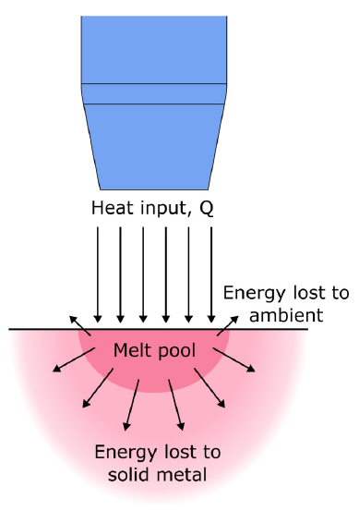
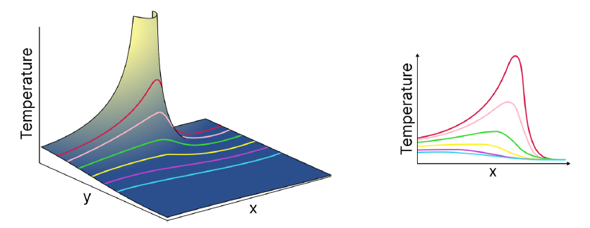
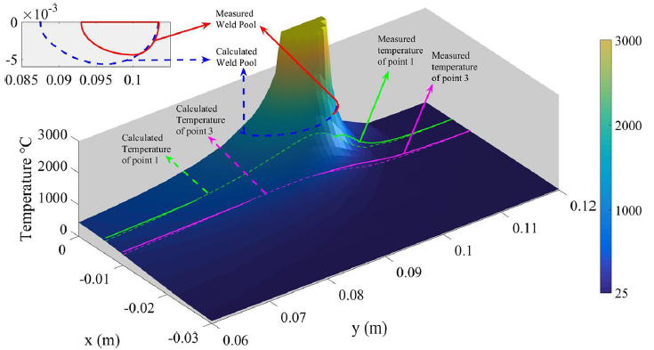

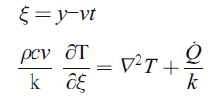

Wire DED
An analytical solution for temperature distribution in fillet arc welding
based on an adaptive function
Nasiri & Enzinger - 2018

Slide 9
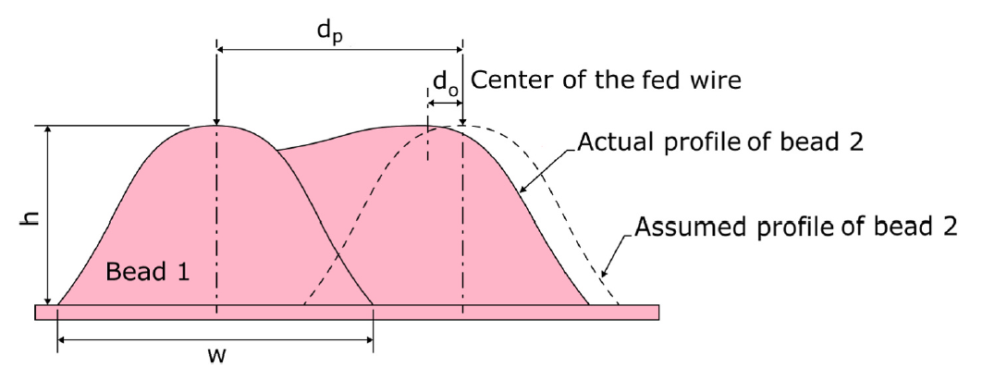
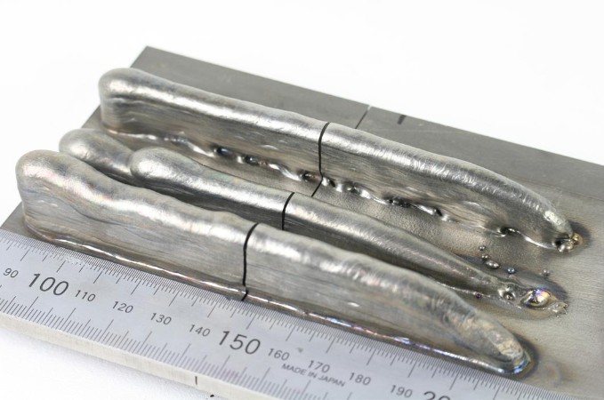
Directed Energy Deposition (DED - ARC)
Wire DED

Slide 10


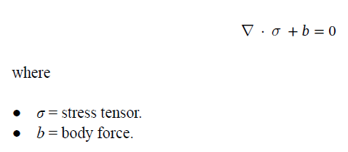





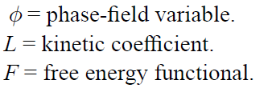
Diffusion
0
0
Marangoni shear stress
Multi-scale modeling approaches in wire arc additive manufacturing: from melt pool dynamics to residual stress prediction & AM PravaH®

Slide 11
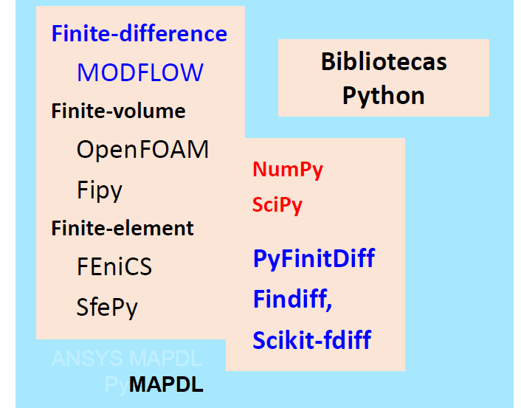
FVM
MODELO:
Fonte (externa) de calor x Material - Condução, convecção, radiação
Contatar:
Prof. Carlos Henrique Marchi UFPR – CFD – Computação
Guilherme Ferreira Gomes UNIFEI – A.M. – CFD
Diego Raimundi Corradi (WAAM) UFMG – OSCILAÇÃO MAGNÉTICA

Slide 12
CFD
https://github.com/DLR-RY/VoFLibrary
Volume of fluid method
Laser heat input … latent input
Surface tension
Marangoni force
“This gives you the basis of how the simulation solver is modelled and how we can rely on the data that has been predicted … based on this robust physic equations that are provided”
AM PravaH®

Slide 13
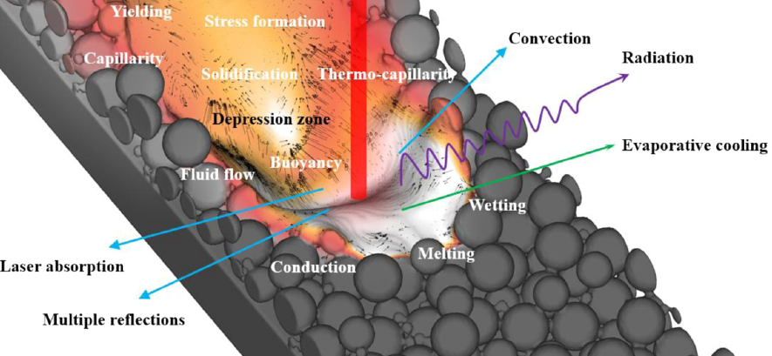
Meso-scale models
pool geometry, bead formation, and dilution.

