Slide 1


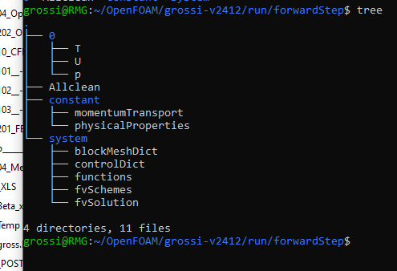

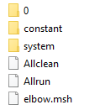

==========
\ \ / F ield
\ \ / O peration
\ \ / A nd
\ \ / M anipulation
Linux
Open
Field Operation And Manipulation

Slide 2

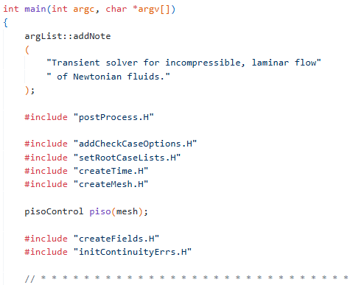
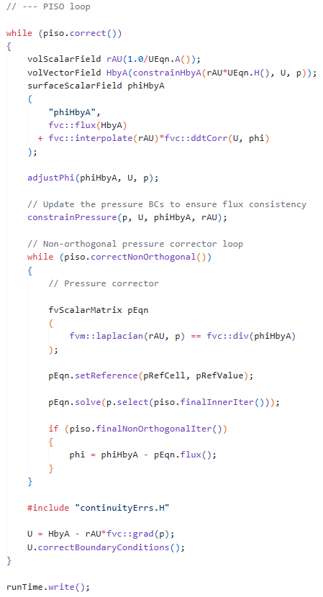
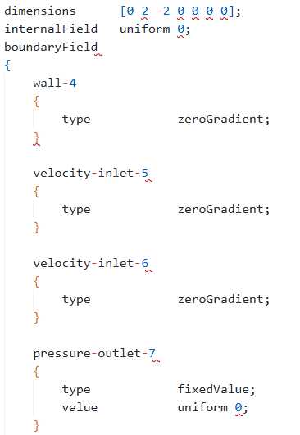
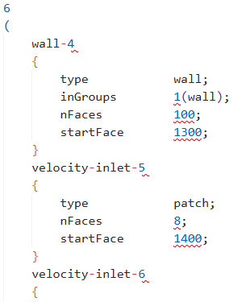
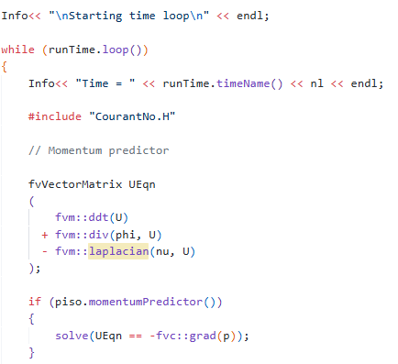
solve
(
fvm::ddt(rho, U)
+ fvm::div(phi, U)
- fvm::laplacian(nu, U)
==
- fvc::grad(p)
)
Source code
class volScalarField;
object p;
class polyBoundaryMesh;
location "constant/polyMesh";
object boundary;

Slide 3
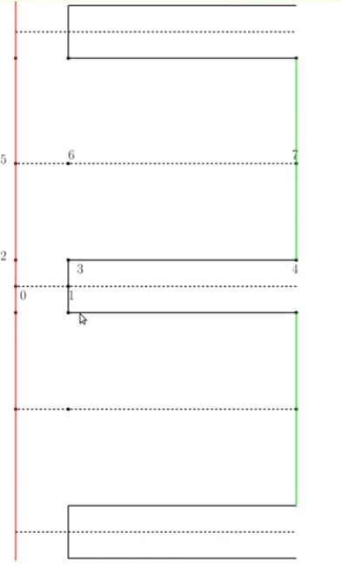
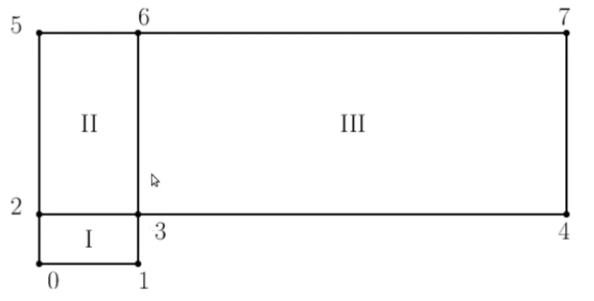
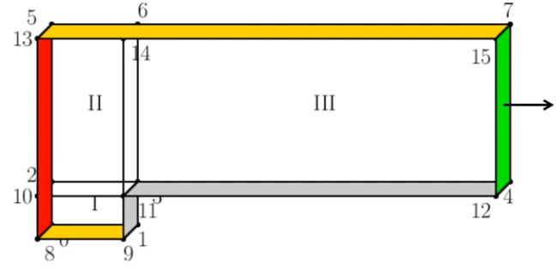
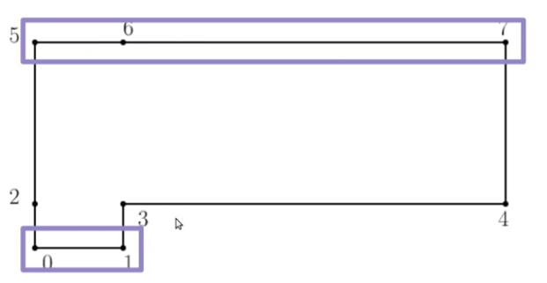
vertices
(
(0 0 -0.05)
(0.6 0 -0.05)
(0 0.2 -0.05)
(0.6 0.2 -0.05)
(3 0.2 -0.05)
(0 1 -0.05)
(0.6 1 -0.05)
(3 1 -0.05)
(0 0 0.05)
(0.6 0 0.05)
(0 0.2 0.05)
(0.6 0.2 0.05)
(3 0.2 0.05)
(0 1 0.05)
(0.6 1 0.05)
(3 1 0.05)
);
blocks
(
hex (0 1 3 2 8 9 11 10) (25 10 1) simpleGrading (1 1 1)
hex (2 3 6 5 10 11 14 13) (25 40 1) simpleGrading (1 1 1)
hex (3 4 7 6 11 12 15 14) (100 40 1) simpleGrading (1 1 1)
);
edges
(
);
mesh
boundary
(
inlet
{
type patch;
faces
(
(0 8 10 2)
(2 10 13 5)
);
}
outlet
{
type patch;
faces
(
(4 7 15 12)
);
}
bottom
{
type symmetryPlane;
faces
(
(0 1 9 8)
);
}
top
{
type symmetryPlane;
faces
(
(5 13 14 6)
(6 14 15 7)
);
}
boundary
(
  obstacle
  {
  type wall;
  faces
  (
  (1 3 11 9)
  (3 4 12 11)
  );
  }
  );
  mergePatchPairs
  (
  );

Slide 4
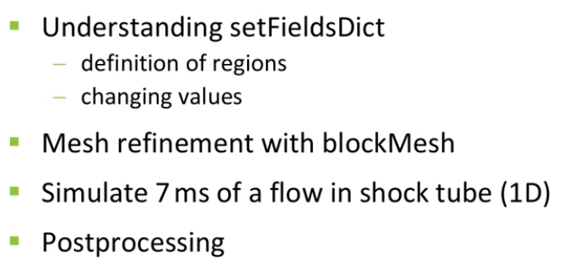
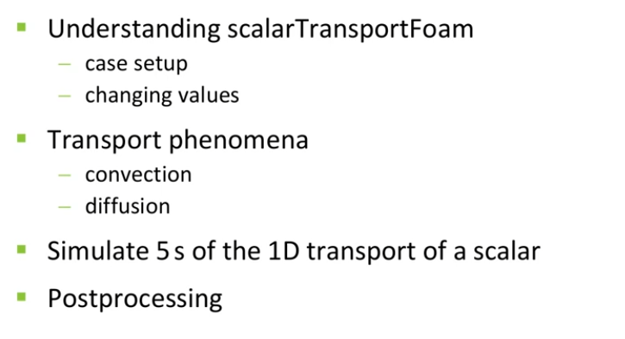
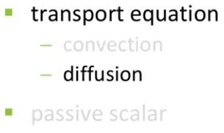
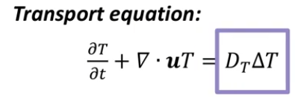
Understanding grid convergence - Part 1
https://www.youtube.com/watch?v=PaDDplpAJJ0
(T)
0
0

Slide 5
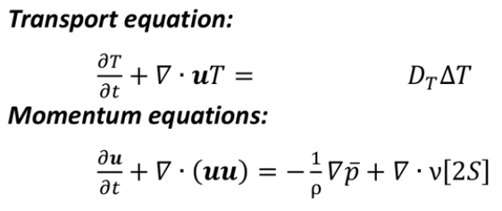
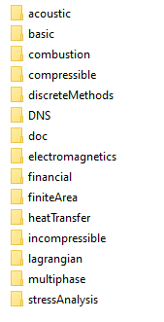
volScalarField T
(
IOobject
(
"T",
runTime.timeName(),
mesh,
IOobject::MUST_READ,
IOobject::AUTO_WRITE
),
mesh
);
volVectorField U
(
IOobject
(
"U",
runTime.timeName(),
mesh,
IOobject::MUST_READ,
IOobject::AUTO_WRITE
),
mesh
);
IOdictionary transportProperties
(
IOobject
(
"transportProperties",
runTime.constant(),
mesh,
IOobject::MUST_READ_IF_MODIFIED,
IOobject::NO_WRITE
)
);
fvScalarMatrix TEqn
(
fvm::ddt(T)
+ fvm::div(phi, T)
- fvm::laplacian(DT, T)
==
fvOptions(T)
);
Solvers
\\wsl.localhost\Ubuntu\mnt\wslg\distro\usr\lib\openfoam\openfoam2412\applications\solvers

Slide 6
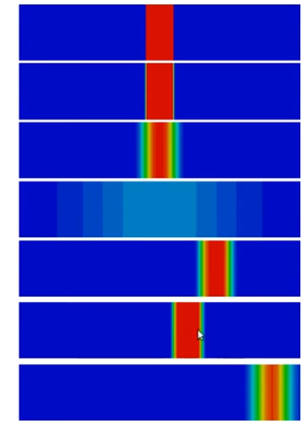
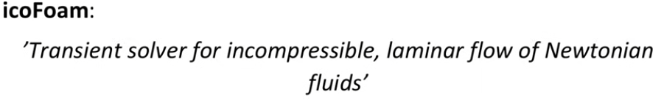
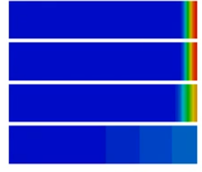
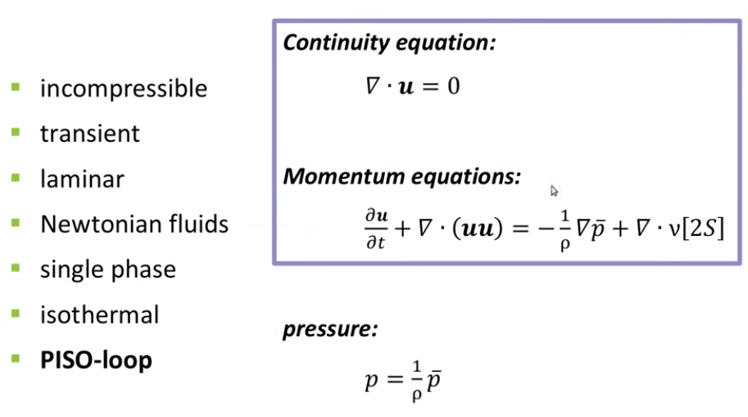
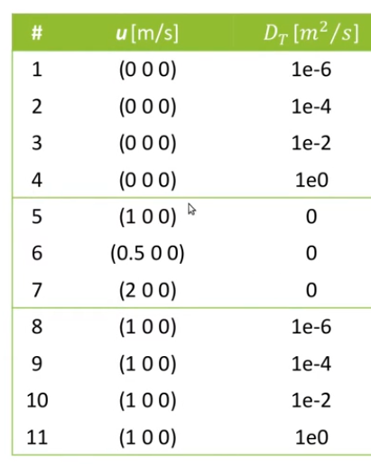
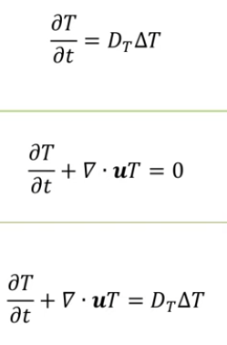
02
scalarTransportFoam
04_b_shockTube_pitzDaily
Transport Case
01
01
Convection
02
Numerical Diffusion
Physical Diffusion
03
03
04
02
04
Convection
/ density

Slide 7

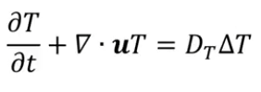
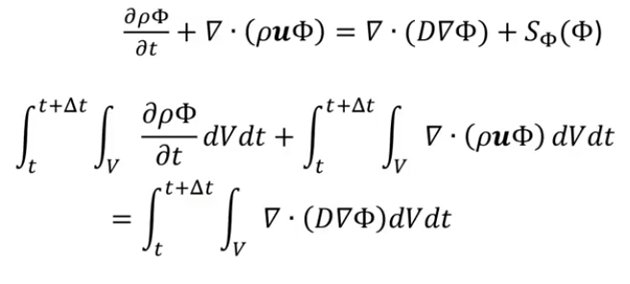

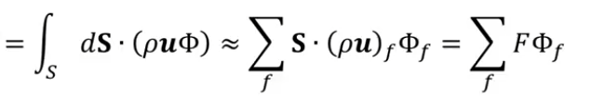
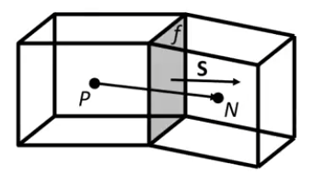



Convection
0
$ρ=1$
$$Φ=T$$
$$∇∇=Δ$$
Finite Volumes

Slide 8
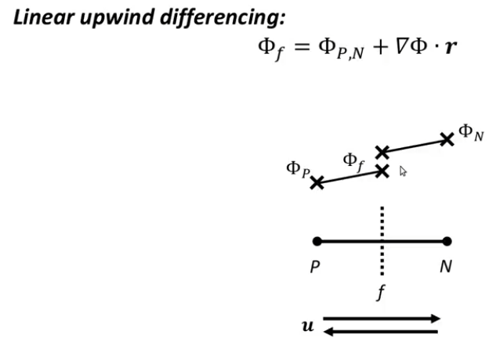
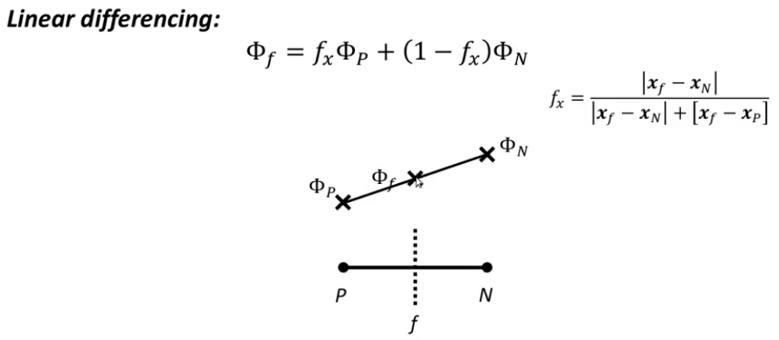


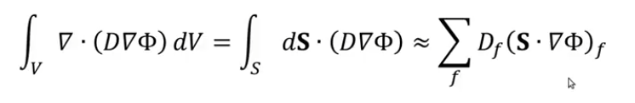
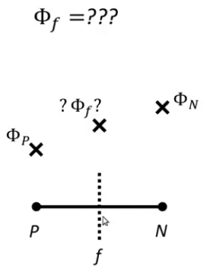
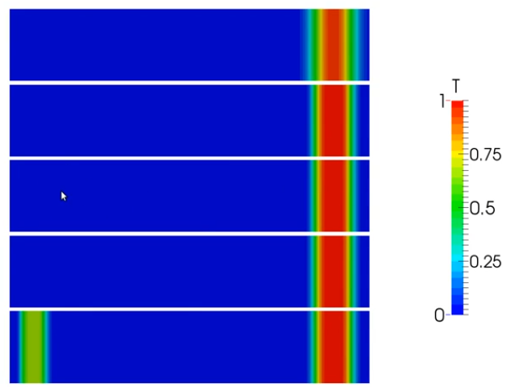
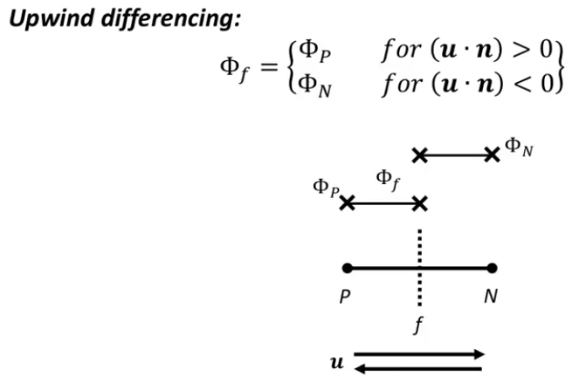

Diffusion
0
Volume
Surfaces
Cell Faces
|| _upwind || _linear || _linearUpwind || _quick || _cubic ||
f
4.4.1 Interpolation schemes
4.4.1.2 Schemes for vector fields
4.4.2 Surface normal gradient schemes
4.4.3 Gradient schemes
4.4.4 Laplacian schemes
4.4.5 Divergence schemes
E:\15_REPOS\a___________________\09_CFD_ON\04_OpenFoam\UserGuide_Version 2.3.1.pdf

