Slide 1
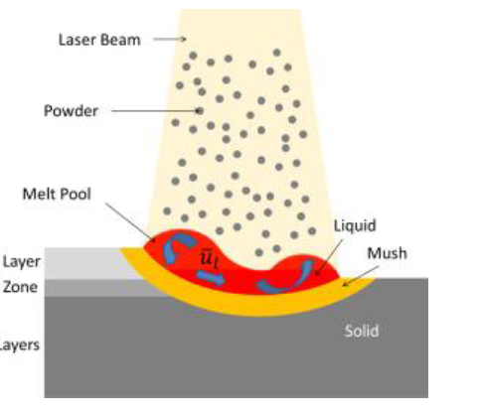
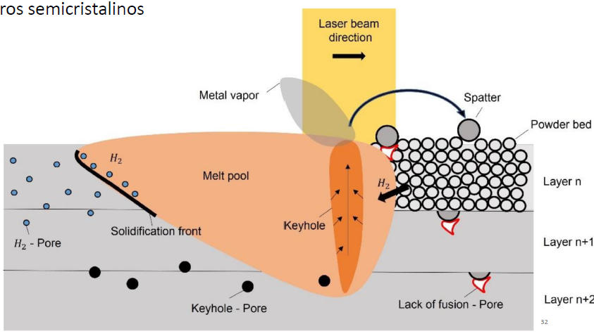
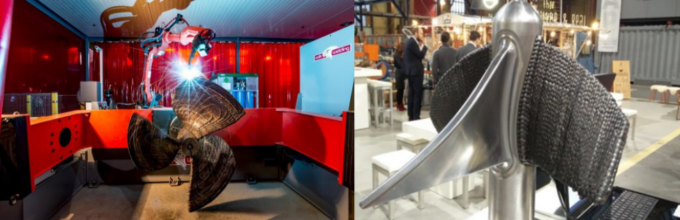
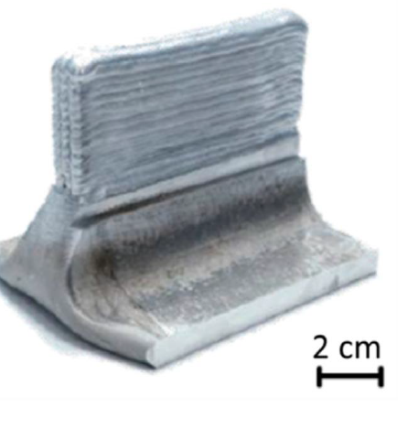
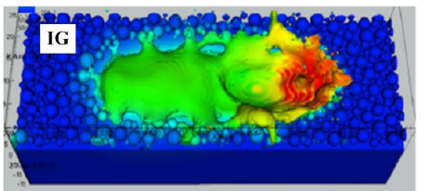
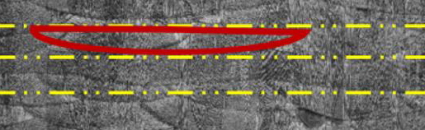
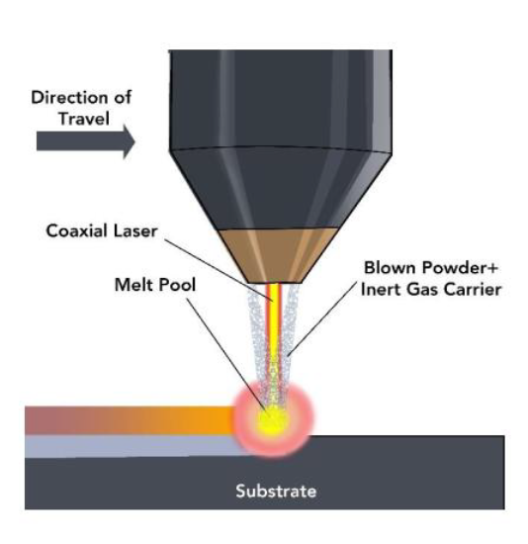
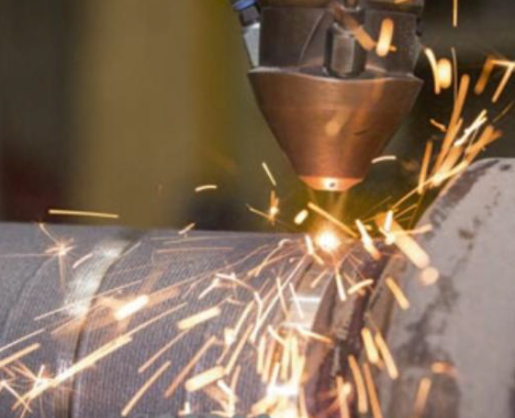
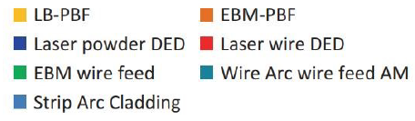
Laser Powder Bed Fusion (PBF)
Wire Arc - WAAM
- Arco Voltaico
DED & WAAM
10a3_MANUFATURA ADITIVA POR DEPOSIÇÃO A ARCO UMA ANÁLISE CRÍTICA DA TECNOLOGIA E PERSPECTIVAS.pdf
Laser Powder Bed Fusion PBF
Directed Energy Deposition DED
Wire Arc WAAM
Binder Jetting – Jat. de Aglutinante BJT
Material Jetting – Jat. de Material MJT
Vat Photopolymerization VTT
Sheet Lamination SHL
Election Beam EBM
Directed Energy Deposition (DED)

Slide 2
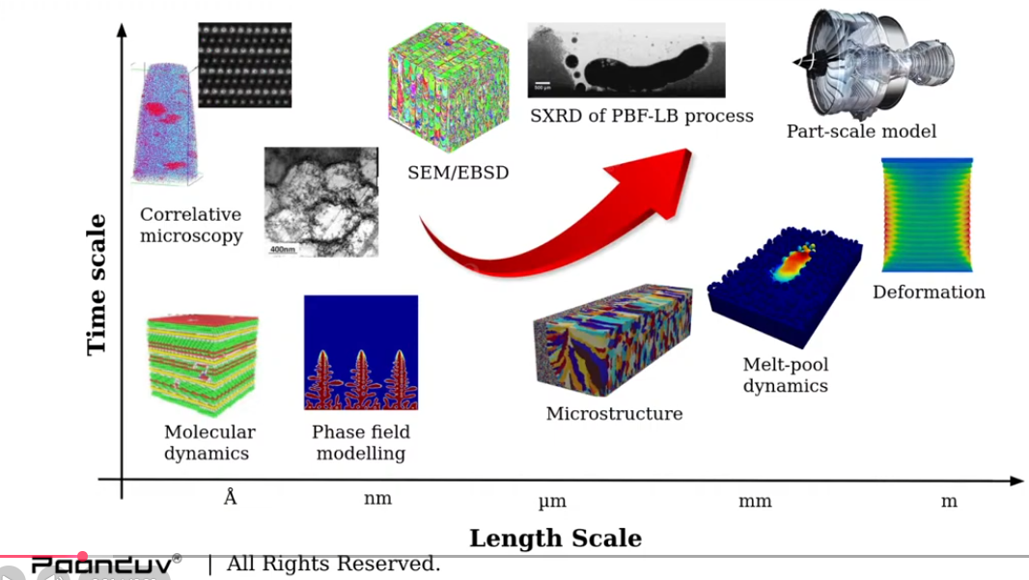
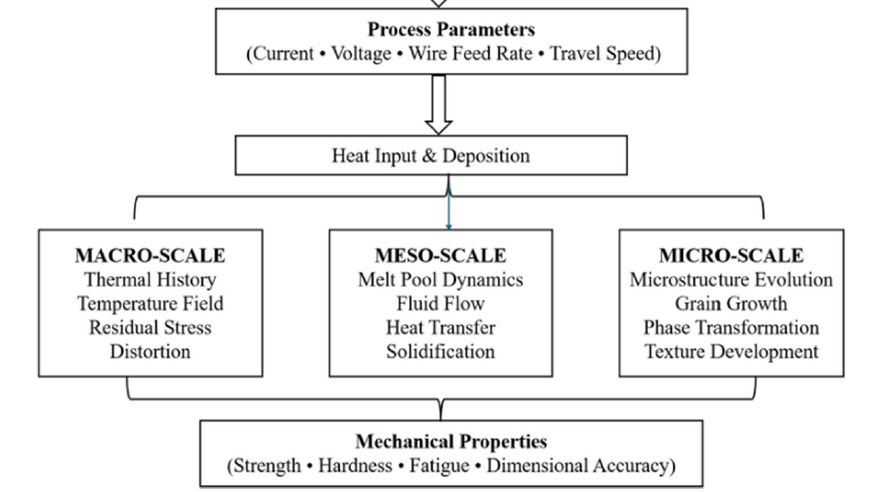
Micro-scale phase-field
grain growth, microstructural transitions, and
solidification kinetics
Meso-scale models pool geometry, bead formation, and dilution.
FONTE: Multi-scale modeling approaches in wire arc additive manufacturing: from melt pool dynamics to residual stress prediction & AM PravaH®
Macro-scale models
heat flow and structural (stress) deformation & interlayer bonding,
01 - finite element analysis (FEA)
02 - thermal–mechanical simulations
03 - phase-field modeling techniques
Macro
Macro
global heat flow, temperature distribution,
and stress evolution during deposition

Slide 3
PROBLEMAS DE FABRICAÇÂO
1- Orientação – direção| sentido
2- Efeito balling (descontínuidades)
3- Keyholes (espaços vazios - vapor)
4- Degradação química e oxidação
5- Processos reativos
6- Partículas residuais
7- Trincas
8- Delaminação
9- Distorção
0- Acabamento superficial ruim
1- Porosidade
Para que modelar?
- Racionalizar o problema
Aula 3 - DED_Deposicao_por_energia_direcionada___e___p86__

Slide 5
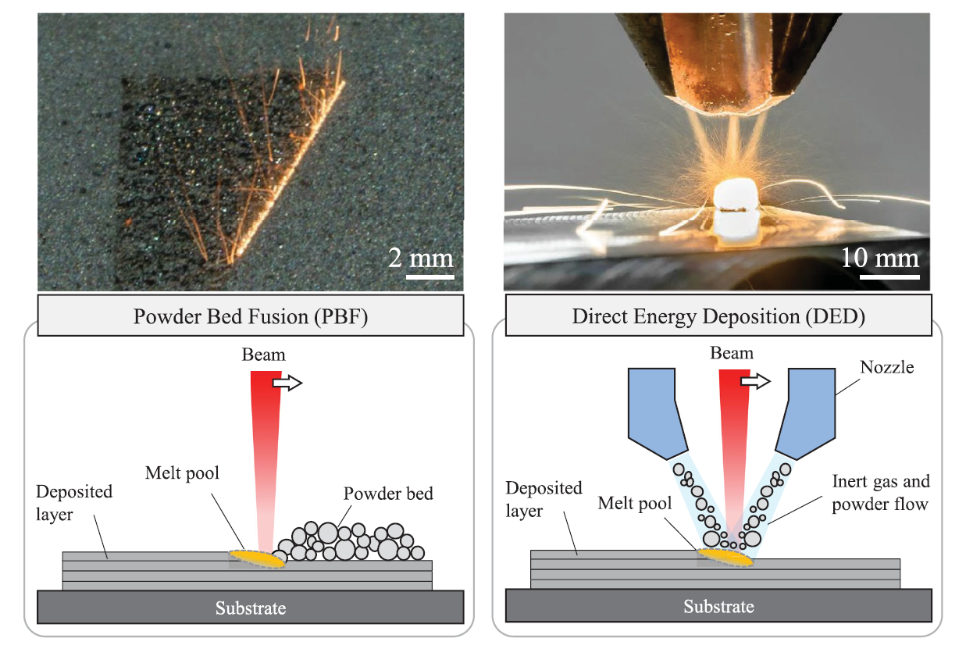
Powder Bed Fusion (PBF)
Directed Energy Deposition (DED)

Slide 6
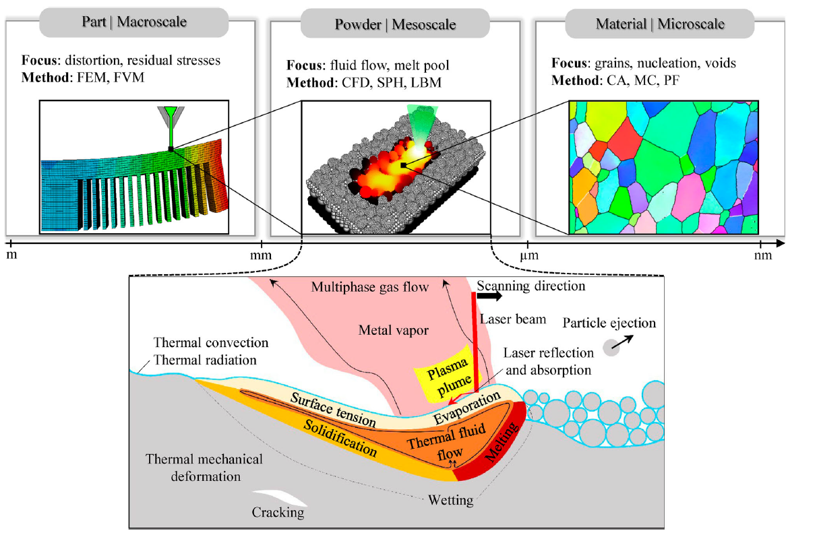
Macro-scale
Meso-scale
Micro-scale

Slide 7
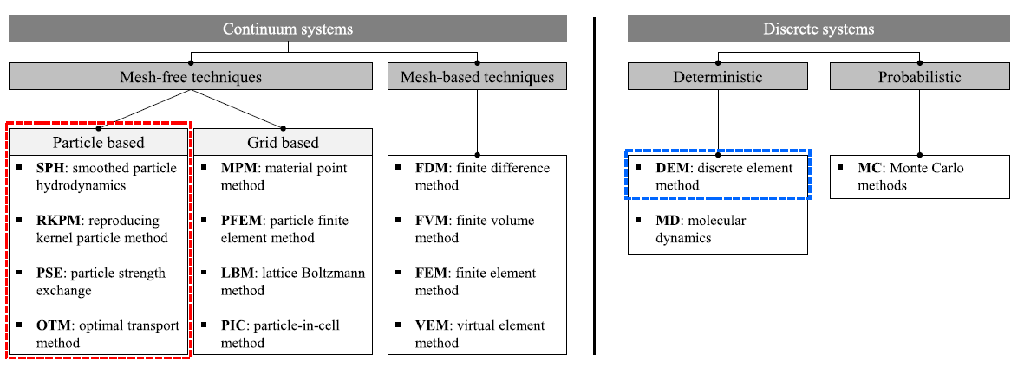
MPM
PFEM

Slide 8
MODELO:
Fonte (externa) de calor x Material - Condução, convecção, radiação

Slide 9
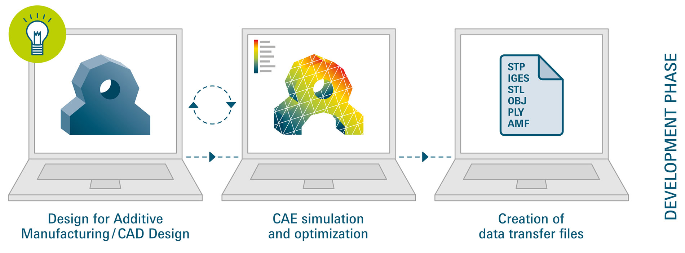
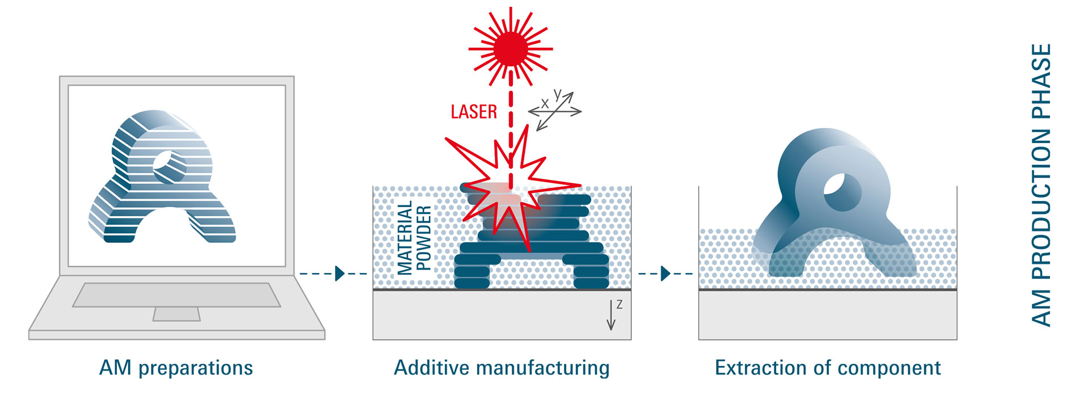
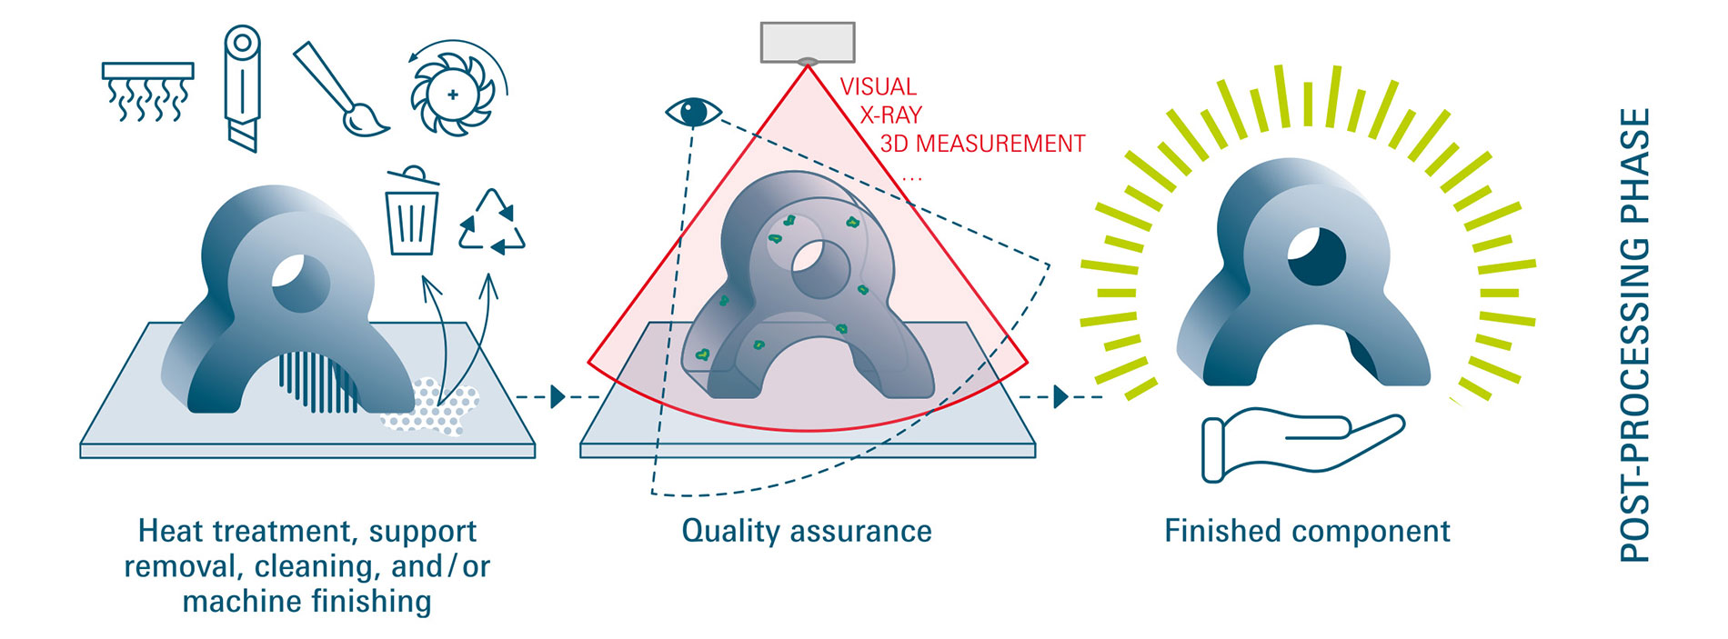
CAD (Computer-Aided Design) – shapes
- parametric 3D models (length, width, angles + Rules + History Tree)
CAE (Computer-Aided Engineering) – data harvesting
- structural stresses, deformations, displacement, and failures - FEA
CAM (Computer-Aided Manufacturing) – making
https://formnext.mesago.com/frankfurt/en/industry-insights/am-field-guide/process_in_general.html

Slide 10

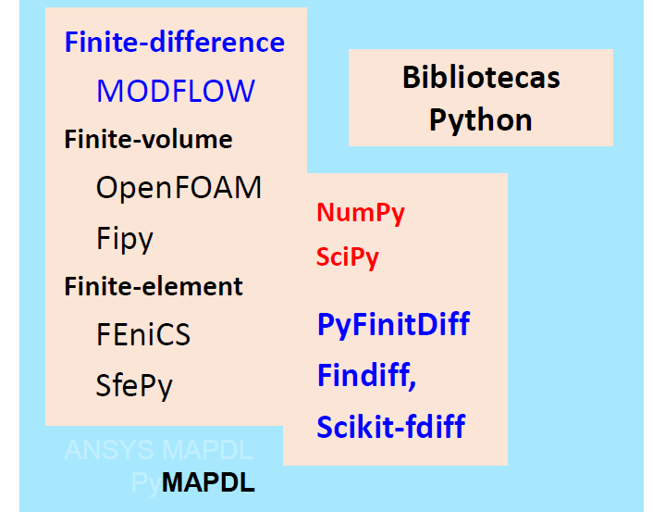

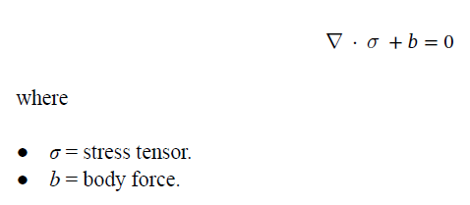




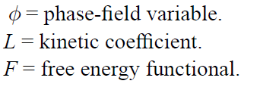

Diffusion
0
0
Marangoni shear stress

Slide 11
AM PravaH®
CFD
https://github.com/DLR-RY/VoFLibrary
Volume of fluid method
Laser heat input … latent input
Surface tension
Marangoni force
“This gives you the basis of how the simulation solver is modelled and how we can rely on the data that has been predicted … based on this robust physic equations that are provided”

