Slide 1
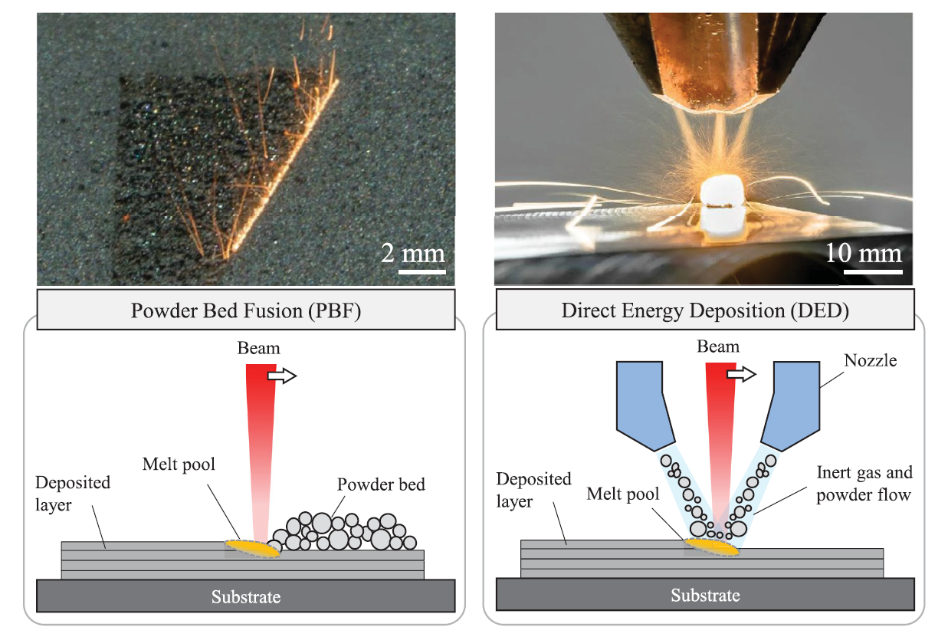
Powder Bed Fusion (PBF)
Directed Energy Deposition (DED)

Slide 2
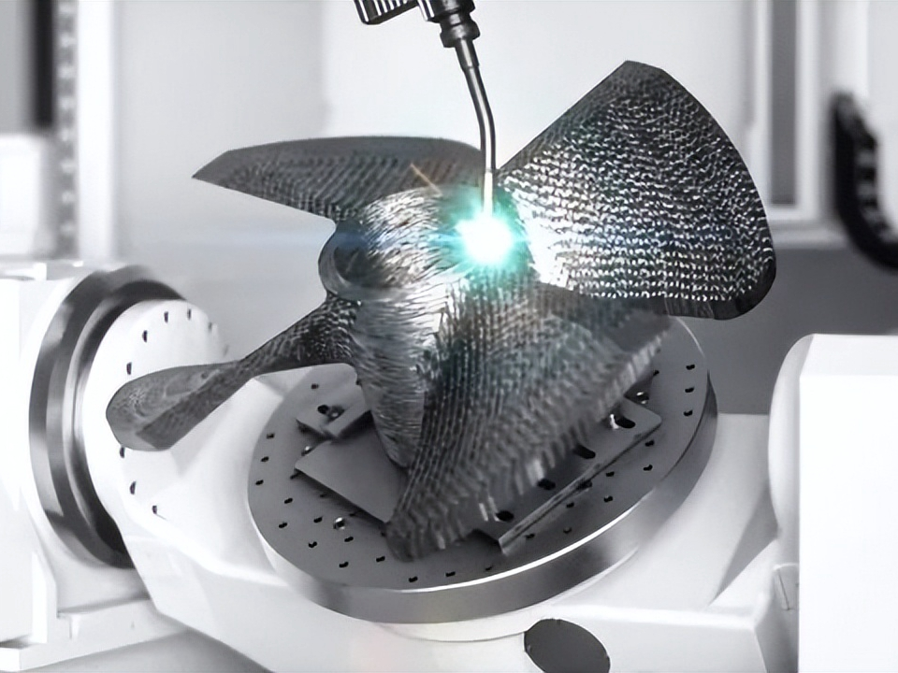
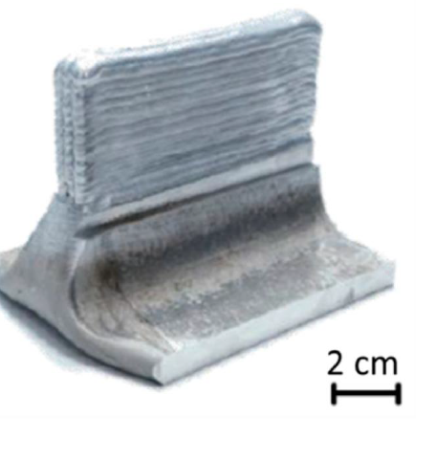
Powder Bed Fusion (PBF)
Directed Energy Deposition (DED - ARC)
Electron Beam Melting
EBM
Vat Photopolymerization VPP
Binder Jetting (glue) BJ
Material Jetting MJ
Sheet Lamination (cut) SHL
Classificações A.M.:
Por fonte de energia
Por tipo de material
Wire Arc
WAAM
Wire DED
GTAW
Arco Voltaico
Modelling and simulation of metal additive manufacturing processes with particle methods: A review https://doi.org/10.1080/17452759.2023.2274494

Slide 3
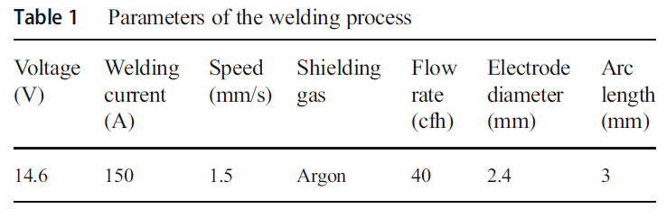
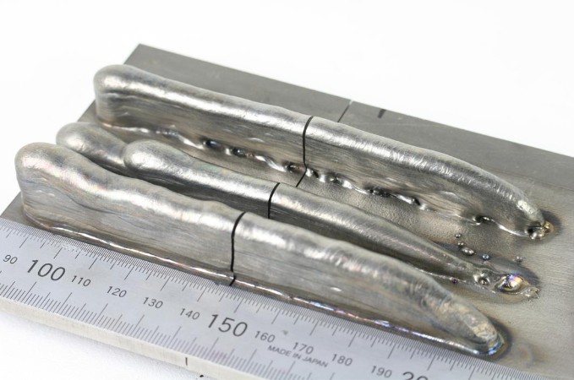

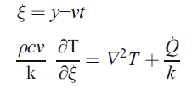


Ex 01
arc welding - analytical solution
Directed Energy Deposition (DED - ARC)
new (x) coordinate system
Convection
Diffusion
k Heat conductivity
R Distance between the moving heat source
and point of interest
c Specific heat
v Welding speed
ξ Moving coordinate parallel to the welding
trajectory

Slide 4
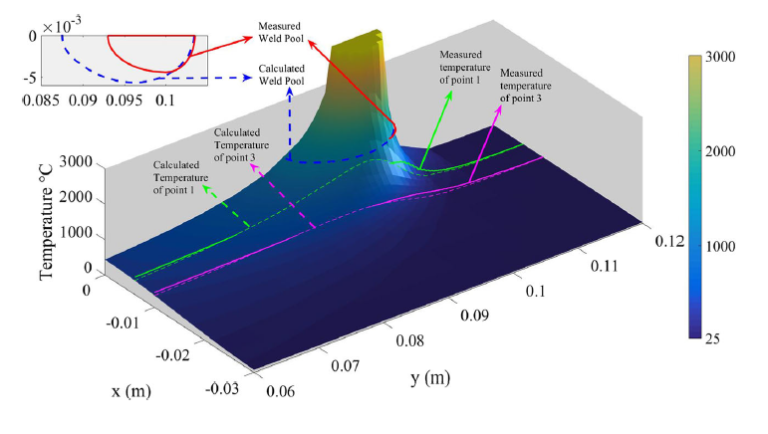
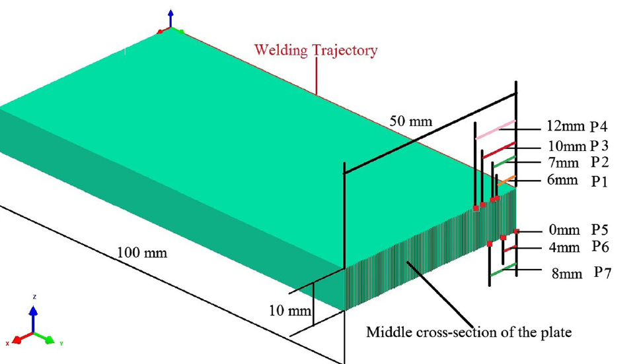
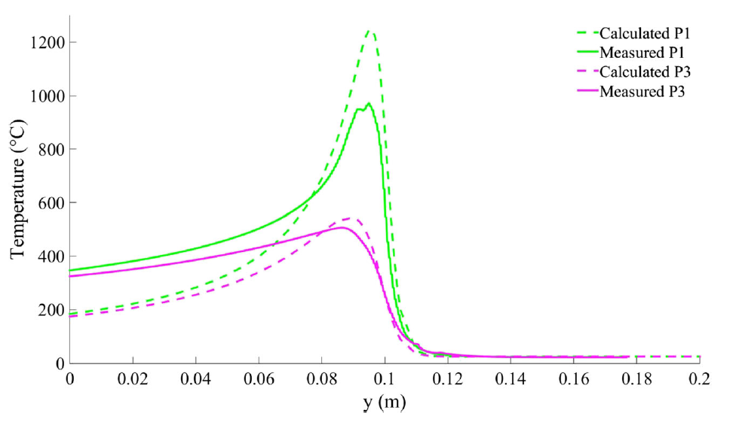
Ex 01
arc welding - analytical solution
Directed Energy Deposition (DED - ARC)
Part 01

Slide 5
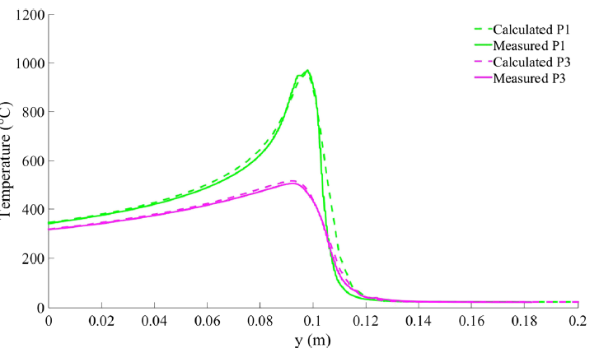
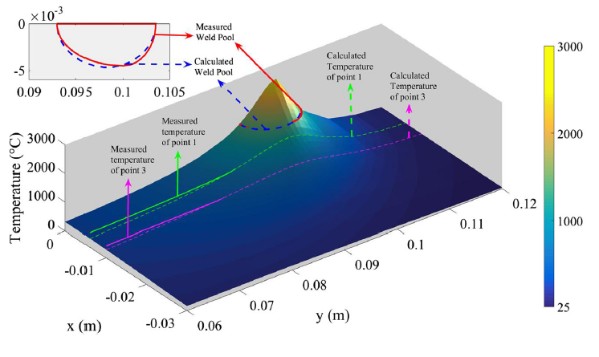
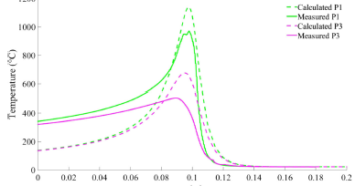
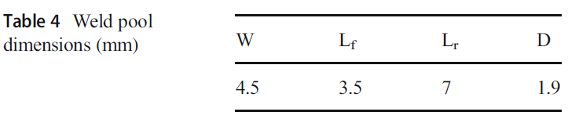

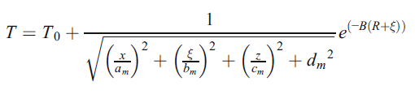


Ex 01
Part 02

Slide 6
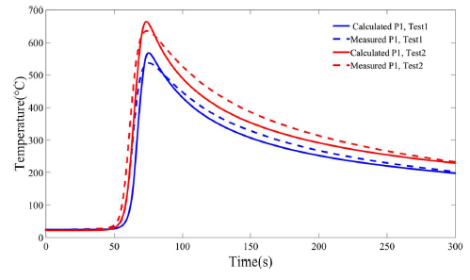
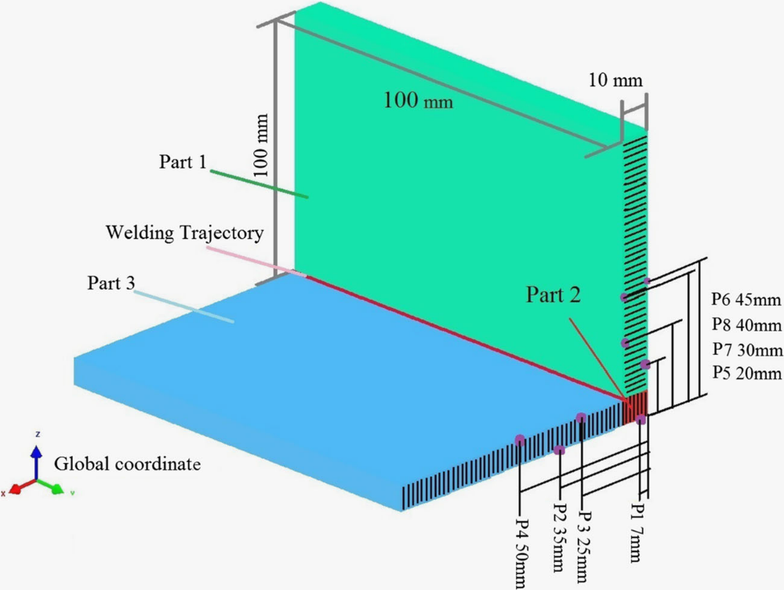
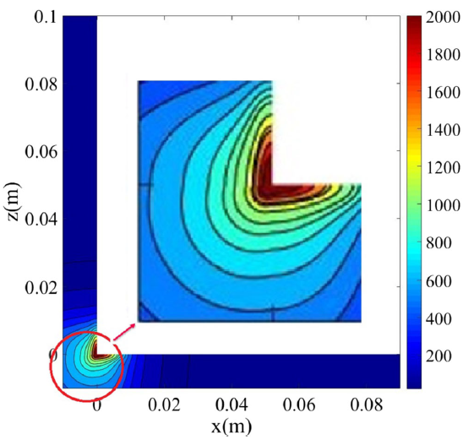
Ex 01
Termopar 01 a 08

Slide 7
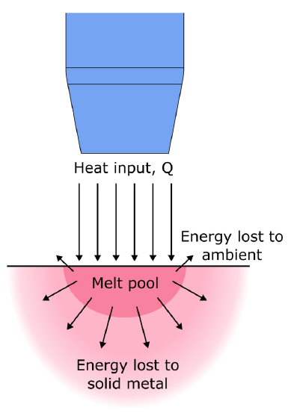
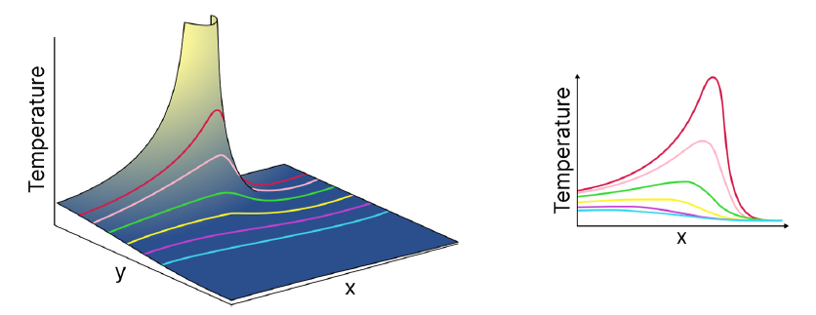
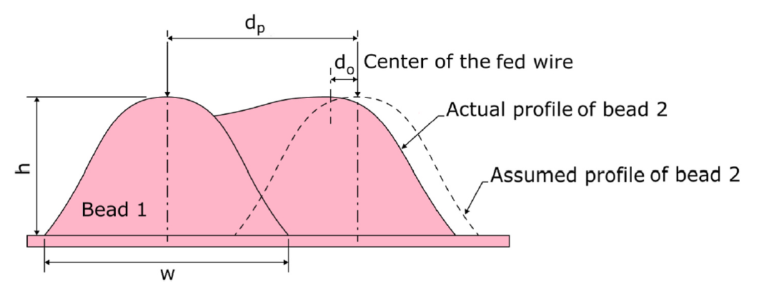
===========
\ \ / F ield
\ \ / O peration
\ \ / A nd
\ \ / M anipulation
Open
O que é um modelo?
Analítico
Numérico

Slide 8
Para que modelar?
PROBLEMAS A.M.
1- Orientação – intensidade
2- Descontínuidades (balling)
3- Keyholes (espaços vazios - vapor)
4- Degradação química e oxidação
5- Partículas residuais
6- Trincas
7- Delaminação / Distorção
8- Acabamento superficial
9- Porosidade
Racionalizar o problema
Controlar o processo de fabricação
Grande quantidade de variáveis !
Aula 3 - ED_Deposicao_por_energia_direcionada___e___p86__

Slide 9
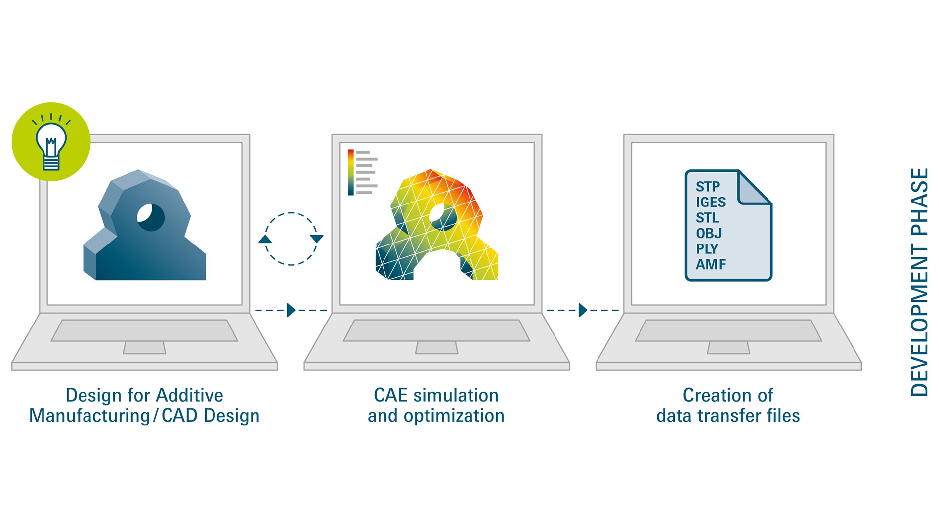
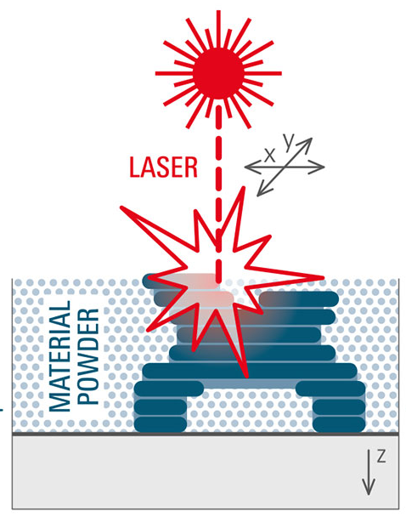
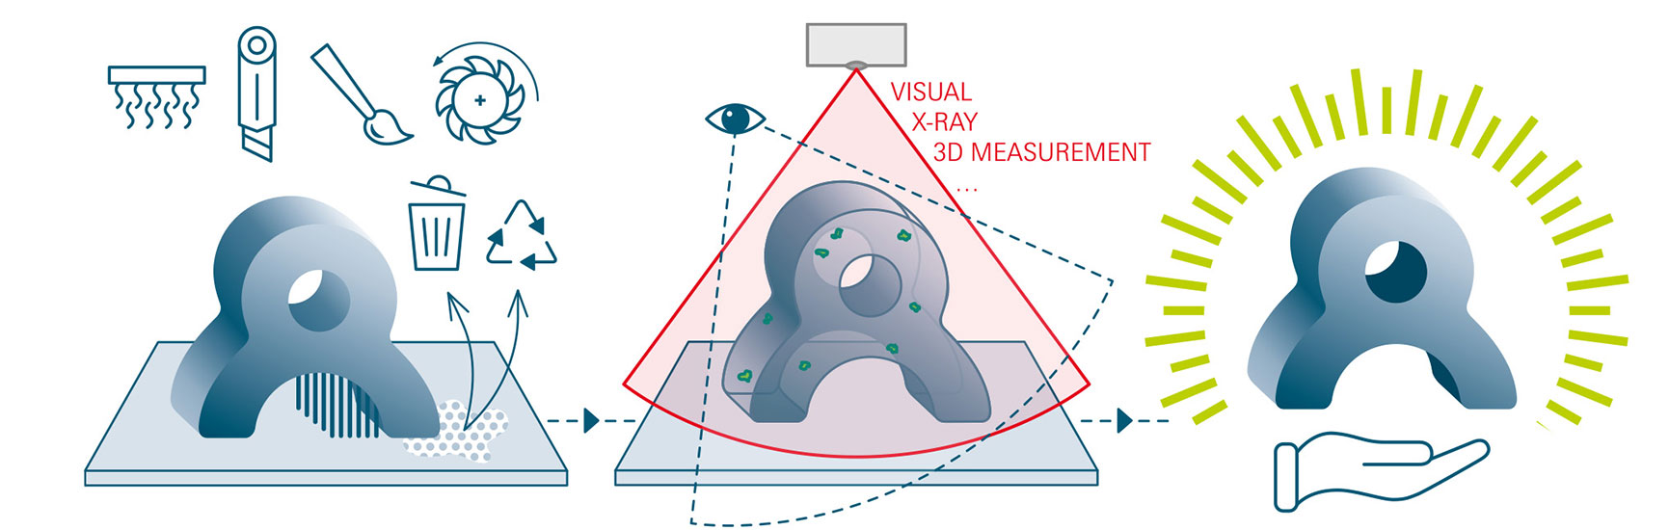
O que modelar?
CAD (Computer-Aided Design) shapes - parametric 3D models (length, width, angles + Rules + History Tree)
CAE (Computer-Aided Engineering) – data harvesting - structural stresses, deformations, displacement, and failures – FEA - CFD
CAM
Computer-Aided Manufacturing
Pós Processamento
Testes, Medições
& controle de qualidade
https://formnext.mesago.com/frankfurt/en/industry-insights/am-field-guide/process_in_general.html

Slide 10
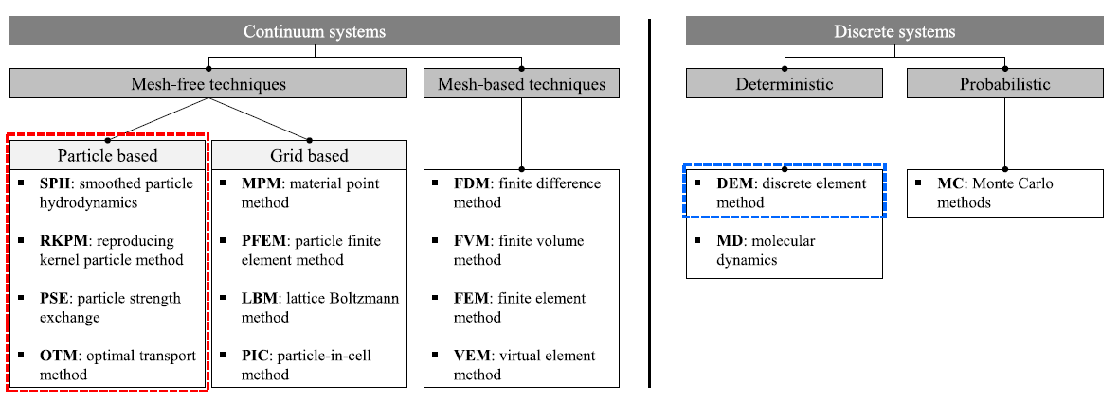
CFD (FDM, FEM, FEA)
Como modelar?
Massive parallelisation
Particle based
Grid based
MPM
PFEM
ML algorithms
physics-based . surrogate models.
simulation-informed closed-loop control feedback real-time monitoring systems.
Macro
01 - finite element analysis (FEA)
02 - thermal–mechanical simulations
03 - phase-field modeling techniques
heat flow, temperature distribution, and stress evolution during deposition
meshfree.
particle-based .
| Probabilistic ? .
Modelling and simulation of metal additive manufacturing processes with particle methods: A review

Slide 11
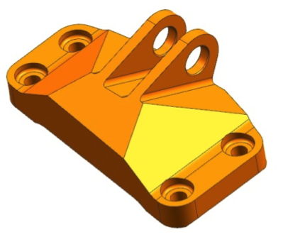
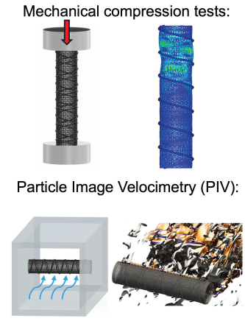

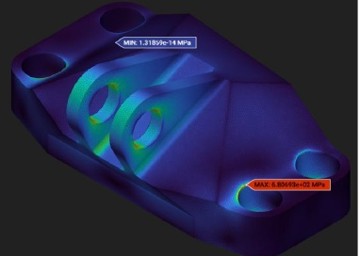
FEA – Análise de Elementos Finitos
- Decompõe um objeto 3D complexo em milhares de pequenas partes gerenciáveis ​​("elementos");
- Calcula tensões estruturais, falhas e deformações.
Stress, Deformação, Vibração, Fadiga
Análise Estrutural
Peça de Suporte
CFD
- Fluidodinâmica Computacional
- Fluxo, pressão, temperatura, ...
FSI – Fluid - Structure Interaction

Slide 12

O que é um modelo?
.. numérico
Finite-difference
MODFLOW
Finite-volume
OpenFOAM
FiPy
FVM
Finite-element
FEniCS ; SfePy ;
FEM Mesh DEM, IBM, LBM, BEM, MEC …
FiPy

Slide 13
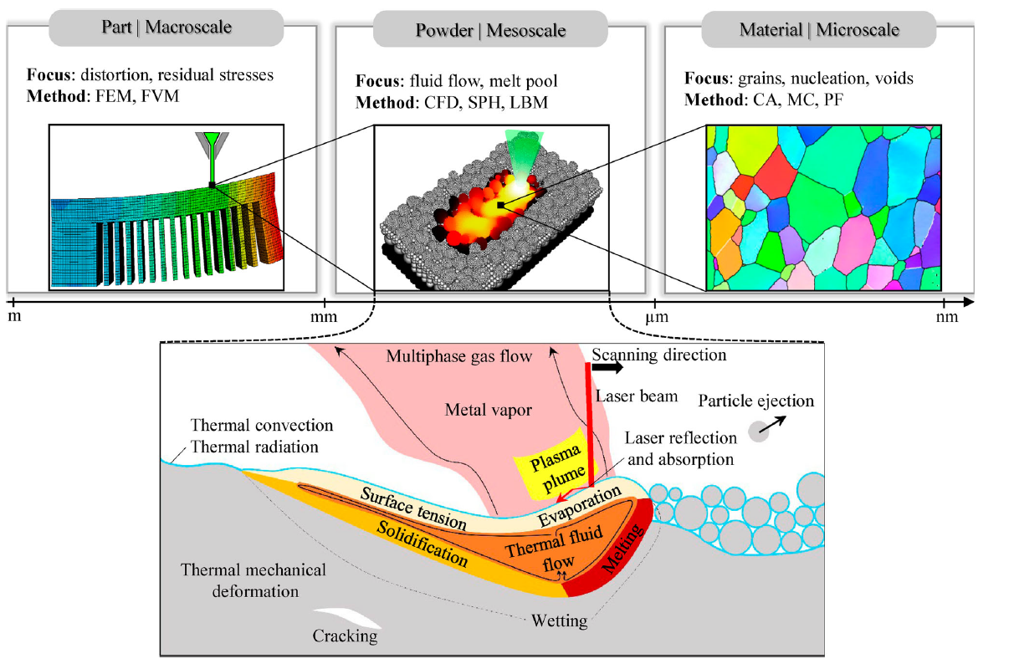
Escalas de modelagem
O que modelar?
Macro-scale models
heat flow and structural (stress) deformation & interlayer bonding,
Meso-scale models
pool geometry, bead formation, and dilution.
Micro-scale phase-field
grain growth, microstructural transitions, solidification kinetics
Foco: Distorção, stress residual
Métodos: FEM, FVM
Foco: Fluxo, poça de fusão
Métodos: CFD, SPH, LBM
Foco: Grãos, nucleação, vazios
Métodos: CA, MC, PF

Slide 14
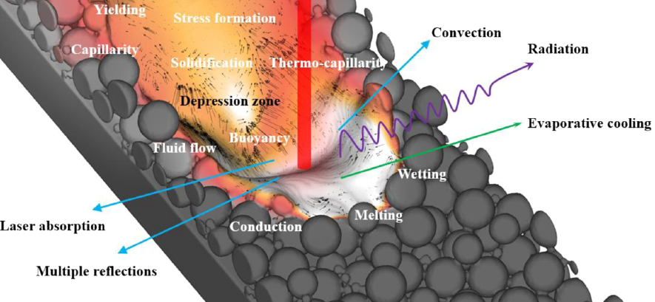
Meso-scale

Slide 15
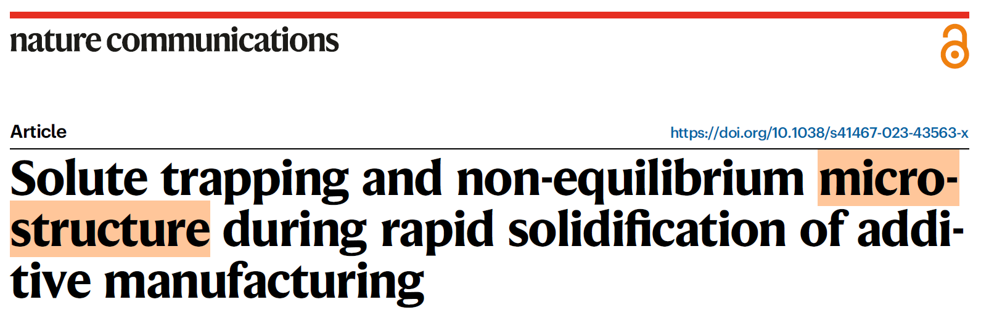
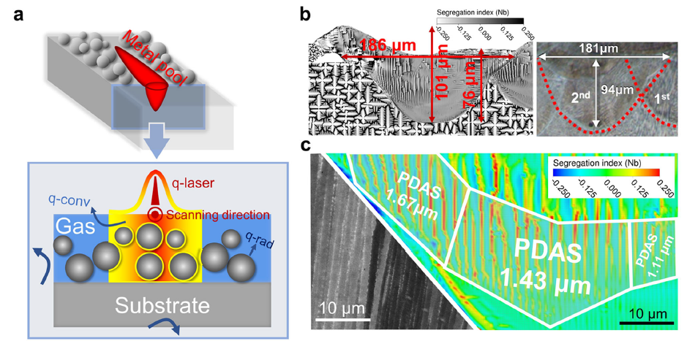
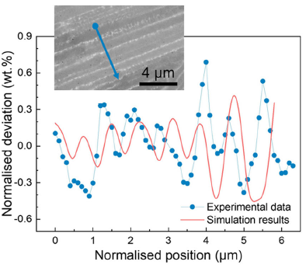
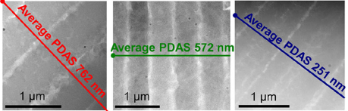
EX:
Micro-scale
Laser
Powder Bed Fusion (L PBF)
Printed
insight into the solute transport process;
high-fidelity physics-based numerical modelling;
effect of melt convection and solute partition.
Model
Temperature, flow velocity, solute concentration, and microstructure
... directly coupled
210 × 400 µm computational domain (2D)
1,341,561
grid 0.25 μm
Solute trapping and non-equilibrium microstructure during rapid solidification of additive manufacturing

Slide 18

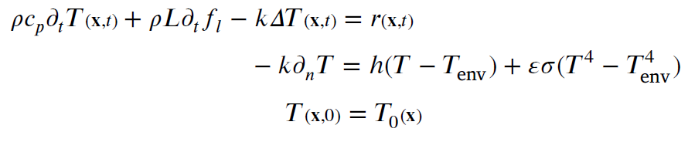
EX:
Heat Affected Zone (HAZ)
latent heat treatment
phase change
multi-timestep methods
the balance of energy equation
+ phase change
+ growing domain
born-dead element technique
𝜌,𝑐𝑝,𝐿,𝑓𝑙 ,𝑟
density
specific and latent heats
liquid fraction and
power density
ℎconv, 𝜀, 𝜎, 𝑇env, 𝑇0
convection heat transfer coefficient
emissivity, Stefan–Boltzmann constant
environment & initial temperatures

Slide 19
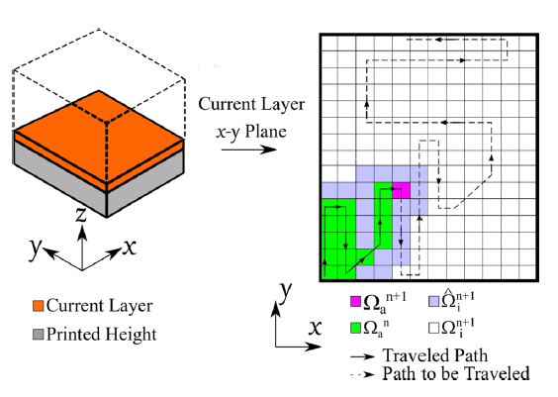




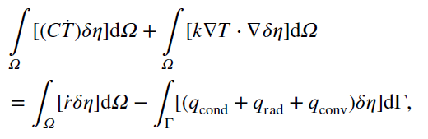
EX:
h-adaptive finite-element (FE) strategy
  mesh coarsening and refinement
common layer interface (CLI) x GCode
̇H rate of enthalpy
q heat-flux per unit volume
ṙ rate of heat source
C (temperature dependent) heat capacity
heat losses
external work of the thermal loads
- A multi‑criteria h‑adaptive finite‑element framework for industrial part‑scale thermal analysis in additive manufacturing processes – Moreira & Chiumenti (2021)
- Numerical simulation and experimental calibration of Additive Manufacturing by blown powder technology. Part I: thermal analysis -- M. Chiumenti
- Residual stress and distortion of rectangular and S-shaped Ti-6Al-4V parts -- M. Chiumenti
Caicedo

Slide 20


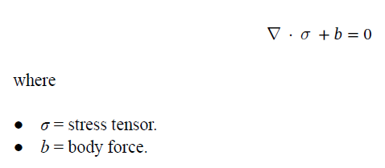





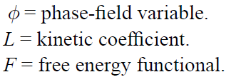
Diffusion
0
0
Marangoni shear stress
Multi-scale modeling approaches in wire arc additive manufacturing: from melt pool dynamics to residual stress prediction & AM PravaH®

Slide 21
Contatar:
Prof. Carlos Henrique Marchi UFPR – CFD – Computação
Guilherme Ferreira Gomes UNIFEI – A.M. – CFD
Diego Raimundi Corradi (WAAM) UFMG – OSCILAÇÃO MAGNÉTICA
MODELO:
Fonte (externa) de calor x Material - Condução, convecção, radiação

Slide 22
CFD
https://github.com/DLR-RY/VoFLibrary
Volume of fluid method
Laser heat input … latent input
Surface tension
Marangoni force
“This gives you the basis of how the simulation solver is modelled and how we can rely on the data that has been predicted … based on this robust physic equations that are provided”
AM PravaH®

