Slide 1
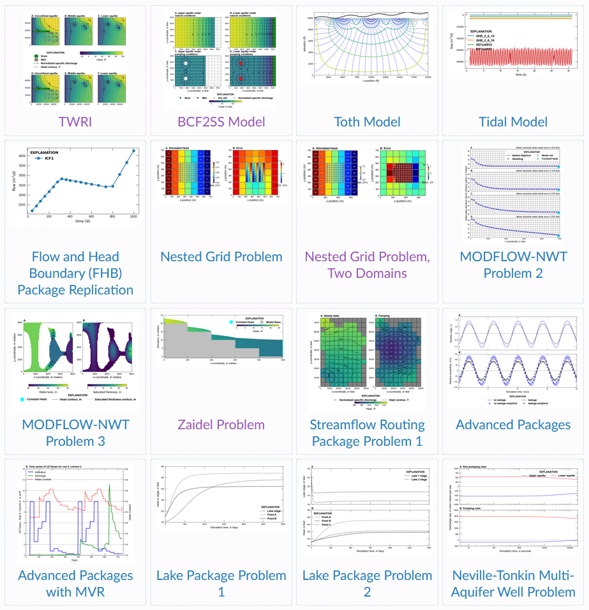
01
05
09
13
11
15

Slide 2
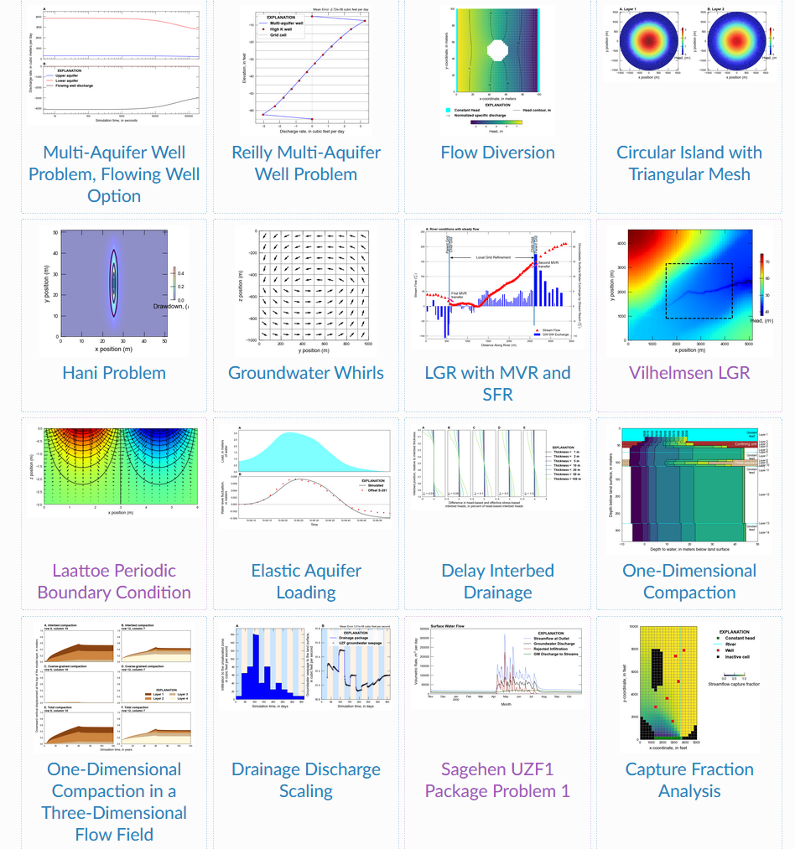
17
21
25
29

Slide 3
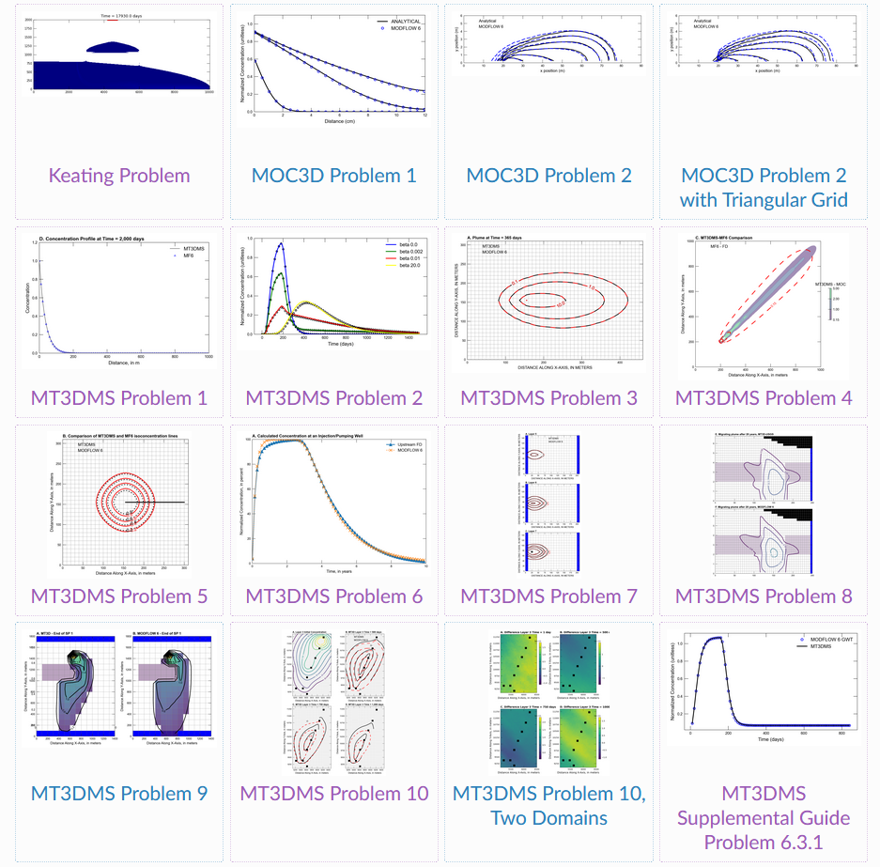
33
37
41
45

Slide 4
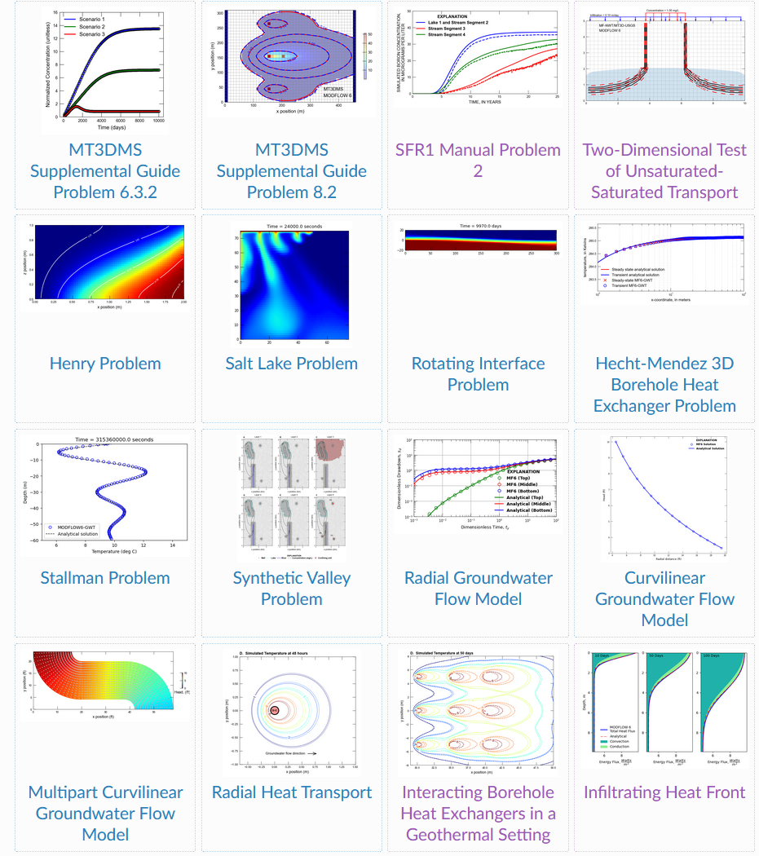
49
53
57
61
51

Slide 5
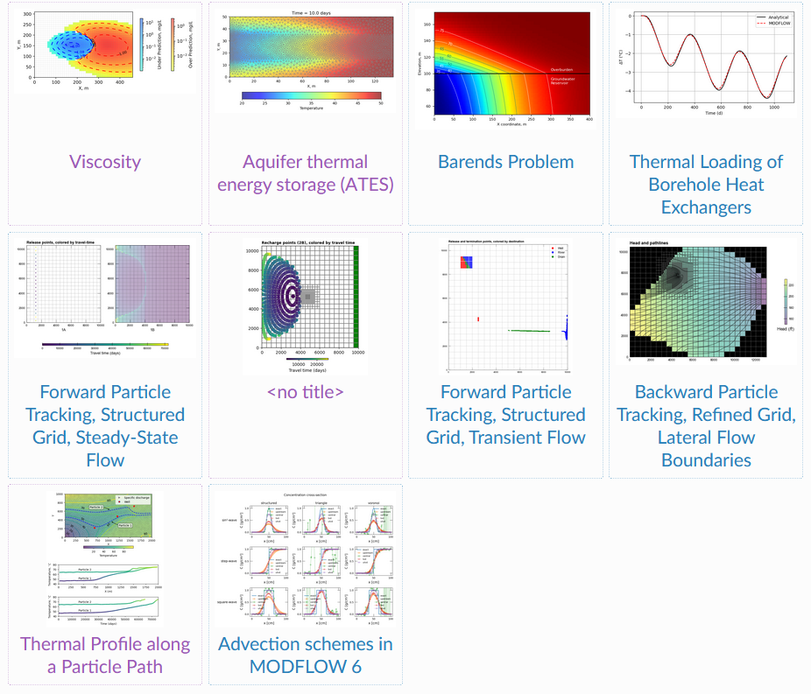
65
69
73
https://modflow6-examples.readthedocs.io/en/latest/notebook_examples.html

