Slide 1
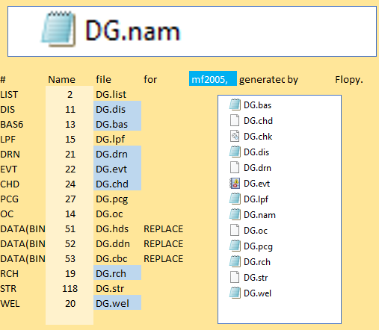
Flopy
flopy.modflow
flopy.utils
numpy
Pamdas
Git
Sys
Pathlib
Pprint
Pooch NET
wsl = data_path / "uspb" / "flopy"
ml = flopy.modflow.Modflow.load("DG.nam", model_ws=wsl, verbose=False)
MODULES
model = fpm.Modflow (modelname = 'gwexample')
fpm.Modflow Bas (model, ibound=ibound, strt=20) fpm.Modflow Lpf (model, hk=10, laytyp=1) fpm.Modflow Wel (model, stress_period_data=lrcQ) fpm.Modflow Pcg (model)
fpm.Modflow Oc (model)
09_groundwater_paper_example_1
ws = os.path.join("temp")
if not os.path.exists(ws):
os.makedirs(ws)
http://localhost:8888/notebooks/04_Flopy/10_groundwater_paper_uspb_example/groundwater_paper_uspb_example.ipynb
E:\15_REPOS\00_Betami\04_Flopy\10_groundwater_paper_uspb_example

