Slide 1
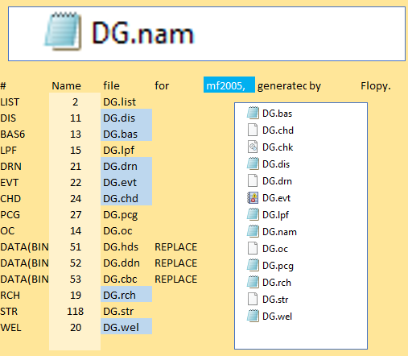
Flopy
flopy.modflow
flopy.utils
numpy
Pamdas
Git
Sys
Pathlib
Pprint
Pooch NET
wsl = data_path / "uspb" / "flopy"
ml = flopy.modflow.Modflow.load("DG.nam", model_ws=wsl, verbose=False)
MODULES
exe = "MF2K5_FMP2_dbg64"
ws = os.path.join("temp")
model = fpm.Modflow(modelname="Beta", exe_name=exe, model_ws=ws)
Essencial model unities
Discretization
01
02
03
04
05
06
fpm.Modflow Dis
fpm.Modflow Bas (model, ibound=ibound, strt=20) fpm.Modflow Lpf (model, hk=10, laytyp=1) fpm.Modflow Wel (model, stress_period_data=lrcQ) fpm.Modflow Pcg (model)
fpm.Modflow Oc (model)
# Grid
# Layers
ws = os.path.join("temp")
if not os.path.exists(ws):
os.makedirs(ws)
# solver
# output control
09_groundwater_paper_example_1
= mf6.ModflowGwf(
http://localhost:8888/notebooks/02_Flopy_1_2_3__/d_01_groundwater_Initial/01/groundwater_paper_example_1.ipynb#
E:\15_REPOS\00_Betami\02_Flopy_1_2_3__\d_01_groundwater_Initial\01\tempIN

Slide 2
MODULES
https://flopy.readthedocs.io/en/latest/code.html
wsl = data_path / "uspb" / "flopy“
ml = flopy.modflow.Modflow.load("DG.nam", model_ws=wsl, verbose=False)
flopy.mf6.ModflowTdis(sim, nper=10, perioddata=[[365.0, 1, 1.0] for _ in range(10)])
flopy.mf6.ModflowIms(sim)
flopy.mf6.ModflowGwfdis(gwf, nlay=3, nrow=4, ncol=5, top=50.0, botm=botm)
flopy.mf6.ModflowGwfic(gwf)
flopy.mf6.ModflowGwfnpf(gwf, save_specific_discharge=True)
flopy.mf6.ModflowGwfchd(gwf, stress_period_data=[[(0, 0, 0), 1.0], [(2, 3, 4), 0.0]])
= mf6.ModflowGwf(
01
02
03
04
05
06
fpm.Modflow Dis
fpm.Modflow Bas (model, ibound=ibound, strt=20) fpm.Modflow Lpf (model, hk=10, laytyp=1) fpm.Modflow Wel (model, stress_period_data=lrcQ) fpm.Modflow Pcg (model)
fpm.Modflow Oc (model)
09_groundwater_paper_example_1
riv_dtype = flopy.mf6.ModflowCHD.get_default_dtype()
print(CHD_dtype)
?

Slide 3
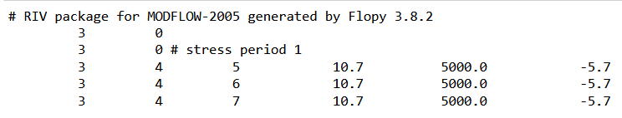
/02_Flopy_1_2_3__/
a___.docs_Notebooks/
03_mf_boundaries_tutorial/
03/
3mf_boundaries_tutorial.ipynb
wsl = data_path / "uspb" / "flopy“
ml = flopy.modflow.Modflow.load("DG.nam", model_ws=wsl, verbose=False)
ws = "./tempIN/FOLDER-A"
name = "m" # Simulation Name
= mf6.ModflowGwf(
m = flopy.modflow.Modflow(modelname="b", model_ws=ws)
riv = flopy.modflow.ModflowRiv(m, stress_period_data=stress_period_data)
dis = flopy.modflow.ModflowDis(m, nper=3)
m.write_input()
m
MODFLOW 1 layer(s) 2 row(s) 2 column(s) 3 stress period(s)
!head -n 10 'tempIN/FOLDER-A/b.riv'
riv_dtype = flopy.modflow.ModflowRiv.get_default_dtype()
print(riv_dtype)
fpm.ModflowWel(model, stress_period_data=lrcQ)
Wel = flopy.modflow.ModflowWel(m, stress_period_data=stress_period_data)
wel_dtype = flopy.modflow.ModflowWel.get_default_dtype()
print(wel_dtype)

Slide 4
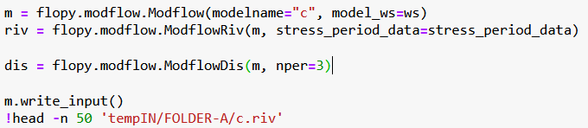
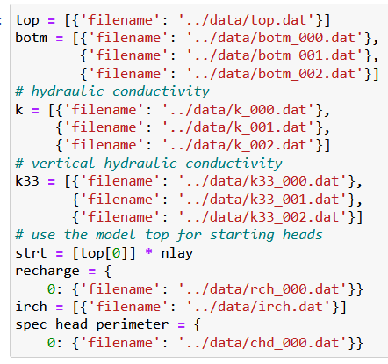
flopy.mf6.ModflowGwfnpf(gwf, save_specific_discharge=True)
flopy.mf6.ModflowGwfchd(gwf, stress_period_data=[[(0, 0, 0), 1.0], [(2, 3, 4), 0.0]])
/04_Pleasant_Lake/
02/
pleasant-lake-flopy-example.ipynb
= mf6.ModflowGwf(

Slide 5
# t DIS
sim.write_simulation()
mfsim.nam
pleasant.ims
pleasant.tdis
# output control
# discretization
# Layers K
# initial conditions
new - 06_nam
Pleaseant 01_dis, 02_ims, 03_npf, 04_oc, 05_tdis
# BC
# BC
# BC

Slide 6
/part0_02_intro_to_freyberg__W_inprogress/intro_freyberg_model_02_02.ipynb

