Slide 1
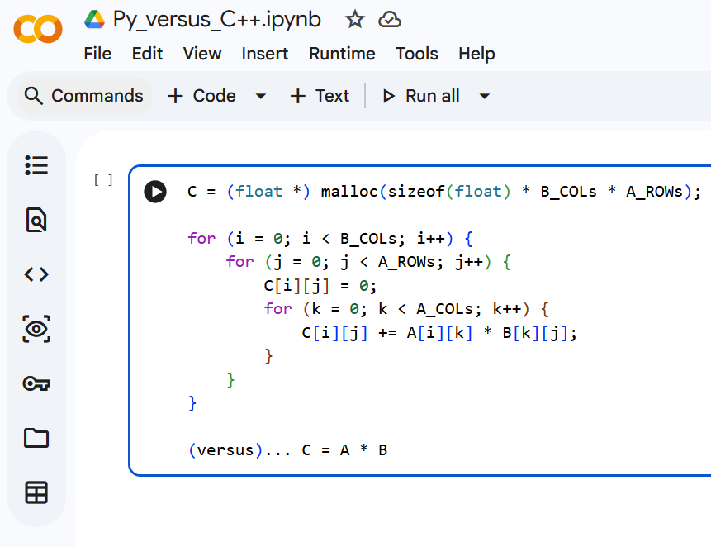
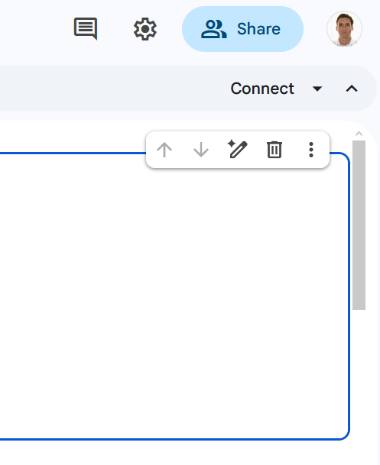

FiPy
https://colab.research.google.com/drive/1x8ZYcXopa_n87rguP4ZIxLN_9jMu6pYK

Slide 2
C = (float *) malloc(sizeof(float) * B_COLs * A_ROWs);
for (i = 0; i < B_COLs; i++) {
for (j = 0; j < A_ROWs; j++) {
C[i][j] = 0;
for (k = 0; k < A_COLs; k++) {
C[i][j] += A[i][k] * B[k][j];
}
}
}
(versus)... C = A * B

