Slide 1
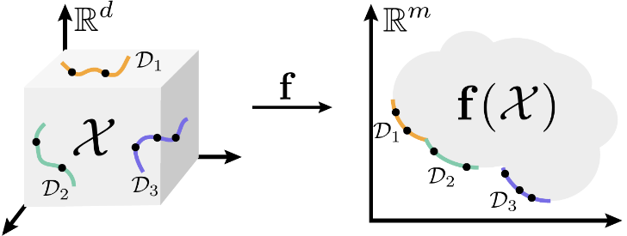


CFD
- Fluxo, pressão, temperatura, ...
+ FEA
Stress, Deformação, Vibração, Fadiga
Sparce matrix
Derivative matrix
Asymmetric matrix
COVariance matrix
Coefficient matrix
Regressor matrix
Design matrix
Análise Estrutural
Finite-difference
MODFLOW
Finite-volume
OpenFOAM
FiPy
F(Φ)
Pylops SciPy.sparse
PyAnsys
PyMAPDL
FVM
- Stiffness
- Mass
matrix
Finite-element
FEniCS ; SfePy ; FEM
DEM, IBM, LBM, BEM, MEC …
Sparce matrix
FSI – Fluid - Structure Interaction
FiPy

Slide 2
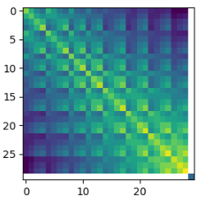
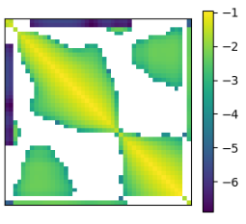
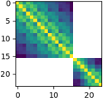

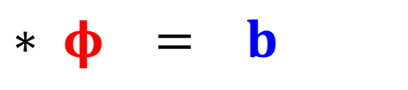
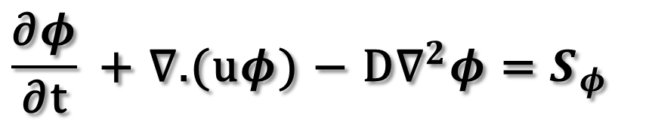
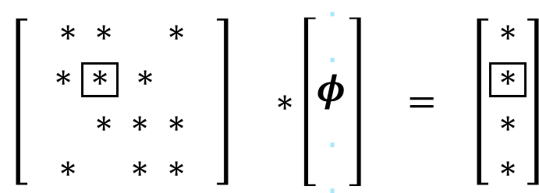
convecção difusão fontes
$$\frac{\text{∂}φ}{\text{∂}\text{t}} \text{+ }\text{∇}\text{.}\text{(}\text{u}φ\text{)} \text{−} \text{D}{\text{∇}}^{2}φ \text{=} S_{φ}$$
$$\left[ \begin{aligned}∗ ∗ ∗ ∗ \\ ∗ \boxed{∗} ∗ ∗ \\ ∗ ∗ ∗ ∗ \\ ∗ ∗ ∗ ∗\end{aligned} \right] ∗\left[\begin{matrix}. \\ . \\ \begin{matrix}φ \\ . \\ .\end{matrix}\end{matrix}\right] = \left[\begin{aligned}∗ \\ \boxed{∗} \\ ∗ \\ ∗\end{aligned}\right]$$
$$A$$
$$∗ φ = b$$
Modelo
OBS
PAR
COV
Zoom +

