Slide 1
Introduction to numerical simulation of fluid flows
JASS 04, St. Petersburg
Mónica de Mier Torrecilla
Technical University of Munich
Finite Volume Method, JASS 04

Slide 2
Overview
Introduction
Fluids and flows
Numerical Methods
Mathematical description of flows
Finite volume method
Turbulent flows
Example with CFX
Finite Volume Method, JASS 04

Slide 3
Introduction
In the past, two approaches in science:
Theoretical
Experimental
Computer Numerical simulation
Computational Fluid Dynamics (CFD)
Expensive experiments are being replaced by numerical simulations :
- cheaper and faster
- simulation of phenomena that can not be experimentally reproduced (weather, ocean, ...)
Finite Volume Method, JASS 04

Slide 4
Fluids and flows
Liquids and gases obey the same laws of motion
Most important properties: density and viscosity
A flow is incompressible if density is constant.
liquids are incompressible and
gases if Mach number of the flow < 0.3
Viscosity: measure of resistance to shear deformation
Finite Volume Method, JASS 04

Slide 5
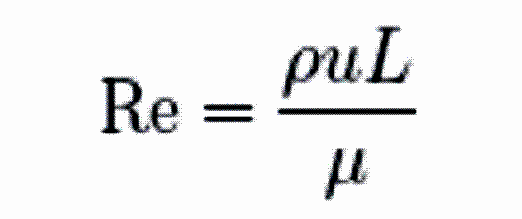
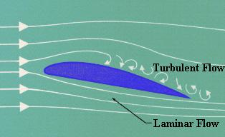
Fluids and flows (2)
Far from solid walls, effects of viscosity neglectable
inviscid (Euler) flow
in a small region at the wall boundary layer
Important parameter: Reynolds number
ratio of inertial forces to friction forces
creeping flow
laminar flow
turbulent flow
Finite Volume Method, JASS 04

Slide 6
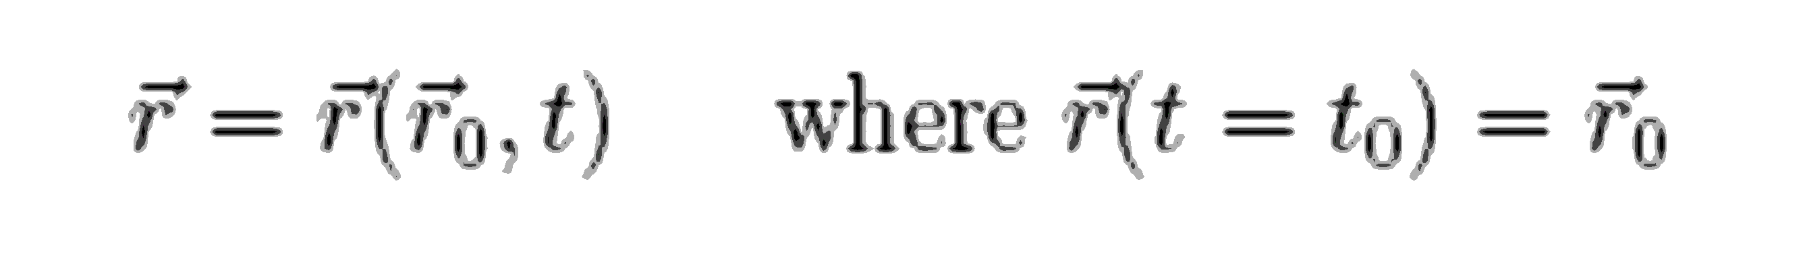

Fluids and flows (3)
Lagrangian description follows a fluid particle as it moves through the space
Eulerian description focus on a fixed point in space and observes fluid particles as they pass
Both points of view related by the transport theorem
Finite Volume Method, JASS 04

Slide 7
Numerical Methods
Navier-Stokes equations analytically solvable only in special cases
approximate the solution numerically
use a discretization method to approximate the differential equations by a system of algebraic equations which can be solved on a computer
Finite Differences (FD)
Finite Volume Method (FVM)
Finite Element Method (FEM)
Finite Volume Method, JASS 04

Slide 8
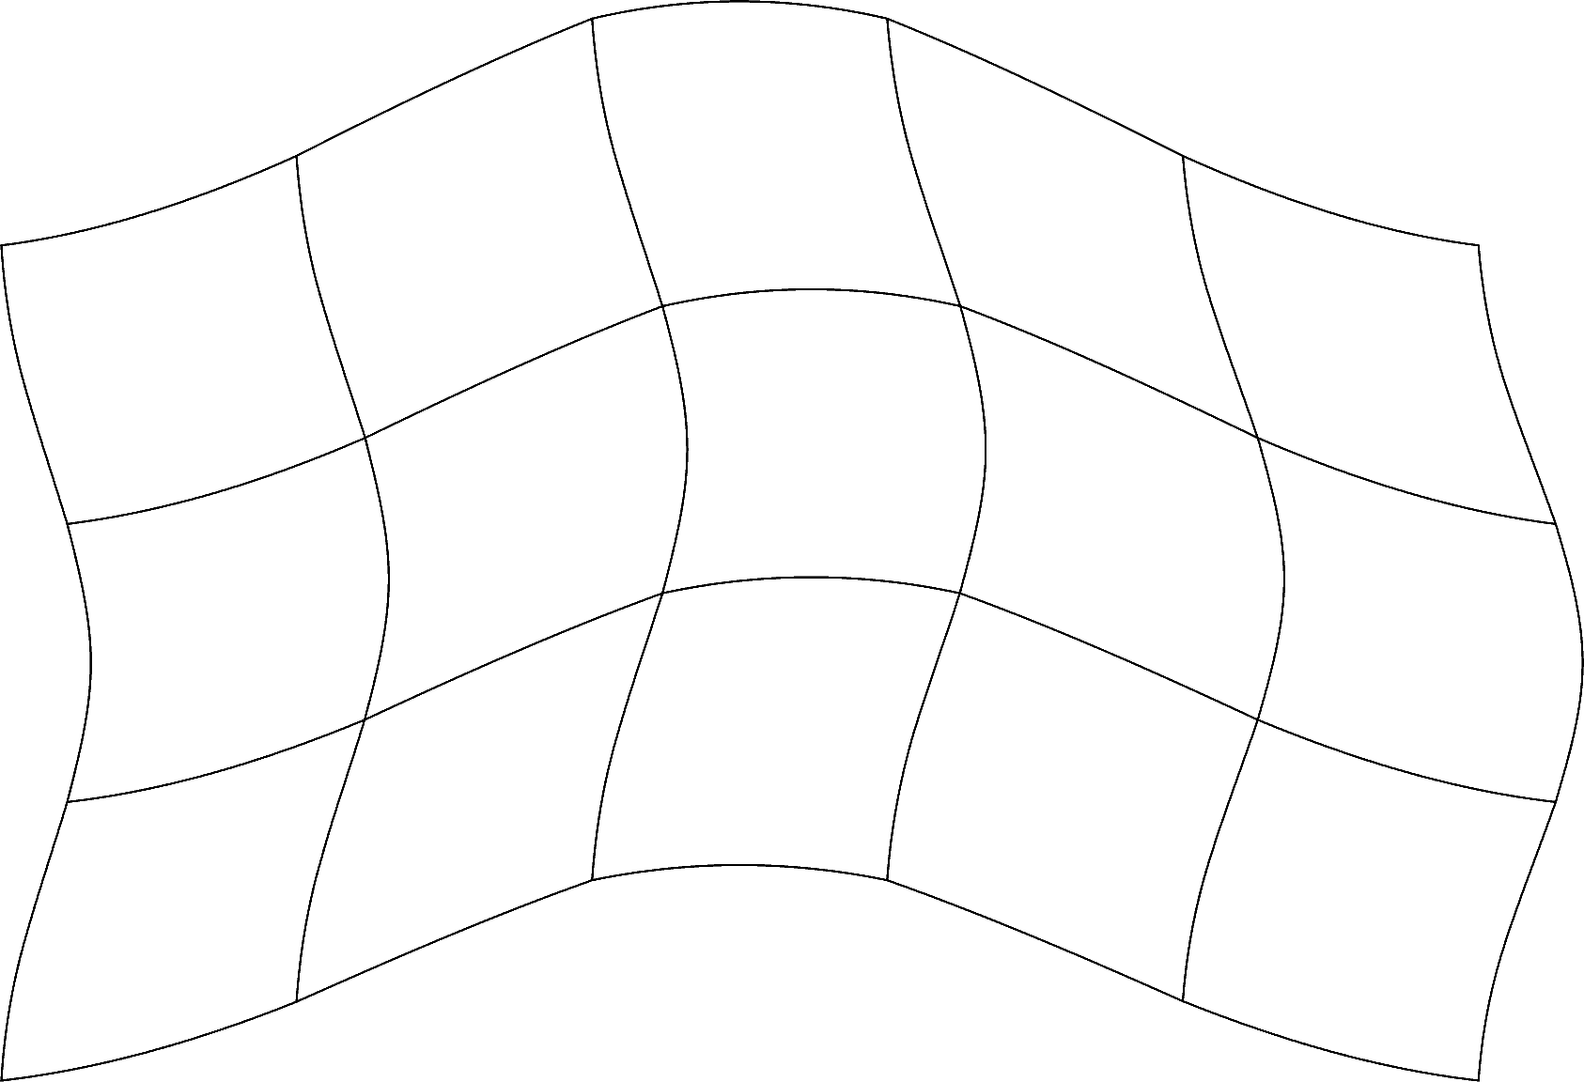
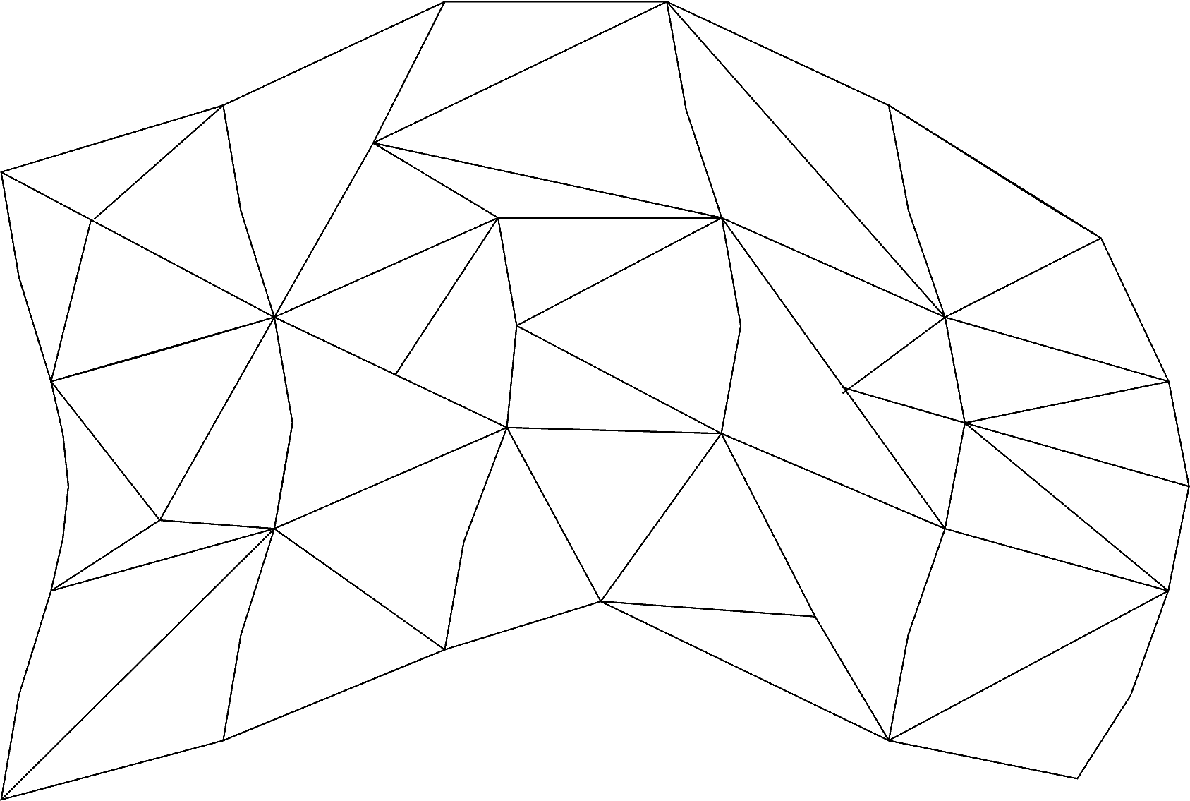
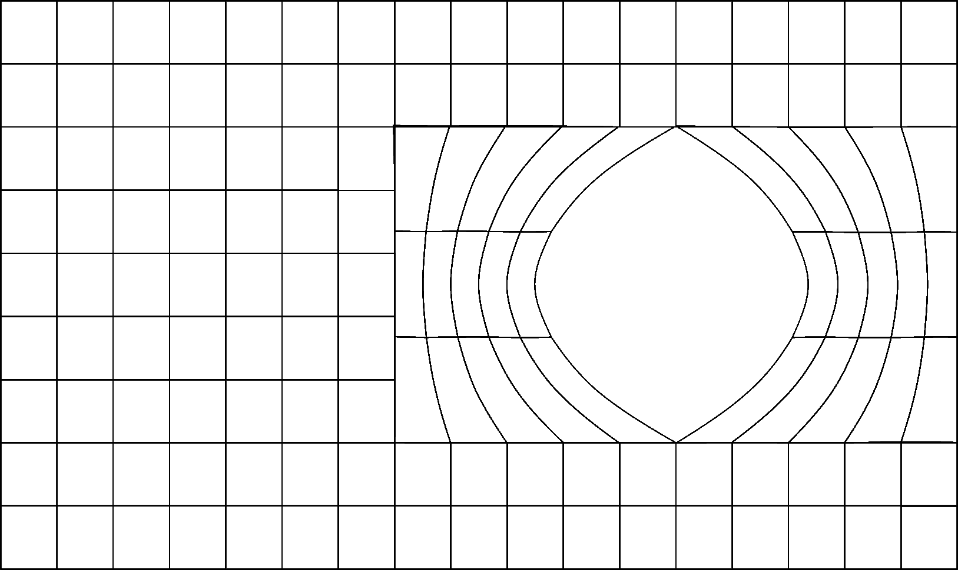
Numerical methods, grids
Grids
Structured grid
  all nodes have the same number
  of elements around it
  only for simple domains
Unstructured grid
  for all geometries
  irregular data structure
Block-structured grid
Finite Volume Method, JASS 04

Slide 9


Numerical methods, properties
Consistency
Truncation error : difference between discrete eq and the exact one
Truncation error becomes zero when the mesh is refined.
Method order n if the truncation error is proportional to
or
Stability
Errors are not magnified
Bounded numerical solution
Finite Volume Method, JASS 04

Slide 10
Numerical methods, properties (2)
Convergence
Discrete solution tends to the exact one as the grid spacing tends to zero.
Lax equivalence theorem (for linear problems):
Consistency + Stability = Convergence
For non-linear problems: repeat the calculations in successively refined grids to check if the solution converges to a grid-independent solution.
Finite Volume Method, JASS 04

Slide 11

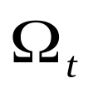
Mathematical description of flows
Conservation of mass
Conservation of momentum
Conservation of energy
of a fluid particle (Lagrangian point of view).
For computations is better Eulerian (fluid control volume)
Transport theorem
volume of fluid that moves with the flow
Finite Volume Method, JASS 04

Slide 12
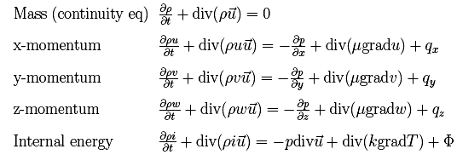
Navier-Stokes equations
Finite Volume Method, JASS 04

Slide 13
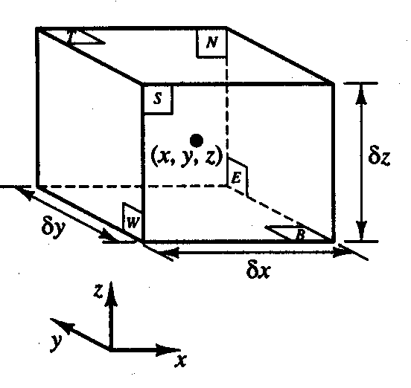
Fluid element
infinitesimal fluid element
6 faces: North, South, East,
West, Top, Bottom
Systematic account of changes in the mass, momentum and energy of the fluid element due to flow across the boundaries and the sources inside the element
fluid flow equations
Finite Volume Method, JASS 04

Slide 14


Transport equation
General conservative form of all fluid flow equations for the variable
Transport equation for the property
Finite Volume Method, JASS 04

Slide 15
Transport equation (2)
Integration of transport equation over a CV
Using Gauss divergence theorem,
Finite Volume Method, JASS 04

Slide 16
Boundary conditions
Wall : no fluid penetrates the boundary
  No-slip, fluid is at rest at the wall
  Free-slip, no friction with the wall
Inflow (inlet): convective flux prescribed
Outflow (outlet): convective flux independent of coordinate normal to the boundary
Symmetry
Finite Volume Method, JASS 04

Slide 17
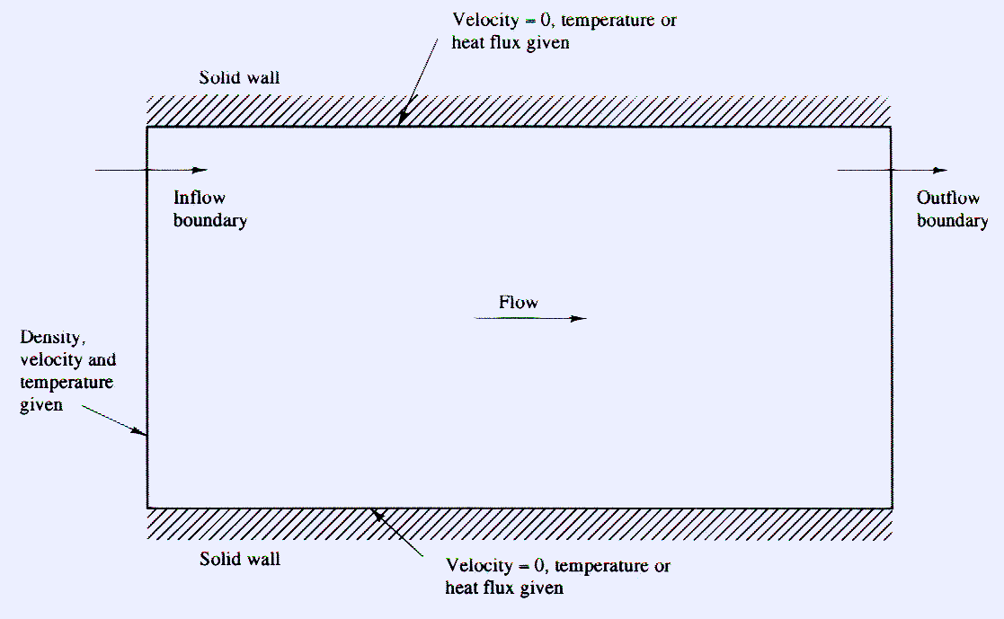
Boundary conditions (2)
Finite Volume Method, JASS 04

Slide 18
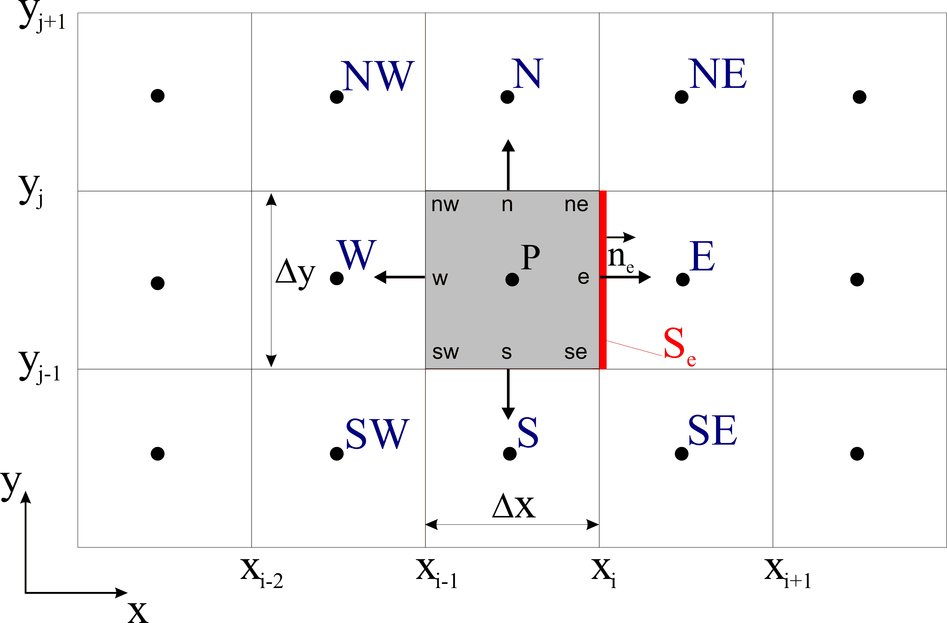
Finite Volume Method
Starting point: integral form of the transport eq (steady)
control volume
CV
Finite Volume Method, JASS 04

Slide 19
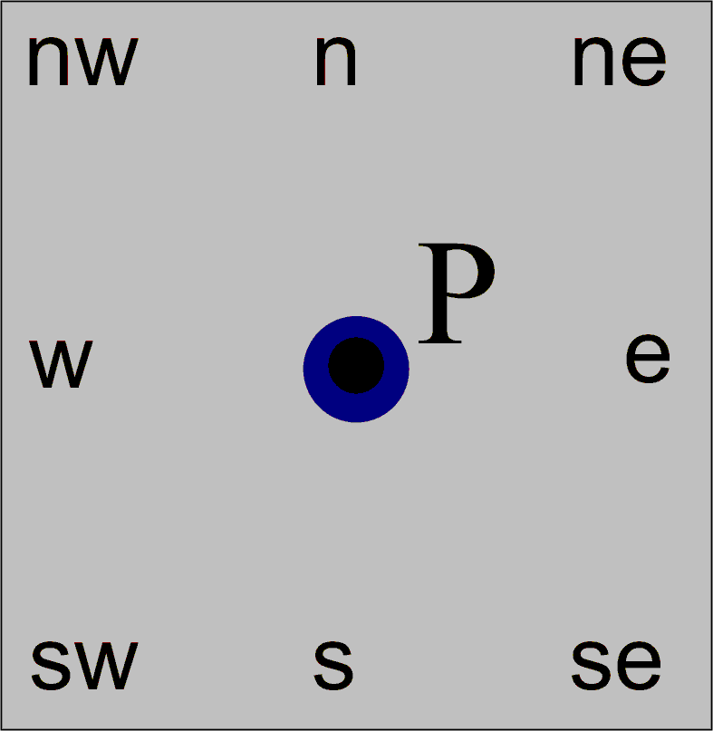

Approximation of volume integrals
simplest approximation:
  exact if q constant or linear
Interpolation using values of q at more points
  Assumption q bilinear
Finite Volume Method, JASS 04

Slide 20

Approximation of surface integrals
Net flux through CV boundary is sum of integrals over the faces
velocity field and density are assumed known
is the only unknown
we consider the east face
Finite Volume Method, JASS 04

Slide 21
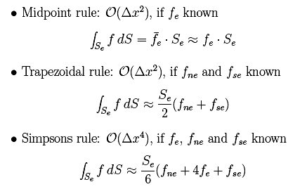
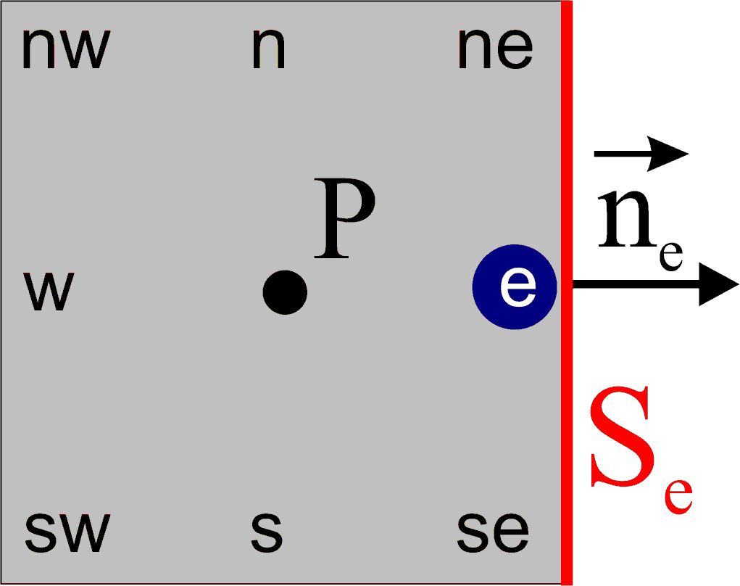
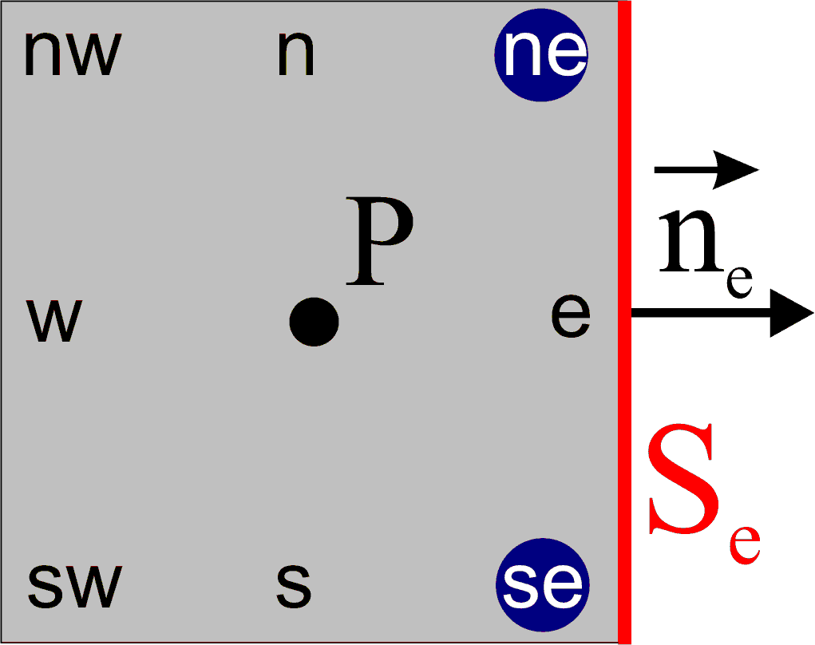
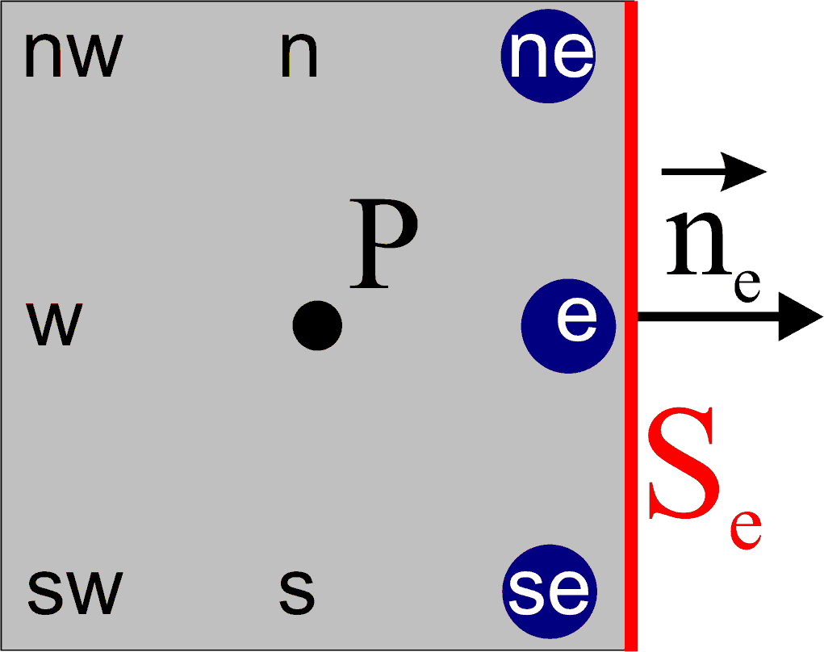
Approximation of surface integrals (2)
Values of f are not known at cell faces interpolation
Finite Volume Method, JASS 04

Slide 22
Interpolation
we need to interpolate f
the only unknown in f is
Different methods to approximate and its normal derivative:
Upwind Differencing Scheme (UDS)
Central Differencing Scheme (CDS)
Quadratic Upwind Interpolation (QUICK)
Finite Volume Method, JASS 04

Slide 23

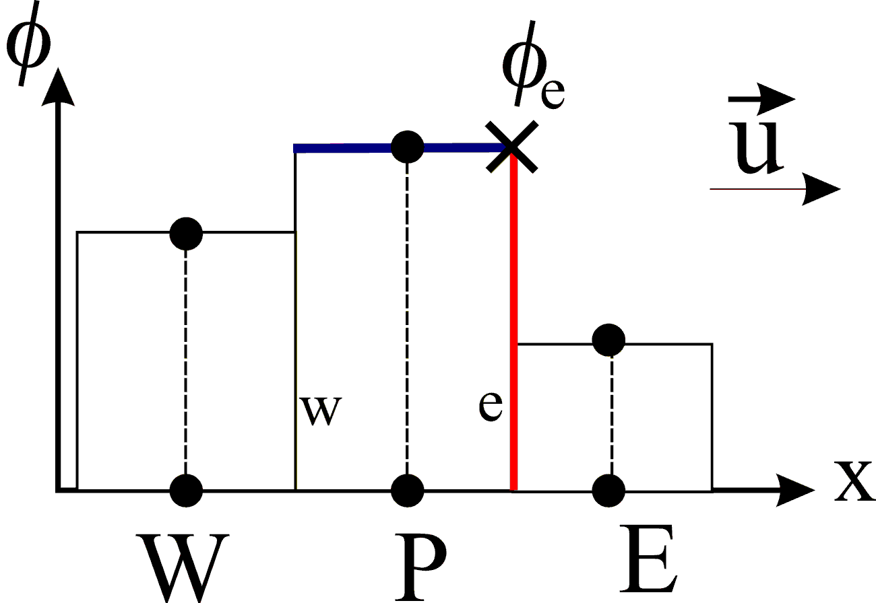
Interpolation (2)
Upwind Differencing Scheme (UDS)
Approximation by its value the node upstream of ‘e’
  first order
  unconditionally stable (no oscillations)
  numerically diffusive
Finite Volume Method, JASS 04

Slide 24

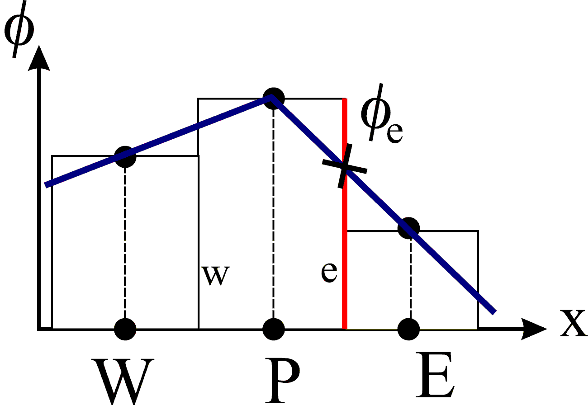
Interpolation (3)
Central Differencing Scheme (CDS)
Linear interpolation between nearest nodes
  second order scheme
  may produce oscillatory solutions
Finite Volume Method, JASS 04

Slide 25

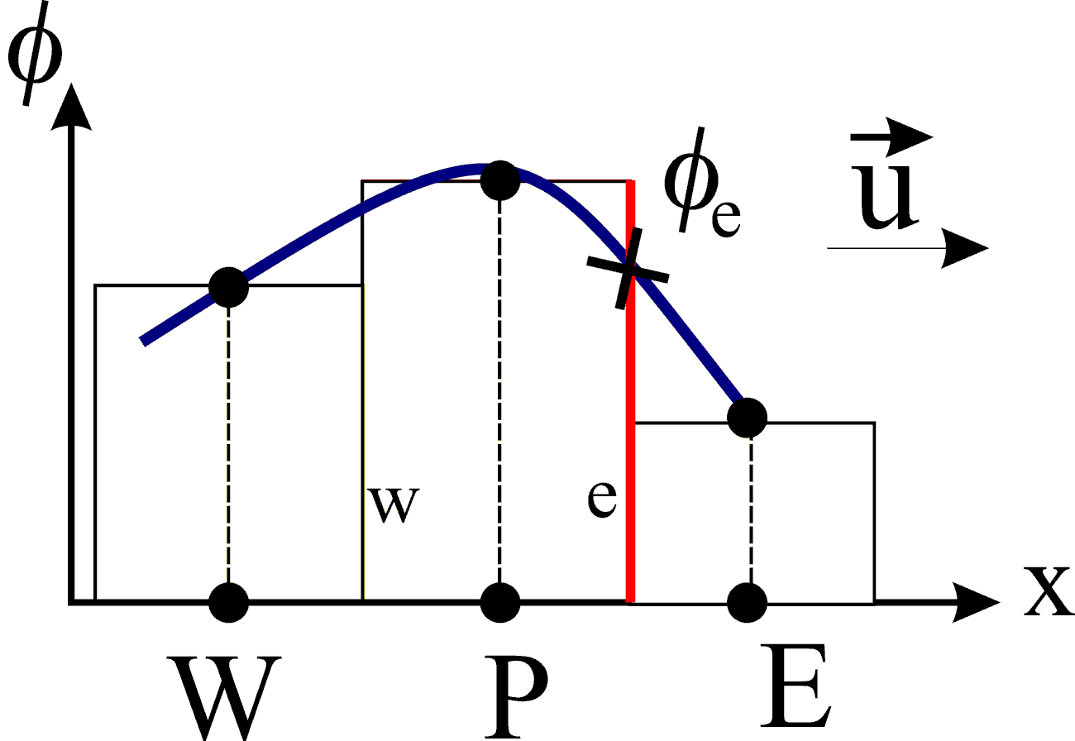
Interpolation (4)
Quadratic Upwind Interpolation (QUICK)
Interpolation through a parabola: three points necessary
P, E and point in upstream side
  g coefficients in terms of
  nodal coordinates
  thrid order
Finite Volume Method, JASS 04

Slide 26


Linear equation system
one algebraic equation at each control volume
matrix A sparse
Two types of solvers:
  Direct methods
  Indirect or iterative methods
Finite Volume Method, JASS 04

Slide 27


Linear eq system, direct methods
Direct methods
Gauss elimination
LU decomposition
Tridiagonal Matrix Algorithm (TDMA)
- number of operations for a NxN system is
- necessary to store all the coefficients
Finite Volume Method, JASS 04

Slide 28
Linear eq system, iterative methods
Iterative methods
Jacobi method
Gauss-Seidel method
Successive Over-Relaxation (SOR)
Conjugate Gradient Method (CG)
Multigrid methods
- repeated application of a simple algorithm
- not possible to guarantee convergence
- only non-zero coefficients need to be stored
Finite Volume Method, JASS 04

Slide 29


Time discretization
For unsteady flows, initial value problem
f discretized using finite volume method
time integration like in ordinary differential equations
right hand side integral evaluated numerically
Finite Volume Method, JASS 04

Slide 30
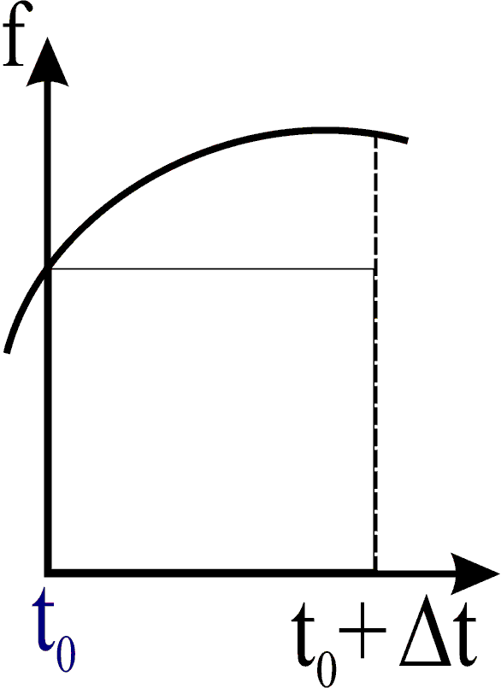

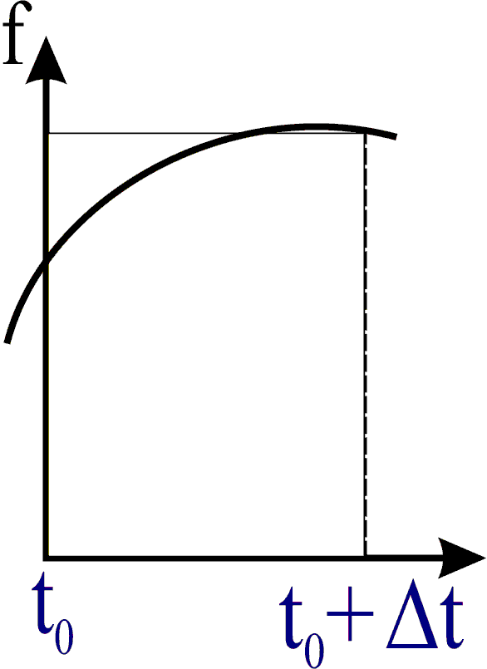
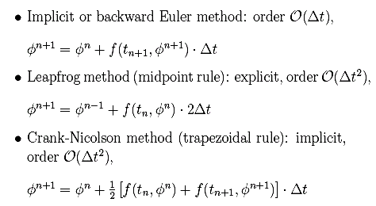
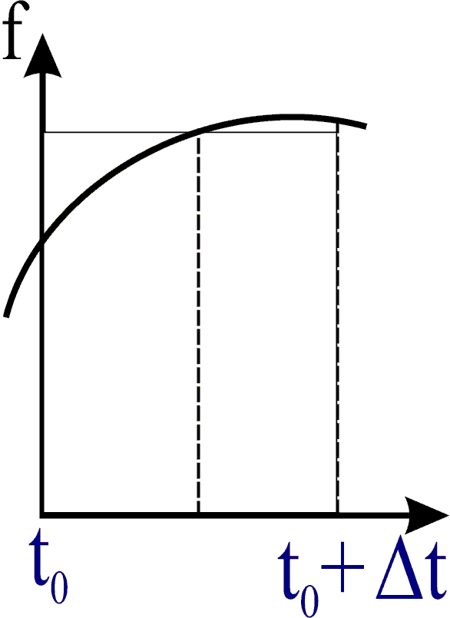
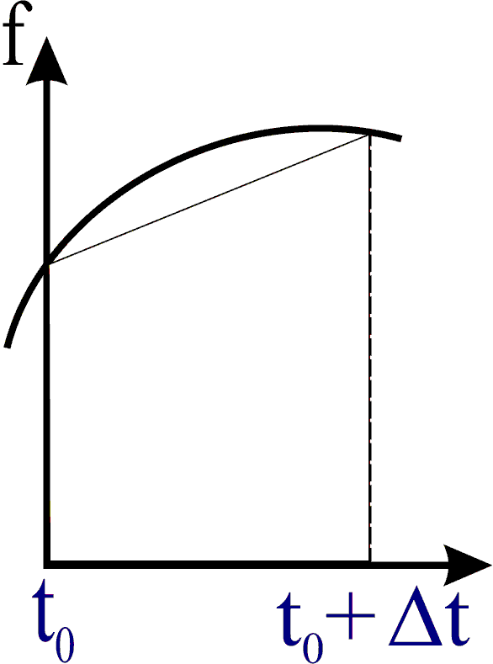
Time discretization (2)
Finite Volume Method, JASS 04

Slide 31
Time discretization (3)
Types of time integration methods
Explicit, values at time n+1 computed from values at time n
Advantages:
- direct computation without solving system of eq
- few number of operations per time step
Disadvantage: strong conditions on time step for stability
Implicit, values at time n+1 computed from the unknown values at time n+1
Advantage: larger time steps possible, always stable
Disadv: - every time step requires solution of a eq system
- more number of operations
Finite Volume Method, JASS 04

Slide 32
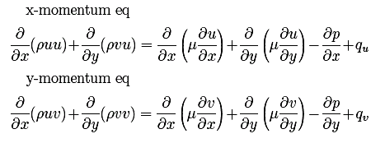

Coupling of pressure and velocity
Up to now we assumed velocity (and density) is known
Momentum eq from transport eq replacing by u, v, w
Finite Volume Method, JASS 04

Slide 33
Coupling of pressure and velocity (2)
Non-linear convective terms
Three equations are coupled
No equation for the pressure
Problems in incompressible flow: coupling between pressure and velocity introduces a constraint
Location of variables on the grid:
Colocated grid
Staggered grid
Finite Volume Method, JASS 04

Slide 34
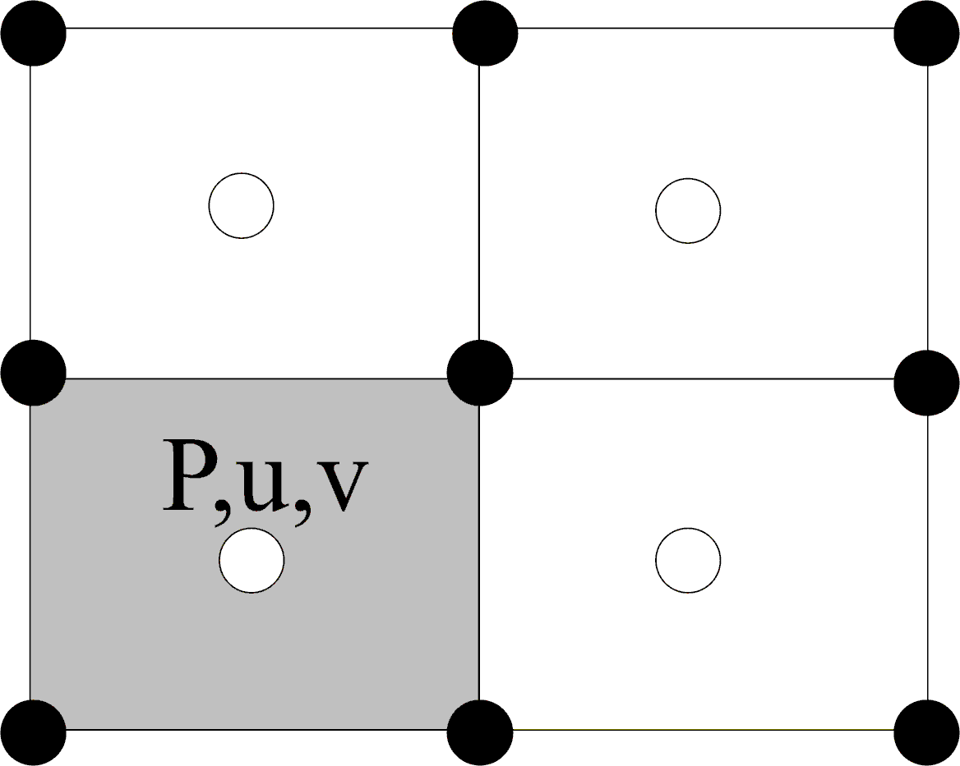
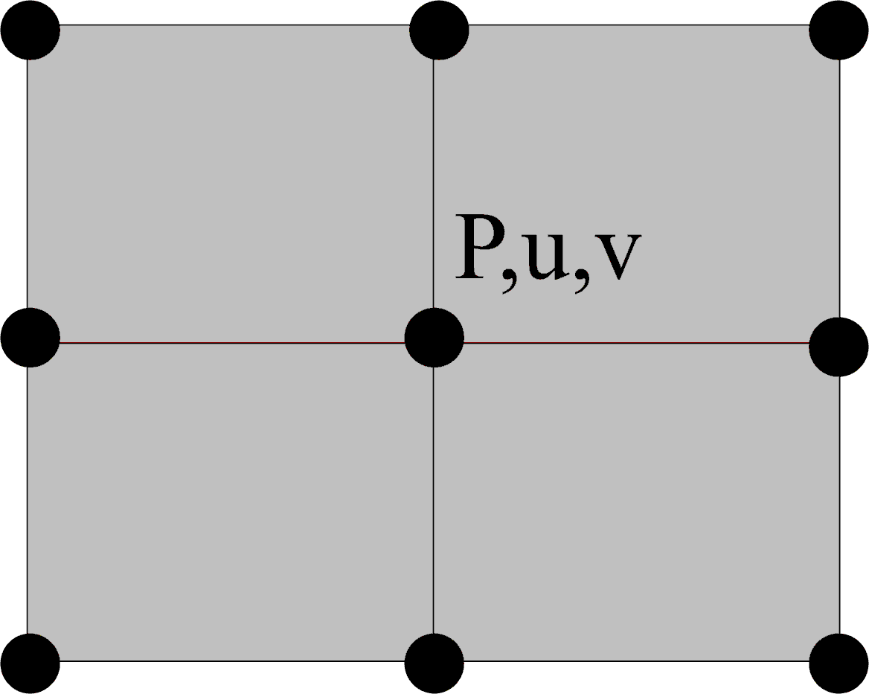
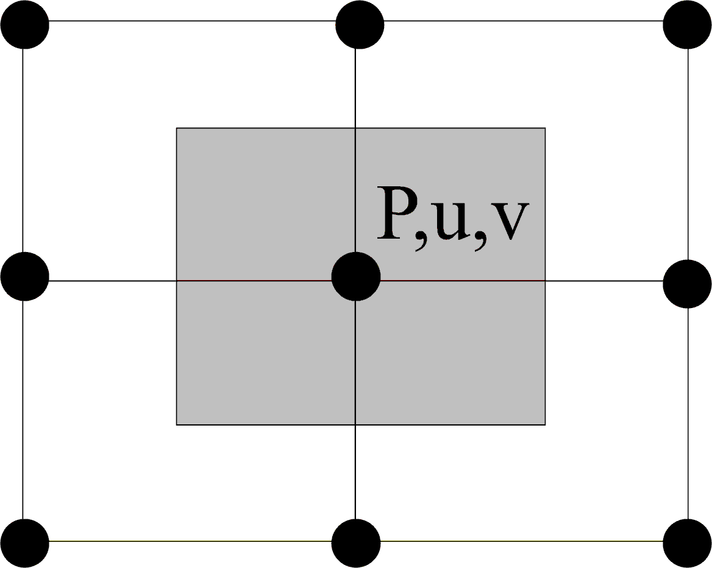
Coupling of pressure and velocity (3)
Colocated grid
Node for pressure and velocity at CV center
Same CV for all variables
Possible oscillations of pressure
Finite Volume Method, JASS 04

Slide 35
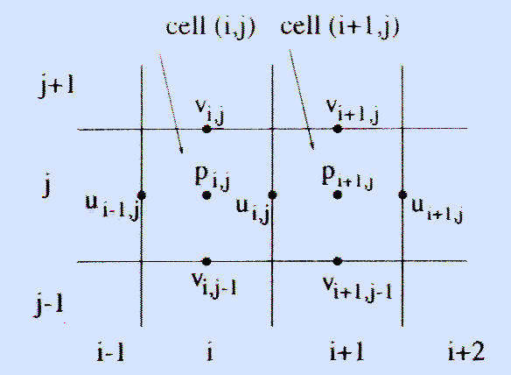
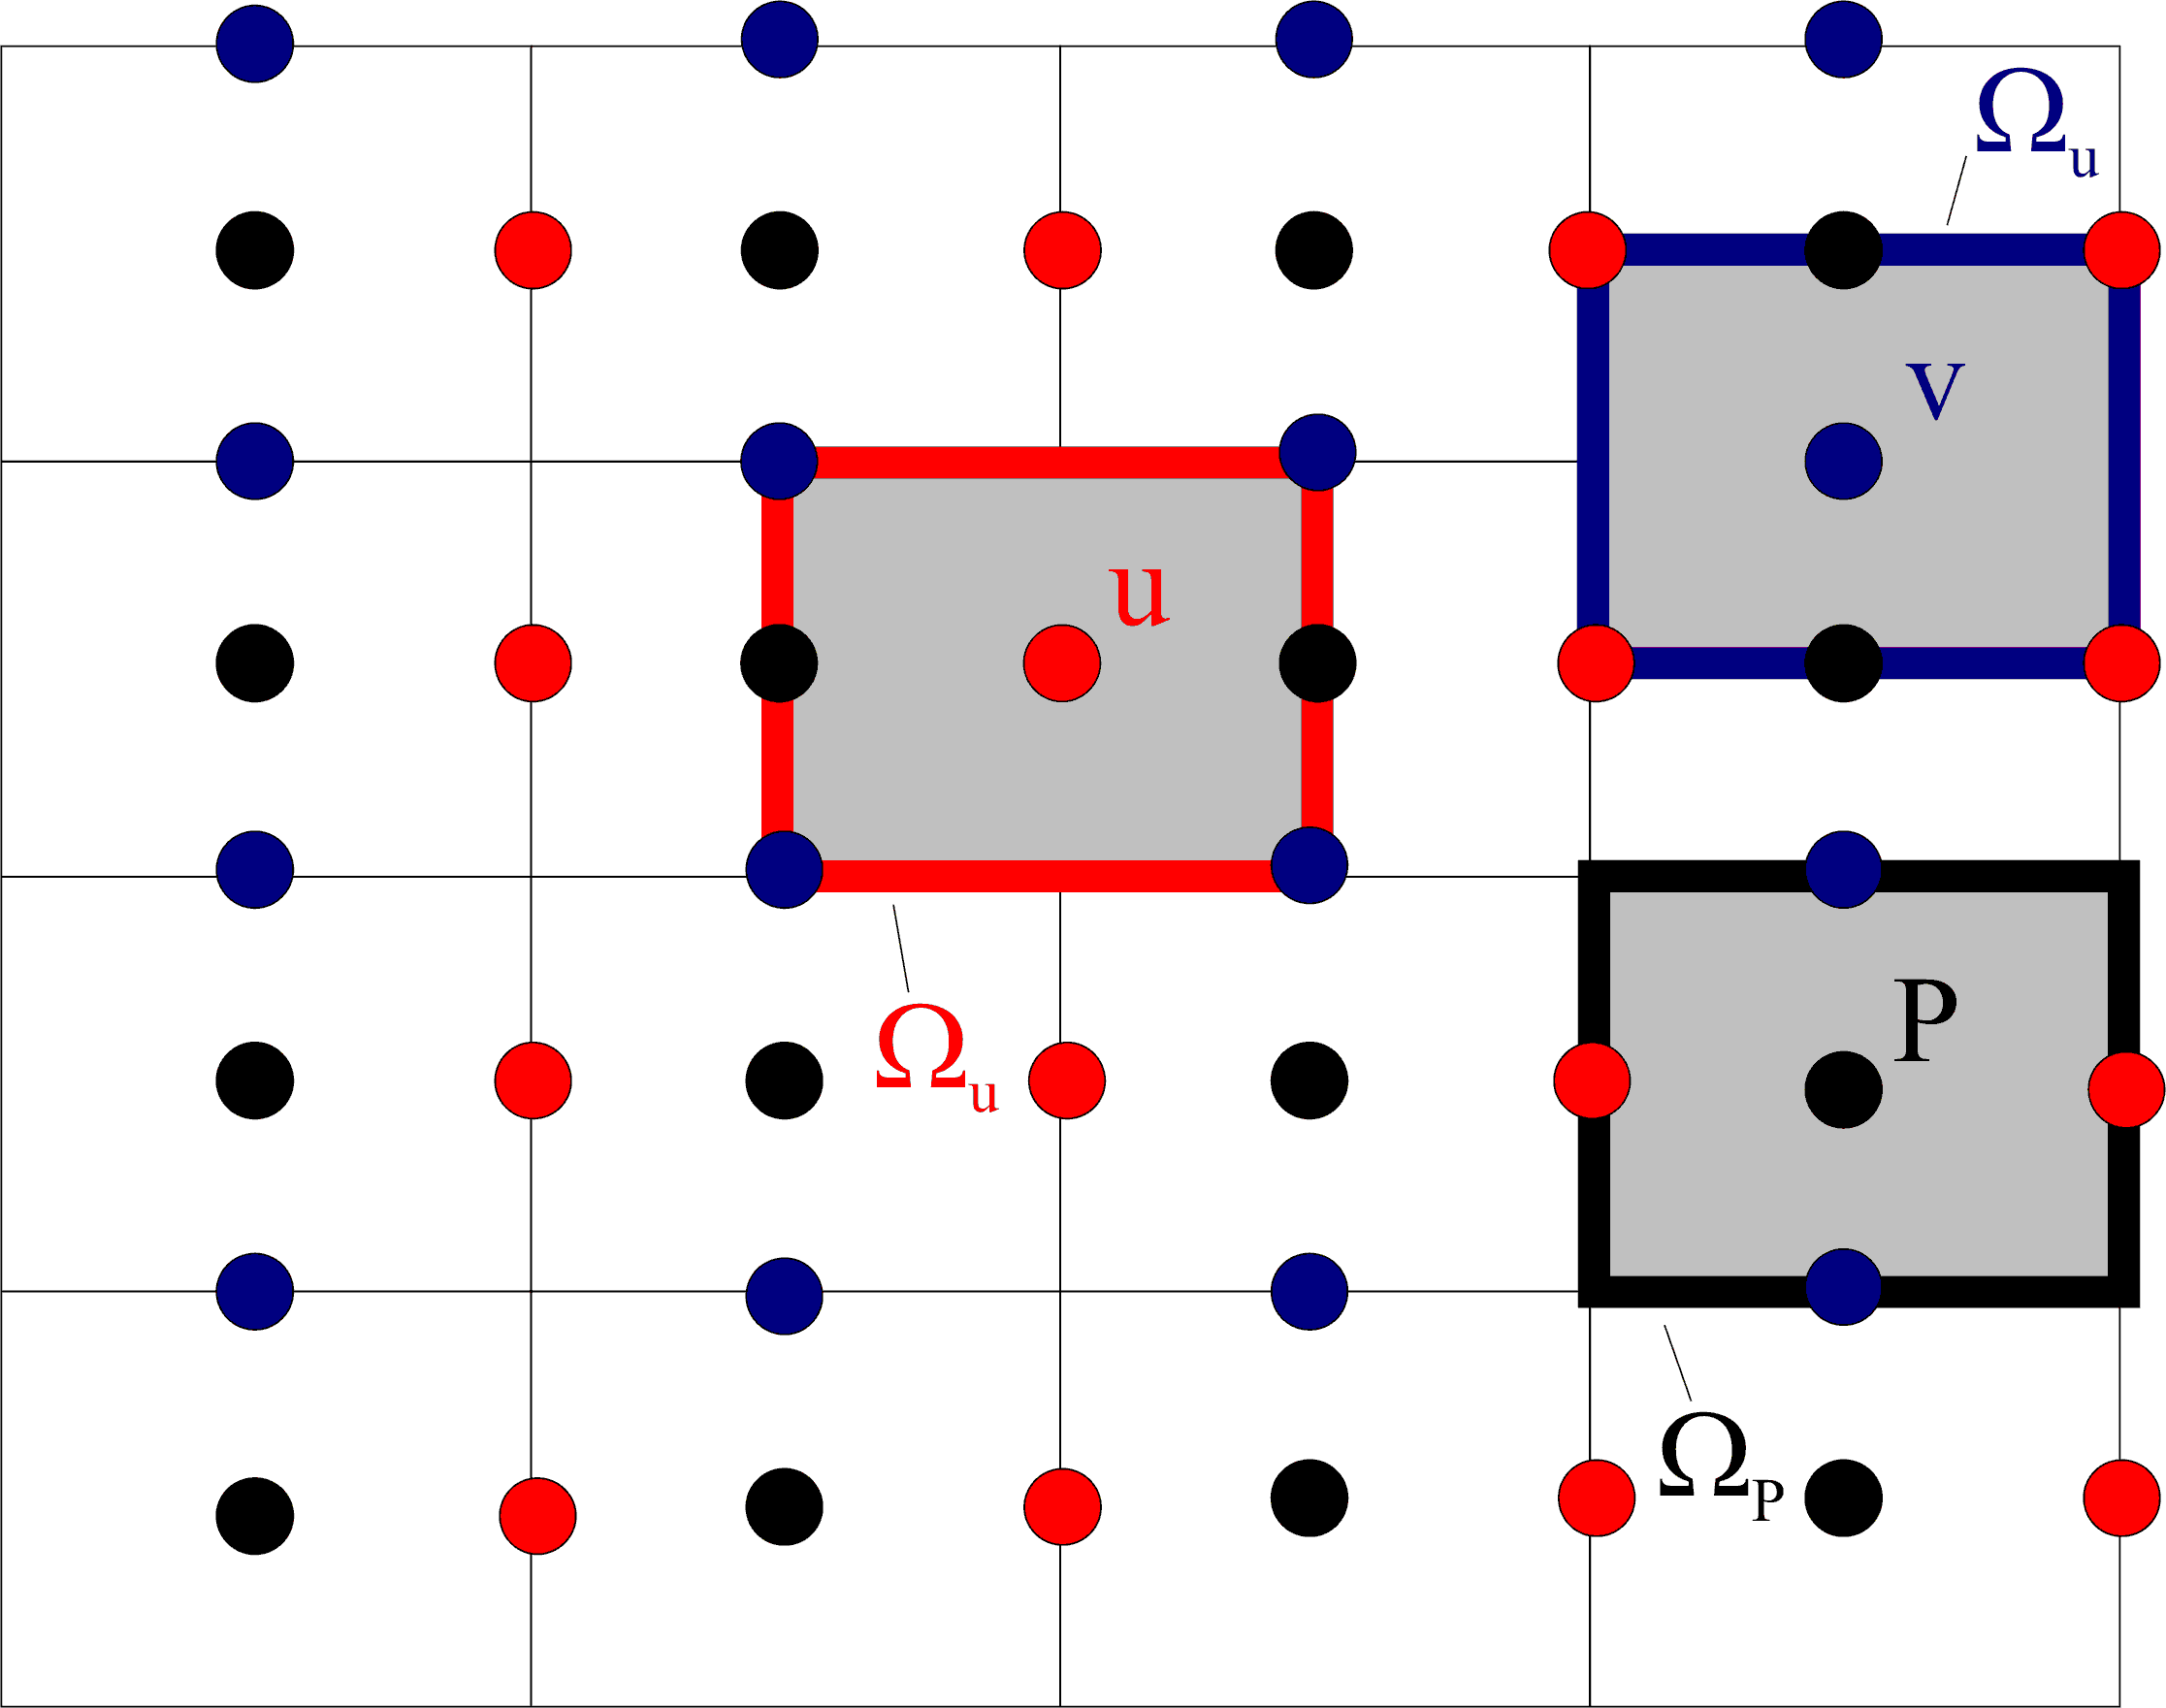
Coupling of pressure and velocity (4)
Staggered grid
Variables located at different nodes
Pressure at the centre, velocities at faces
Strong coupling between velocity and pressure, this helps to avoid oscillations
Finite Volume Method, JASS 04

Slide 36
Summary FVM
FVM uses integral form of conservation (transport) equation
Domain subdivided in control volumes (CV)
Surface and volume integrals approximated by numerical quadrature
Interpolation used to express variable values at CV faces in terms of nodal values
It results in an algebraic equation per CV
Suitable for any type of grid
Conservative by construction
Commercial codes: CFX, Fluent, Phoenics, Flow3D
Finite Volume Method, JASS 04

Slide 37
Turbulent flows
Most flows in practice are turbulent
With increasing Re, smaller eddies
Very fine grid necessary to describe all length scales
Even the largest supercomputer does not have (yet) enough speed and memory to simulate turbulent flows of high Re.
Computational methods for turbulent flows:
Direct Numerical Simulation (DNS)
Large Eddy Simulation (LES)
Reynolds-Averaged Navier-Stokes (RANS)
Finite Volume Method, JASS 04

Slide 38


Turbulent flows (2)
Direct Numerical Simulation (DNS)
Discretize Navier-Stokes eq on a sufficiently fine grid for resolving all motions occurring in turbulent flow
No uses any models
Equivalent to laboratory experiment
Relationship between length of smallest eddies and the length L of largest eddies,
Finite Volume Method, JASS 04

Slide 39

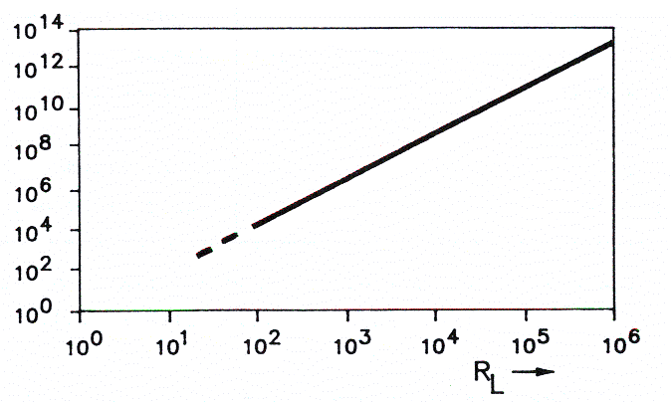
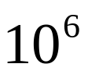
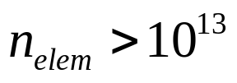
Turbulent flows (3)
Number of elements necessary to discretize the flow field
In industrial applications, Re >
Finite Volume Method, JASS 04

Slide 40

Turbulent flows (4)
Large Eddy Simulation (LES)
Only large eddies are computed
Small eddies are modelled, subgrid-scale (SGS) models
Reynolds-Averaged Navier-Stokes (RANS)
Variables decomposed in a mean part and a fluctuating part,
Navier-Stokes equations averaged over time
Turbulence models are necessary
Finite Volume Method, JASS 04

Slide 41

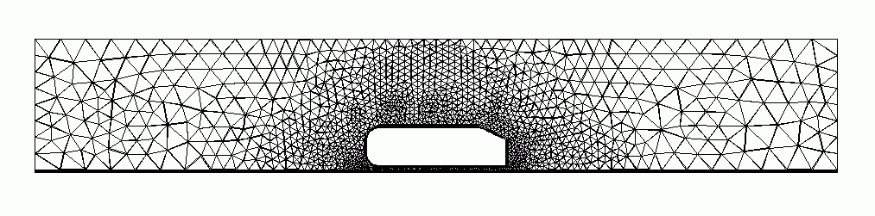
Example CFX
Finite Volume Method, JASS 04

Slide 42
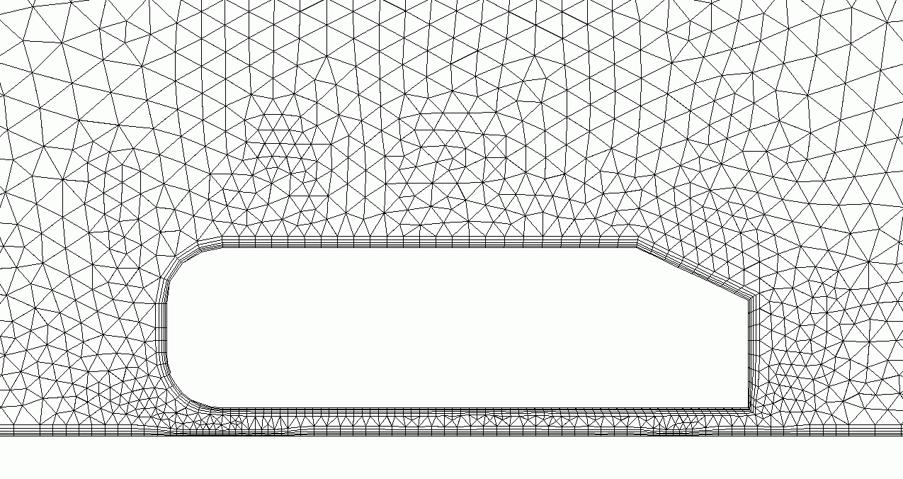
Example CFX, mesh
Finite Volume Method, JASS 04

Slide 43
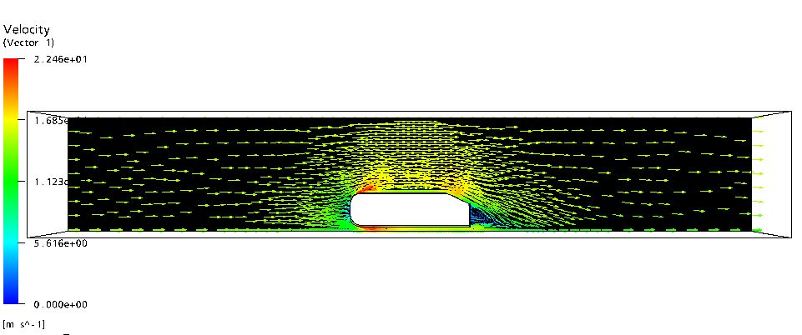
Example CFX, results
Finite Volume Method, JASS 04

Slide 44
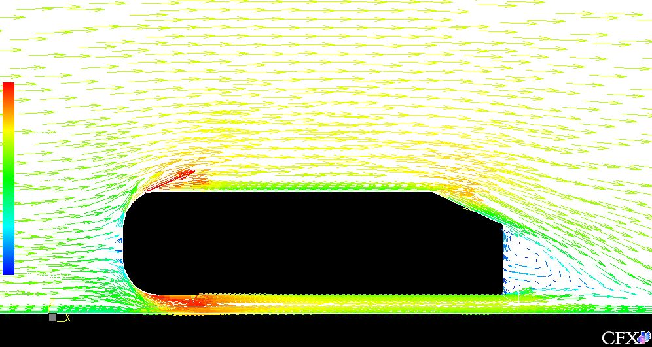
Example CFX, results(2)
Finite Volume Method, JASS 04

