Slide 1
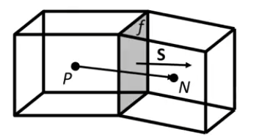


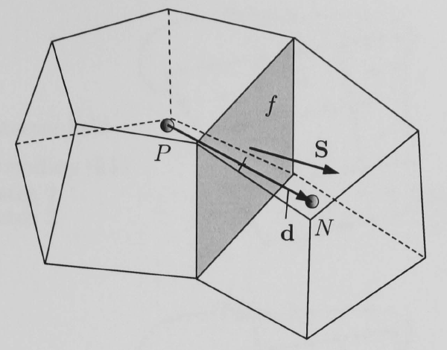

Finite Volume
Henrik Rusche 73-74

Slide 2



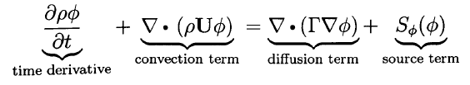

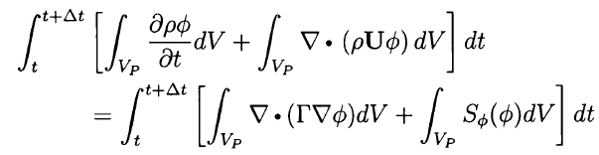
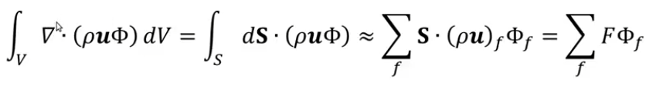
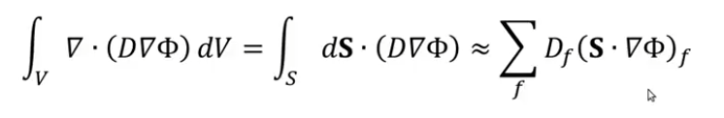
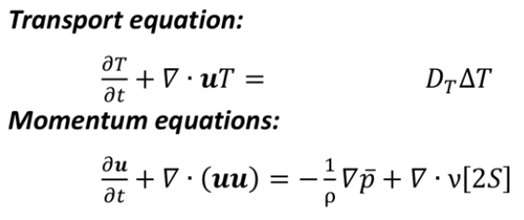







2.5
Schemes!
2.3
Notes on CFD
$$=$$
2.4
Convection
Diffusion
$$=$$
Volume
Volume
$$=$$
Surfaces
Surfaces
Cell Faces
Cell Faces
$$=$$
Tutorial Four p. 45
scalarTransportFoam
Solve (
fvm::ddt(rho, U)
+ fvm::div(phi, U)
- fvm::laplacian(nu, U)
==
- fvc::grad(p))
fvScalarMatrix TEqn (
fvm::ddt(T)
+ fvm::div(phi, T)
- fvm::laplacian(DT, T)
==
fvOptions(T) );
divSchemes {
default none;
// div(phi,T) Gauss upwind;
// div(phi,T) Gauss linear;
// div(phi,T) Gauss linearUpwind grad(T);
// div(phi,T) Gauss QUICK;
div(phi,T) Gauss cubic; }
fvSchemes
Henrik Rusche 73-74

Slide 3



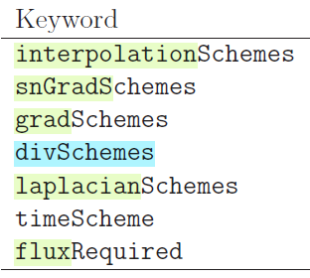
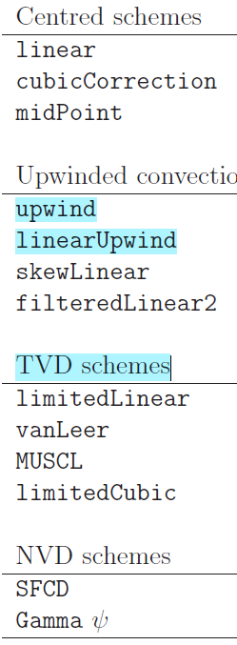
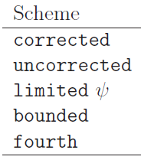
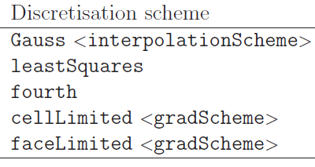
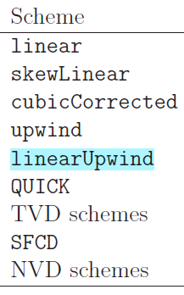
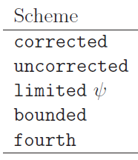
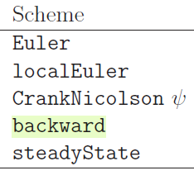
Conservação de massa
Qde de movimento
4.4 Numerical schemes
4.4.1 Interpolation schemes
4.4.2 Surface normal ∆ schemes
4.4.3 Gradient schemes
4.4.4 Laplacian schemes
4.4.5 Divergence schemes ____
4.4.6 Time schemes
4.4.7 Flux calculation
4.4.1.1 Schemes for strictly bounded scalar fields
4.4.1.2 Schemes for vector fields
shame
4.4 Numerical schemes
4.4.1.2 - Fields
4.4.2 snGradSchemes *
4.4.3 gradSchemes sub-dictionary *
115 controlDict (4.3)
118 fvSchemes (4.4)
125 fvSolution (4.5)
4.4.2
4.4.3
4.4.5
4.4.4
4.4.6
4.4.7
4.4.5 divSchemes sub-dictionary *
4.4.4 laplacianSchemes *
4.4.6 ddtSchemes *
interpolationSchemes DICT*
default linear;
default upwind phi;
default limitedLinear 1.0 phi;
4.4.1.1 - scalar
default limitedVanLeer -2.0 3.0;
default vanLeer01;
4.4.7 Flux calculation
UserGuide_Version 2.3.1

Slide 4
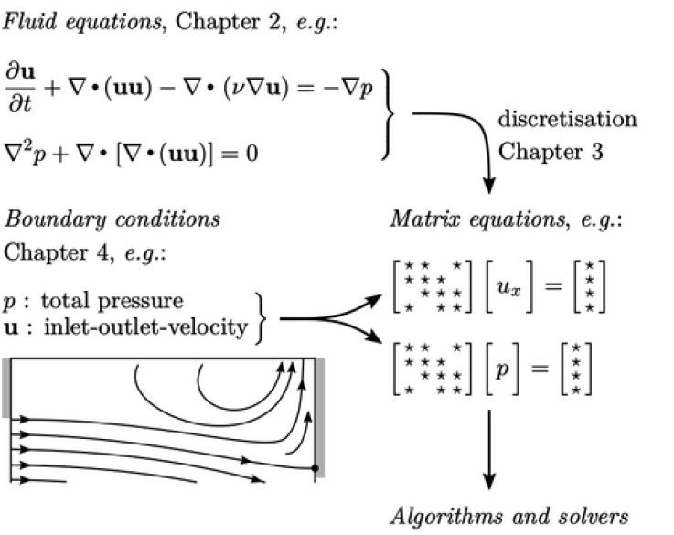
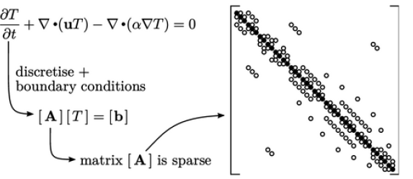
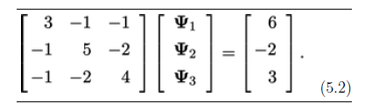
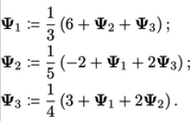
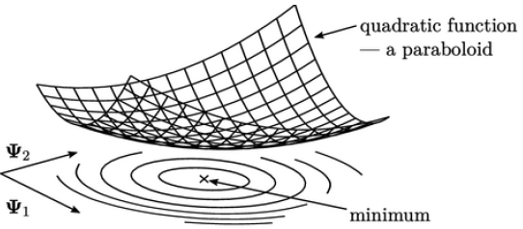
5.1 Structure of matrices
5.2 Gauss-Seidel method
5.3 Convergence
5.4 Residual
5.5 Diagonal dominance
5.6 Under-relaxation
5.7 Iterative solution
5.8 Accelerating convergence
5.9 Systems of equations (113)
5.10 Pressure-velocity coupling
103 Notes on CFD
5.14 Descent methods
5.15 Conjugate gradient method
5.16 Preconditioning and asymmetry
5.17 Multi-grid method
5.18 GAMG method
5.23 Summary of algorithms and solvers
131 Chapter 6 Introduction to Turbulence
Notes on CFD

Slide 5
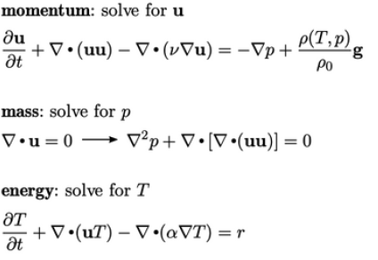
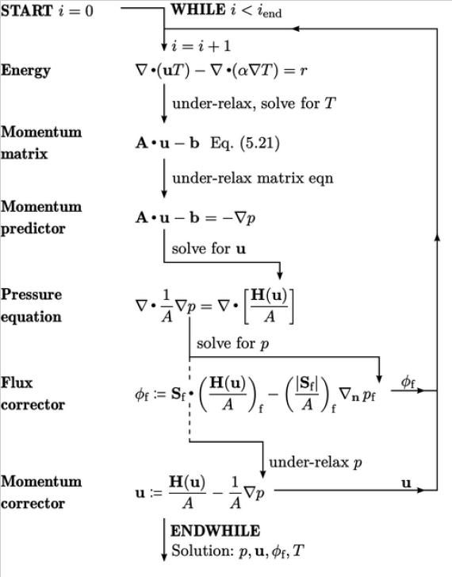
118
Notes on CFD

Slide 6







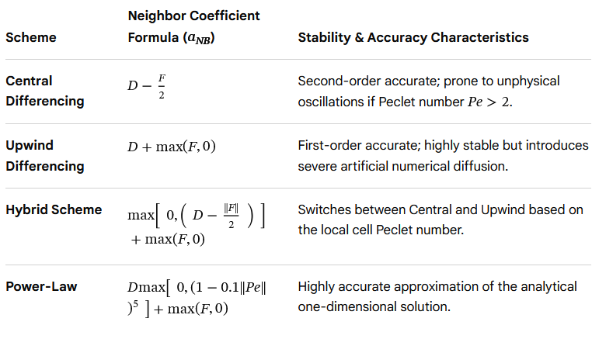





2.5
2.3
2.24
2.12
2.11 Discretization of time derivative
2.13
2.24
you looking to implement this discretization into a specific coding language ?
Implicit
2.28
Explicit
2.29
Discretized Standard transport equation
2.30 (p88) 83
Under-Relaxation
you need to apply a particular differencing scheme (like QUICK or Second-Order Upwind) ?

Slide 7
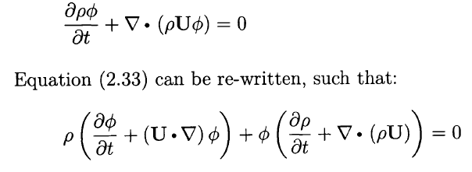
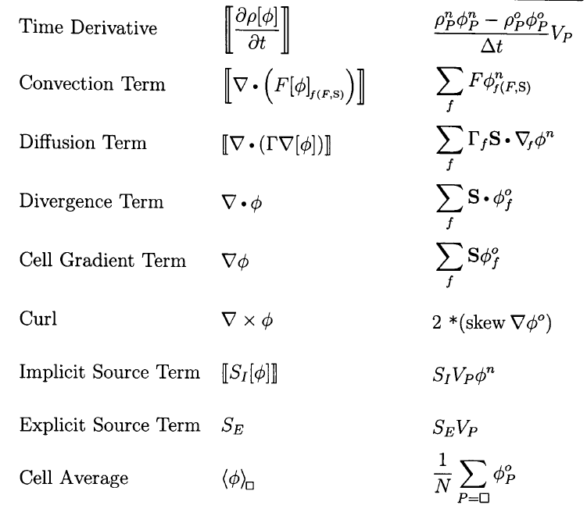

2.3
2.12
Finite Volume Notation
2.3

