Slide 1


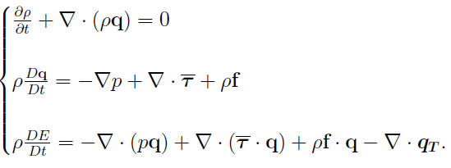




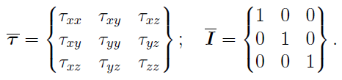

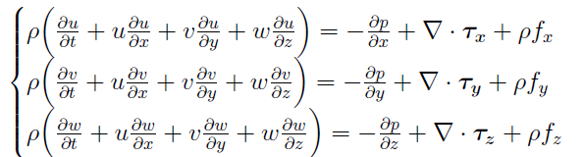
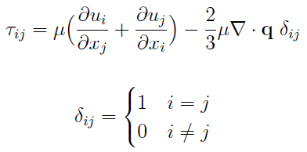


Conservation of mass
Momentum
Energy
Salvatore MANGANARO

Slide 2








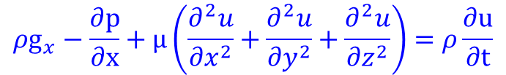



$$∇.V=0$$
Continuidade
Momento
Energia
$ρ\frac{∂V}{∂t}=$ $ρg−∇p+μ{ ∇}^{2}V$
$$ρC_{V}\frac{∂T}{∂t}=K{ ∇}^{2}T+Φ$$
$$\frac{∂q_{x}}{∂x}+\frac{∂q_{y}}{∂y}+\frac{∂q_{z}}{∂z}=0$$
-$q_{ij}=$ - $K_{ji}\frac{∂h}{∂ij}$
$$ρg_{x}−\frac{∂p}{∂x}+\frac{∂τ_{xx}}{∂x}+\frac{∂τ_{yx}}{∂y}+\frac{∂τ_{zx}}{∂z}=ρ \left(\frac{∂u}{∂t}+u\frac{∂u}{∂x}+v\frac{∂u}{∂y}+w\frac{∂u}{∂z}\right)$$
$$K_{x}\frac{∂^{2}h}{{∂x}^{2}}+K_{y}\frac{∂^{2}h}{{∂y}^{2}}+K_{z}\frac{∂^{2}h}{{∂z}^{2}}=0$$
$$K_{i}∇^{2}$$
$$∇=i\frac{∂}{∂x}+j\frac{∂}{∂y}+k\frac{∂}{∂z}$$
$$∇ V=u\frac{∂}{∂x}+v\frac{∂}{∂y}+w\frac{∂}{∂z}$$
$$∇ V=∇\left(∇φ\right)=0$$
$${ρg}_{x}−\frac{∂p}{∂x}+μ\left(\frac{∂^{2}u}{{∂x}^{2}}+\frac{∂^{2}u}{{∂y}^{2}}+\frac{∂^{2}u}{{∂z}^{2}}\right)=ρ\frac{∂u}{∂t}$$
$$∇^{2}φ=\frac{∂^{2}φ}{{∂x}^{2}}+\frac{∂^{2}φ}{{∂y}^{2}}+\frac{∂^{2}φ}{{∂z}^{2}}=0$$
MODFLOW
FiPy
CFD
Frank M. White

