Slide 1
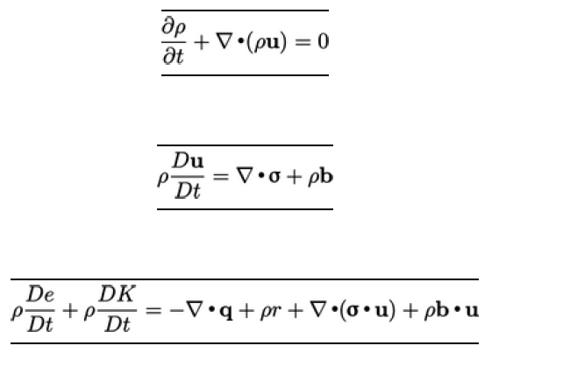




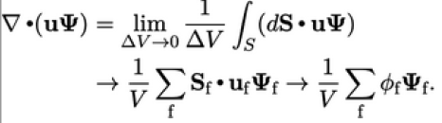
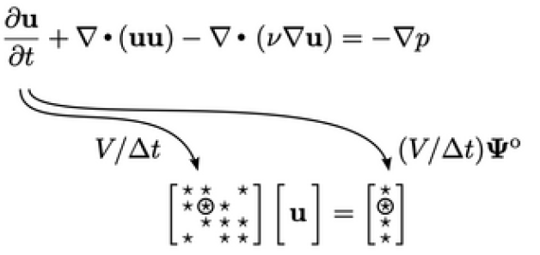


Mass 2.4
Momentum 2.7
Energy 2.15 Sec
3.8
Advection term
MF6-ADJ:
77

