Slide 1
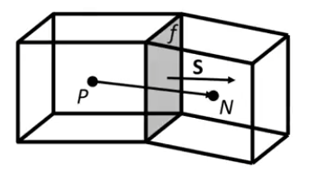


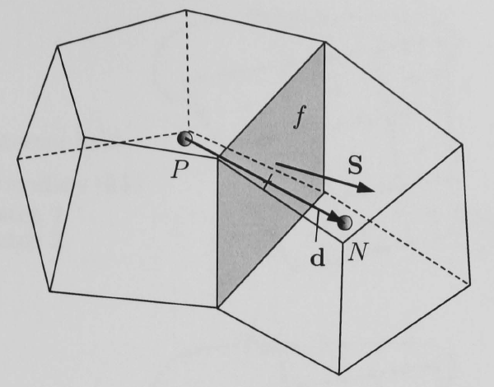

Finite Volume
4.4.1 Interpolation schemes
4.4.2 Surface normal ∆ schemes
4.4.3 Gradient schemes
4.4.4 Laplacian schemes
4.4.5 Divergence schemes ____
4.4.6 Time schemes
4.4.7 Flux calculation
4.4.1.1 Schemes for strictly bounded scalar fields
4.4.1.2 Schemes for vector fields

Slide 2



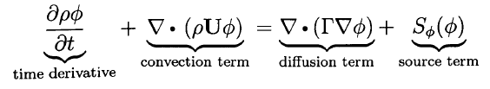

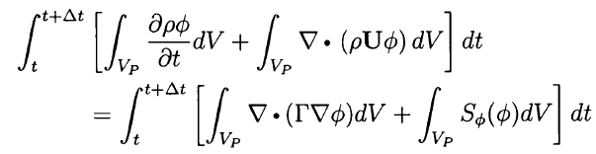
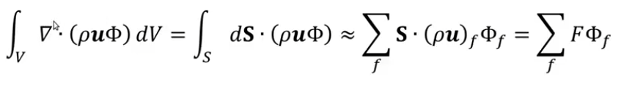
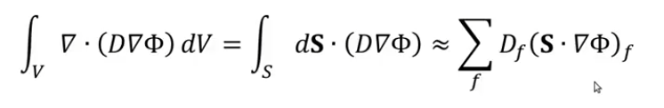







2.5
Schemes!
2.3
Notes on CFD
$$=$$
2.4
Convection
Diffusion
$$=$$
Volume
Volume
$$=$$
Surfaces
Surfaces
Cell Faces
Cell Faces
$$=$$
Tutorial Four p. 45
scalarTransportFoam
Solve (
fvm::ddt(rho, U)
+ fvm::div(phi, U)
- fvm::laplacian(nu, U)
==
- fvc::grad(p))
fvScalarMatrix TEqn (
fvm::ddt(T)
+ fvm::div(phi, T)
- fvm::laplacian(DT, T)
==
fvOptions(T) );
divSchemes {
default none;
// div(phi,T) Gauss upwind;
// div(phi,T) Gauss linear;
// div(phi,T) Gauss linearUpwind grad(T);
// div(phi,T) Gauss QUICK;
div(phi,T) Gauss cubic; }
fvSchemes

Slide 3



Conservação de massa
Qde de movimento

