Slide 1

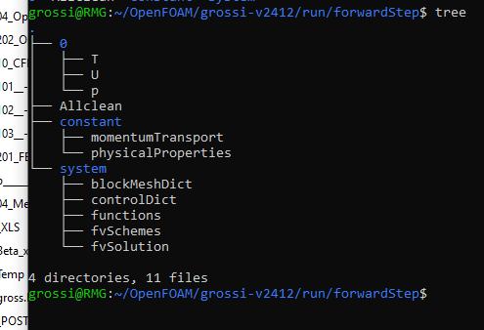
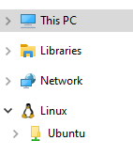
==========
\ \ / F ield
\ \ / O peration
\ \ / A nd
\ \ / M anipulation
Open
Field Operation And Manipulation

