Slide 1
MI-Garage CPD
JB + ASM

Slide 2
Topics Covered
What is Deep Learning
Data manipulation
Multi-Layer Perceptron
Convolutional Neural Networks
Recurrent Neural Networks
QA Session

Slide 3
What is deep learning?
Deep learning is part of a broader group of machine learning algorithms based on learning data representations.
Learning can be supervised or unsupervised.
Deep learning is based on ‘biological’ structures and uses multiple layers to derive information from the input.

Slide 4
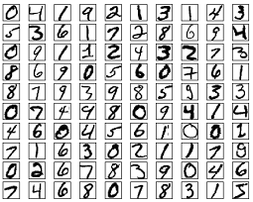
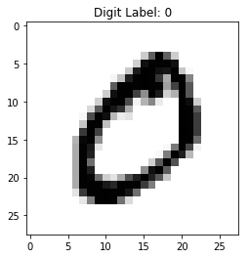
MNIST Dataset
Notes:
- For all the examples today we will be using the MNIST hand written digits dataset.
- This data consists of 60000 samples, each of which is pre-processed to be a 784 element 1D vector, representing a 28*28 grey-scale image.

Slide 5
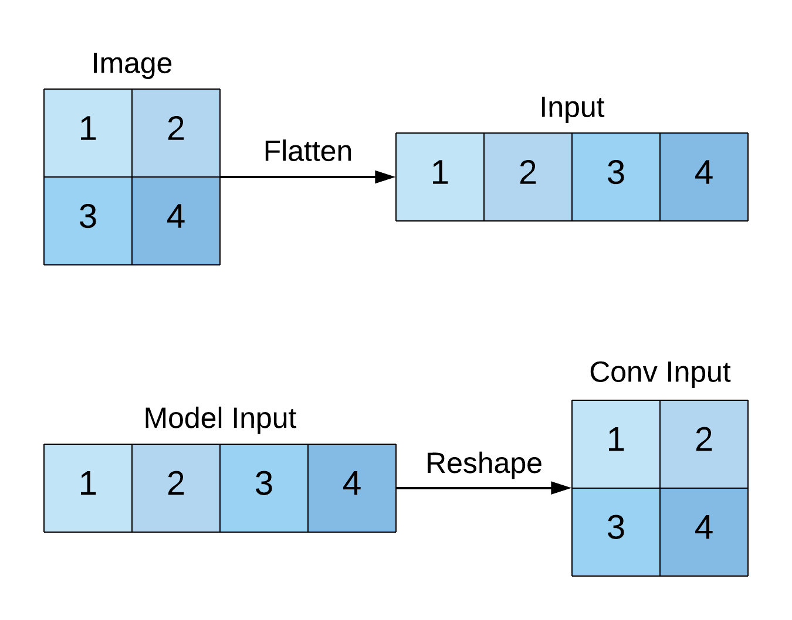
Data Manipulation
Notes:
For MNIST digits data default
Original Data Shape
Modified Data Shape
We do this because most types of NN take input as a 1D vector.

Slide 6
What about non-numerical data?
Words -> word2vec, doc2vec, …
Graphs -> node2vec, ReFeX, …
Etc.. -> …
Notes:
For any type of non-numerical data we must create a vector representations called embeddings.
The function of an embedding is to capture the ‘essence’ of a given data point and produce an N-dimensional feature vector that is representative of the given data

Slide 7


Prepare your devices
Download zip from:
https://goo.gl/UYJ4di
Navigate to:
https://colab.research.google.com
Sign in with your Google account.
Select File -> Upload Notebook...
Drag and drop or browse to select the notebook you want.

Slide 8
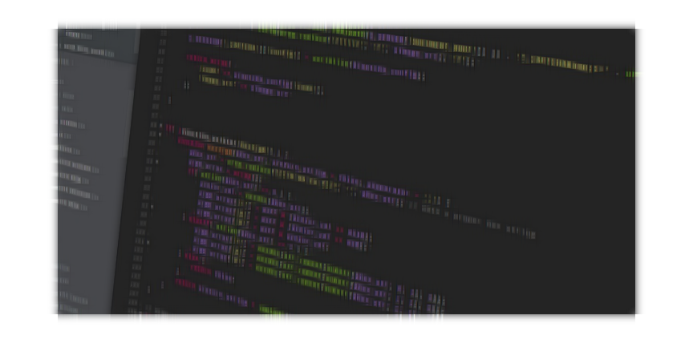
Let’s look at some data manipulation code…

Slide 9
MLP
MLP – Multi-Layer Perceptron
It’s ‘multi-layer’ because there is more than one hidden layer
Feed-forward network with back-propagation.
Supervised Learning

Slide 10
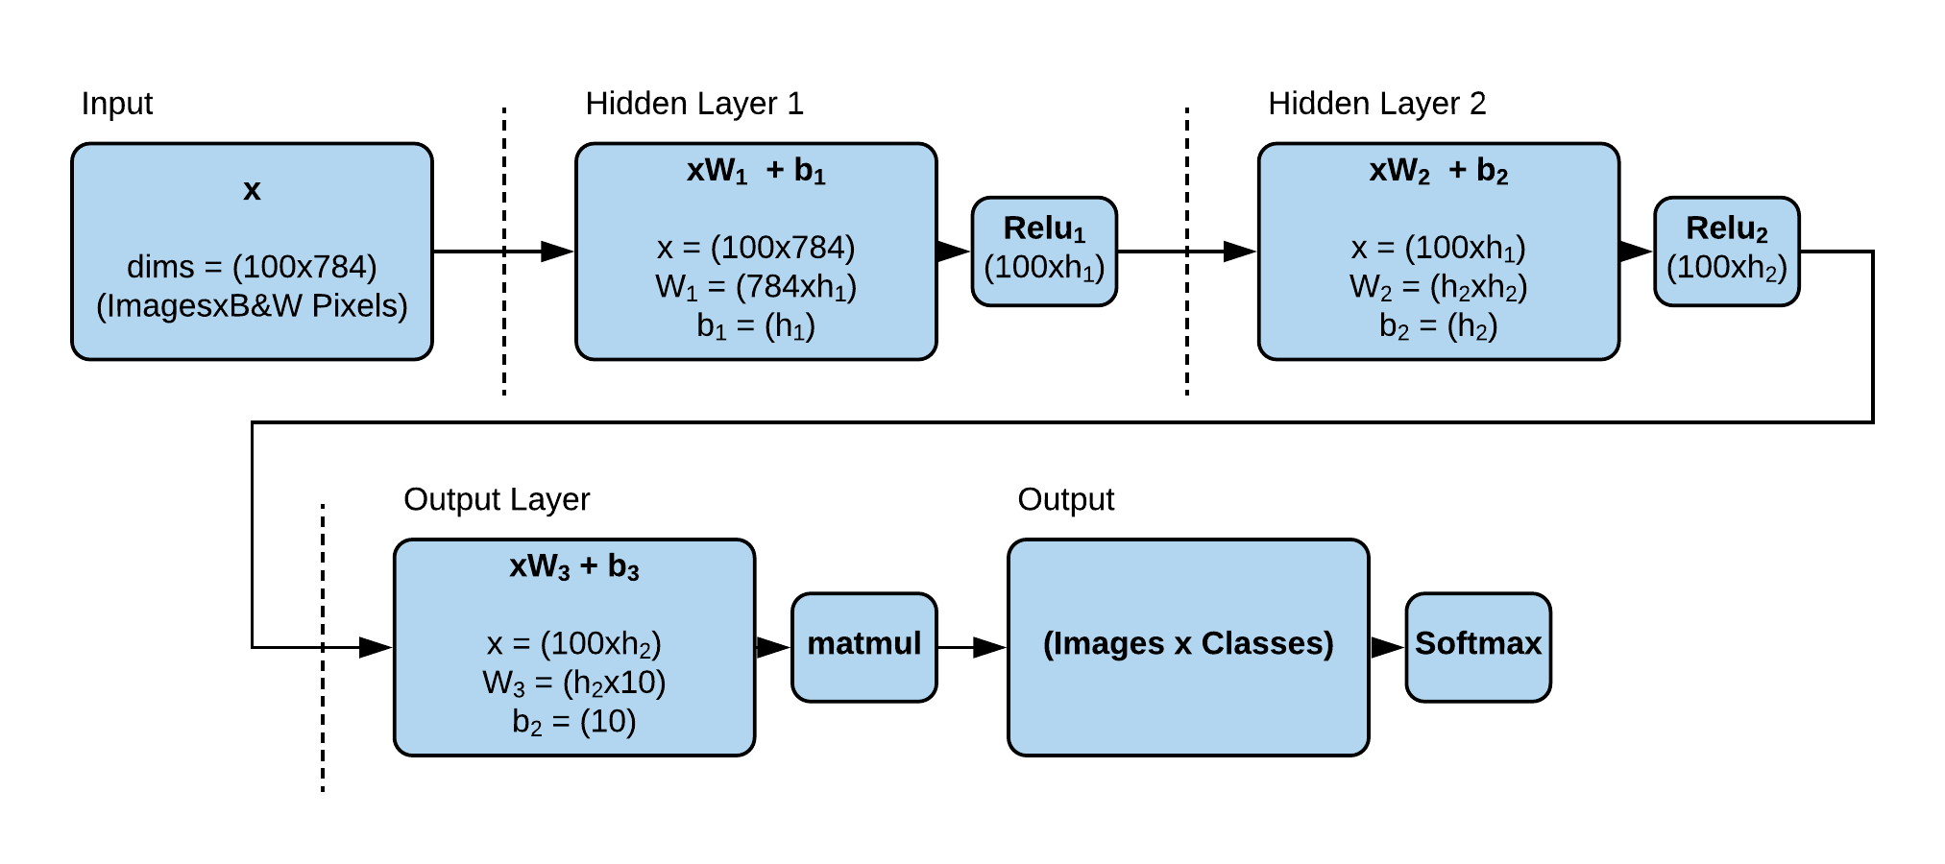
MLP - Overview
Notes:
Assuming a batch of 100 training examples, with 10 classes
Input passes through each layer and activation
Activation just means output. The linear activation in the last layer of this model means just return the output without doing to it
- How do you choose the number of features extracted from each layer ( n_hidden_1 and n_hidden_2)?
An empirically-derived rule of thumb is: the optimal size of the hidden layer is usually between the size of the input and size of the output layers, i.e. we could choose the number of extracted features (often called as neurons) in the layer to equal the mean of the number of features in the input and output layers.

Slide 11
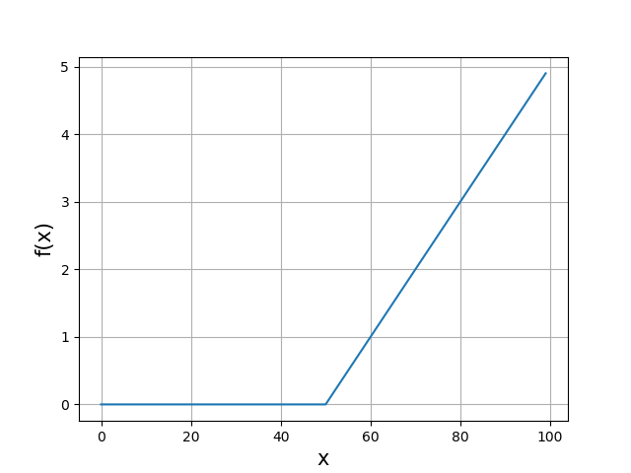
What is ReLU activation?
ReLU is non-linear.
Notes:
- The important thing to note is that it’s non-linear (as opposed to the xW+b part, which is linear.)
Why do we need to add non-linearities? Because if not, the entire network could collapse to one layer.
So the output returned is just n_classes numbers, one for each class. In the case of MNIST, that’s 10 numbers because there are 10 possible outcomes (images are digits ranging from 0 to 9).

Slide 12
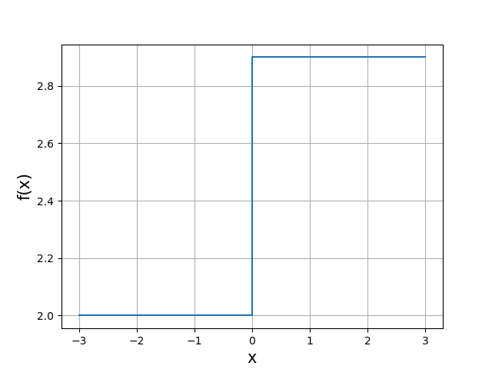
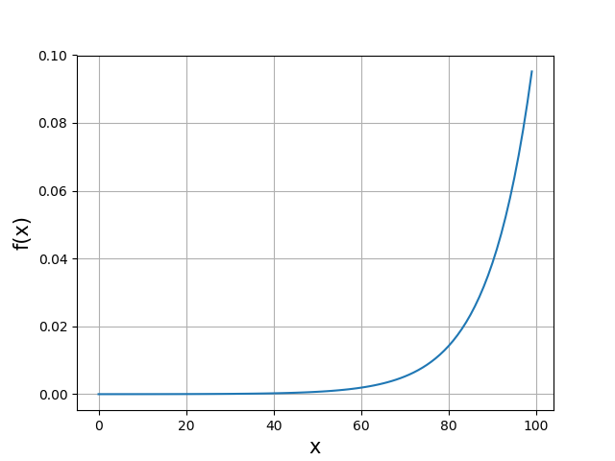
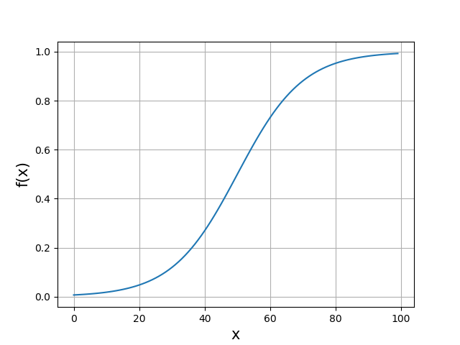
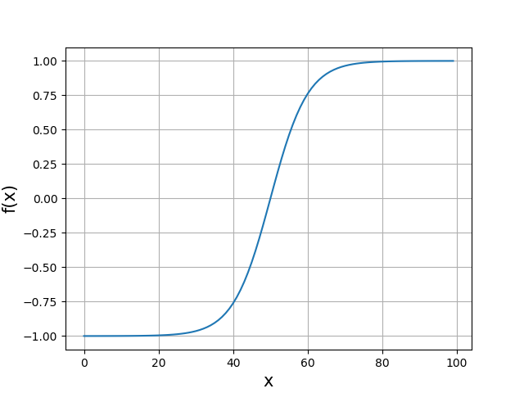
Other Activation Functions
Binary Step
Softmax
Sigmoid
Tanh
Notes:
A binary step function is generally used in aPerceptron linear classifier. It thresholds the input values to 1 and 0, if they are greater or less than zero, respectively.
This activation function is useful when the input pattern can only belong to one of two groups i.e. binary classification.
The softmax function’s output tells us the probabilities that any of the classes are true, so it produces values in the range (0,1). It highlights the largest values and tries to suppress values which are below the maximum value, its resulting values always sum to 1.
This function is widely used in multiple classification logistic regression models.
The sigmoid activation function maps the input values in the range (0,1) ,which is essentially their probability of belonging to a class.
It is mostly used for multi-class classification.
However, the output it produces is not zero-centered, which causes difficulties during optimization. It also has a low convergence rate.
The tanh non-linearity compresses the input in the range (−1,1)
It provides an output which is zero-centered. So, large negative values are mapped to negative outputs, similarly, zero-valued inputs are mapped to near zero outputs.
The gradients for tanh are steeper than sigmoid, tanh is commonly referred to as the scaled version of sigmoid.

Slide 13
MLP Usage
MLPs are suitable for classification or regression prediction problems where inputs are assigned a class or label.
Ideal use cases include:
Un-supervised learning, e.g. word2vec and auto-encoders
Classification
Regression prediction
Possible additional data types:
Image data
Text Data
Time series data
Other types of data

Slide 14
Let’s look at some MLP code…

Slide 15
CNN
CNN – Convolutional Neural Network
A CNN is similar to a MLP in that they are both constructed of neurons that have learnable weights and biases.
CNNs optimise the network by minimising the feed-forward features through convolution.
Notes:
weights shift gradient
bias shifts entire curve

Slide 16
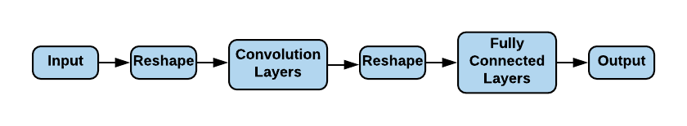
CNN - Workflow
Notes:
Here we have the model the function conv_net represents.

Slide 17
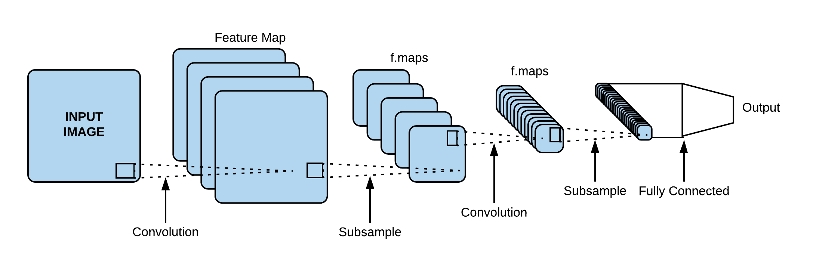
CNN - Overview

Slide 18
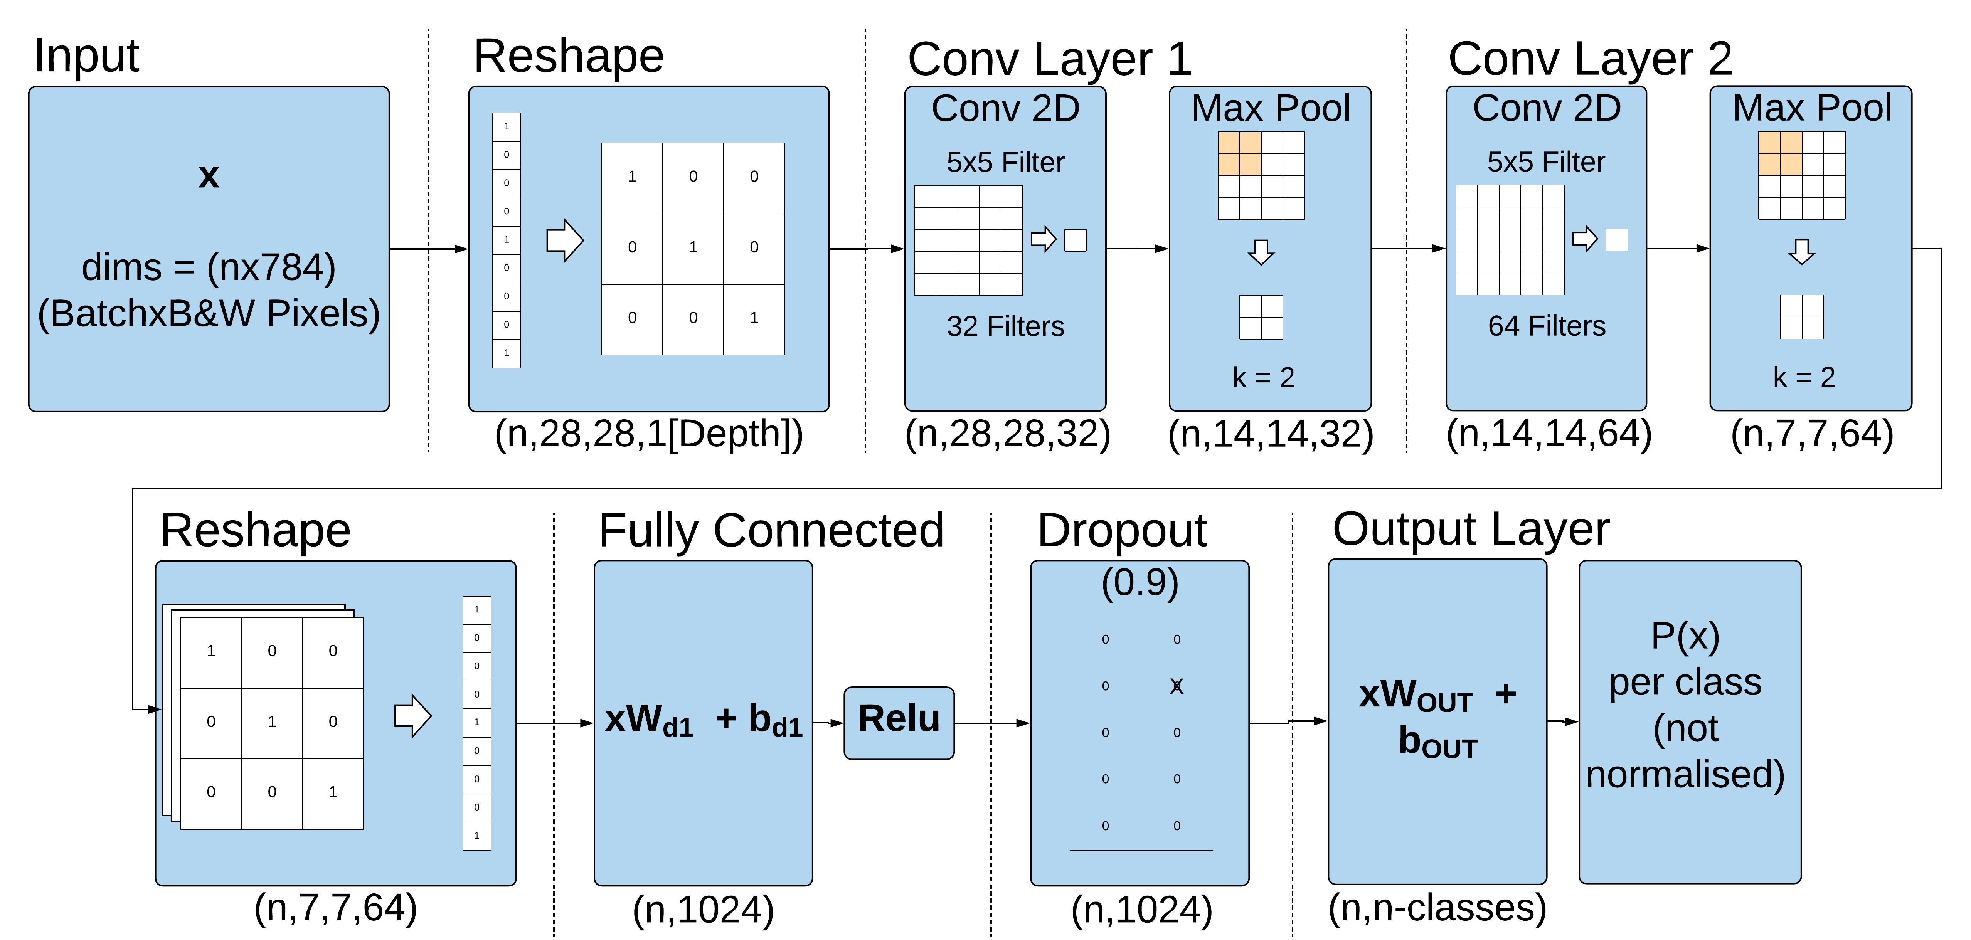
CNN - Details
Notes:
We can see that there are fives types of layers here:
layers for reshaping input
convolution layers
max pooling layers
fully-connected layers
dropout layers.
In our example the batch size given is 128. That means that each time, at most 128 images are fed into our model.

Slide 19
Reshaping Layers
Notes:
- We reshape input twice in this model. The first time is at the beginning:
- That is, each sample input was one-dimensional array: an image flattened into a list of pixels. That is, the default MINST data loader does this.
- The second time we reshape input is right after the convolutional layer before the first fully connected layer:
- We’re doing this again to prepare 1D input for the fully connected layer:

Slide 20
What is a convolutional layer?
© Fletcher Bach 2016
Notes:
A convolution layer tries to extract higher-level features by replacing data for each (one) pixel with a value computed from the pixels covered by the e.g. 5×5 filter centered on that pixel.
We slide the filter across the width and height of the input and compute the dot products between the entries of the filter and input at each position.
This function comprises three parts:
Conv2D layer from Tensorflow
tf.nn.conv2d()
This is a replacement of xW (multiplying input by weights) present in a fully connected layer.
Add bias
ReLU activation
This transforms the output like so: ReLU(x) = max(0,x)
It is structurally the same as a fully connected layer, except we multiply the input with weights in a different way.

Slide 21
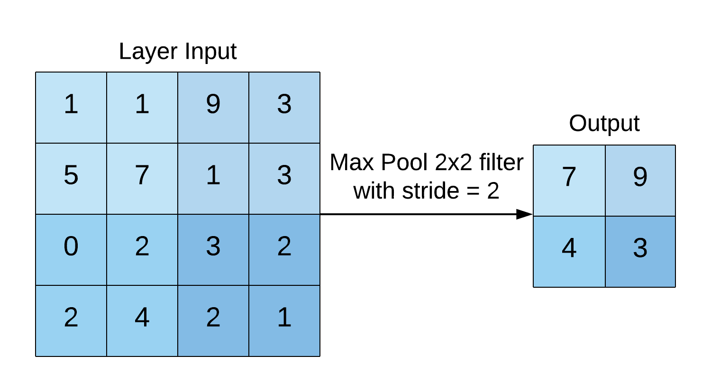
What is the Max Pool layer?
Notes:
Pooling layers reduce the spatial size of the output by replacing values by a function of those values.
For example in max pooling, you take the maximum out of every pool (filter size) as the new value.

Slide 22
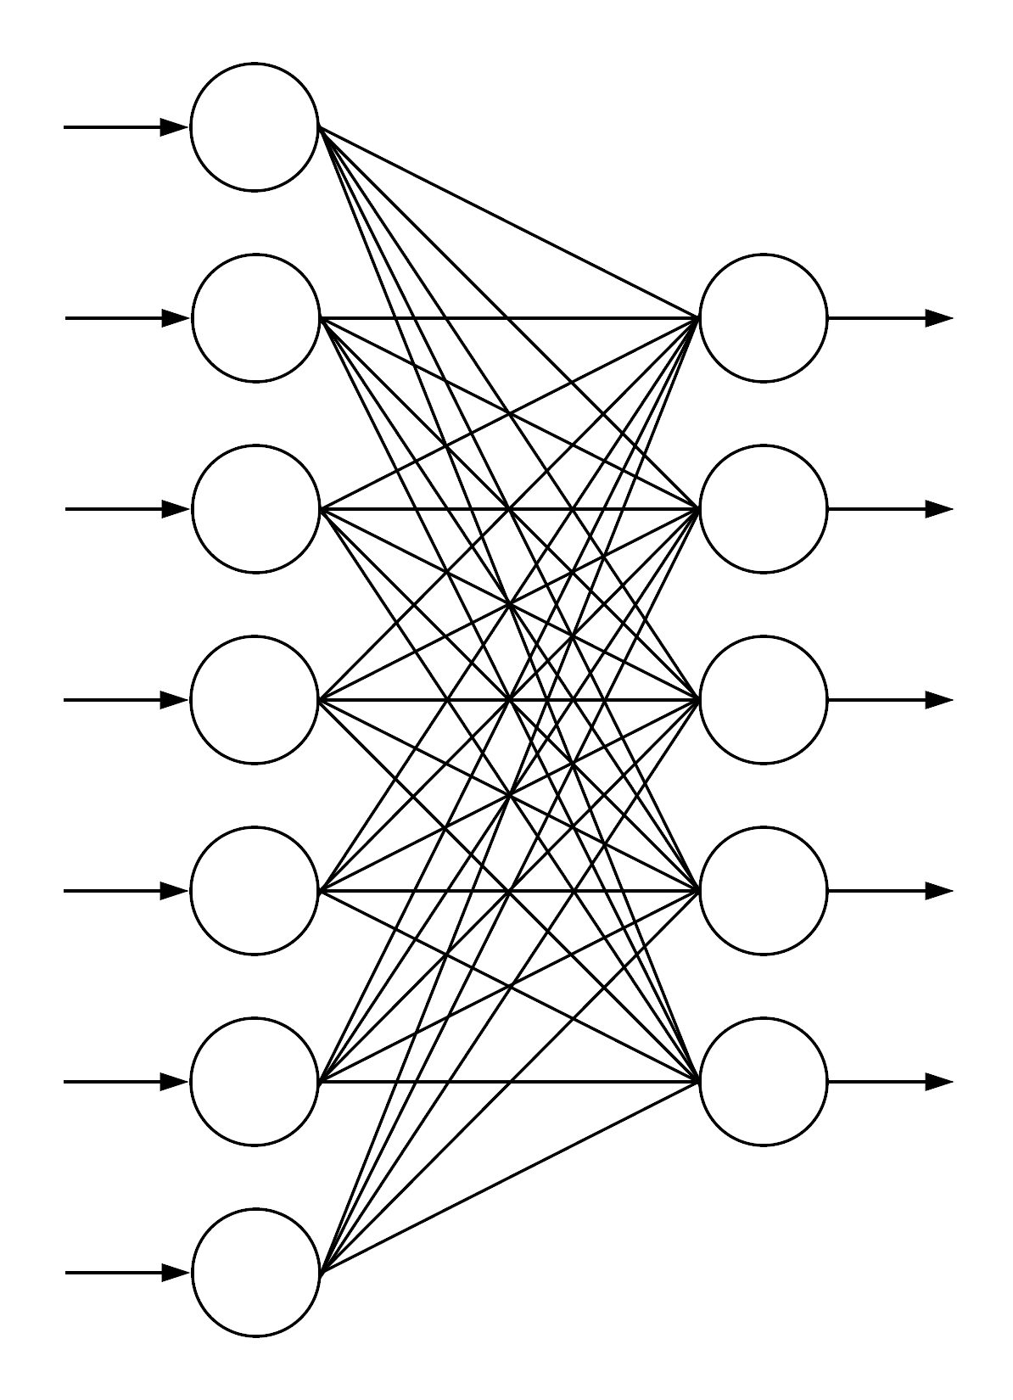
Fully Connected Layers
Notes:
- In fully connected layers each neuron is connected to every neuron in the next layer.

Slide 23
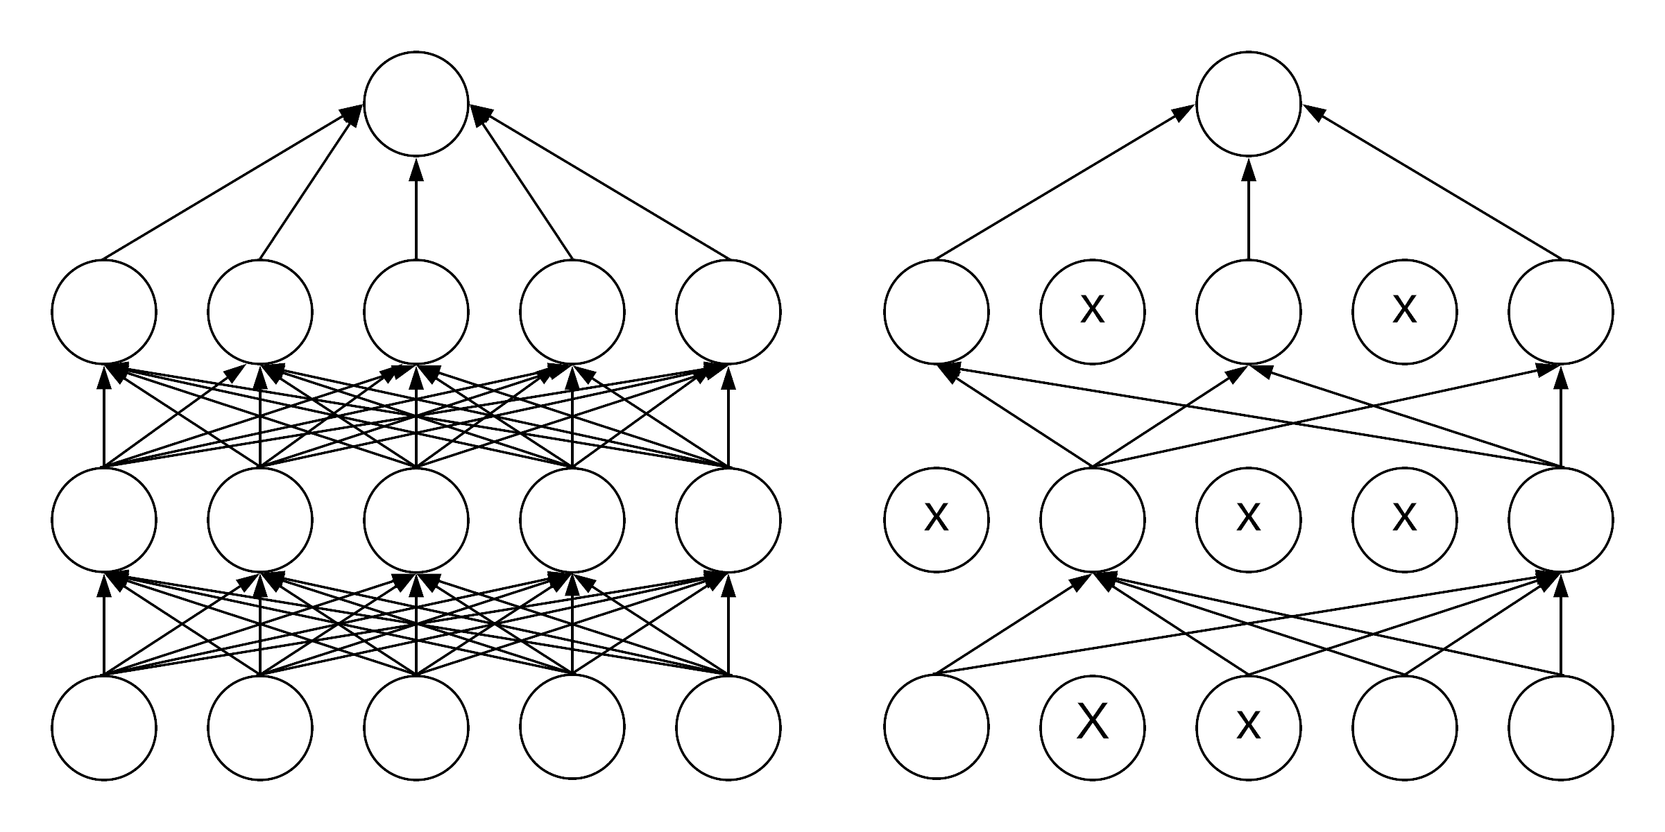
Dropout
Notes:
- To minimise over fitting we use dropout.
In dropout, at each training iteration, you drop random neurons from the network. You choose a probability for a neuron to be kept, usually between 50% and 75%, and then at each iteration of the training loop, you randomly remove neurons with all their weights and biases.
Different neurons will be dropped at each iteration (and you also need to boost the output of the remaining neurons in proportion to make sure activations on the next layer do not shift). When testing the performance of your network of course you put all the neurons back.

Slide 24
CNN Usage
CNNs were originally designed to map image data to an output variable. CNNs are the default method prediction problems involving image data.
Ideal use cases include:
Image data
Classification prediction problems
Regression prediction problems
Possible additional data types:
Text data
Time series data
Sequence input data

Slide 25
Let’s look at some CNN code…

Slide 26
RNN
RNN – Recurrent Neural Network
Feed-forward network
RNNs use a hidden layer as memory store to learn sequences and ‘remember’ previous examples.

Slide 27
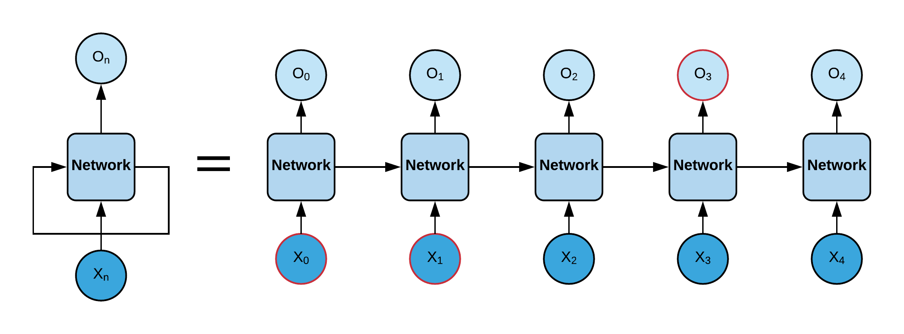
RNN
Notes:
We don’t start our thinking from scratch every second, thoughts have persistence.
This is something traditional neural networks can’t do
RNNs address this issue. RNNs have loops in them, allowing information to persist.
An RNN can be considered as many copies of a given network, each passing a message to the next.
RNNs can learn to use information from the past to predict the current output.

Slide 28
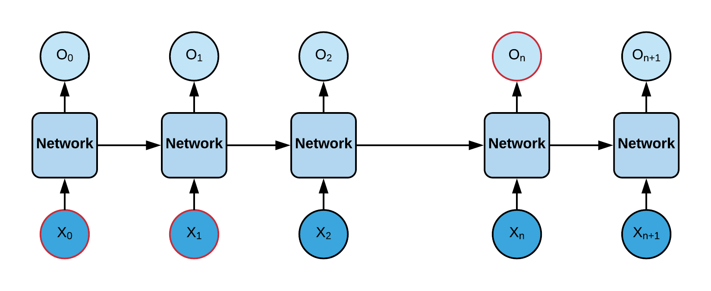
Long-Term Dependencies Issue
Notes:
- Often, we only need to look at recent information to perform the current task.
- However, it is possible for the space between the previous relevant information and the point currently being evaluated to become very large.
- As that distance becomes larger, RNNs start to struggle to learn to connect the information.

Slide 29
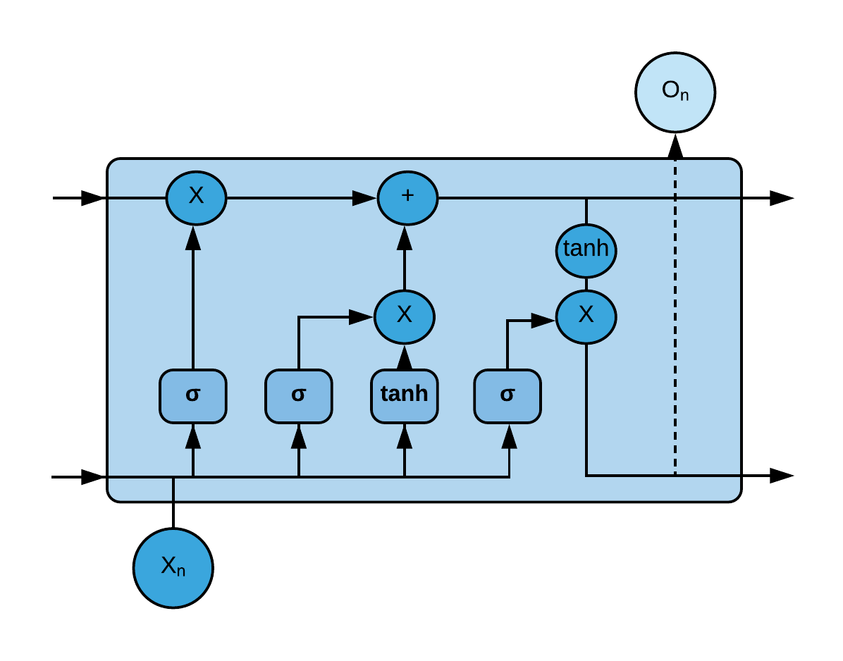
LSTM Layer
Notes:
- LSTMs are a special class of RNN that are capable of learning long-term dependencies.
- Remembering information for long periods of time is not something they struggle to learn.
Like RNNs LSTMs have a recurring structure. However, instead of having a single neural layer, like an RNN, there are four layers.
Here 3 of those layers are sigmoid.
A sigmoid layer outputs numbers between zero and one, describing how much of each component should be let through. A value of zero means “let nothing through,” while a value of one means “let everything through!”
The other layer is a tanh
Like the sigmoid, the tanh function is also sigmoidal (“s”-shaped), but instead outputs values that range (-1, 1)
tanh hasstronger gradients: since data is centered around 0, the derivatives are higher which helps to minimise bias in the gradients
- These layers interact to allow information to persist.

Slide 30
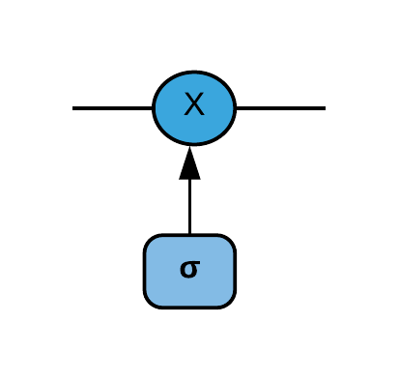
LSTM - Gates
LSTM has the ability to add or remove information to the cell state by using gates.
Each gate is composed out of a sigmoid NN layer and a point-wise multiplication operation.

Slide 31
LSTM - Gates
Sigmoid layer output = [0..1]
This represents the amount of each component to let through.
Zero means nothing passes the gate.
One means all information passes the gate.

Slide 32
RNN Usage
RNNs were designed to work with sequence to sequence prediction problems. Such as One-to-Many, Many-to-One and Many-to-Many.
Ideal use cases include:
Time series data
Sequence input data
Audio data
Generative models
Possible additional data types:
Text data
Classification prediction problems
Regression prediction problems

Slide 33
Let’s look at some RNN code…

Slide 34
Other problems / Questions

