Slide 1
Student Management System
Project Presentation
Name:
2210213601 ROSTEL EBELE GENI NDOUDI
2210213528 BENICHA DIVINE MANTSANGA MOUNTSO
2310213519 Andy Aury GIRITEKA

Slide 2
Introduction
The Student Management System is a desktop application developed to efficiently manage student information in an organized and secure manner. The system allows administrators to add, update, delete, and search student records through a user-friendly interface.

Slide 3
Project Architecture
( windows form part )
. Login system
. Main form
. Student form
. Course form
.Score form
.Exit

Slide 4
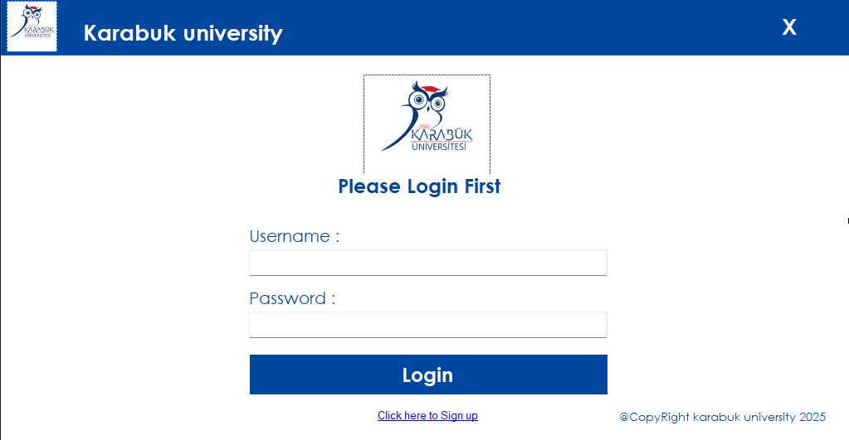
Login form

Slide 5
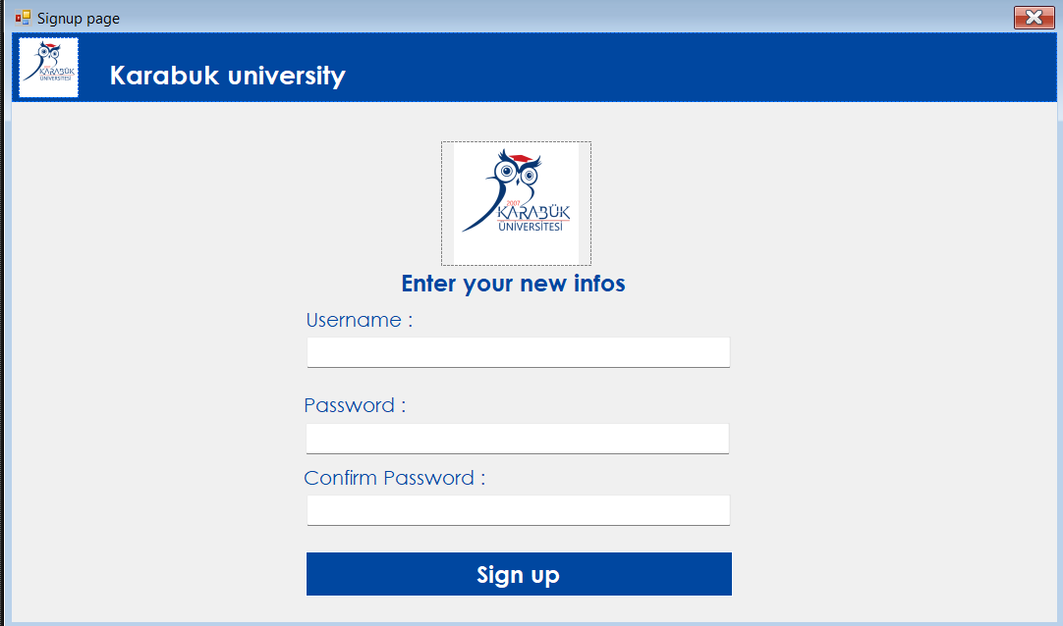
SignUP

Slide 6
Description
The user enter his identifiers if he’s new he must sign up first.
Each user is able to only see his own student other can’t see them but the admin user can access too all of them

Slide 7
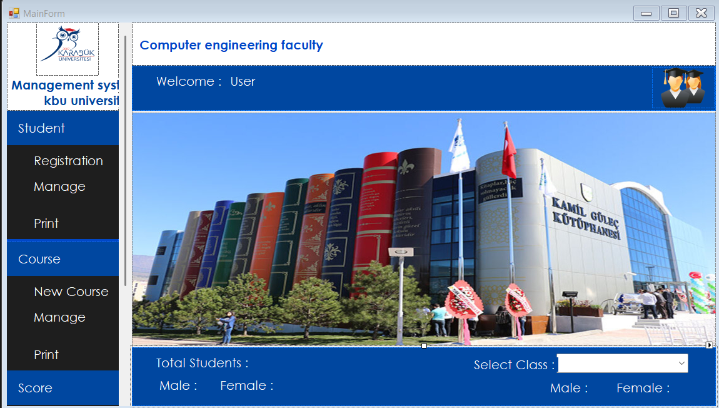
Main Form

Slide 8
Description
This is the main menu of our program we can see the name of the user upstaire and down staire we can search for a class and know the number of student their and see the total number of studednt tou can also select if you just want the number of femal or male.
On the left we have : Student, course , score, dashborad and exit.

Slide 9
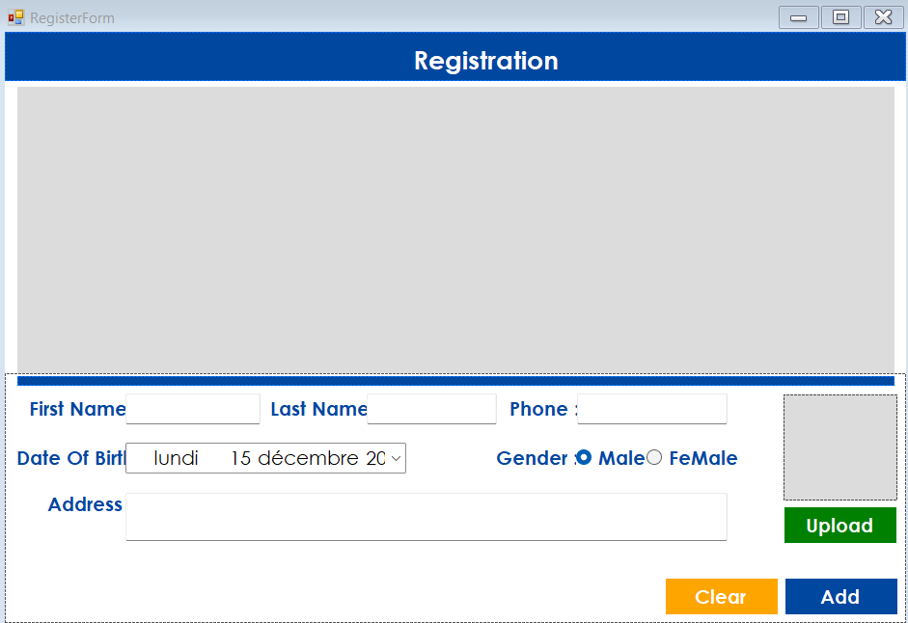
Student form
1- Student register

Slide 10
It is used to register a new student in the system.
The user fills in the student’s information such as first name, last name, phone number, date of birth, gender, and address.
A photo can also be uploaded using the Upload button.
The Add button saves the student’s information, while the Clear button resets the form.

Slide 11
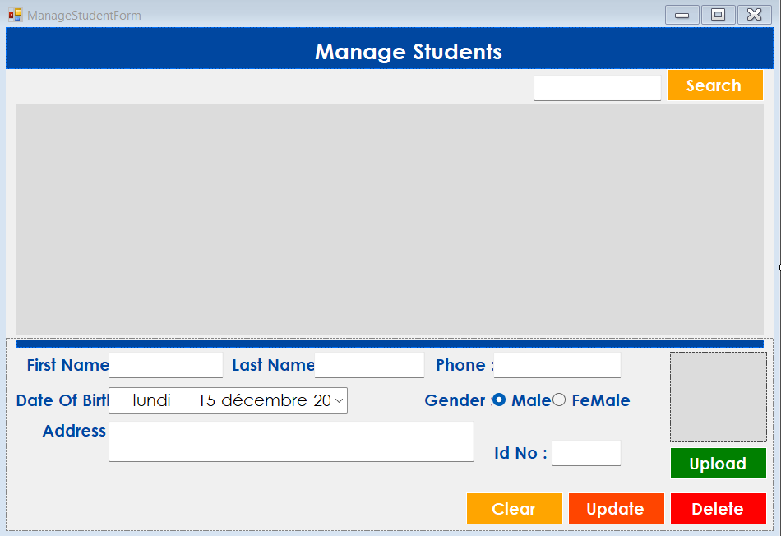
2- Student manager

Slide 12
It’s used to upload student data.
At the top, there is a search bar that allows the user to search for a student.
The data gridview displays the list of students.
At the bottom, there is a form to update or modify student information, including first name, last name, phone number, date of birth, gender, address, and student ID.
You can also delete a student when you select him.

Slide 13
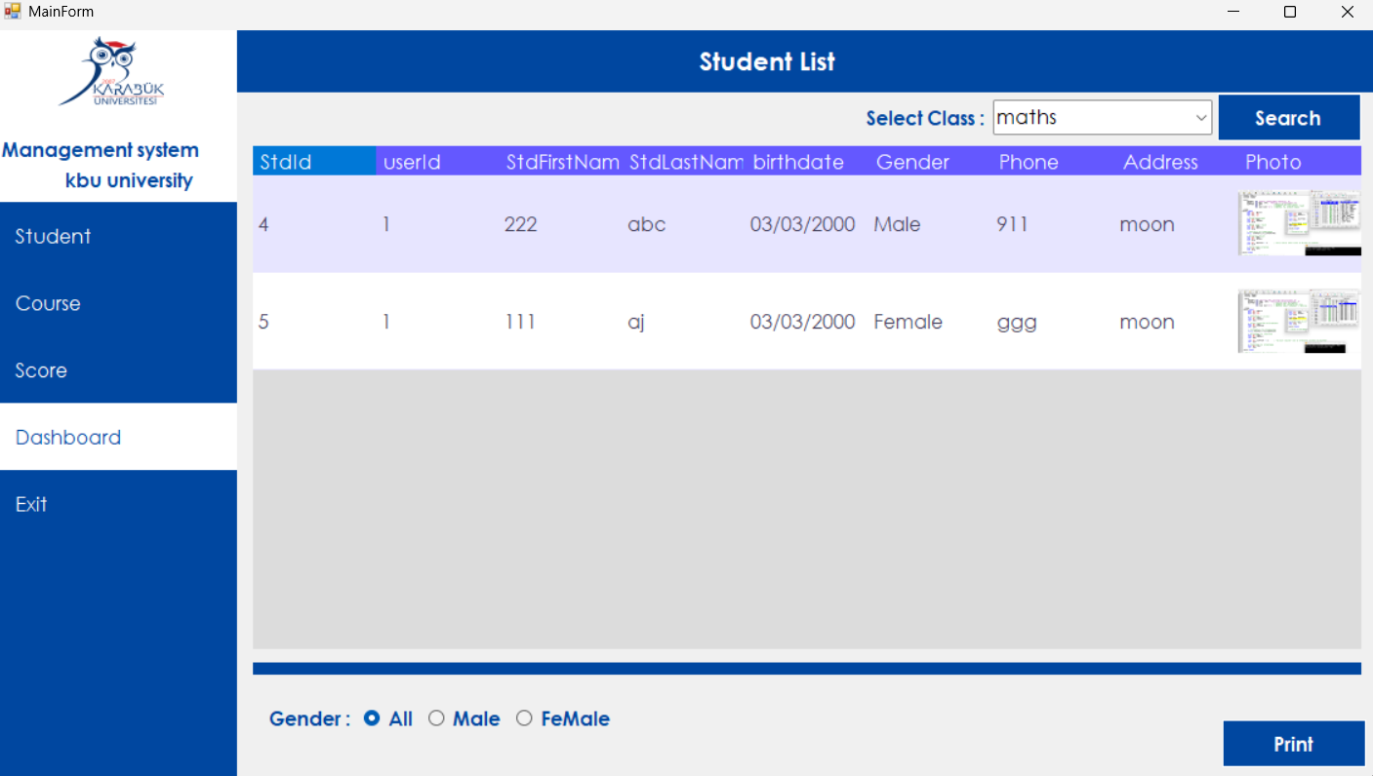
3- student print

Slide 14
This window is used to print the students displayed in the DataGridView.
Two types of filters are available: a search bar and a gender filter.
Both filters can be used at the same time.

Slide 15
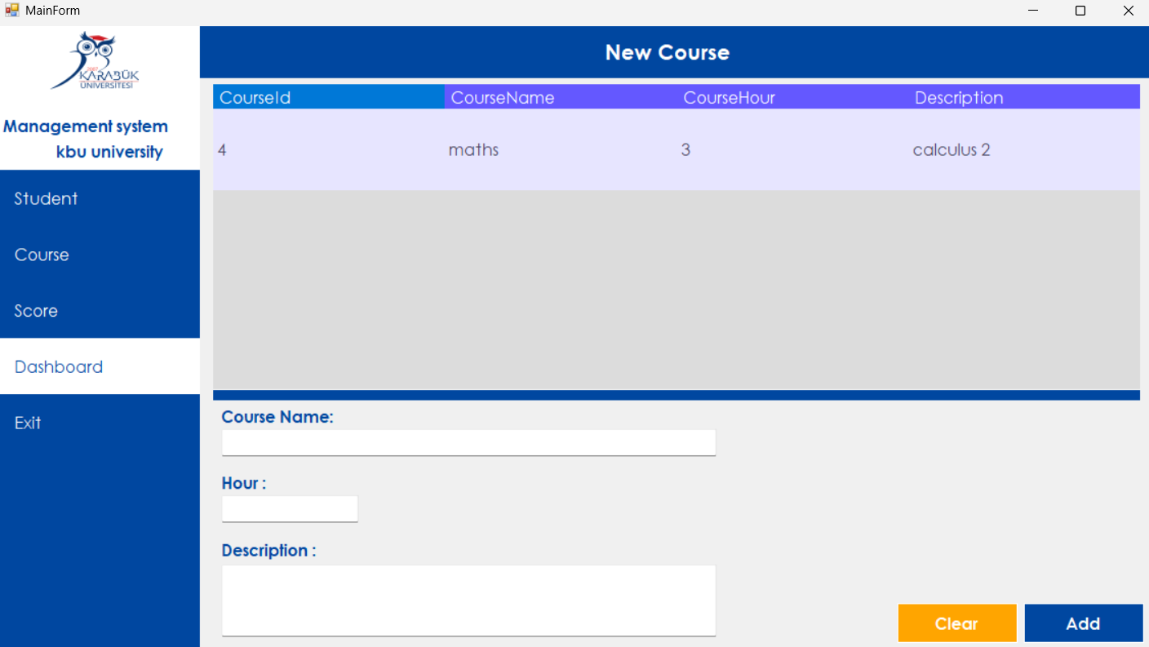
Course form
1- New corse

Slide 16
This window is used to create courses.
The DataGridView displays the list of courses.
At the bottom, there is a form to add or clear course information, such as the course name, number of hours, and description.

Slide 17
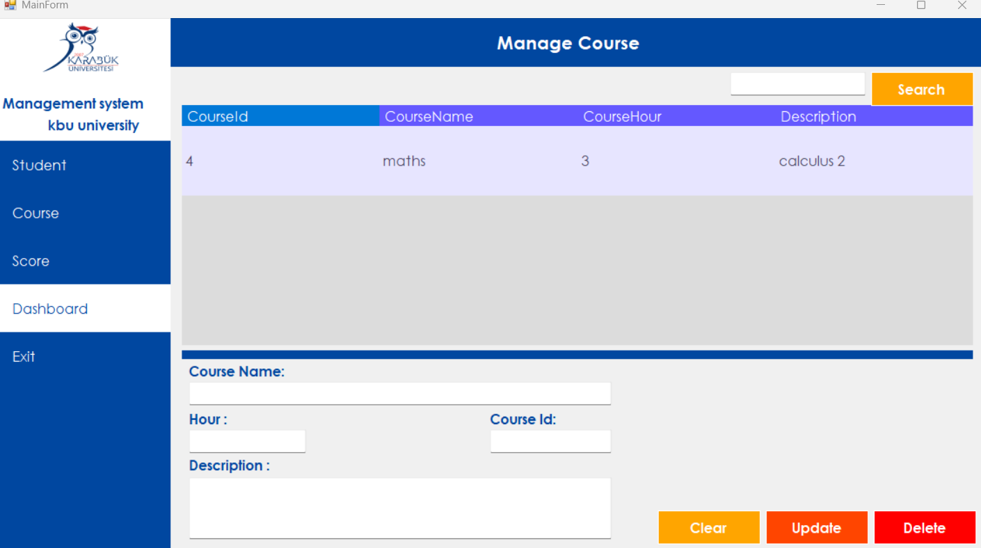
2- Course management

Slide 18
This window is used to manage course data.
At the top, there is a search bar that allows the user to search for a course.
The DataGridView displays the list of courses.
At the bottom, there is a form to update course information.
A course can also be deleted after selecting it.

Slide 19
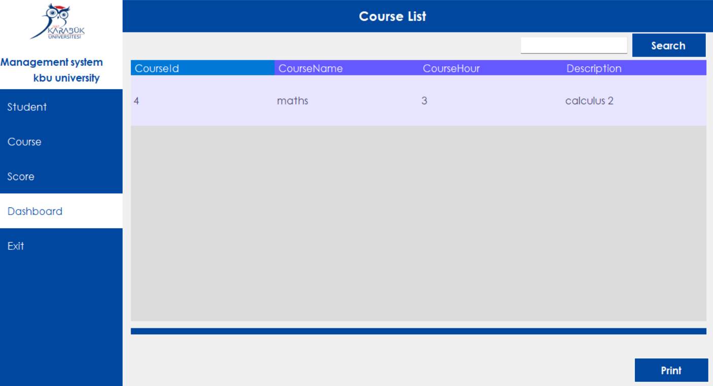
3-print course

Slide 20
This window print the course display in the data gridview .
You can also filter by seaching a specific one.

Slide 21
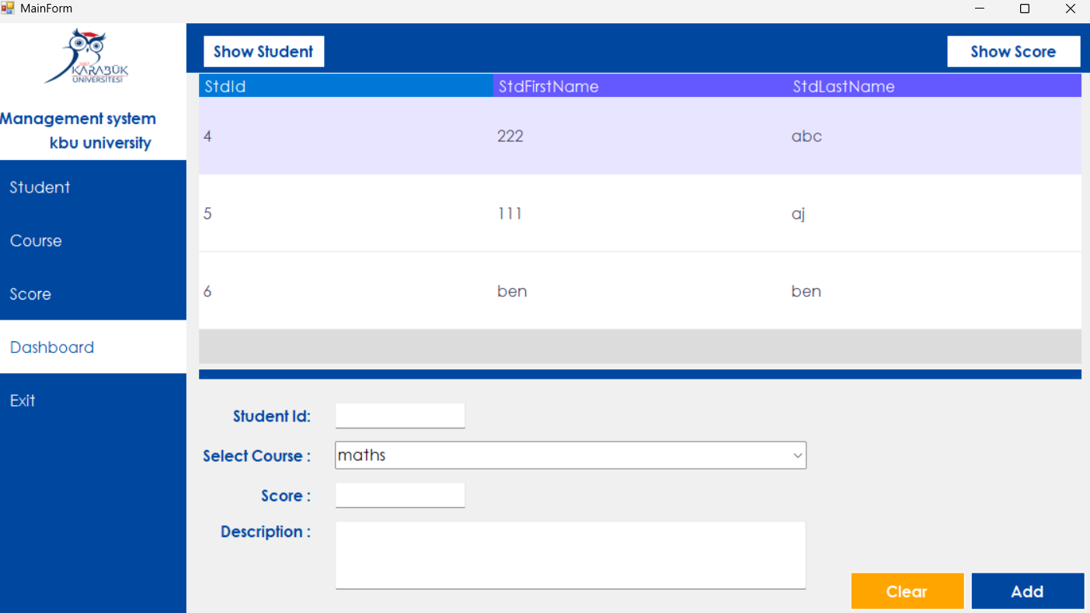
Score form
1- New score

Slide 22
This window is used to load student scores for a course.
There are two options for filter:
Display only student information: ID, name, and first name
Display student scores: ID, name, surname, class name, score, and appreciation

Slide 23
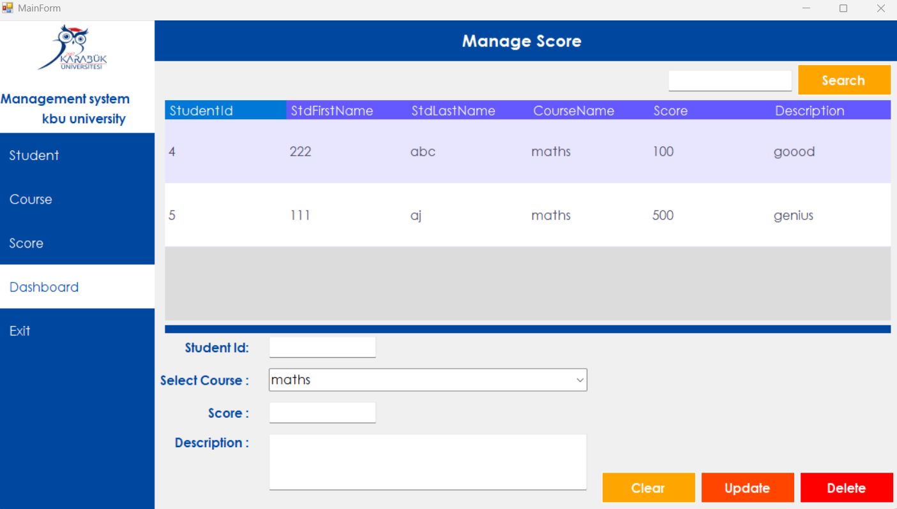
2- Score management

Slide 24
Like for previous management form here you can upload a score depend on their cours.
You can also delete them.

Slide 25
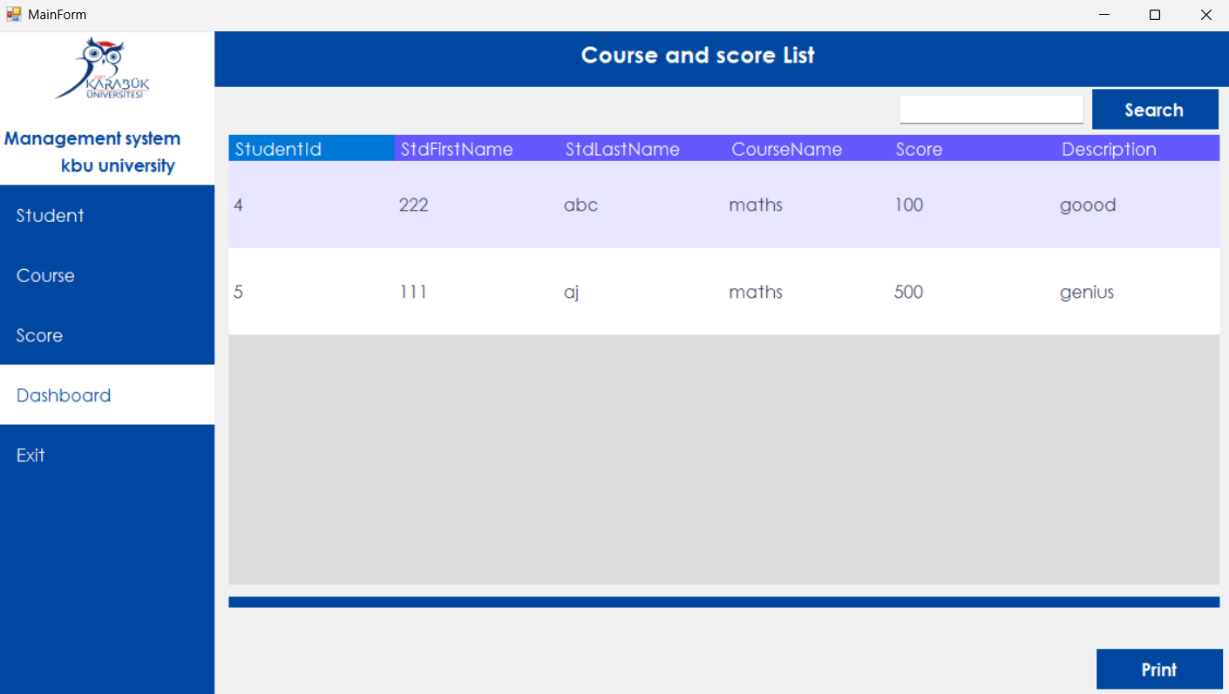
3- Print Score

Slide 26
Similar to the previous print form, this window is used to generate printed reports of student scores displayed in the DataGridView.
The user can select a specific course to filter and print the corresponding student score data.

Slide 27
Dashboard: Used to return to the main menu.
Exit: Brings the user back to the login page.

Slide 28
Data base

Slide 29
For database creation and execution, we’ve used mysql and XAMPP was used as a local database management environment, providing the necessary services for local data storage and access during development.

Slide 30
The project includes four database-related classes: DbConnect, DatabaseInitializer, CourseClass, and DGVPrinter.
These classes are integrated into the Windows Forms application using Object-Oriented Programming principles to ensure modularity and code reusability.

Slide 31
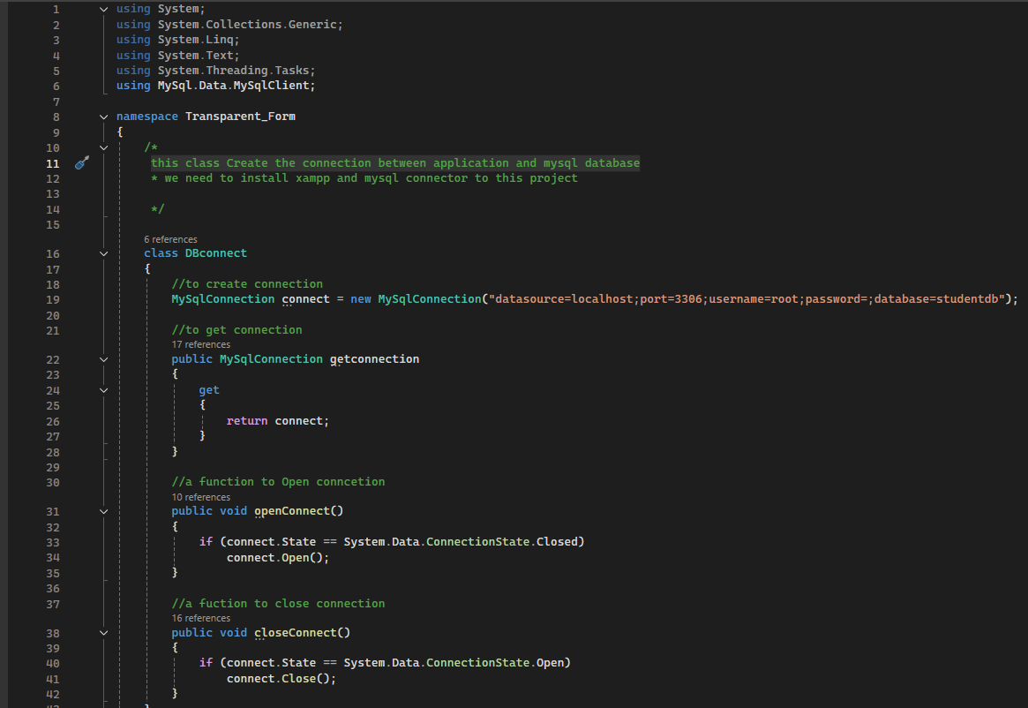
1- Dbconnect this class Create the connection between application and mysql database

Slide 32
2-DatabaseInitializer
Create variables and connect them to the mysql database.
Create tables that’ll be use in the program ( user, student, course, score).

Slide 33
3- CourseClass
This class create object and fonctions for cours form

Slide 34
DGVPrinter is a utility class used in Windows Forms applications to print the content of a DataGridView.
In the Student Management System, DGVPrinter is used to:
Print student data displayed in the DataGridView
Print student scores by course
Generate simple reports from on-screen data

