Slide 1
Flexbox

Slide 2
Flexible way of laying out items as a column or row

Slide 3
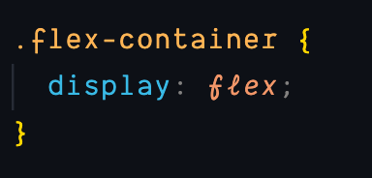
Start with a container and give it a display: flex;
The flex container now has control over it’s direct children
By default all of the children will be left aligned and will shrink to their content width
div class=“flex-container”
div
span
i
input

Slide 4
A flex container has two axes, a main and a cross axis
By default the direction on the container is: flex-direction: row
main
cross
1
2
3

Slide 5
flex-direction: row-reverse
main
cross
3
2
1

Slide 6
flex-direction: column
cross
main
1
2
3

Slide 7
flex-direction: column-reverse
cross
main
3
2
1

Slide 8
Alignment using the main axis
By default the items are set along the main axis with justify-content: flex-start;
main
cross

Slide 9
We can:
justify-content: flex-end; to move all items to the end of the main axis
main
cross

Slide 10
We can:
justify-content: center; to center all items on the main axis
main
cross

Slide 11
We can:
justify-content: space-between; to distribute available space between items on the main axis
main
cross

Slide 12
We can:
justify-content: space-around; to distribute available space around items on the main axis
main
cross

Slide 13
Alignment using the cross axis:
align-items: flex-start; aligns items to the start of the cross axis (overrides default stretch value)
main
cross

Slide 14
We can:
align-items: flex-end; aligns items to the end of the cross axis
main
cross

Slide 15
We can:
align-items: center; aligns items to the center of the cross axis
main
cross

Slide 16
We can:
align-items: stretch; items are positioned to stretch across the cross axis
main
cross

Slide 17
We can:
align-items: baseline; items are positioned relative to the baseline of the cross axis
main
cross
text
text
text

Slide 18
Flex items
Each item in a container is called a flex item
Being part of a flex container enables the use of different properties
main
cross

Slide 19
Wraping flex items
If the flex items exceed the width of the main axis they will overflow
main
cross

Slide 20
Wraping flex items
To prevent that we can wrap the flex items: flex-wrap: wrap;
main
cross

Slide 21
Alignment property (same values as align-items)
align-self: auto: (default) inherits the align-items property from the parent (default stretch)
main
cross

Slide 22
Alignment property
align-self: flex-start;
main
cross

Slide 23
Alignment property
align-self: flex-end;
main
cross

Slide 24
Alignment property
align-self: center;
main
cross

Slide 25
Alignment property
align-self: baseline;
main
cross
text
text
text

Slide 26
Sizing
Specify flex-grow: 1, (defaults to 0) on a child and it will take up all the free available space
main
cross
text
text
text

Slide 27
Sizing
Specify flex-grow: 1, on all children and they will grow to fill up all the available extra space proportionally
main
cross
text
text
text

Slide 28
Sizing
Specify flex-shrink: 2, (defaults to 1) so that it will shrink 2 times relative to it’s neighbor's
(they need to have flex-grow and flex-basis)
main
cross
text
text
text

Slide 29
Sizing
flex-basis: 200px, (defaults to auto) it’s the flex equivalent for specifying width,
overrides width property
main
cross
text
text
text

Slide 30
Ordering
order: 2
main
cross
2
1
3

Slide 31
Flex
Shorthand for flex-grow, flex-shrink, flex-basis:
flex: 1 1 300px

Slide 32
Flex-flow
Shorthand for flex-direction and flex-wrap:
flex-flow: row wrap

Slide 33
Demo time!

Slide 34
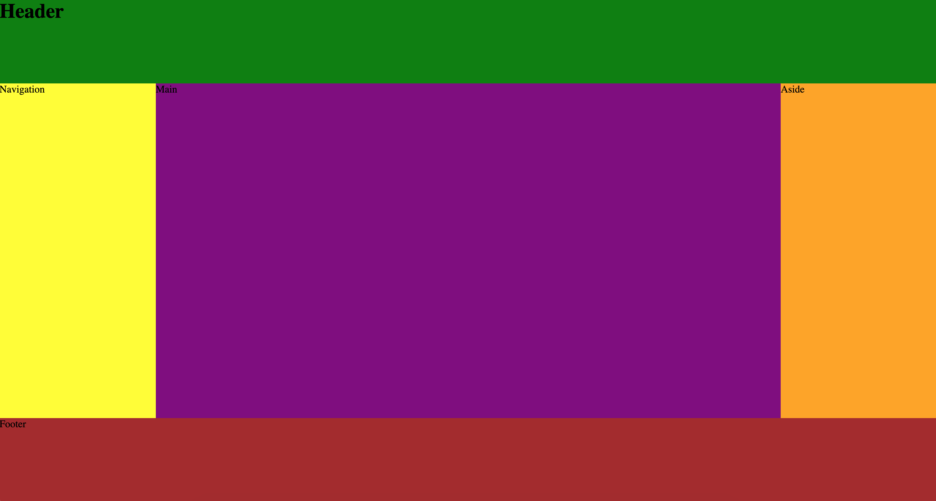
Holy Grail Layout

Slide 35
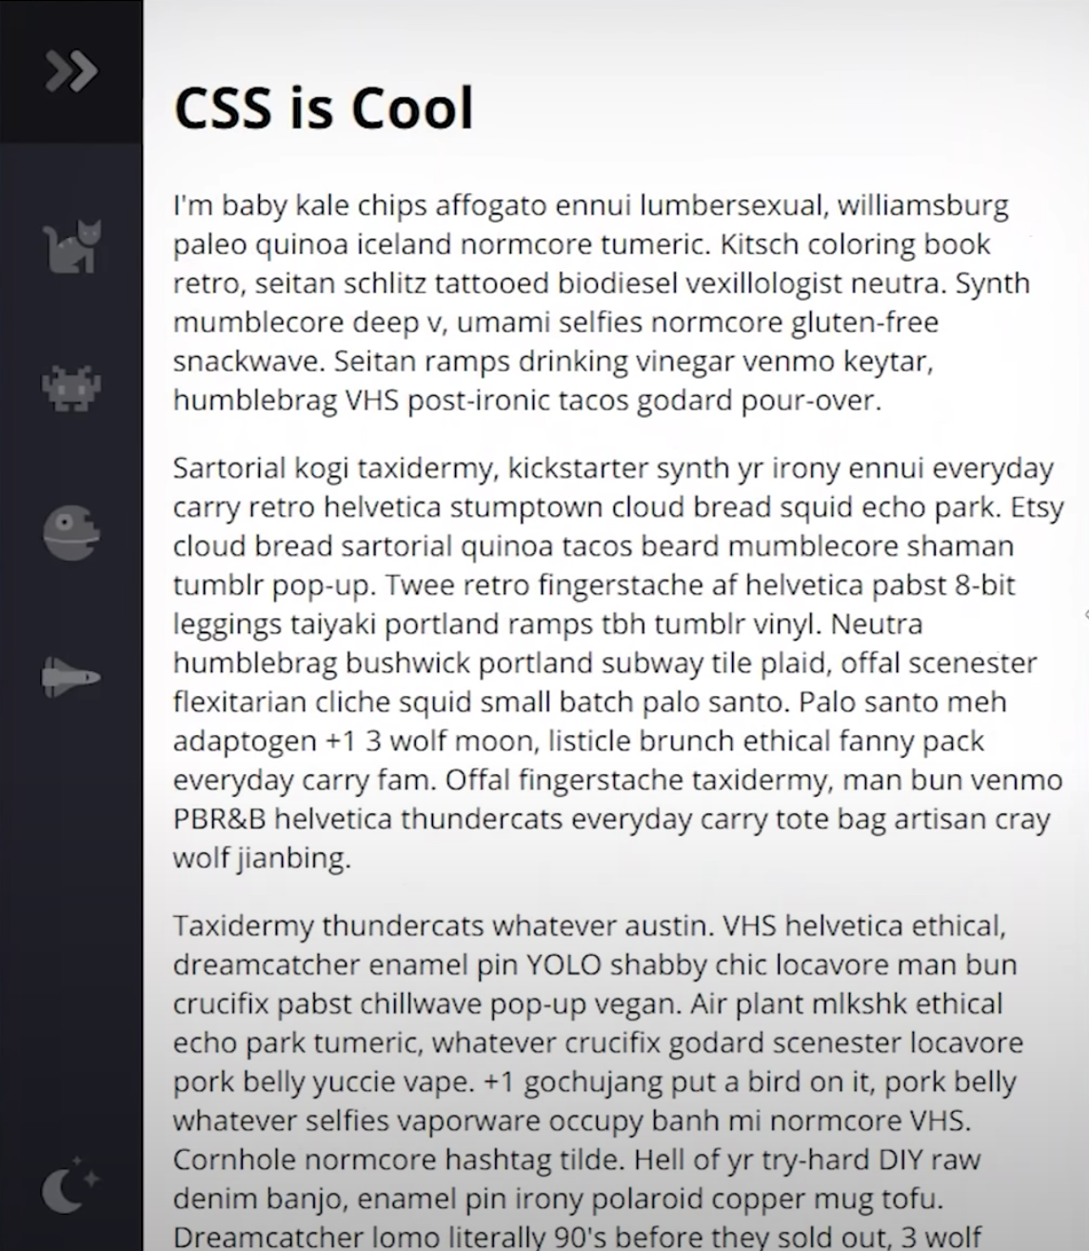
Building a navigation menu

Slide 36
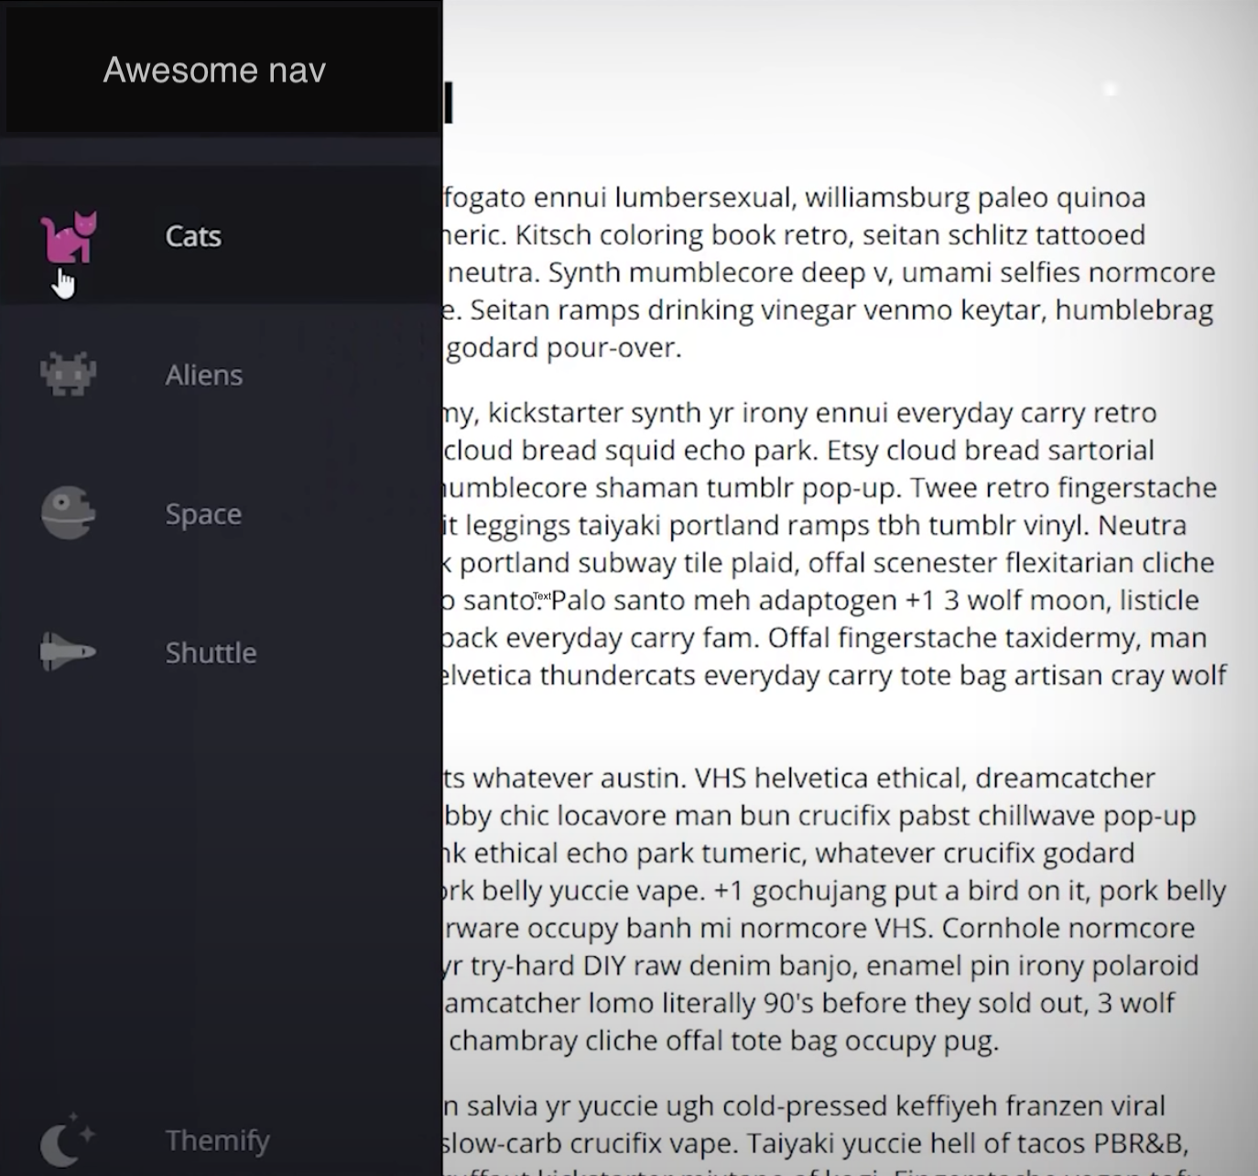
Building a navigation menu

