Slide 1
Inference Services on Kubernetes
Malte Groth

Slide 2
About me
Cloud Technology Evangelist at Deepshore
since 2019 at Deepshore
founded the Analytics & ML Team
Collaborator at MML@IKIM Essen
main subjects:
Cloud Technology & Cloud Architecture
Life-Cycle-Management & Operations
Automation in Kubernetes
MLOps

Slide 3

About Deepshore
OMI: associated partner / technical rollout partner
Kubernetes Certified Service Provider (KCSP)
Member of Cloud Native Computing Foundation
Member of Innovation Park Artificial Intelligence (IPAI)
Main subjects:
Cloud Technology
Distributed Systems
R&D in the field of AI, e.g.
AI optimized operations
Anomaly detection based on IoT data
Digital assistance for document management
Quelle: www.deepshore.de

Slide 4
Goal of this presentation
Show how we can serve AI models in consideration of
High Availability
Reliability
BUT ALSO: Efficiency and Usability

Slide 5
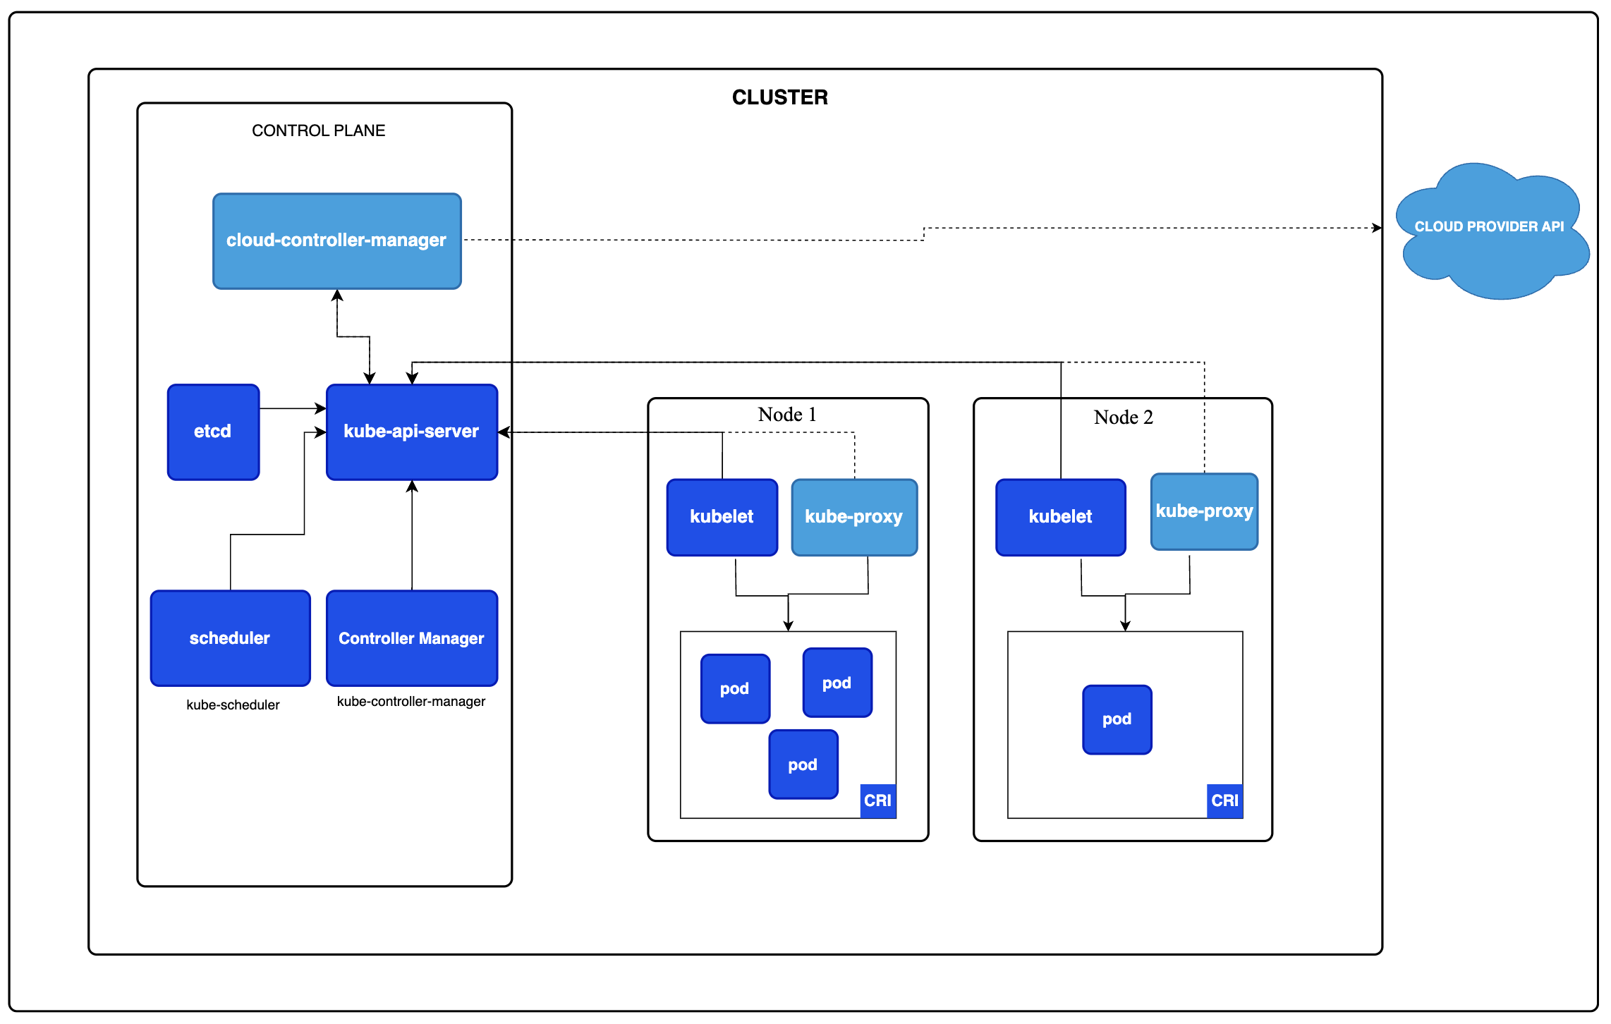
What is Kubernetes?
„Kubernetes is a …
open-source
container orchestration system
for automating
software deployment,
scaling
and management.“
Quelle: www.kubernetes.io

Slide 6
Why Kubernetes?
High Availability:
K8s clusters consists of multiple nodes
K8s controllers enable service (pod) replication
K8s controllers provide self-healing mechanisms
Resource Efficiency:
K8s comes with a powerful scheduling
Link: https://dzone.com/articles/kubernetes-advantages-and-disadvantages

Slide 7
KServe: Model Inference platform on Kubernetes
KServe
offers (auto)scaling, e.g.
if number of requests increases
if there is no load at all (scale to zero)
standardized inference protocol across ML frameworks
simplifies model deployment
Link: https://kserve.github.io/website/0.11/

Slide 8
InferenceService
InferenceServices
provide Inference APIs out-of-the-box
support multiple ML frameworks/Model Serving Runtimes
support for obtaining models from different storage locations
provide Autoscaling, incl. Scale-To-Zero
"Since your model is being deployed as an InferenceService, not a raw Kubernetes Service, you just need to provide the storage location of the model and it gets some super powers out of the box 🚀."

Slide 9
InferenceService
Pod
API
MSR
Request
Model
Storage

Slide 10
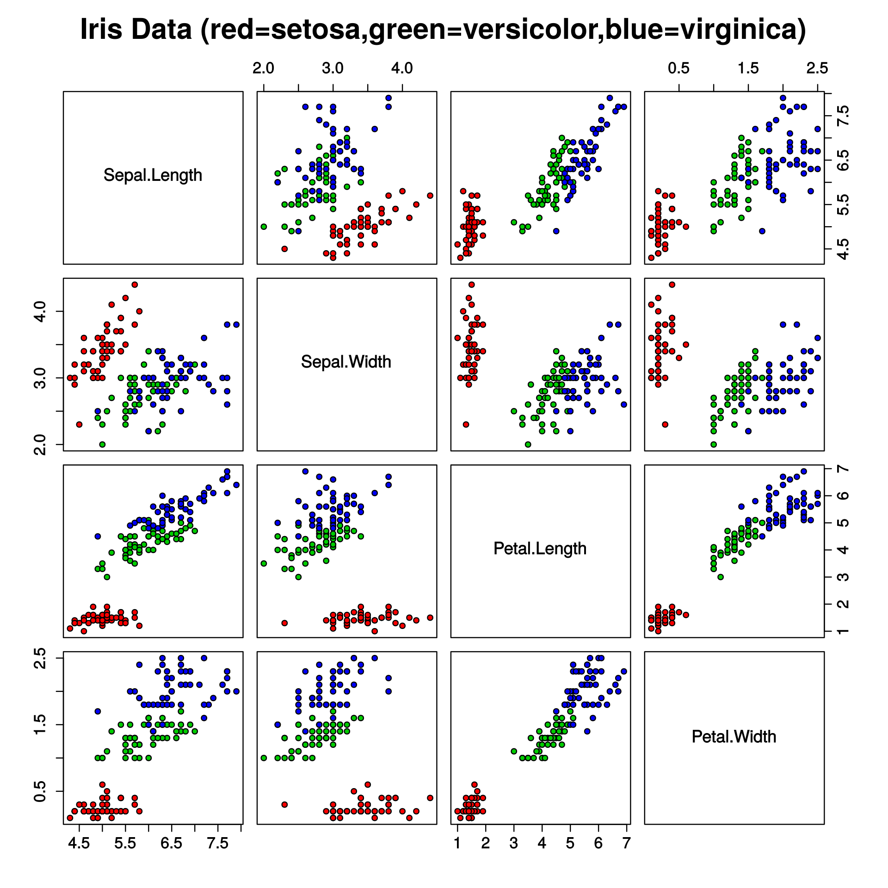
Setup Hands-On Demo
k8s cluster by minikube
KServe is already installed
the model classifies species of iris
(see: https://en.wikipedia.org/wiki/Iris_flower_data_set)
the model was already uploaded to MinIO
Quelle: www.wikipedia.de

Slide 11
Inference API (data plane protocol)
Versions:
v1 (REST)
v2 (REST, grpc)
v2 corresponds to OIP: https://github.com/open-inference/open-inference-protocol

Slide 12
Model Serving Runtimes
MSR: Applications providing/serving models efficiently and quickly
Kserve supports
TorchServe (Link: https://pytorch.org/serve/server.html)
Triton Inference Server (Link: https://github.com/triton-inference-server/server)
MLServer (Link: https://mlserver.readthedocs.io/en/latest/)
Custom MSR

Slide 13
Model Storage
Models can be provided by
S3
Azure Blob Storage
URL
PVC

Slide 14
Autoscaling
Autoscaling
Scales to zero if there is no request (given minReplicas is 0)
Scales up to maxReplicas if more replicas are needed

Slide 15
Summary
Kubernetes + KServe support High Availability (multiple nodes, pod replication, self-healing)
Kubernetes + KServe help to utilize resources efficiently (scheduling, autoscaling)
KServe makes serving models very easy --> Usability
KServe has features that improve reliability (versioning, monitoring etc.)

Slide 16
Outlook
Perform autoscaling on GPUs
Show model versioning in action
Increase reliability by making use of GitOps
Integration of FHIR resources in the Kubernetes-API
…

Slide 17
Thank you for your attention
Contact: malte.groth@deepshore.de

