Slide 1
KaiPass
Is your pass to zen
改善
Notes:
Have you noticed how bored were you getting during the lock down? We had and we are not alone.

Slide 2
Market size
1.5 billion people were under lockdown
62% of them suffered from boredom¹
Potential market size - up to
0.9 billion people(LOL)
OK, just 0.5 billion of them are internet users
Notes:
According to *Washington post* sixty two percent of people suffered from boredom during the lock down. What means that our potential market size is more than zero point nine billion people
OK, narrowing it down to the number of active internet users and we get half a billion.
Being bored can affect your mental health and that is the problem we solve.
KaiPass will not only entertain you but also help to improve many aspects of your life

Slide 3
KaiPass
Kaizen – Japanese theory for “change for better”
Battle pass – a type of monetization approach rewarding
the player with in-game items for playing the game and
completing specific challenges
}
Kaizen theory
+
KaiPass
Is your pass to zen
Battle pass
Notes:
Kaizen is a Japanese word which means "change for the better". KaiPass is based on the principles from Kaizen theory merged with popular nowadays promotion model "Battle pass".
But how does it works?

Slide 4
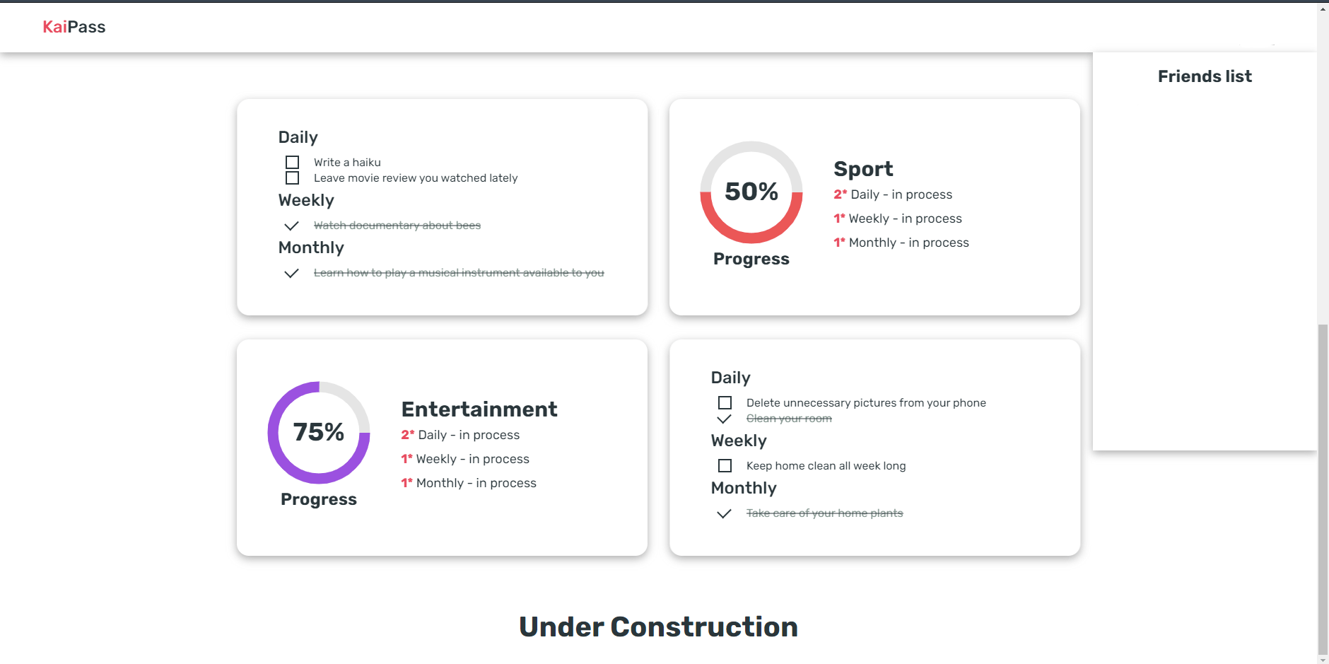
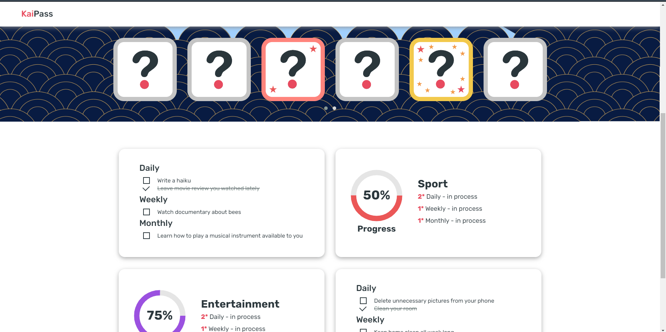
How does it work
Notes:
Everything is pretty simple. Every user has daily, weekly and monthly tasks which are divided into different categories and directed to improve different aspects of life. Every challenge taken upgrades KaiPass level and gives awards for your profile customization. But this idea doesn't make sense unless there is a social component as competition system. You can track your friends' progress and try to beat them. Also there is an achievement system that will show to your friends your successes in sports, education, etcetera. This should encourage you to daily improve yourself with Kaizen principles. Every day you will get closer to the goal you set.

Slide 5
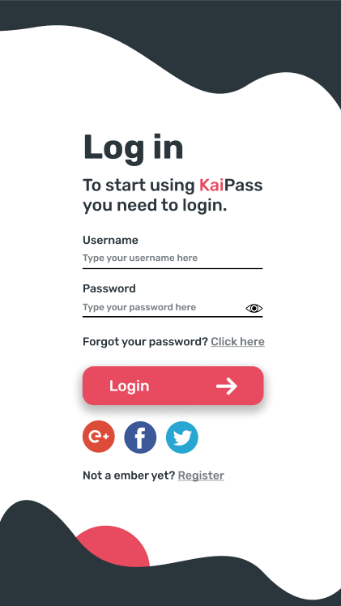
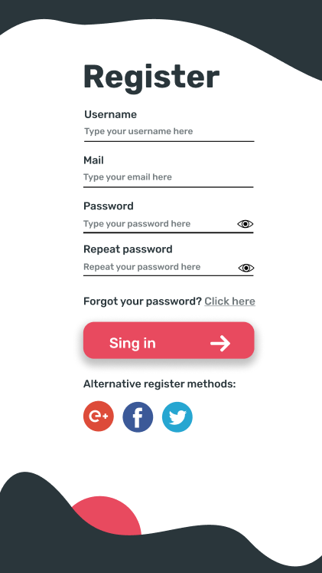
Plans for the future
Mobile app concept
Notes:
we have many great ideas how to develop our project: We are working on mobile app and we are going to add awards and subscriptions for thematic services

