Slide 1
NYCU-Zyxel Project:
WiFi Motion Sensing Technology
Monthly Progress Report: July 2021
Presenter: Tsung-Ting Tsai (蔡宗廷), Ph.D. Student
NYCU PI: Kai-Ten Feng (方凱田), Ph.D., Professor
Institute of Communications Engineering
National Yang Ming Chiao Tung University, Hsinchu, Taiwan
July 6th, 2021
Notes:
1

Slide 2
Outline
Project Schedule
Scenarios
Time-varying Performance Analysis under Different Types of Inputs
Monthly Summary
Problem Discussion
Future Works

Slide 3
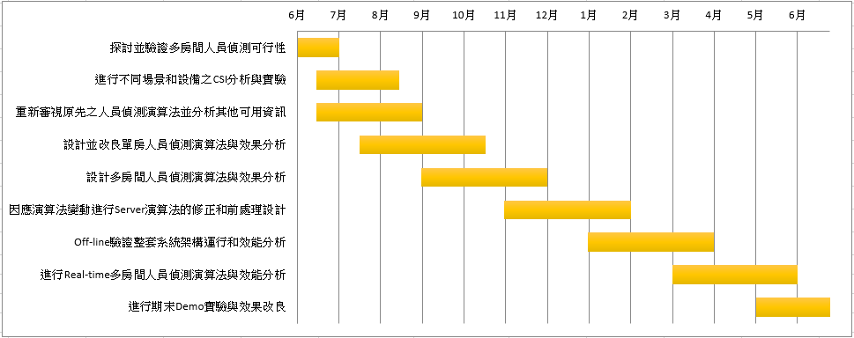
Project Schedule

Slide 4
Scenarios
Time-varying data analysis: use four different rounds of data as input to analyze the performance of presence detection
Goal: try to find out and compare the performance of different types of input data
Including CSI amplitude, variance of CSI amplitude, and CSI phase difference
Type | Input: Amplitude Only | Input: Amplitude & Variance of Amplitude | Input: Amplitude & Phase Difference
Time-varying Data Analysis | V | V | V

Slide 5
Time-varying Performance Analysis under Different Types of Inputs

Slide 6
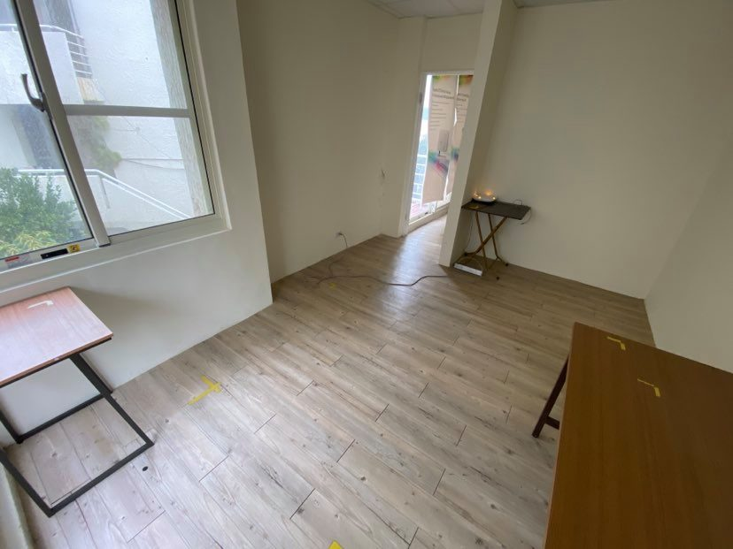
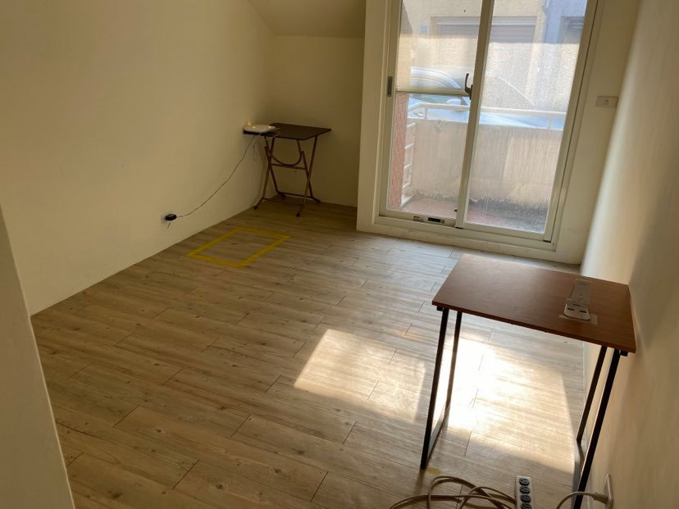
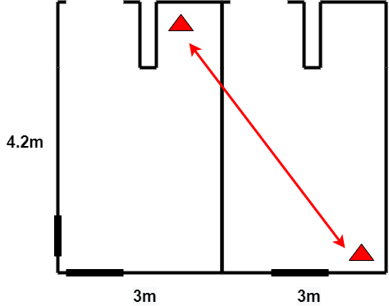
Presence Detection with Tx/Rx at Different Rooms: Experimental Setup (1/2)
Tx: WAX650
Rx: WAX510
Tx: WAX650
Rx: WAX510
Package: 5000 pkts per case
Distance: ~5m
Rx:
WAX510
Tx:
WAX650

Slide 7
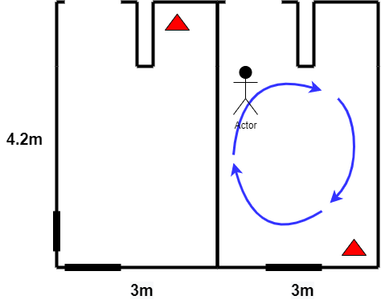
Presence Detection with Tx/Rx at Different Rooms: Experimental Setup (2/2)
Person walks and stands in the room randomly
Using four rounds data at different time interval as input to compare the influence of time-varying
Tx: WAX650
Rx:
WAX510
Tx:
WAX650

Slide 8
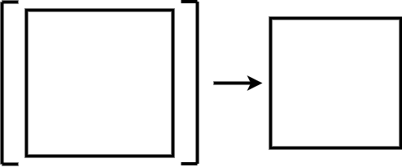
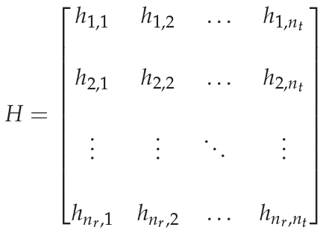

Training Model with Different Input Data (1/4)
$\text{y}\text{(}\text{t}\text{) }\text{= }\text{Hx}\text{(}\text{t}\text{) }\text{+ }\text{n}\text{(}\text{t}\text{)}$
x(t): MIMO system transmit matrix
y(t): MIMO system receive matrix
n(t): channel additive white Gaussian noise matrix
H: channel fading factor matrix
Amplitude
Ω
Batch x Time x Data
Learning Network

Slide 9
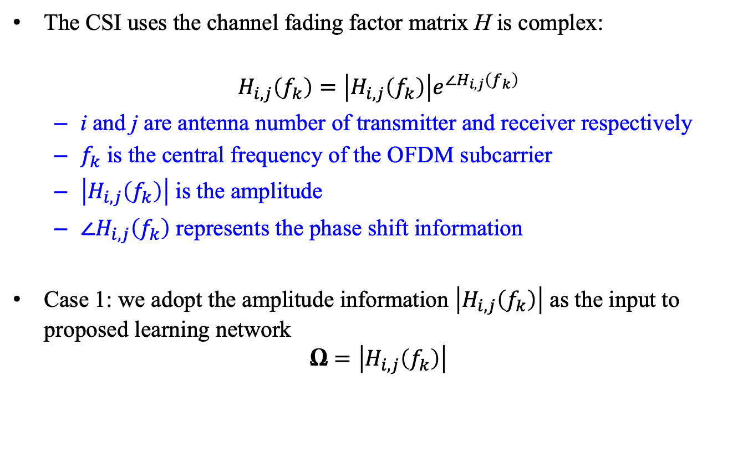
Training Model with Different Input Data (2/4)
The CSI uses the channel fading factor matrix H is complex:
$$H_{i,j}\left(f_{k}\right)=\left|H_{i,j}\left(f_{k}\right)\right|e^{∠H_{i,j}\left(f_{k}\right)}$$
i and j are antenna number of transmitter and receiver respectively
$f_{k}$ is the central frequency of the OFDM subcarrier
$\left|H_{i,j}\left(f_{k}\right)\right|$ is the amplitude
$∠H_{i,j}\left(f_{k}\right)$ represents the phase shift information
Case 1: we adopt the amplitude information $\left|H_{i,j}\left(f_{k}\right)\right|$ as the input to proposed learning network
$$\text{Ω}=\left|H_{i,j}\left(f_{k}\right)\right|$$

Slide 10
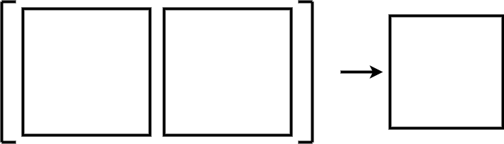

Training Model with Different Input Data (3/4)
Variance
of
Amplitude
Λ
Batch x Time x Data
Case 2: we adopt both the CSI amplitude and its variance as system input:
$$\text{Λ}\text{ = }\text{var}\text{(}\text{Ω}\text{)}$$
where $\text{Λ}$ is the variance of the time domain of CSI amplitude Ω
Learning Network
Amplitude
Ω
Batch x Time x Data

Slide 11

Training Model with Different Input Data (4/4)
$\text{Case}\text{ 3: }\text{we} \text{adopt} \text{both} \text{the} \text{CSI} \text{amplitude} \text{and} \text{CSI} \text{phase} \text{difference} \text{as} \text{system} \text{input}\text{:}$
$$\text{Φ}\text{ =} ∠H_{i,j+1}\left(f_{k}\right)−∠H_{i,j}\left(f_{k}\right)$$
where $\text{Φ}$ is the phase difference of two chains for each time and subcarrier
Note: we still need to confirm if the data from those two chains represents phase difference
Phase Difference
Φ
Batch x Time x Data
Learning Network
Amplitude
Ω
Batch x Time x Data

Slide 12
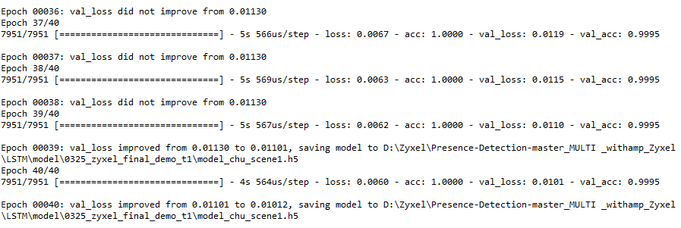
Performance Evaluation: Amplitude Only (1/2)
The training model of round one’s data can achieve 99% validation accuracy and 0.01012 validation loss
We will use this model to predict another three rounds of data
To evaluate the time-varying effects

Slide 13



Performance Evaluation: Amplitude Only (2/2)
Testing data: round 1
Testing data: round 2
Testing data: round 3
Testing data: round 4
The performance of using model of round one data to predict different rounds of data will lead low accuracy because the influence of time varying

Slide 14
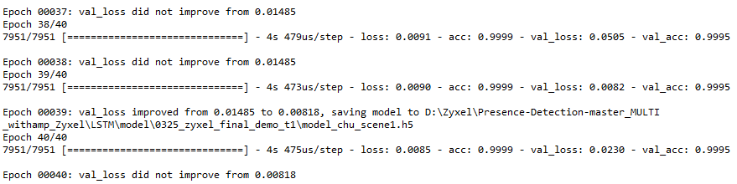
Performance Evaluation: Amplitude & Variance of Amplitude (1/2)
The training model of round one;s data can achieve 99% validation accuracy and 0.00818 validation loss
We will use this model to predict another three rounds of data

Slide 15
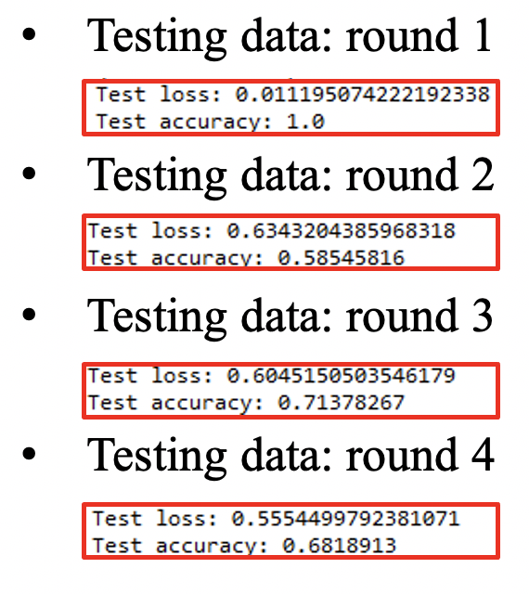
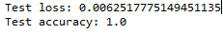
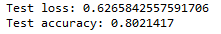
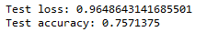
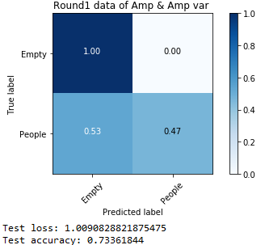
Performance Evaluation: Amplitude & Variance of Amplitude (1/2)
Testing data: round 1
Testing data: round 2
Testing data: round 3
Testing data: round 4
The accuracy of each round is improved when we include the variance of amplitude as input data
Amplitude Only

Slide 16
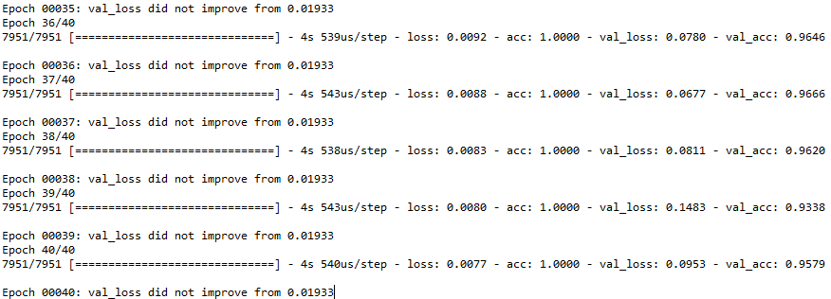
Performance Evaluation: Amplitude & Phase Difference (1/2)
The training model of round one’s data can achieve 95% validation accuracy and 0.01933 validation loss
We will use this model to predict another three rounds of data

Slide 17
Performance Evaluation: Amplitude & Phase Difference (2/2)
Testing data: round 1
Testing data: round 2
Testing data: round 3
Testing data: round 4
Compared to pure amplitude as input, the performance by additionally include phase difference as input data does not improve testing accuracy
Further investigation and evaluation is required
Amplitude Only

Slide 18
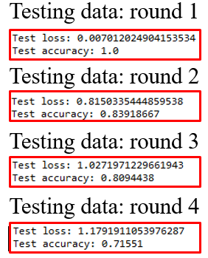
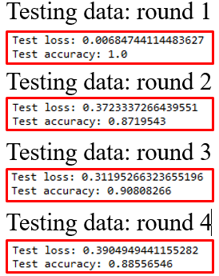
Performance Comparison for Static and Walking Scenario: Amplitude & Variance of Amplitude
Performance comparison between static and walking scenarios:
Predict static versus people walking based on the same training model
Better accuracy can be achieve in walking case compared to static case
Empty Room & Static
Empty Room & Walking

Slide 19
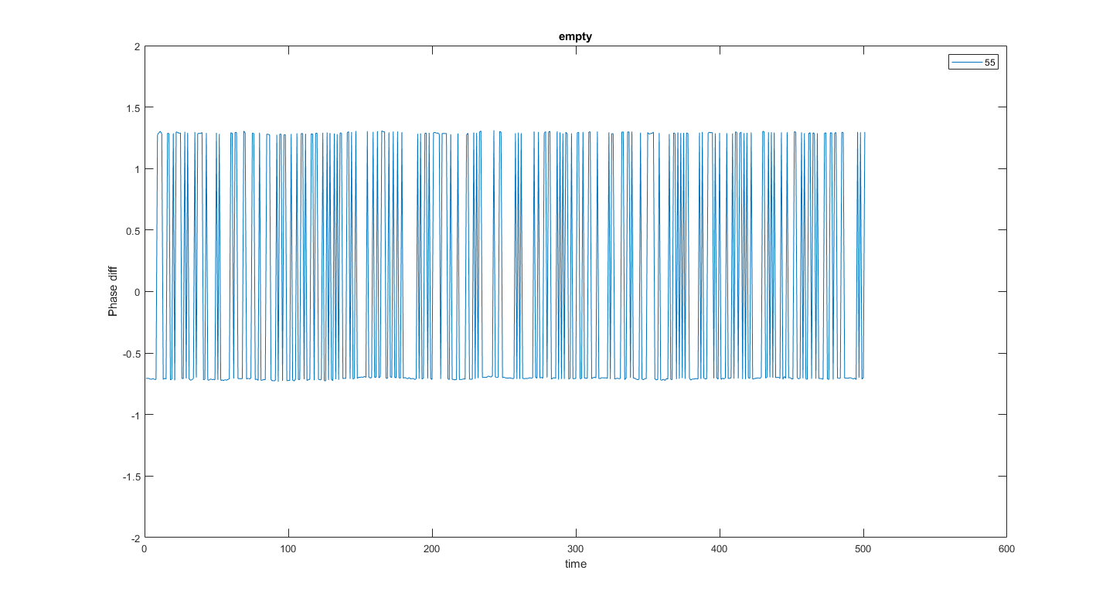
Monthly Summary
僅用CSI Amplitude去預測是否有人在於不同輪的資料中效果有限, 其原因為CSI會受時變性的影響導致判別錯誤
將variance of amplitude加入網路去學習後可以發現對於不同輪的資料 其判別準確度有改善, 因為variance of amplitude在於不同時間量測, 只要環境變化皆會產生波動, 可預期用來抵抗時變性
將phase difference加入網路去學習後效果並不理想, 初步推測原因為phase difference存在有幅度較大的跳動, 且每次量測的值皆存在有offset
需要再進行前處理設計濾除phase difference大幅度的跳動後嘗試效果

Slide 20
Problem Discussion
已購買單天線設備, 預計於chamber進行實驗探討其phase difference之物理意義
Zyxel是否有chamber能提供進行實驗
Workshop的進度和課程推進討論

Slide 21
Future Works
進行單天線的phase difference實驗進行分析, 嘗試找出chain之物理意義
改良加入CSI phase difference進行前處理的設計, 觀測其對於時變性抵抗的效果
以加入variance of amplitude的方向持續改良人員偵測演算法, 提升判定精準度
改良學習演算法的網路架構
設計Server端的前處理演算法, 以達成多傳一收real-time的人員偵測實驗

Slide 22
Thank You
Q & A

