Slide 1
Beacon Project
Speaker: Sheng-Han Chung
(groundhogsh@gmail.com)
Advisor: Kai-Ten Feng, Ph.D, Professor
(ktfeng@mail.nctu.edu.tw)
Institute of Communications Engineering
National Chiao Tung University (NCTU) Hsinchu, Taiwan
July 15th, 2021

Slide 2
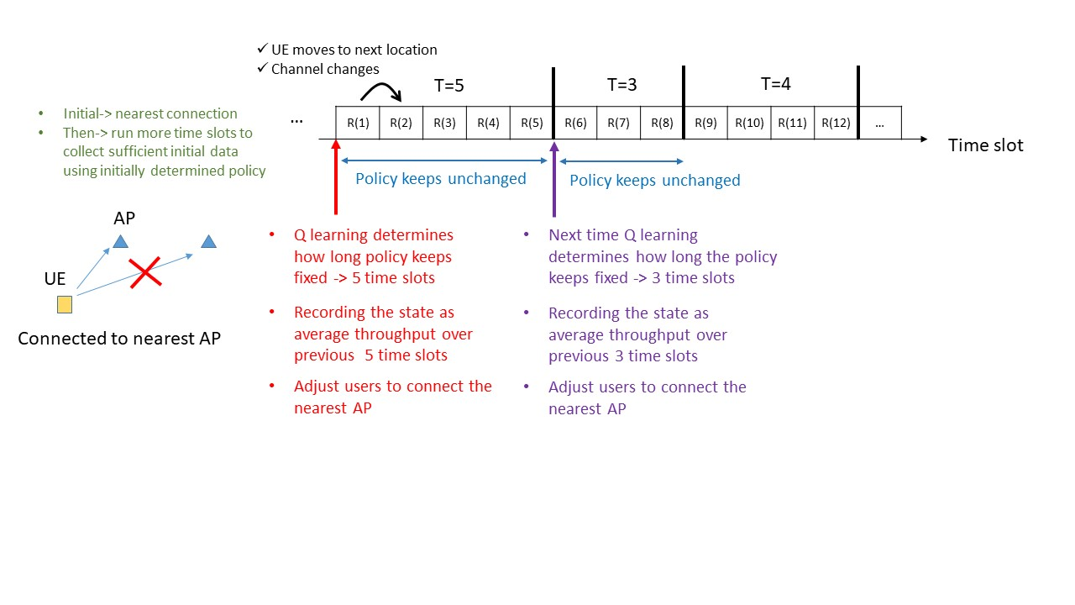
Introduction

Slide 3
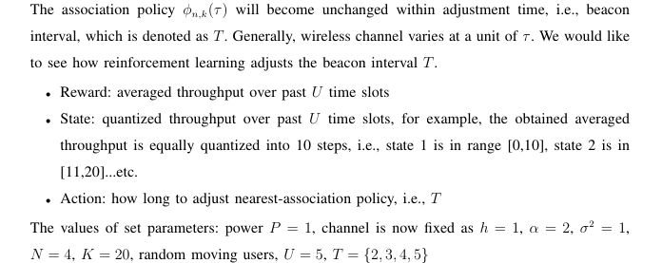
Introduction

Slide 4
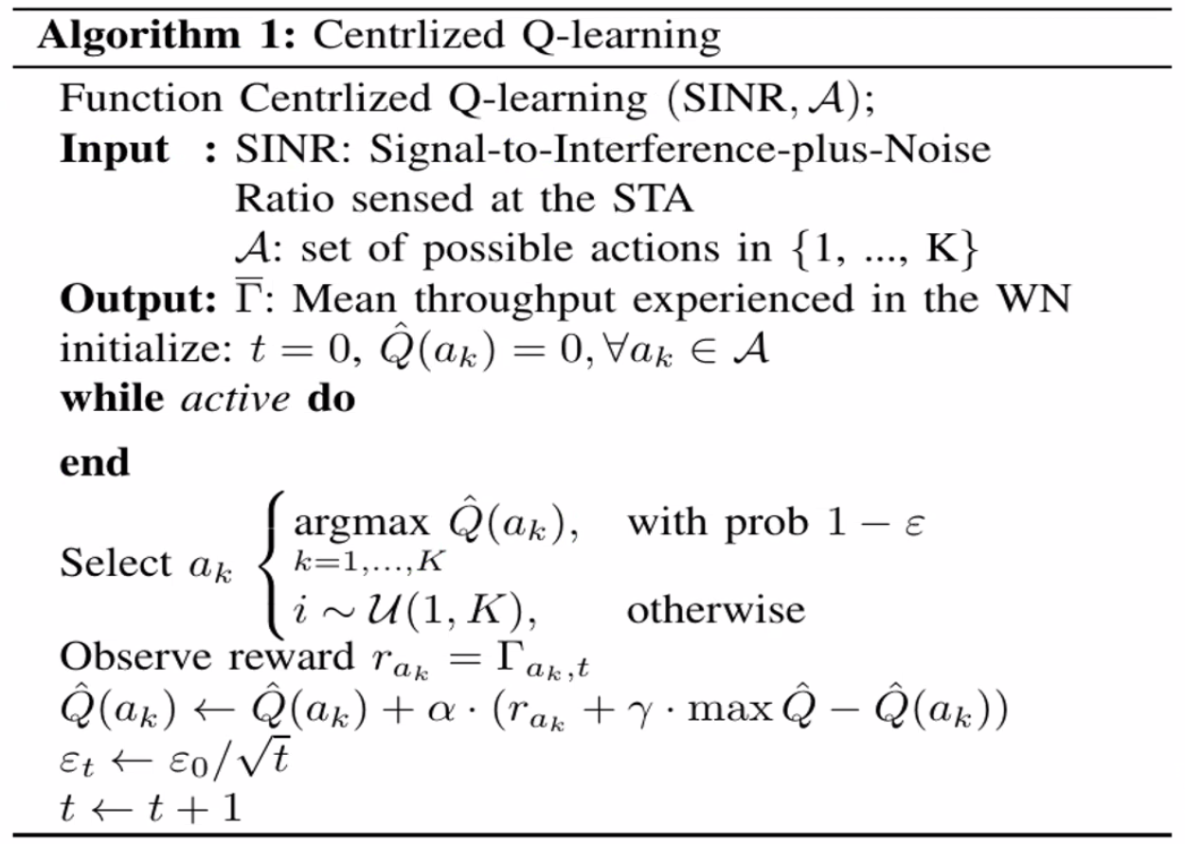
Algorithm design

Slide 5
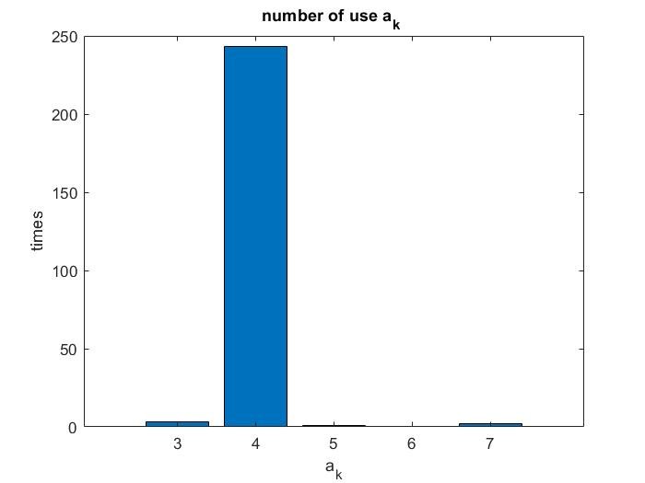
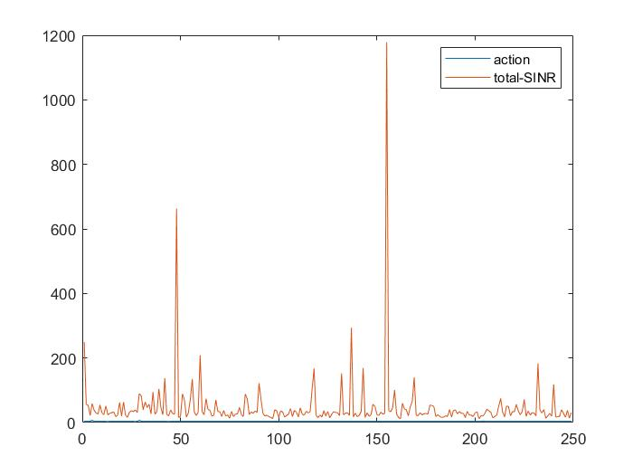
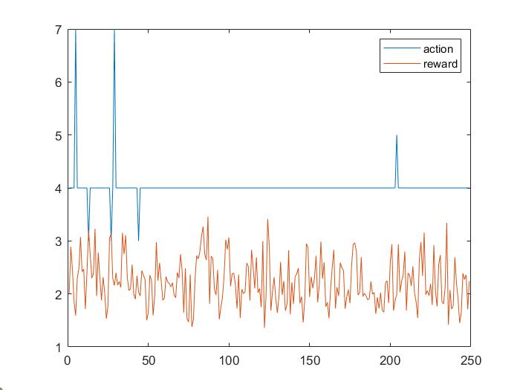
Result
(epsilon, alpha , gamma ) =
(0.8 , 0.5 , 0.9)

Slide 6
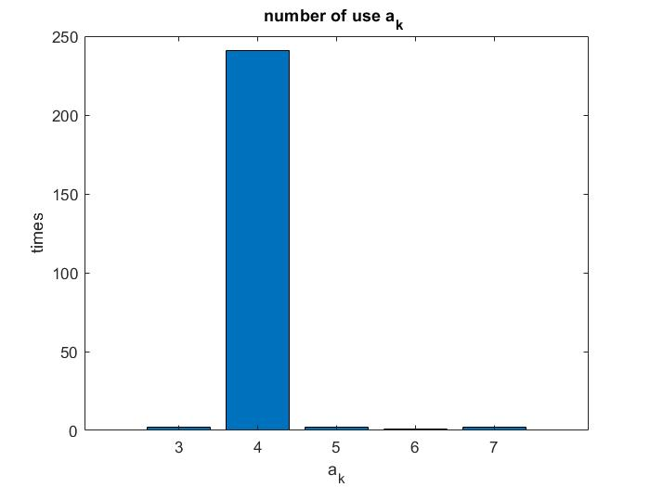
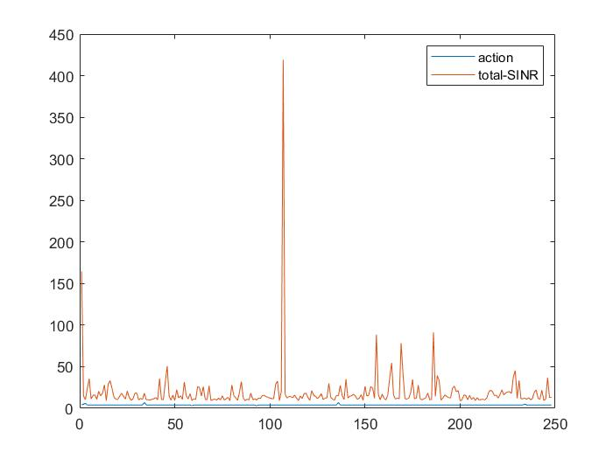
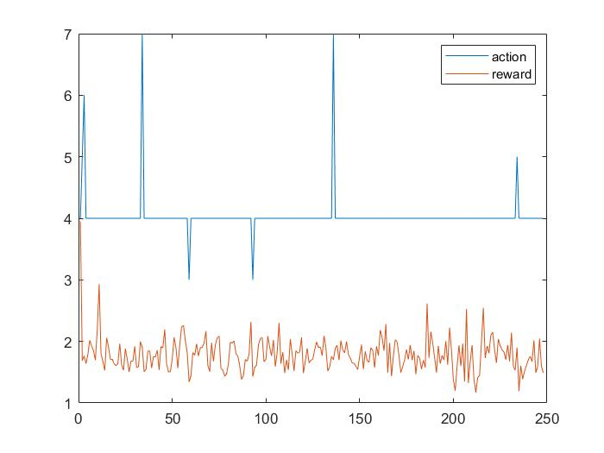
Result
(epsilon, alpha , gamma ) =
(0.8 , 0.1 , 0.9)

Slide 7
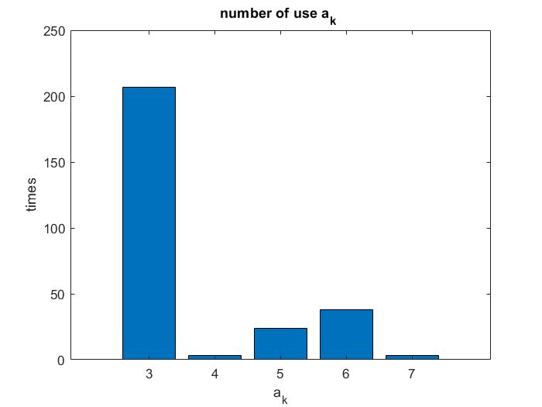
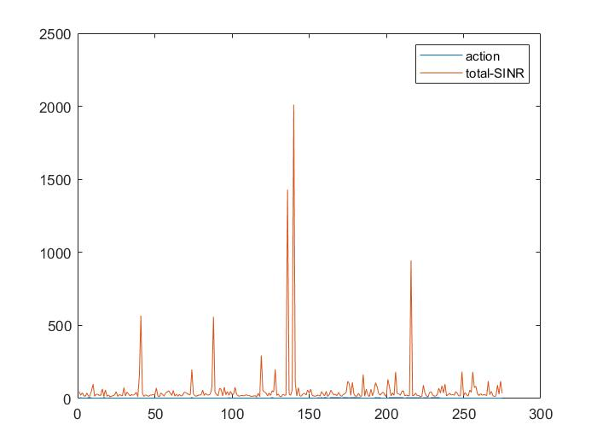
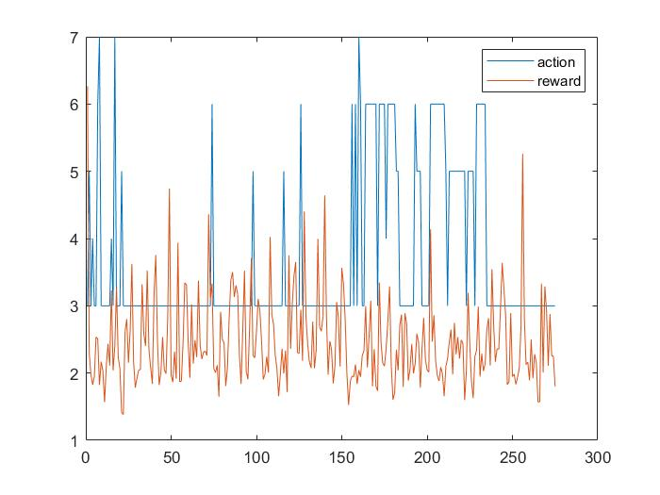
Result
(epsilon, alpha , gamma ) =
(0.8 , 0.75 , 0.9)

Slide 8
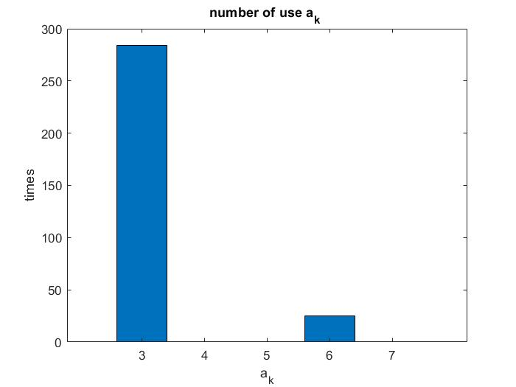
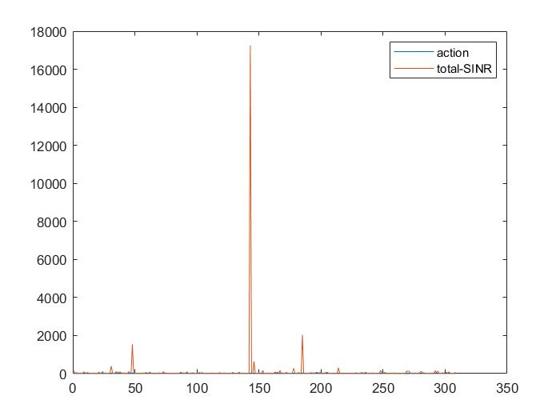
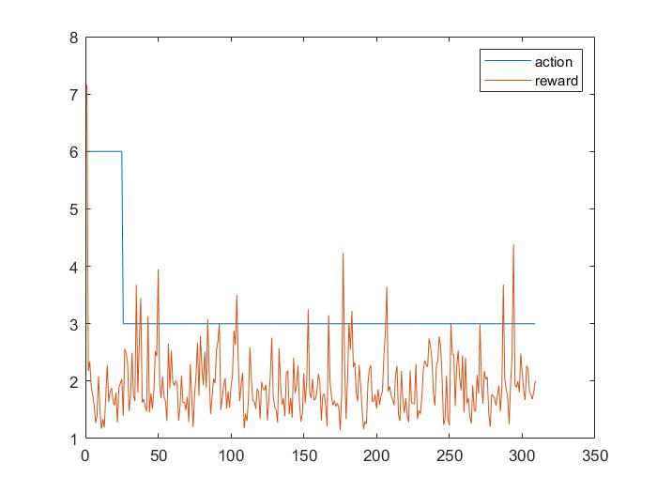
Result
(epsilon, alpha , gamma ) =
(0.1 , 1 , 0.95)

Slide 9
Algorithm design

Slide 10
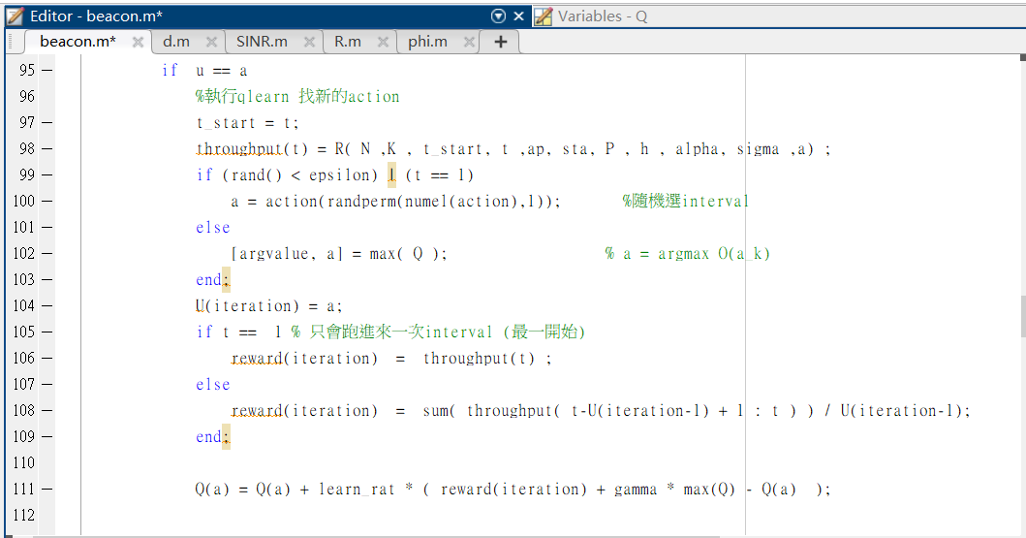
Algorithm design

