Slide 1
Learning-based Adjustable Beam Number Training Algorithm and Experimental Implementation for Millimeter Wave
Speaker: Ting-Wei Chang
(tony840525@gmail.com)
Advisor: Kai-Ten Feng, Ph.D, Professor
(ktfeng@mail.nctu.edu.tw)
Institute of Communications Engineering
National Chiao Tung University (NCTU) Hsinchu, Taiwan
September 12th, 2019

Slide 2
IEEE 802.11be Extremely High Throughput: The Next Generation of Wi-Fi Technology Beyond 802.11ax
Speaker: Sheng-Han Chung
Advisor: Kai-Ten Feng, Ph.D, Professor
Institute of Communications Engineering
National Yang Ming Chiao Tung University (NYCU) Hsinchu, Taiwan
July 19th, 2021

Slide 3
Outline
Introduction
System Model
IEEE 802.11ad/ay Beam Training Frame Structure
Problem Formulation
Learning-based Adjustable Beam Number Training (LABNT) Algorithm
Supervised Learning Modeling
Uniformly Distributed Mutual Information (UDMI) Method
Reinforcement Learning-based Beam Number Decision
Simulation Results
Experimental Results
Conclusions
References

Slide 4
Outline
Introduction
System Model
IEEE 802.11ad/ay Beam Training Frame Structure
Problem Formulation
Learning-based Adjustable Beam Number Training (LABNT) Algorithm
Supervised Learning Modeling
Uniformly Distributed Mutual Information (UDMI) Method
Reinforcement Learning-based Beam Number Decision
Simulation Results
Experimental Results
Conclusions
References

Slide 5
Introduction (1/5)
For past few years, abundant applications require extremely high throughput or low latency, e.g., AR/VR and high deﬁnition video [1], [2]
Frequency bands at sub-6 GHz becomes insufﬁcient due to increments of novel applications and mobile devices
mmWave provides high throughput thanks to its extremely large bandwidth
Although mmWave can provide huge spectrum resource, there are also some disadvantages to be solved
Severe attenuation by rain or oxygen absorption [3]
Suffer from much higher path loss than low frequency signal
These will limit the transmission range and power with mmWave system
Beamforming technique is adopted to overcome high path loss and attenuation due to the enhanced antenna gain [4]
With beamforming, mmWave signals will become directional and its transmission range will also increase due to higher transmission power [5]
Therefore, we have to find the optimal beam direction to maximize throughput

Slide 6
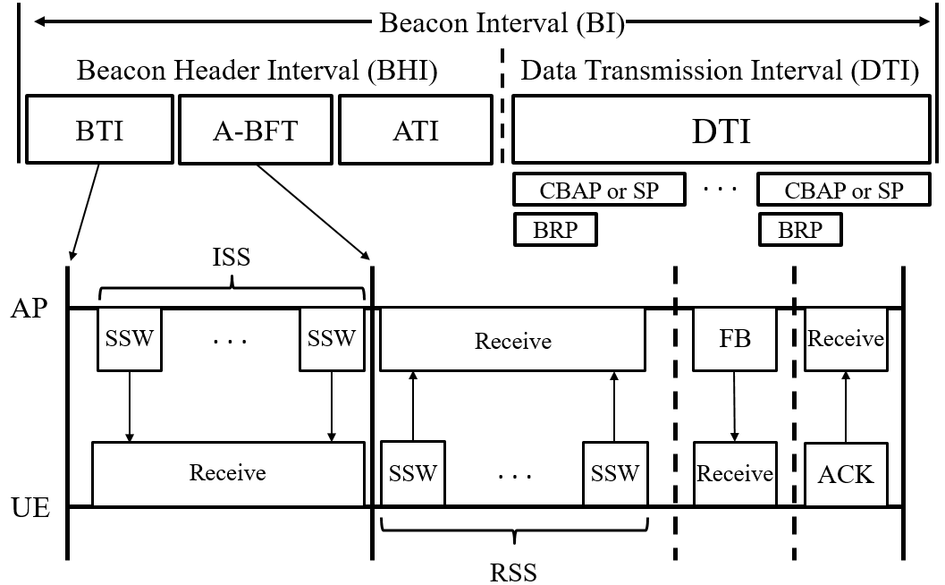
IEEE 802.11ad/ay Beam Training Frame Structure (2/4)
During BTI, the AP will train its optimal transmission beam, so called initiator sector sweep (ISS)
The AP will beacon sector sweep (SSW) frames from sequential sectors
In these SSW frames, the receiving user equipment (UE) will obtain the beam (index) ID and signal-to-noise ratio (SNR) of each beam

Slide 7
References (1/3)
[1] S. Scott-Hayward and E. Garcia-Palacios, “High Deﬁnition Video in IEEE 802.15.3c mm-Wave Wireless Personal Area Networks,” in Proc. IEEE 36th Conference on Local Computer Networks (LCN), pp. 93–100, Oct. 2011.
[2] S. Borkar and H. Pande, “Application of 5G Next Generation Network to Internet of Things,” in Proc. International Conference on Internet of Things and Applications (IOTA), pp. 443–447, Jan. 2016.
[3] R. K. Crone, “Propagation Effects at Millimeter Wavelengths,” in Proc. IEEE Military Communications Conference (MILCOM), vol. 2, pp. 432–437 , Oct. 1985.
[4] W. Roh, J. Seol, J. Park et al., “Millimeter-wave Beamforming as an Enabling Technology for 5G Cellular Communications: Theoretical Feasibility and Prototype Results,” IEEE Communications Magazine, vol. 52, no. 2, pp. 106–113, Feb. 2014.
[5] V. Raghavan, S. Subramanian, J. Cezanne et al., “Directional Beamforming for Millimeter-Wave MIMO Systems,” in Proc. IEEE Global Communications Conference (GLOBECOM), pp. 1–7, Dec. 2015.
[6] T. Nitsche, C. Cordeiro, A. B. Flores et al., “IEEE 802.11ad: Directional 60 GHz Communication for Multi-Gigabit-per- second Wi-Fi,” IEEE Communications Magazine, vol. 52, no. 12, pp. 132–141, Dec. 2014.
[7] Y. Ghasempour, C. R. C. M. da Silva, C. Cordeiro et al., “IEEE 802.11ay: Next-Generation 60 GHz Communication for 100 Gb/s Wi-Fi,” IEEE Communications Magazine, vol. 55, no. 12, pp. 186–192, Dec. 2017.

Slide 8
References
[1] D. Lopez-Perez, A. Garcia-Rodriguez, L. Galati-Giordano, M. Kasslin and K. Doppler, "IEEE 802.11be Extremely High Throughput: The Next Generation of Wi-Fi Technology Beyond 802.11ax," in IEEE Communications Magazine, vol. 57, no. 9, pp. 113-119, September 2019, doi: 10.1109/MCOM.001.1900338.

