Slide 1
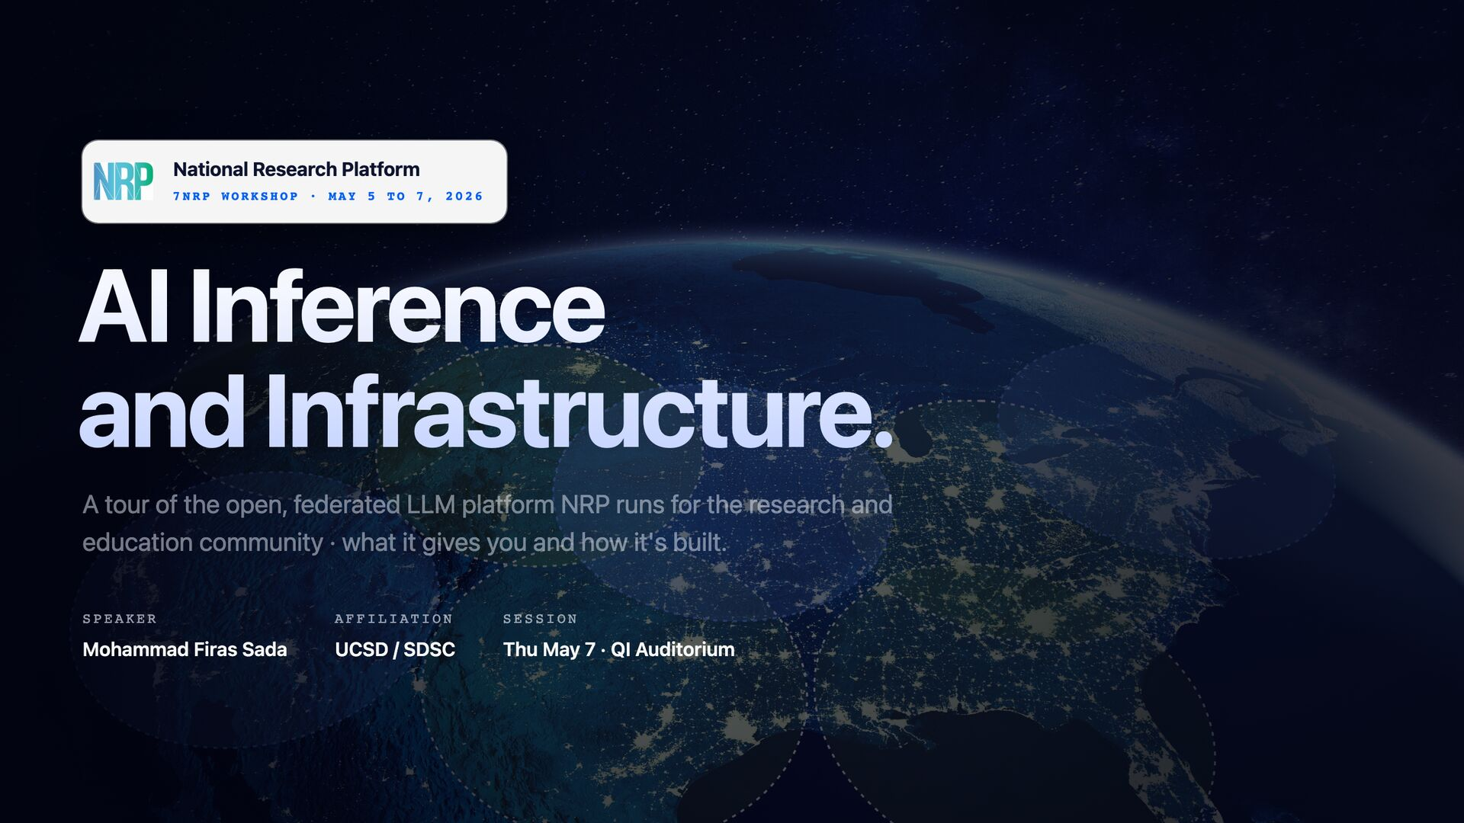

Slide 2
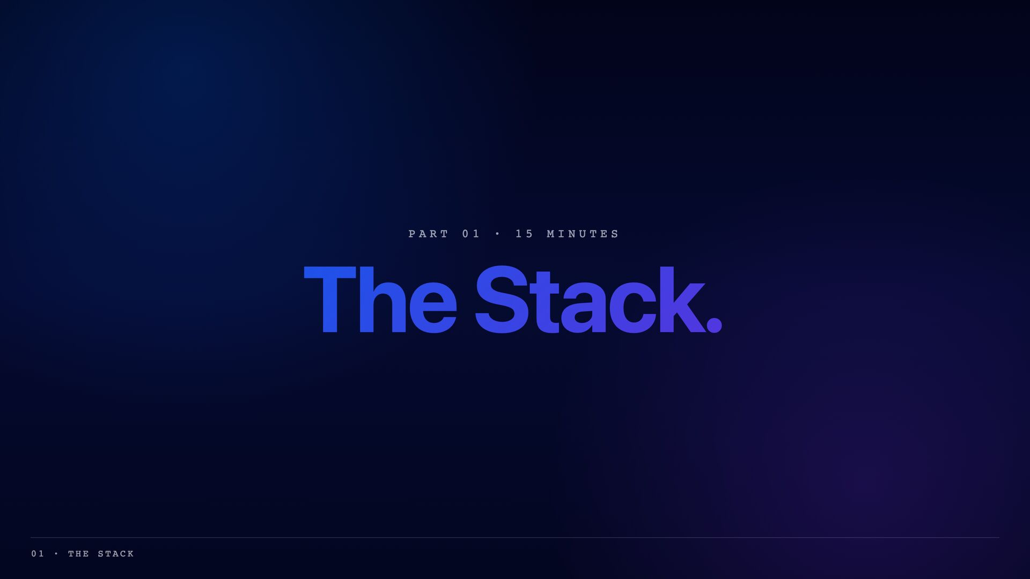

Slide 3
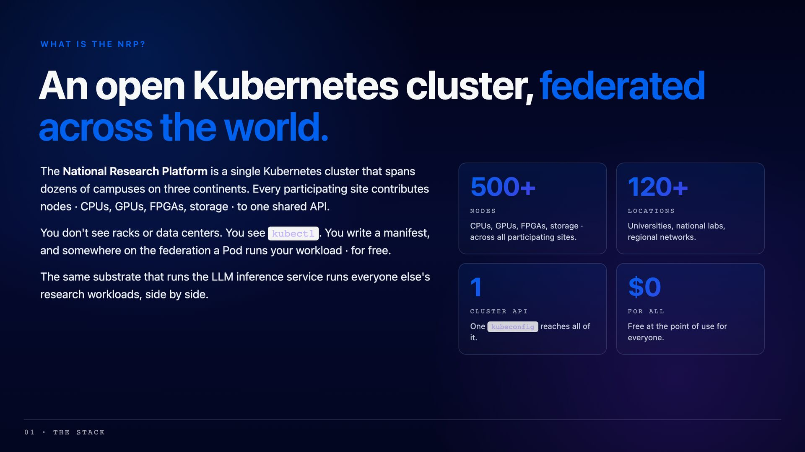

Slide 4
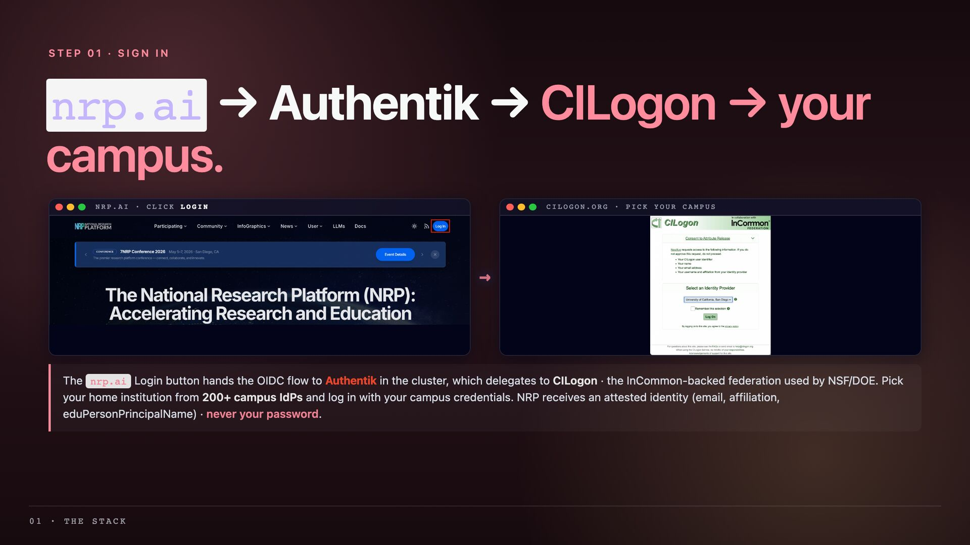

Slide 5
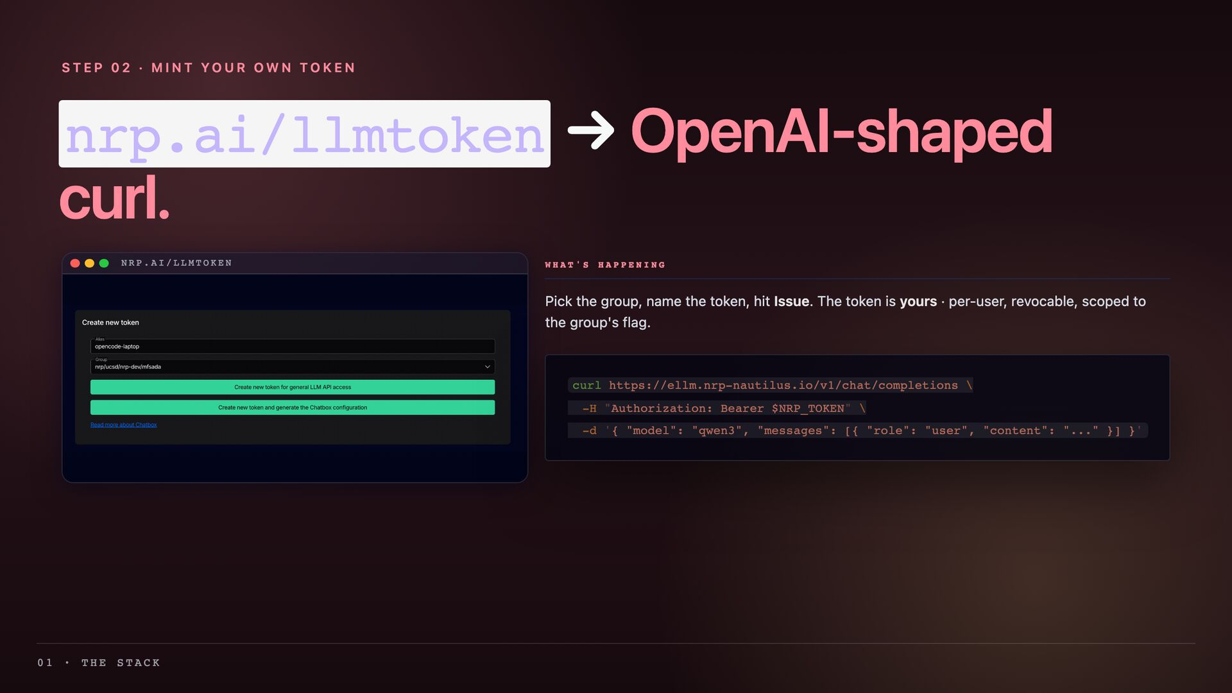

Slide 6
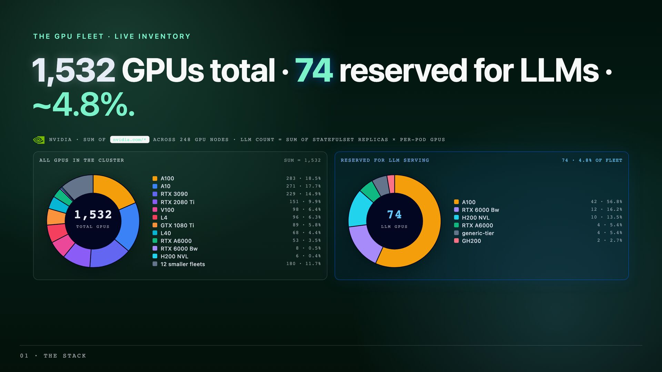

Slide 7
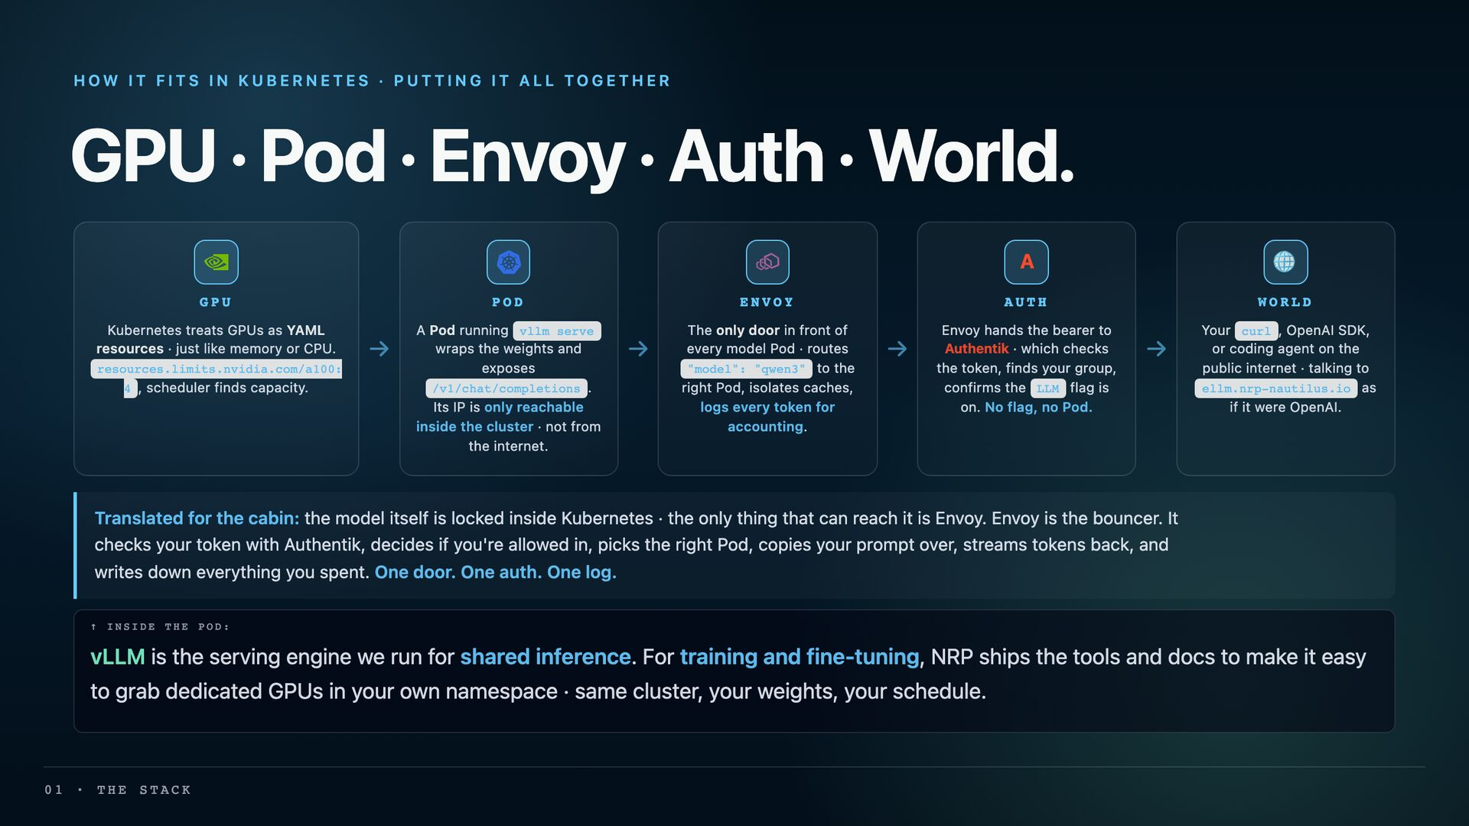

Slide 8
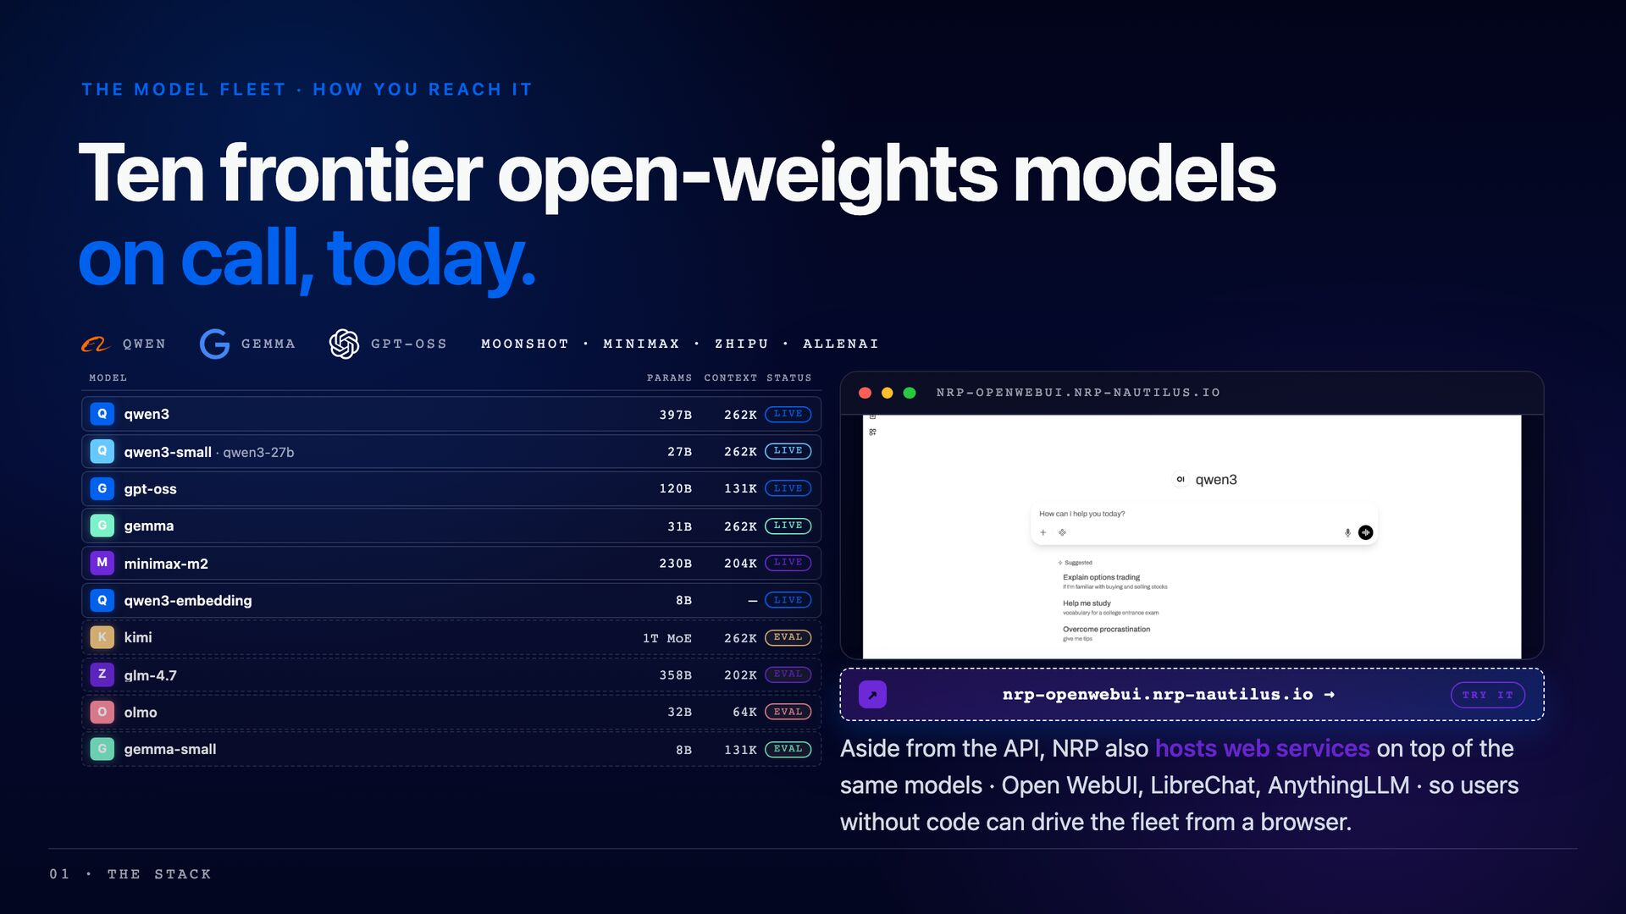

Slide 9
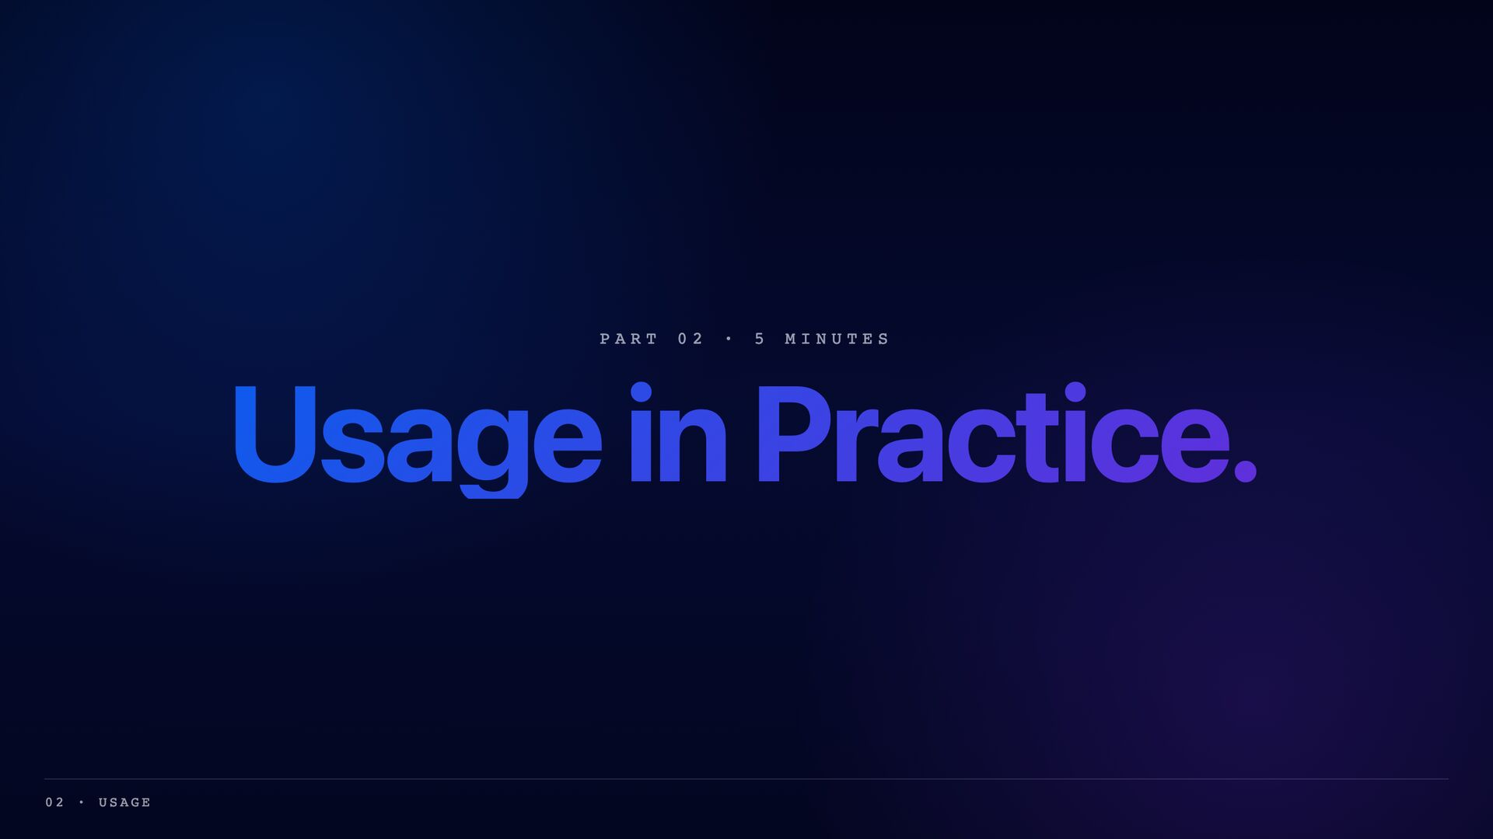

Slide 10
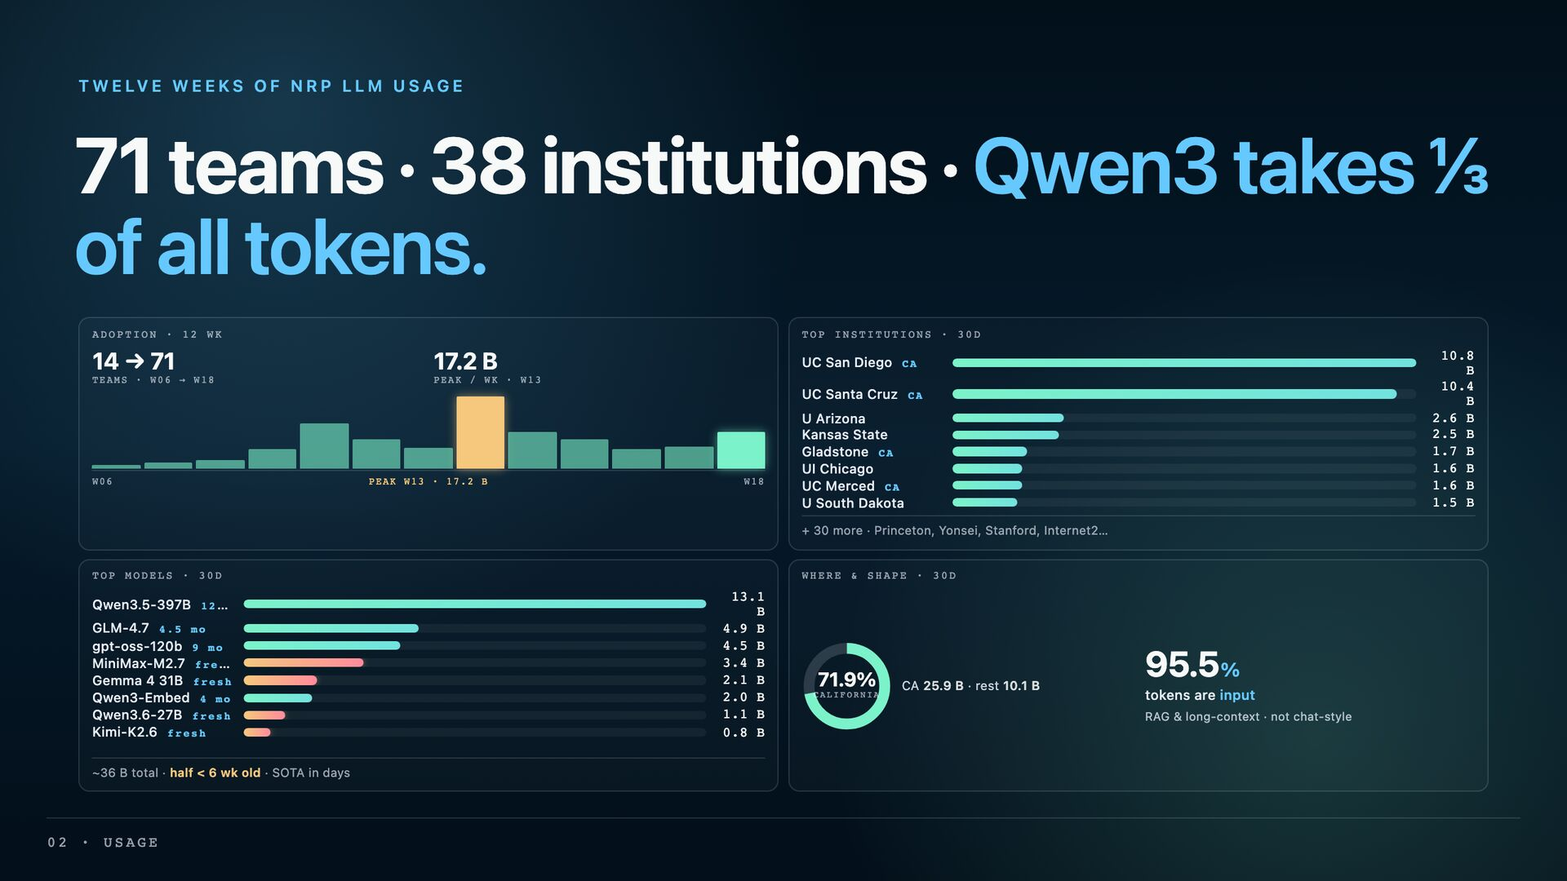

Slide 11
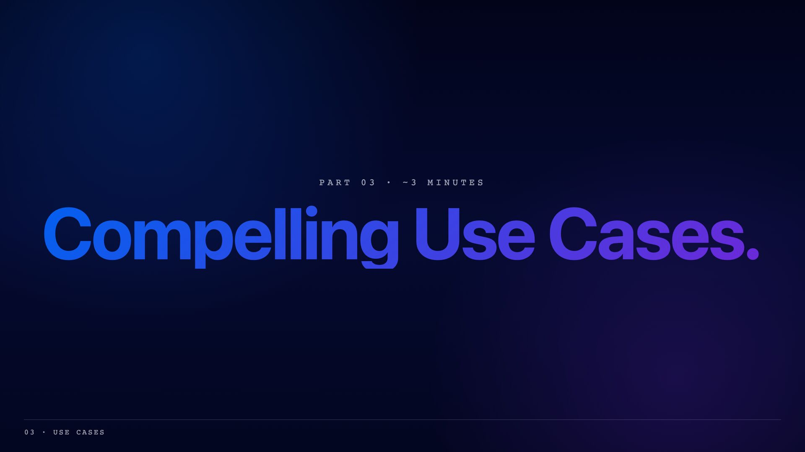

Slide 12
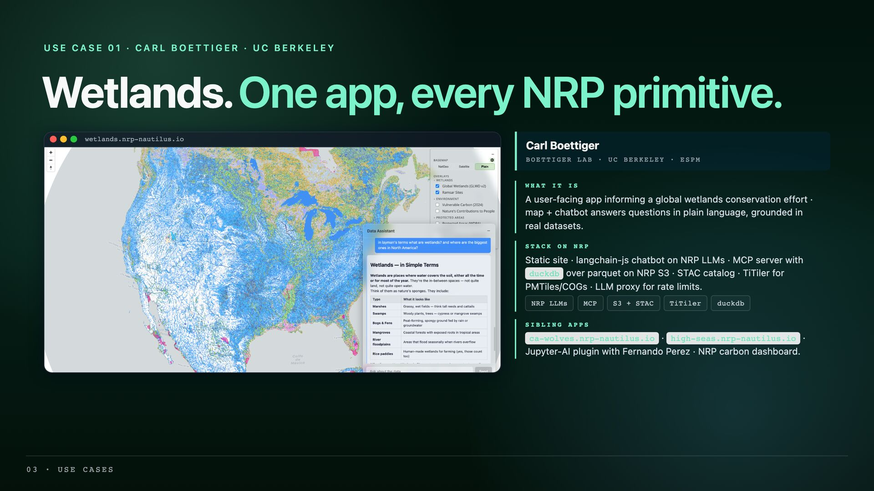

Slide 13
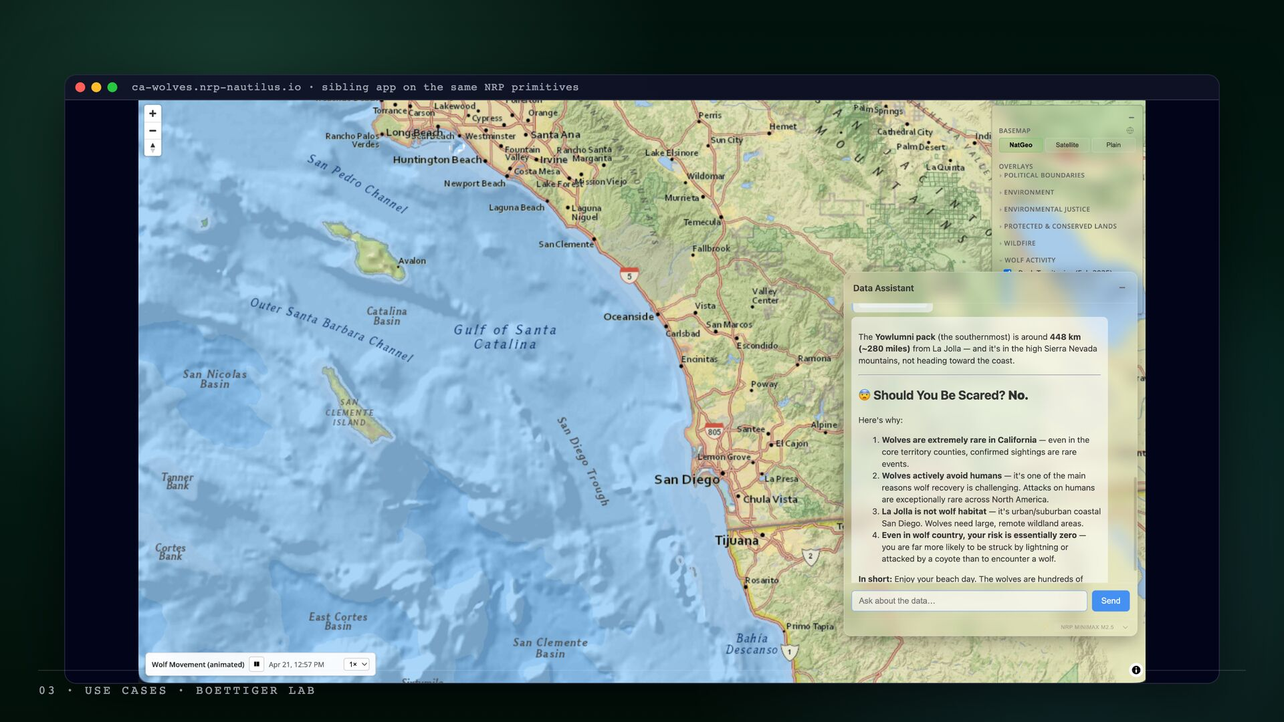

Slide 14
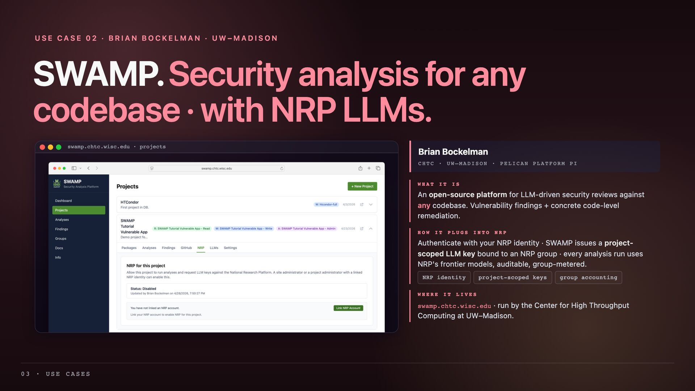

Slide 15
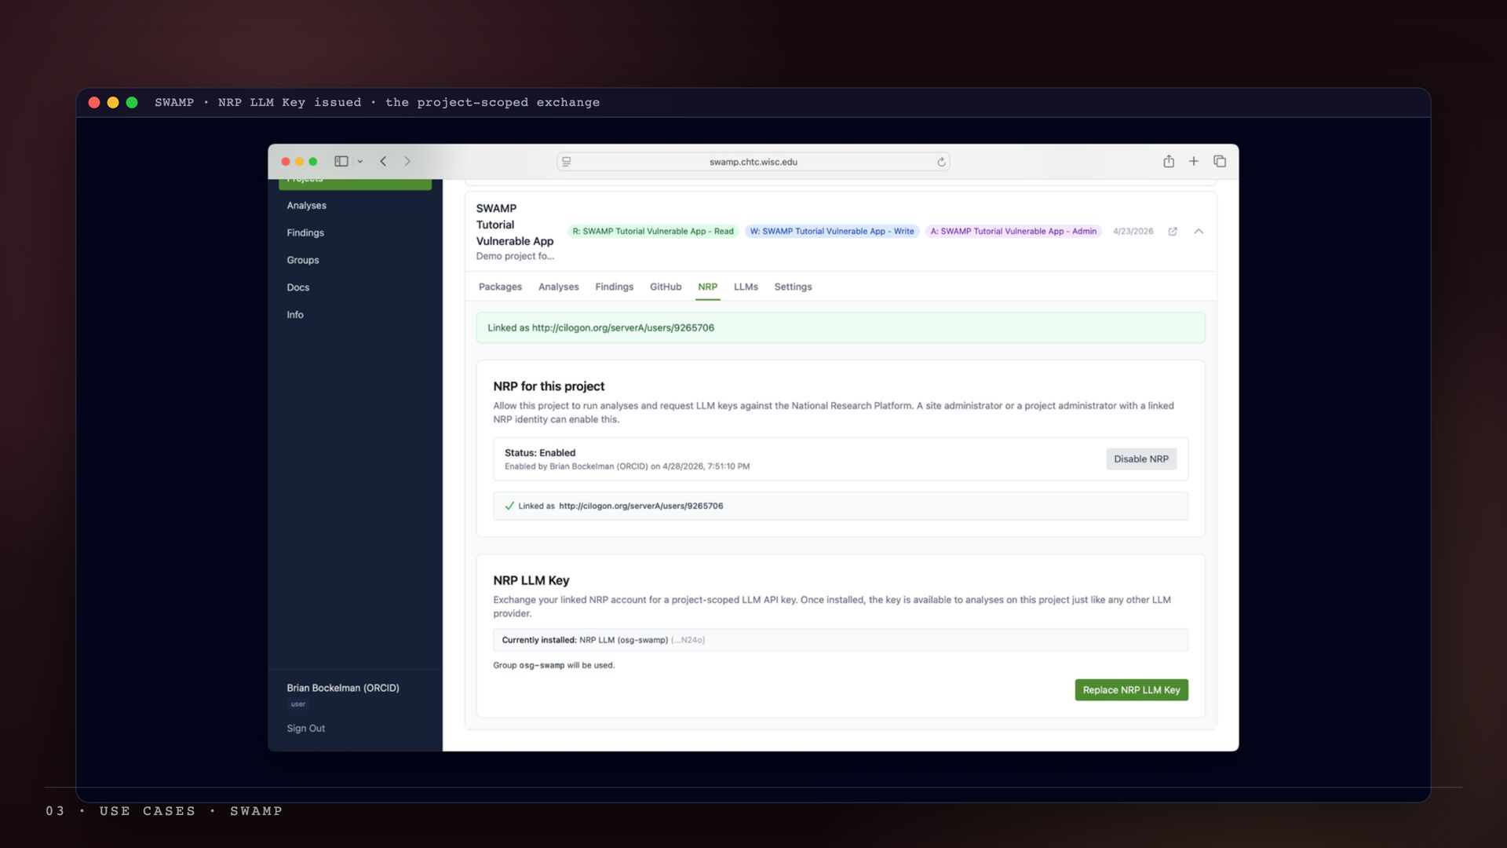

Slide 16
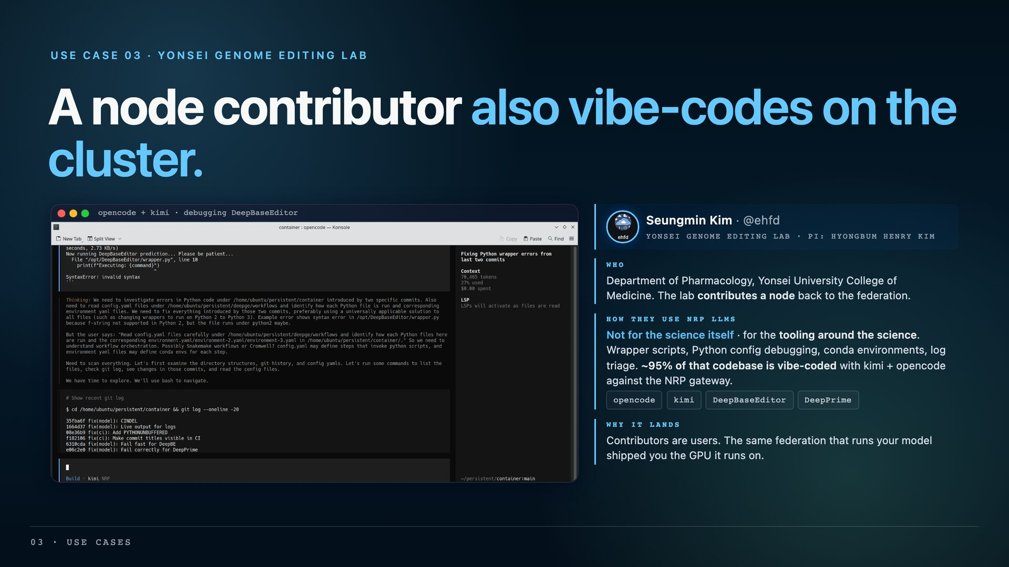

Slide 17
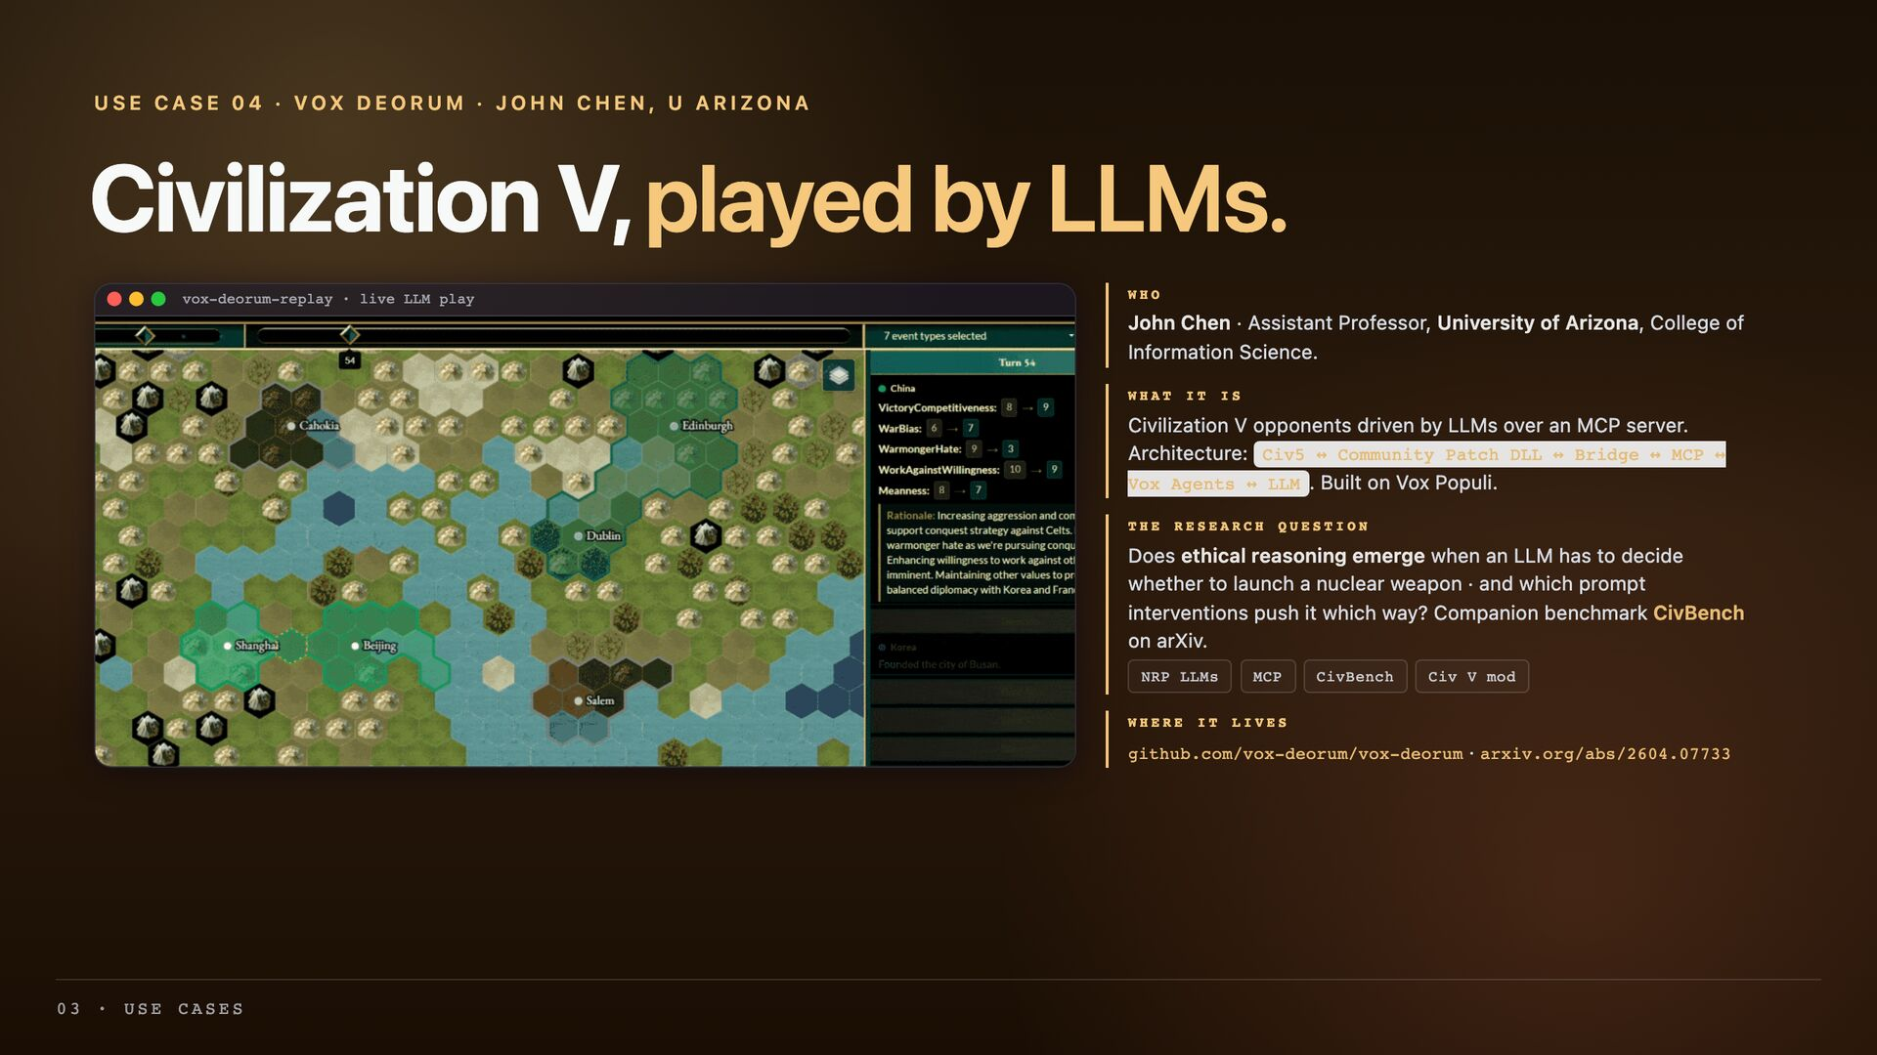

Slide 18
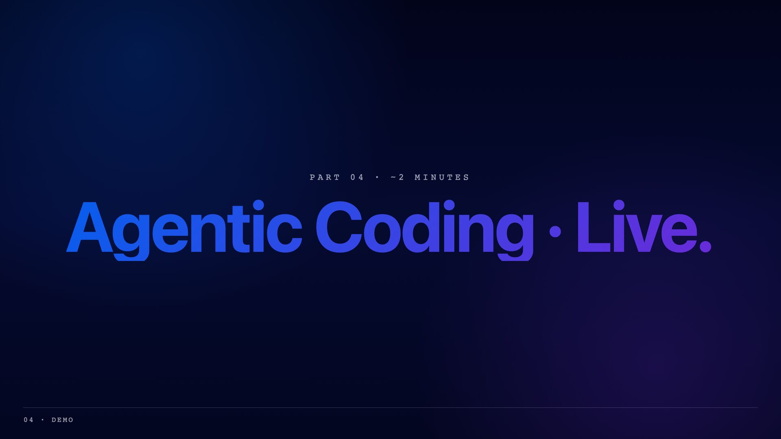

Slide 19
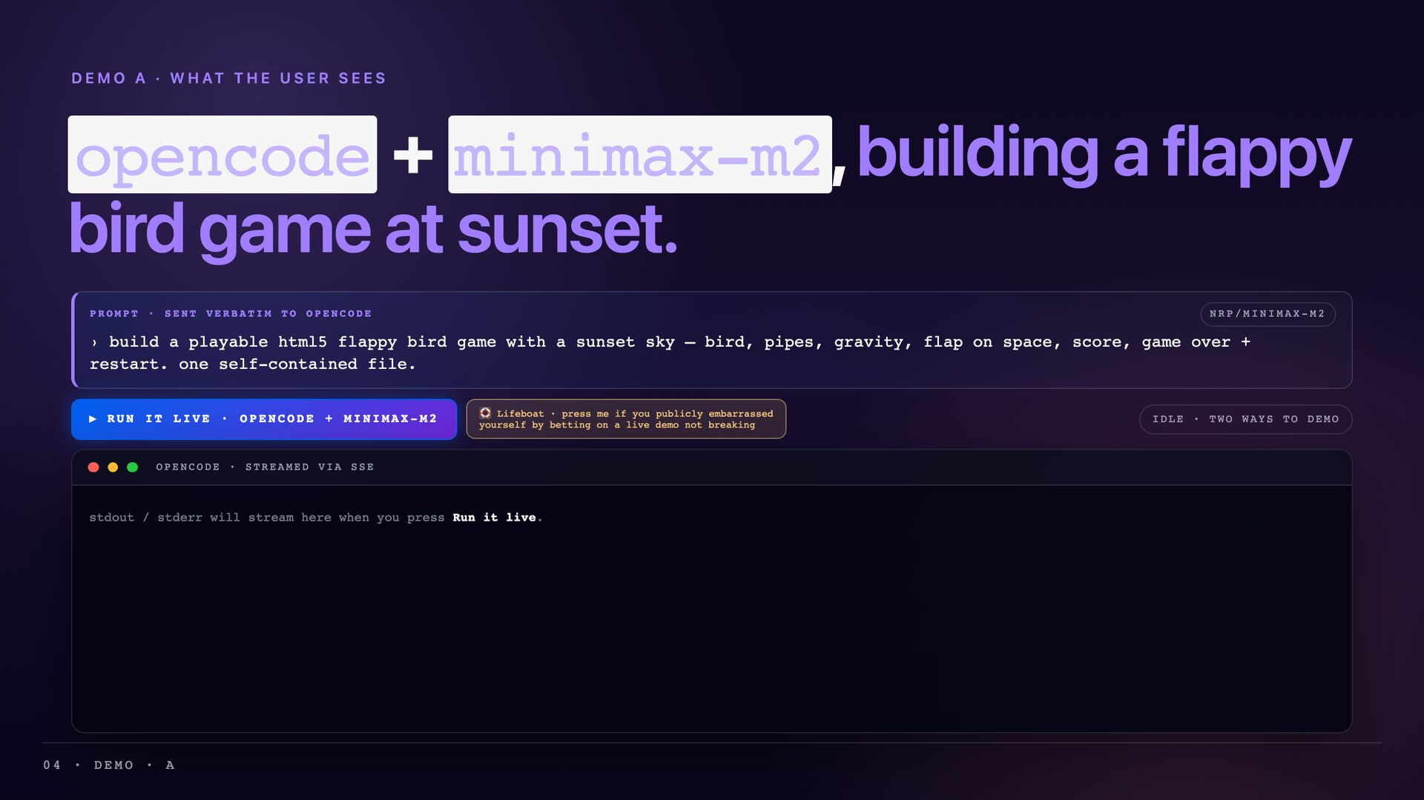

Slide 20
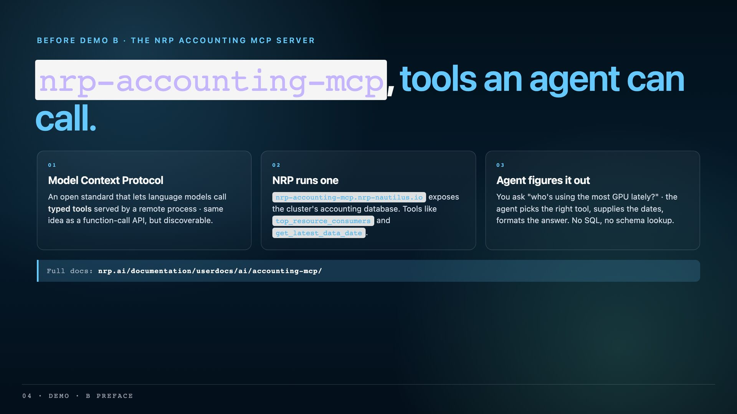

Slide 21
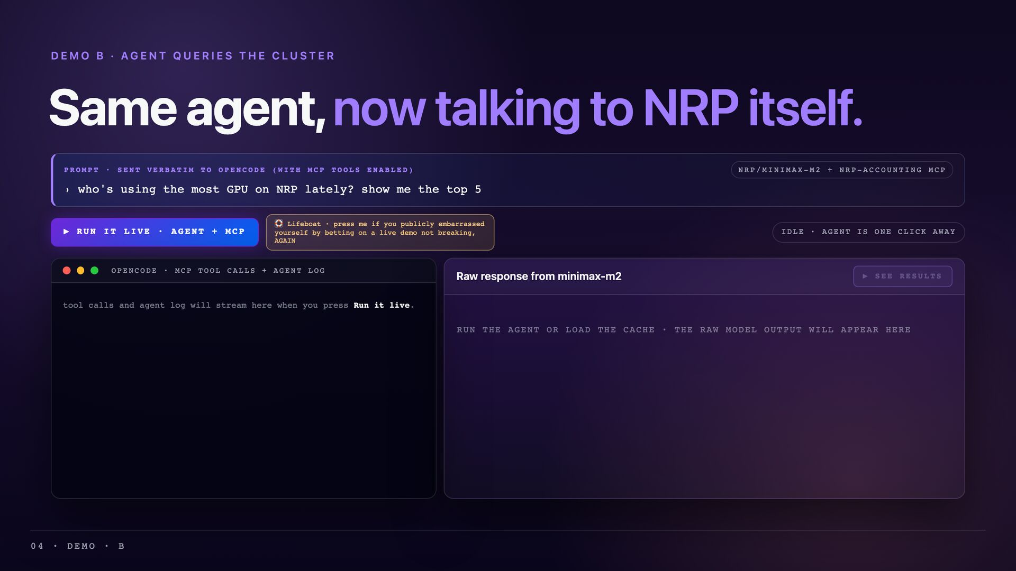

Slide 22
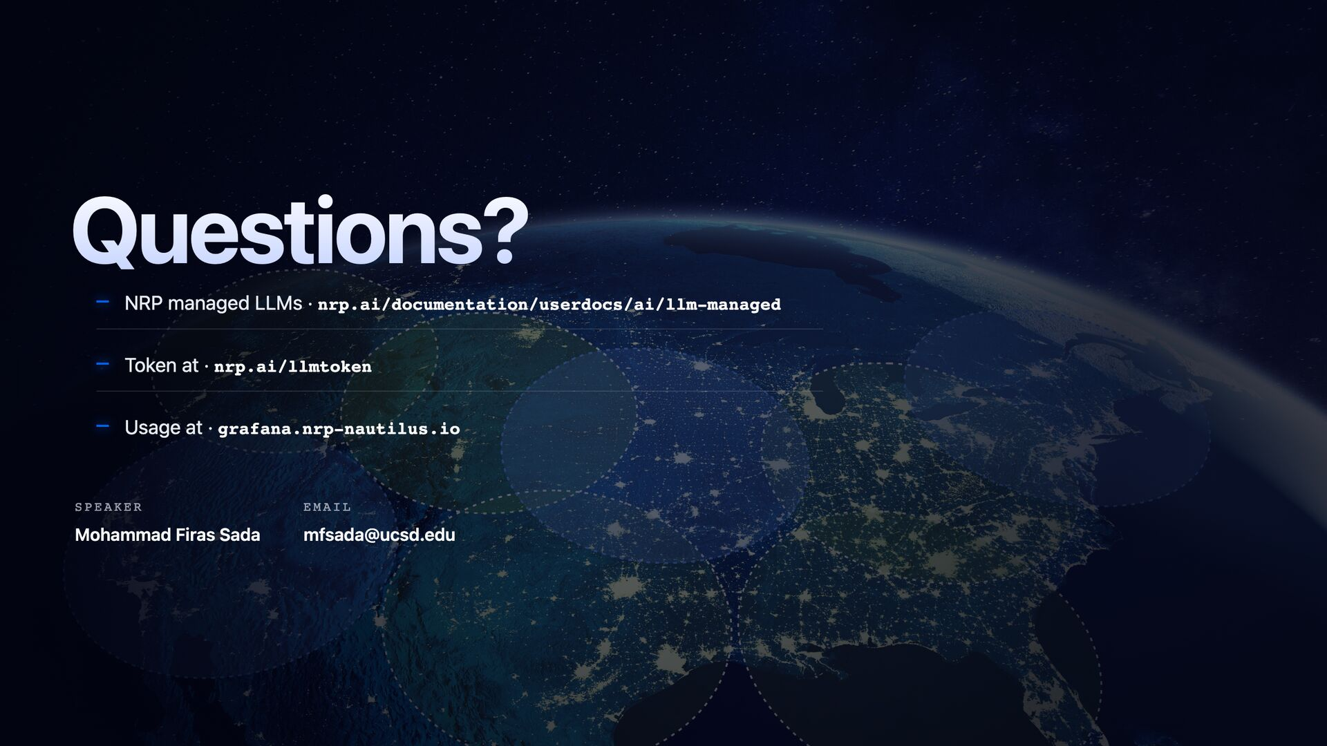
Notes:
========================================================================= SPEAKER NOTES · NOT VISIBLE ON PROJECTOR Audience plant questions for Q&A (drawn from Part 1). Pick 2–3 to seed with friendly attendees beforehand. These are tuned to land specific points in front of the boss. ========================================================================= 1. "How does the NRP managed-LLM stack compare to commercial inference (Together, Fireworks, Bedrock) on cost-per-million-tokens, model breadth, and time-to-availability for new open-weights releases?" → Lets you say: Qwen3.5, Kimi-K2.6, MiniMax-M2.7, GLM-4.7 all live within weeks of release. Free for the user. SDSC + Internet2 affiliates get 2× concurrency. Boss-friendly framing: NRP is a strategic alternative, not a free toy. 2. "The cache_salt mechanism is interesting · how much of vLLM's GPU time is reclaimed by prefix caching at the gateway level, and is that measurable per user?" → Lets you talk engineering depth. Distinguishes NRP from "OpenAI wrapper" services. Boss likes "we are building real infra." 3. "You showed federated GPUs across UCSD, Mizzou, OSU, Fresno State, Sacramento State and others · what's the operational story when a site goes down vs. centralized clouds?" → Lets you discuss the federation moat: BackendTrafficPolicy retry, multi-replica StatefulSets, scaled-to-zero GH200 reserves. Boss likes "we have operational maturity AND a moat." 4. "What's the path from open-weights inference today to fine-tuning or serving custom models on NRP tomorrow · same gateway?" → Lets you forward-position: yes, the same Envoy + AIGatewayRoute pattern absorbs custom models in project namespaces. Boss likes "this stack scales beyond inference." 5. "Authentik + group flags is unusual · what's the operational benefit over per-user API keys like commercial services?" → Lets you frame: identity travels end-to-end (cache_salt is hashed x-user-id), labs self-organize via groups, admins control LLM flag at the group level not user level. Boss likes "we built this thoughtfully." 6. "How fast does NRP move on a new SOTA model? You named ten · what's the median lag between HF release and NRP availability?" → Lets you brag about velocity. Hard to land directly without sounding boastful, easy to land via a planted question. Talking-point ammo if the boss is in the room: - Gateway is upstream Envoy AI Gateway (CRDs aigateway.envoyproxy.io/v1beta1). - Per-route timeouts: 1200 s general, 3600 s for long-context qwen. - StatefulSets per model so RWO model caches don't collide. - Server-side cache_salt = base64(sha256(x-user-id)) · privacy enforced at the gateway, not trust-the-client. - Token costs recorded as Envoy dynamic metadata, fed to the accounting service; surfaced on grafana.nrp-nautilus.io. - Authentik in the `authentik` namespace fronts all of NRP's identity. - LLM flag is a group-level boolean in prp/llm-proxy. =========================================================================

