Slide 1
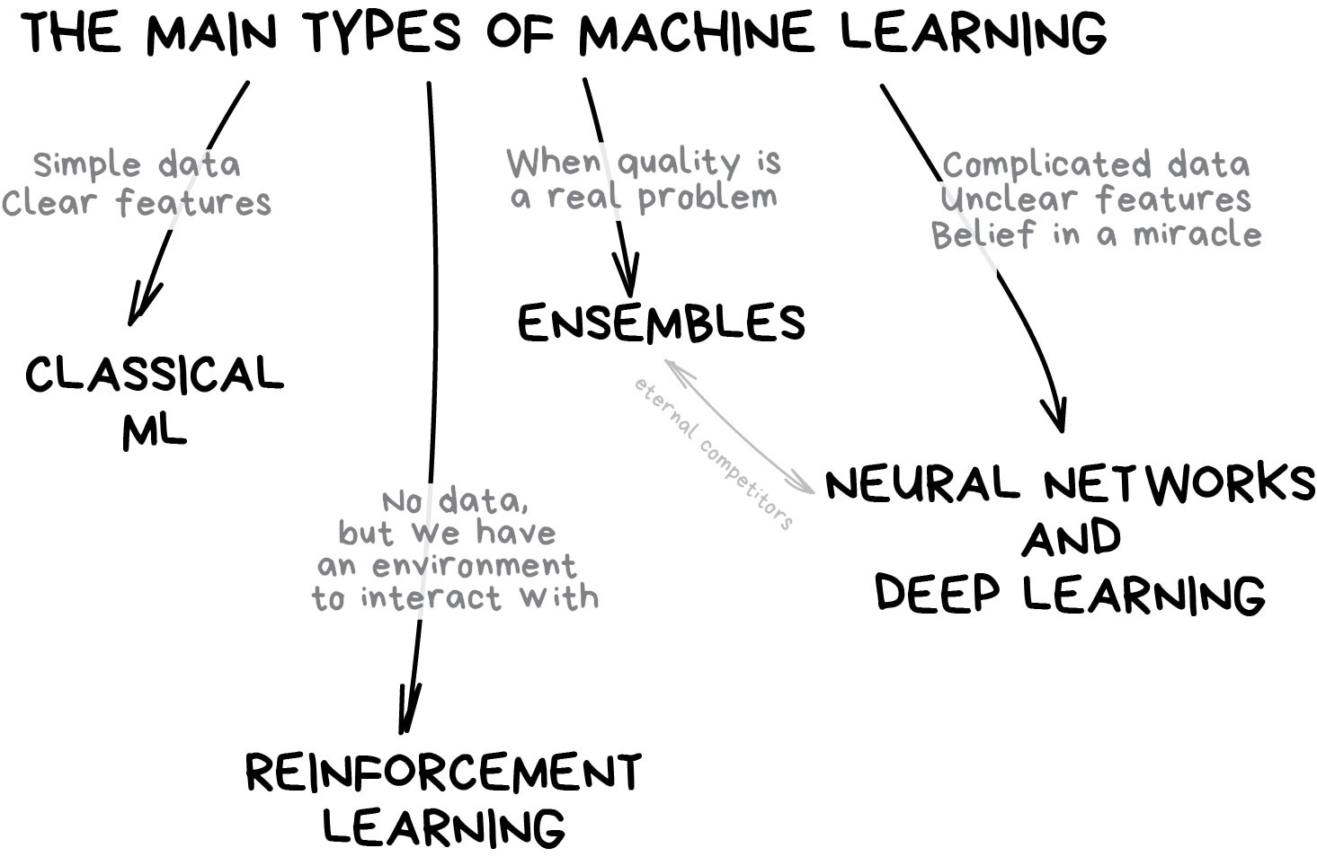
Aquaseca Ensembles
Abe Farley
Dave Murray
Rachel Spinti

Slide 2
Ensemble Selection
Interested in Mountain Recharge, Streambed K, and Sy
Used max and min for variables of interest
Changed the other variables to test sensitivity
Ensemble # | K top and bottom | Kz middle | Specific Yield | Mountain Recharge | Valley ET | Riparian ET | Streambed K
9 | 1 | 1 | 1 | 1 | 1 | 1 | 1
8 | 2 | 2 | 1 | 1 | 2 | 2 | 1
7 | 2 | 2 | 3 | 3 | 2 | 2 | 1
6 | 2 | 2 | 3 | 1 | 2 | 2 | 3
5 | 2 | 2 | 1 | 3 | 2 | 2 | 3
4 | 2 | 2 | 3 | 3 | 2 | 2 | 3
3 | 3 | 3 | 3 | 3 | 3 | 3 | 1
2 | 3 | 3 | 3 | 1 | 3 | 3 | 3
1 | 3 | 3 | 1 | 3 | 3 | 3 | 3
0 | 3 | 3 | 3 | 3 | 3 | 3 | 3

Slide 3
Rankings
Ensemble # | Scenario | Predicted Rank | Actual Rank | Rank Diff
0 | 3333333 | 1 | 1 | 0
1 | 3313333 | 2 | 3 | 1
2 | 3331333 | 3 | 2 | 1
3 | 3333331 | 4 | 4 | 0
4 | 2233223 | 5 | 6 | 1
5 | 2213223 | 6 | 8 | 2
6 | 2231223 | 7 | 7 | 0
7 | 2233221 | 8 | 9 | 1
8 | 2211221 | 9 | 10 | 1
9 | 1111111 | 10 | 5 | 5
Predicted rank
Actual rank

Slide 4
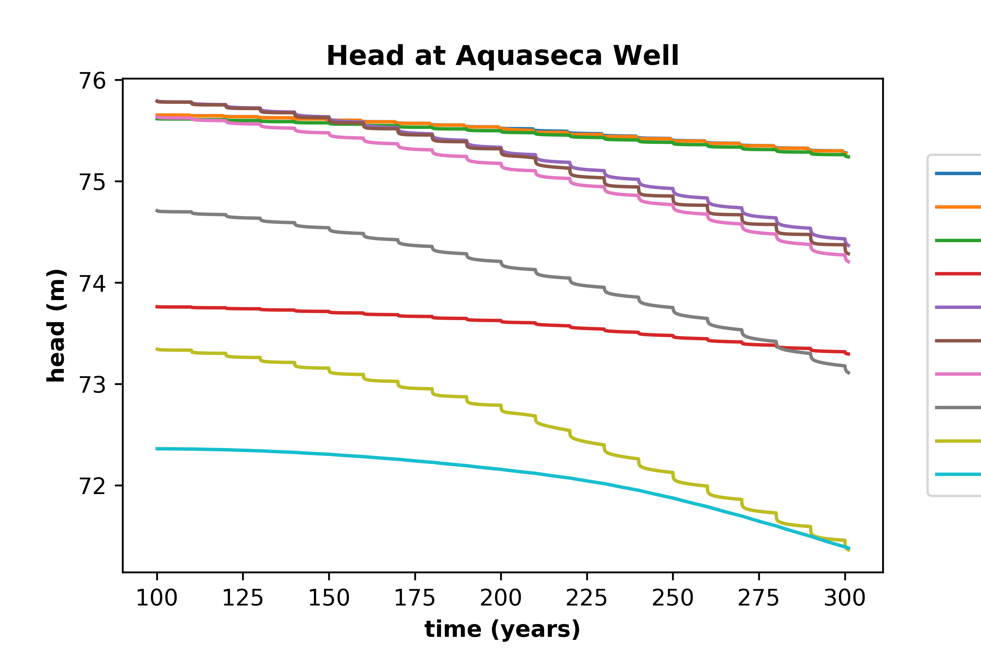
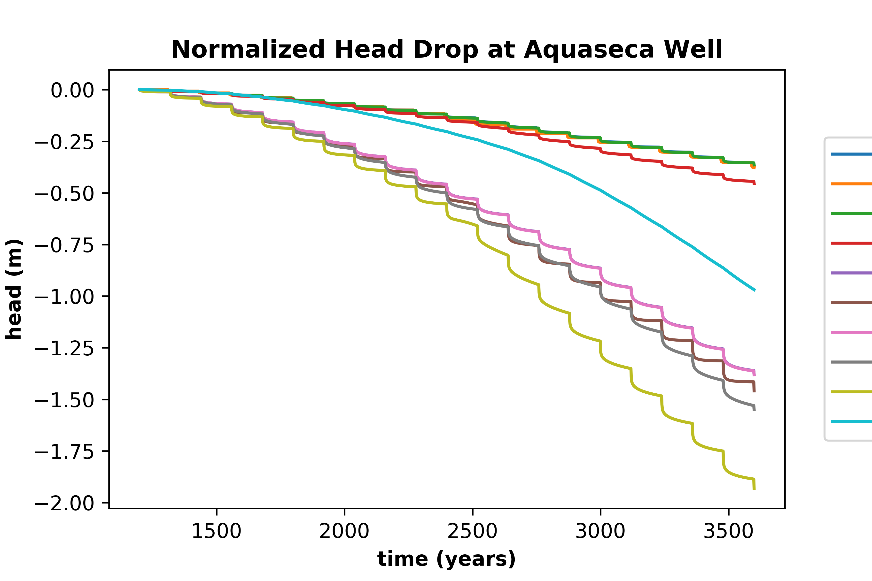
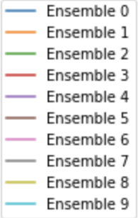
Results

Slide 5
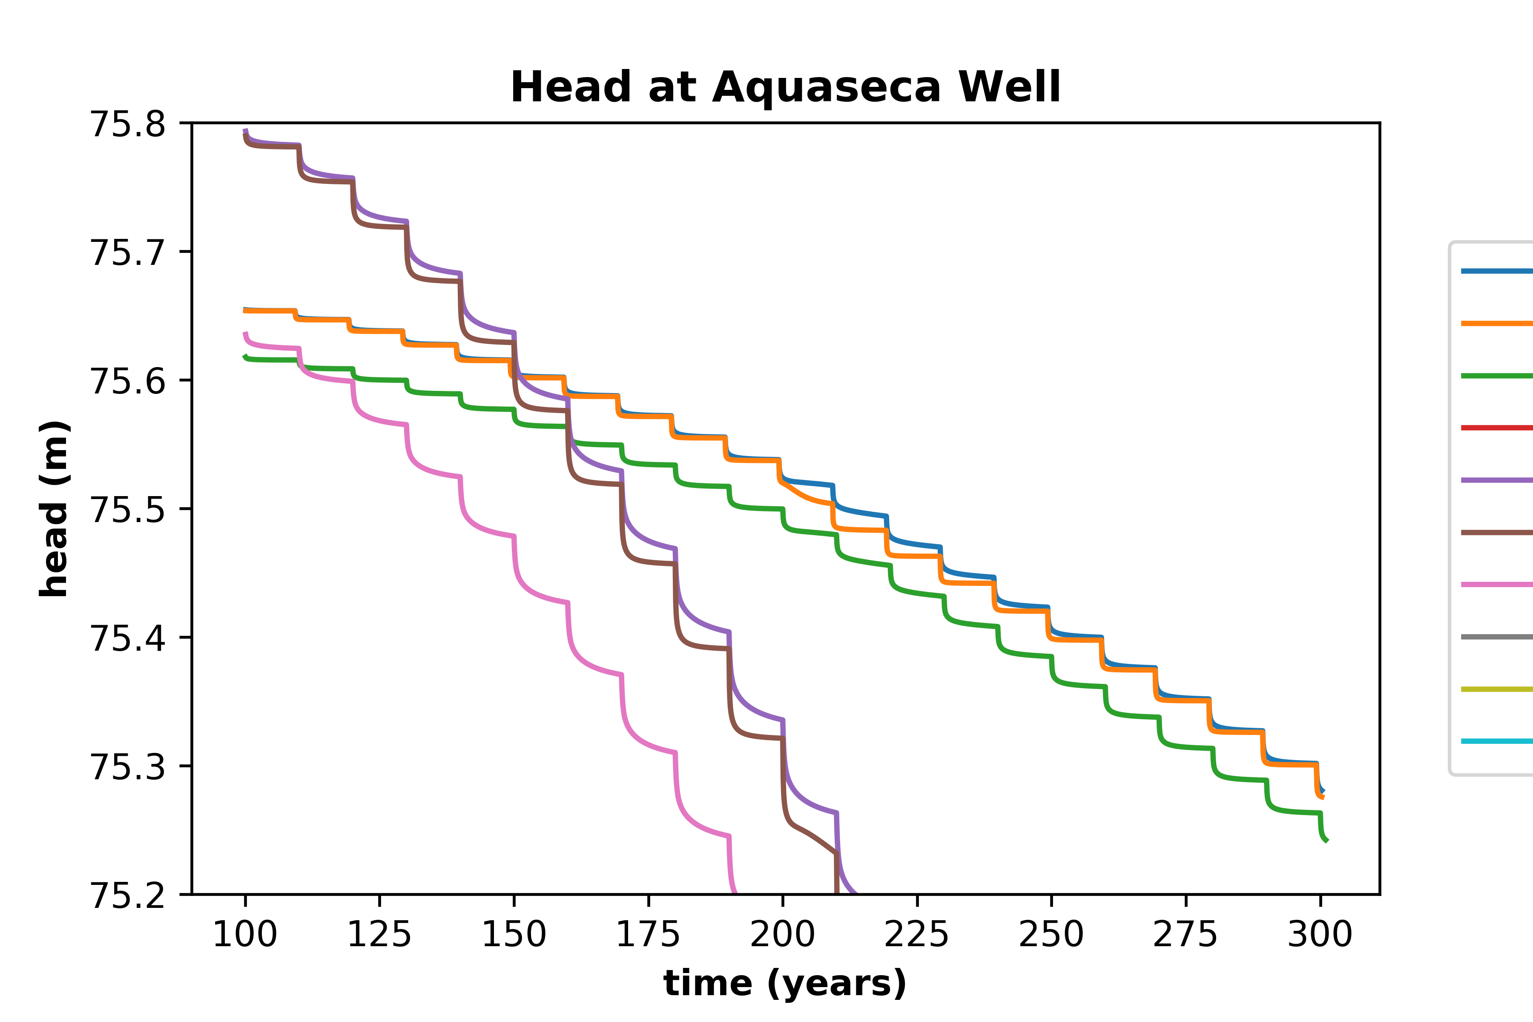

Slide 6
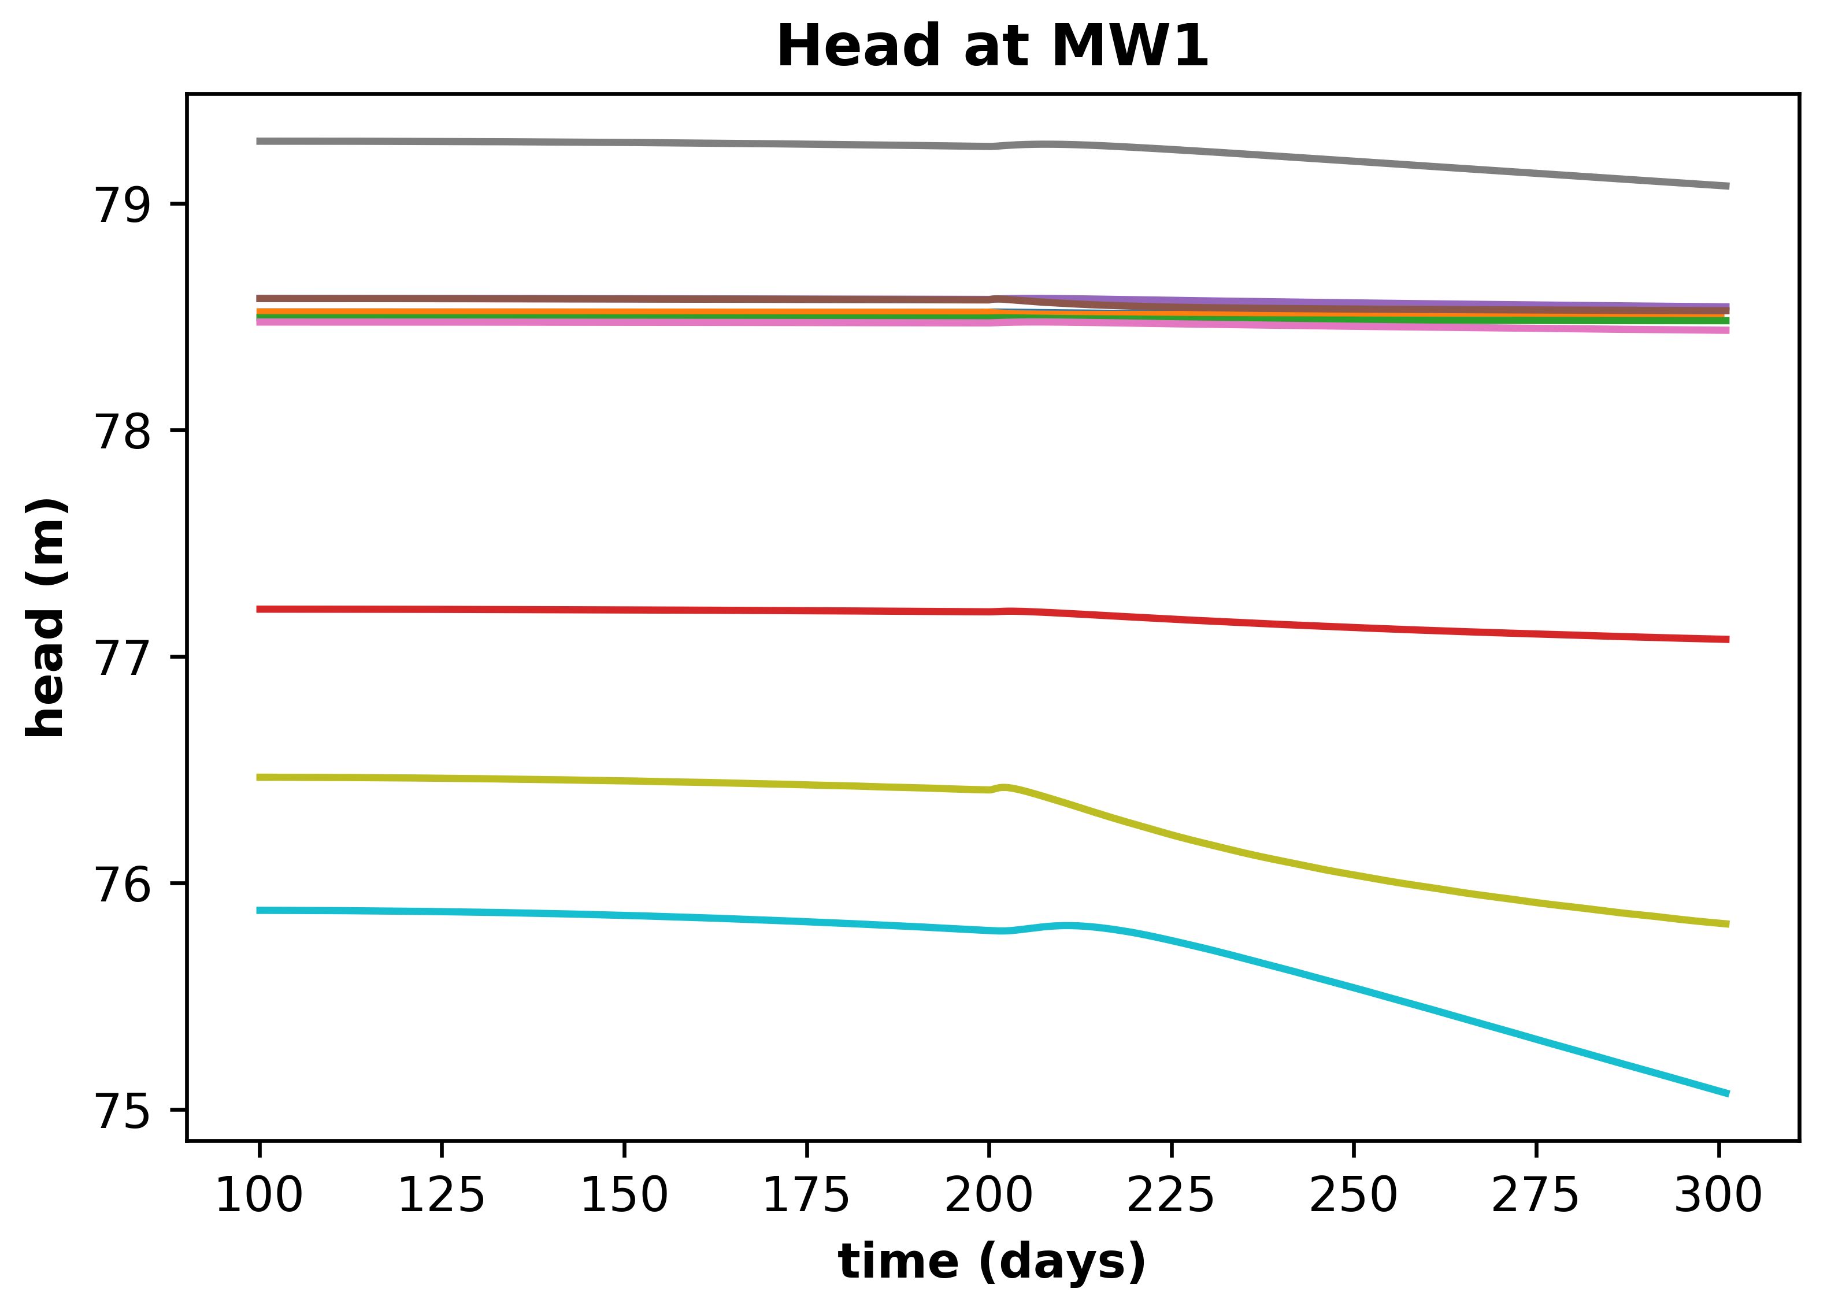
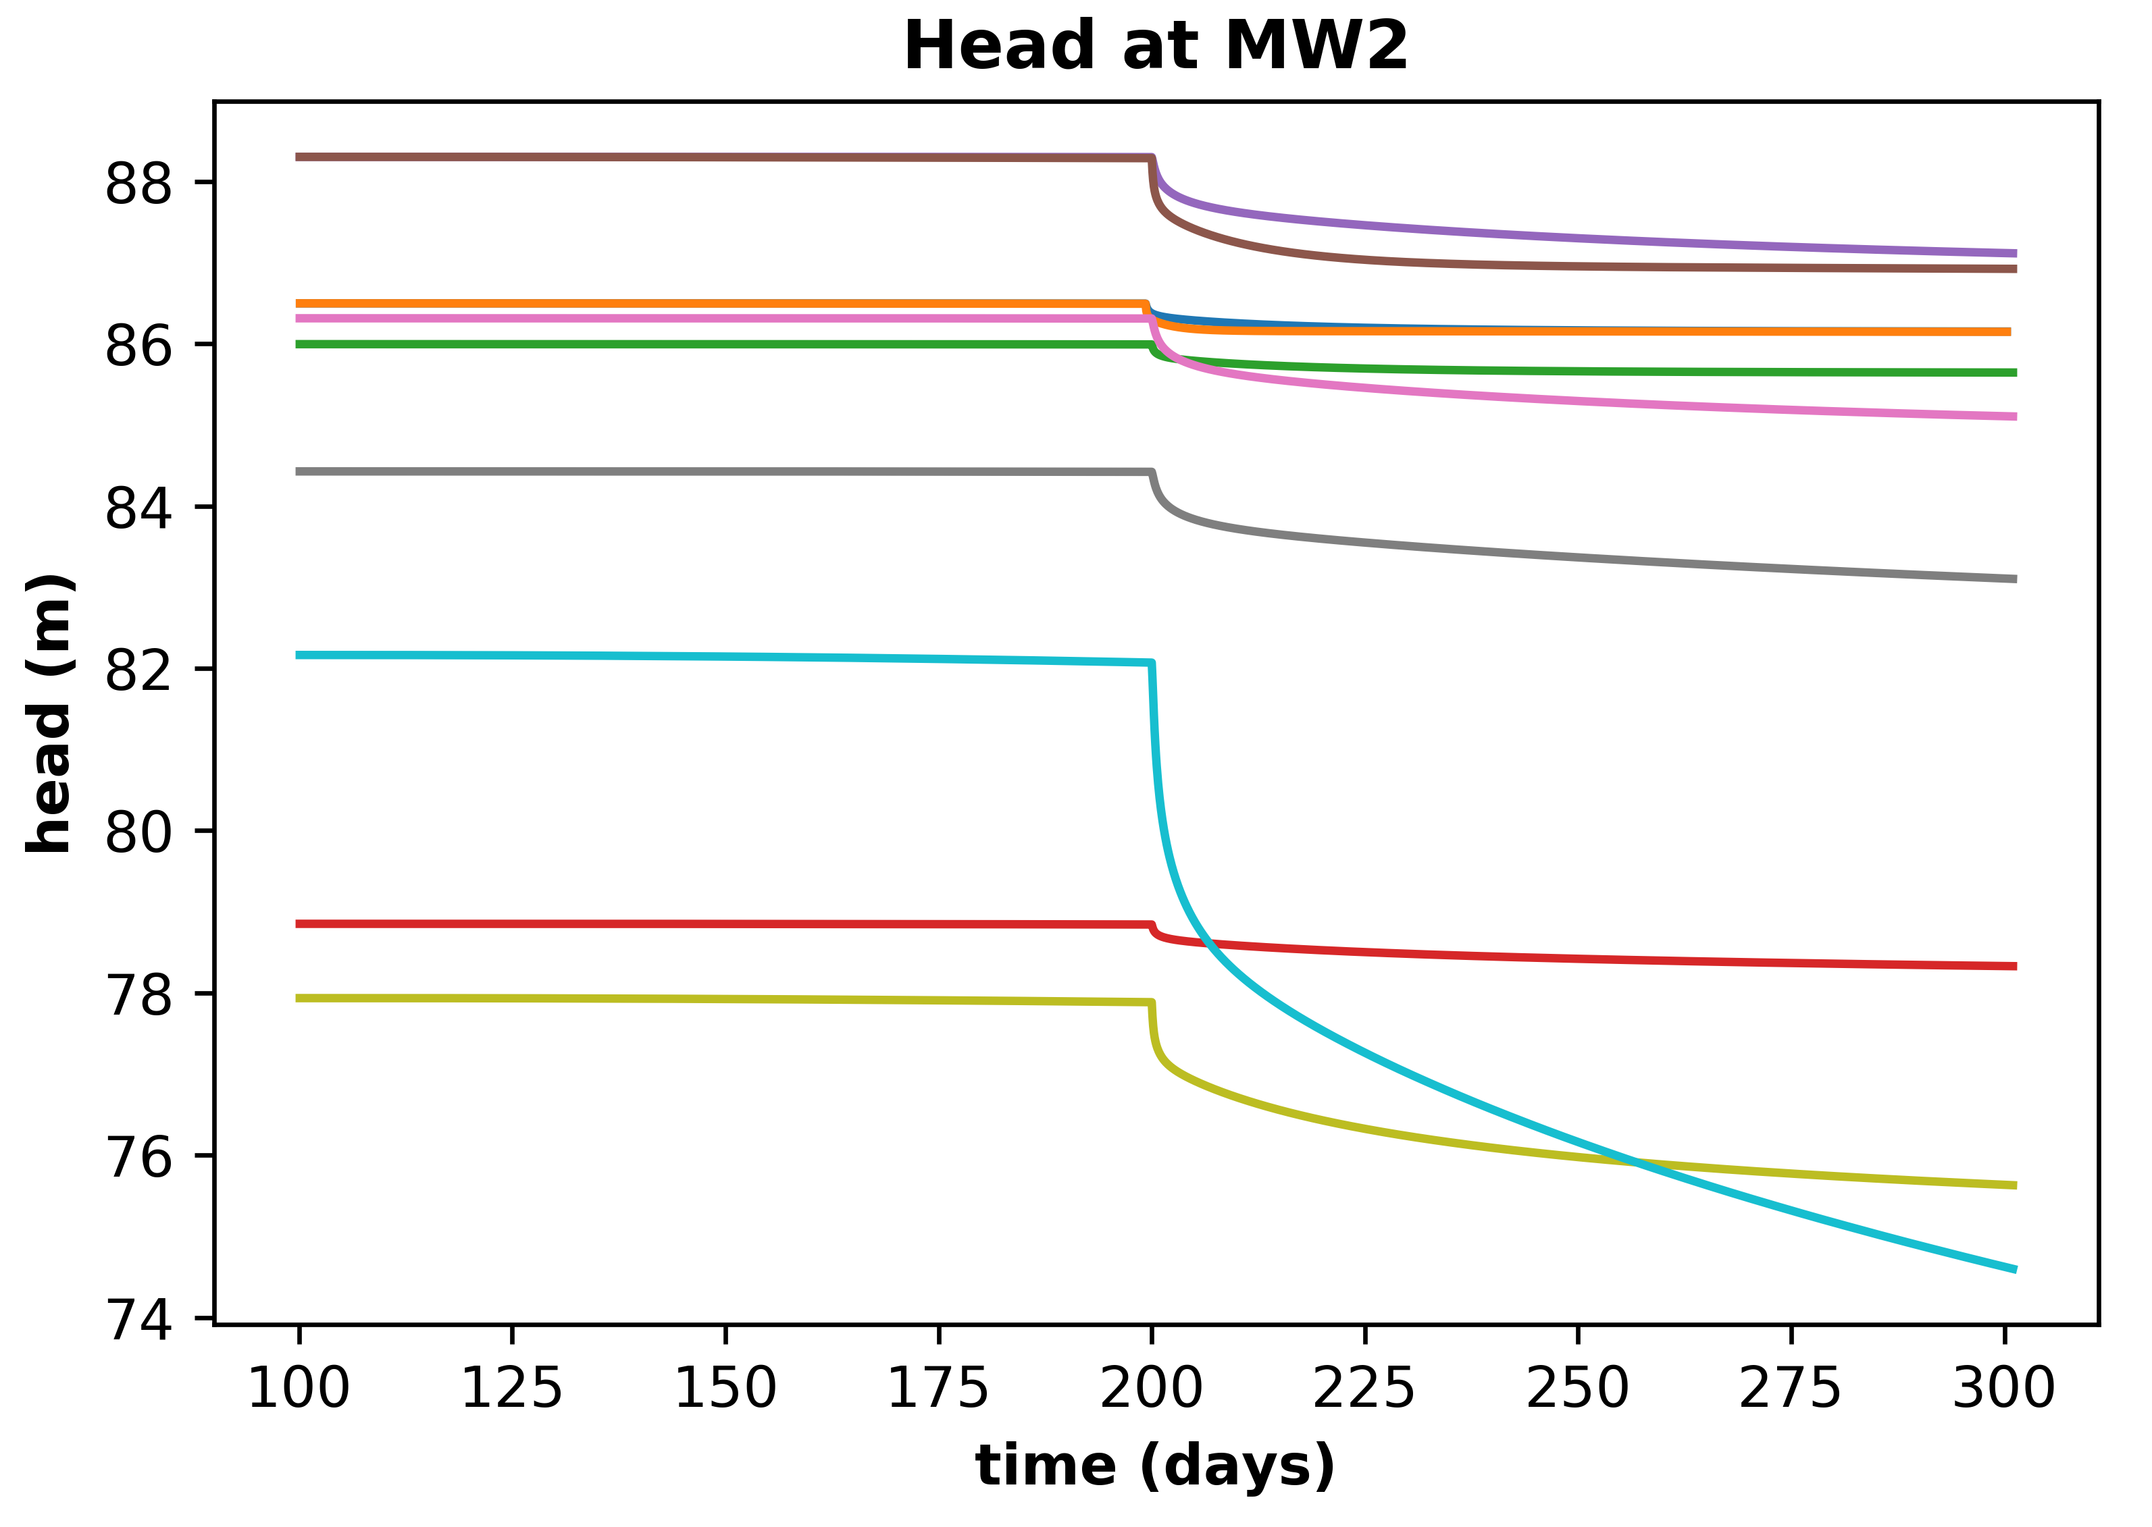
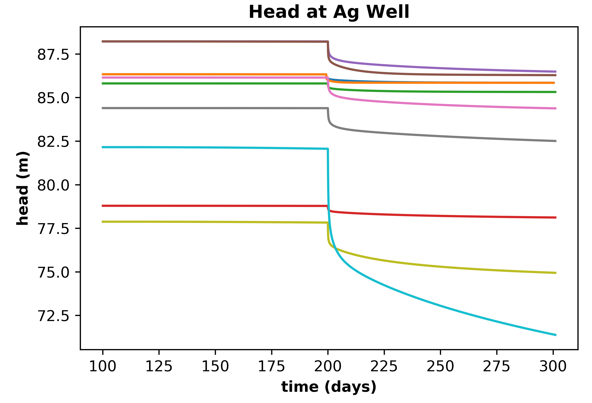

Slide 7
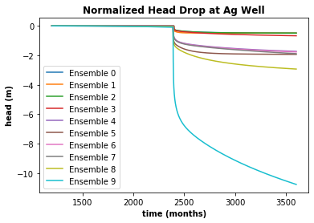
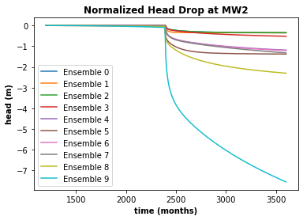
Normalized Heads for the MW 2 and Ag Wells

Slide 8
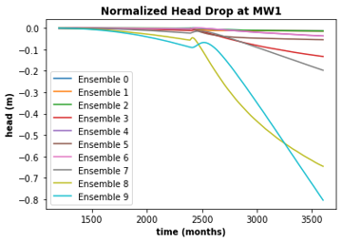
The greatest impact at MW 1 occurs in ensembles with low stream K to system K.
Ag Recharge bump most evident in 8 and 9 – other common parameters are Sy and Mtn Rech (both 1s)

Slide 9
Things we did well
Normalized plots for drawdown made for easy comparison of the extend and trends of the drawdowns in the various ensembles
Asides from a few exceptions, the predicted ranking matched up fairly well with the actual ranking (most off by only 0 or 1)

Slide 10


Worst Mistakes
Ensemble 9
See table entry
Why?
Consideration of parameters
Honorable mention: Ensemble 5 – 2 rankings higher (more impact) than expected
Ensemble Selection:
Focused on Mt Rech, Sy, and streambed K, but larger variety is needed to draw more conclusions
Some scenarios were challenging to get to converge which caused long runtimes and decreases in the damping (and therefore quality of the result)...mostly ensemble 0 but also 1-4.

