Slide 1
Transient River and Head Boundaries
Abe Farley, Dave Murray, Rachel Spinti

Slide 2
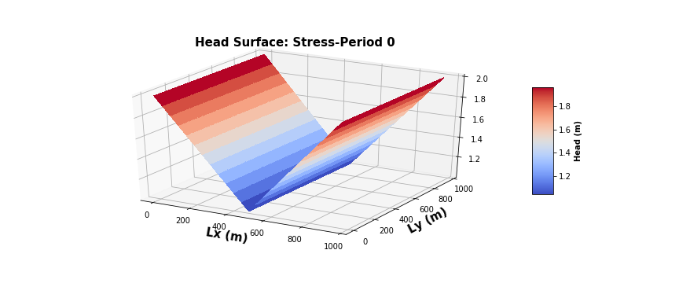
3D Head Profiles st0:
in phase
out of phase

Slide 3
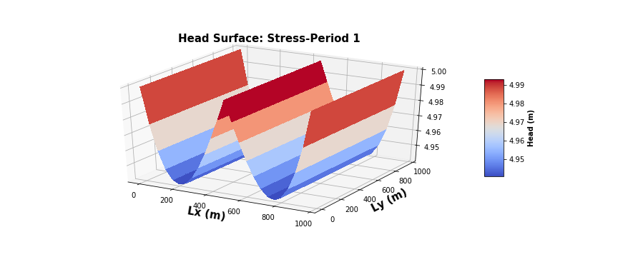
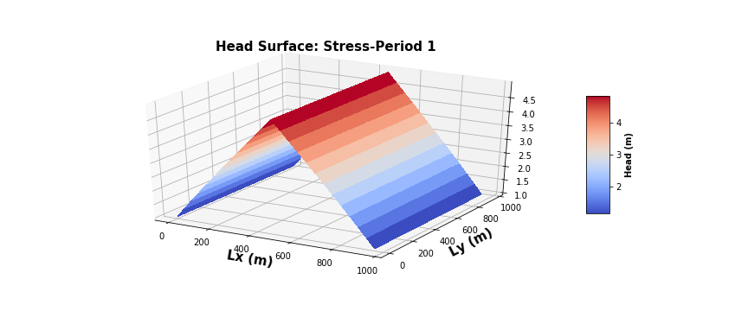
3D Head Profiles st1:
in phase
out of phase

Slide 4

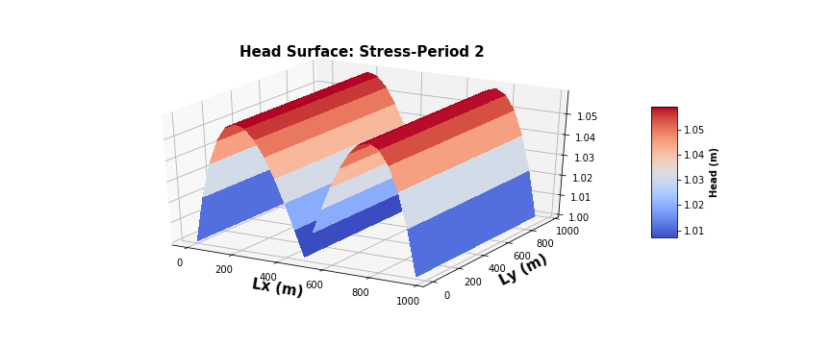
3D Head Profiles st2:
in phase
out of phase

Slide 5
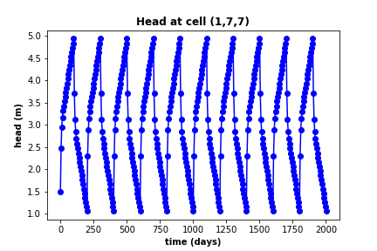
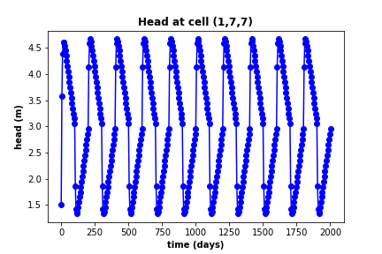
Head at Midpoint over time:
in phase
out of phase

Slide 6
Leakage Comparison
Stress period | Leakage In phase | Leakage out phase
0 | -207.25 | -207.25
1 | 31.94 | 797.07
2 | -31.94 | -797.07
3 | 31.94 | 797.07
4 | -31.94 | -797.07
5 | 31.94 | 797.07
6 | -31.94 | -797.07
7 | 31.94 | 797.07
8 | -31.94 | -797.07
9 | 31.94 | 797.07
10 | -31.94 | -797.07
11 | 31.94 | 797.07
12 | -31.94 | -797.07
13 | 31.94 | 797.07
14 | -31.94 | -797.07
15 | 31.94 | 797.07
16 | -31.94 | -797.07
17 | 31.94 | 797.07
18 | -31.94 | -797.07
19 | 31.94 | 797.07
20 | -31.94 | -797.07

Slide 7
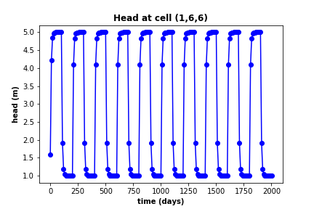
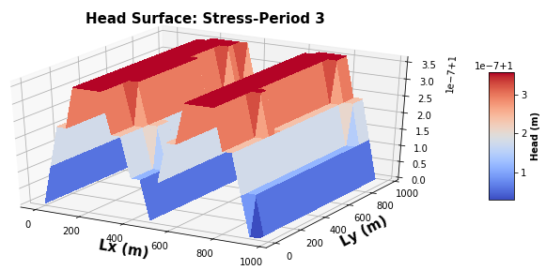
Broken Modflow

