Slide 1
Homework 4: Effects of Adding Evapotranspiration
Amanda Triplett and Ben Mitchell

Slide 2
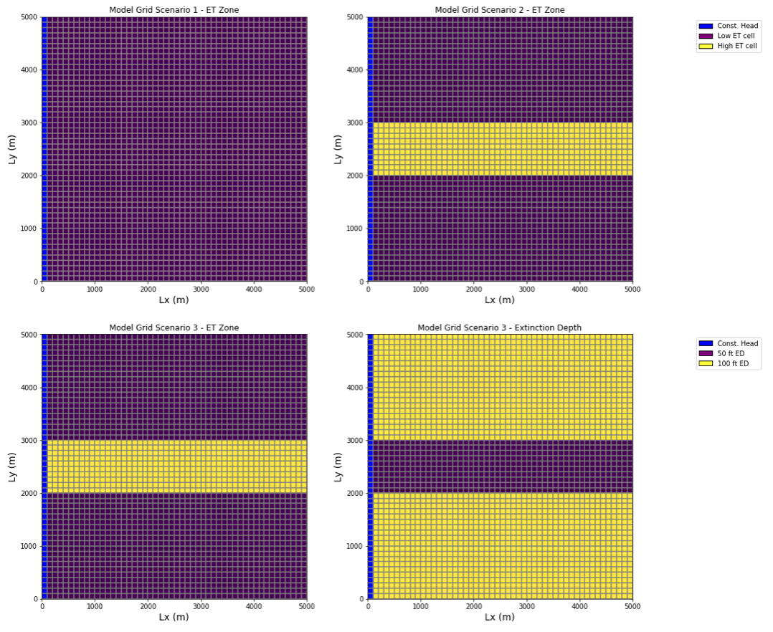
Setting up the Model Domain
Scenario 1: Uniform recharge (1e-4), uniform extinction depth (100m), uniform ET (1e-4)
Scenario 2: Uniform recharge 1e-4,uniform extinction depth (100m) central 1000m has higher ET rate of 1e-3 the rest has the same ET
Scenario 3: Uniform recharge (1e-4), variable extinction depth (central zone has 50m), variable ET (same as scenario 2)

Slide 3
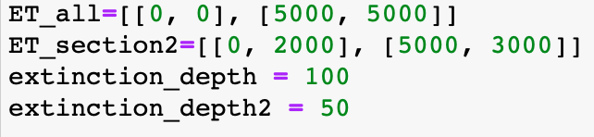
Set-up Notes
Setting up ET zones
Setting up extinction depth as an array
Adding numbers to the names of everything, would a loop have been better in this case? Other methods?

Slide 4
The Water Balance
Which scenarios had the most and least ET and why?
What happens when ET is greater than recharge?
Could you calculate this by hand? Why or Why not?
 | Recharge (m/day) | ET (m/day)
Scenario 1 | 2450 | -1789.35
Scenario 2 | 2450 | -4149.96
Scenario 3 | 2450 | -2976.31

Slide 5
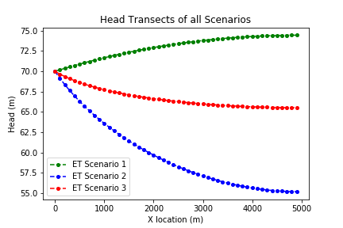
Head Profiles
Are these head profiles what you expected?
Why is the head maximum at the constant head boundary for scenarios 2 and 3?
What support is there for the given head profile from the water balance?
At what ET would a head profile switch from Scenario 1 to 2/3? Can you predict it?
Explain what the path of a water particle might look like moving from left to right in the domain for each scenario

Slide 6
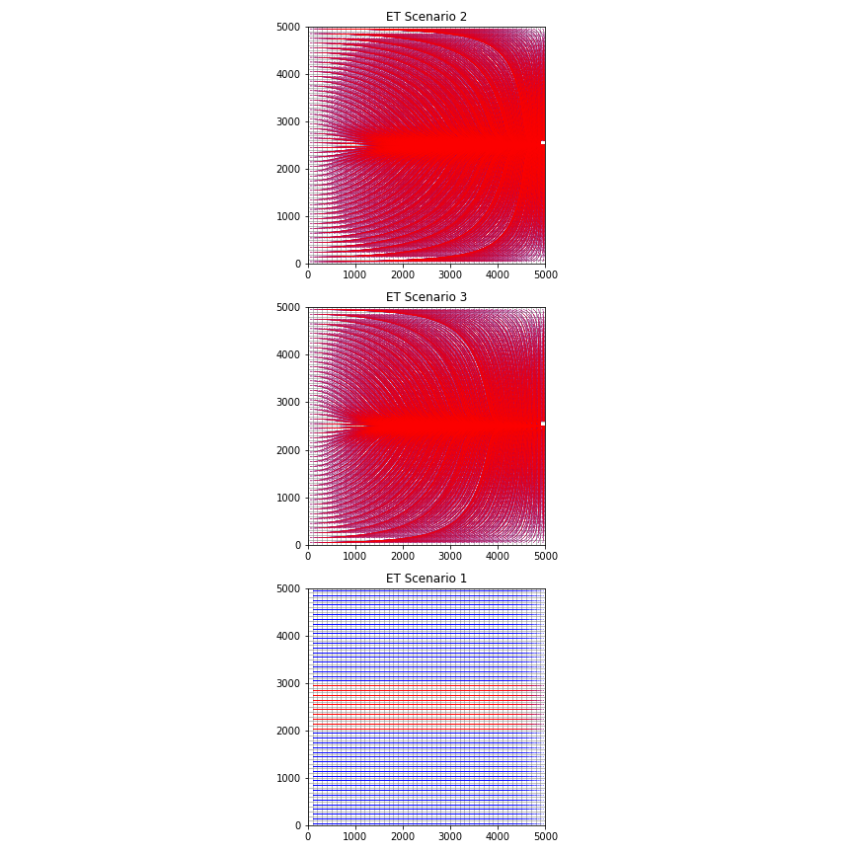
Flow Paths
What direction are the particles moving in Scenarios 1, 2 and 3?
All particles look like they pass through the ET zone in both scenarios. Does this make sense based on the water budget and head profiles we’ve seen? Why or why not?
Can you see any differences between the flow paths of scenarios 1 and 2? What are the processes behind those differences?

Slide 7
Take Home Messages
How could you make the ET processes modeled here more representative of a real-world domain?
What should you keep in mind when setting up ET processes in your model domain?
Do you feel like you understand how you would pass in more complex matrices of ET or extinction depth? How important do you think resolving these factors are across a domain?
Final thoughts and feelings?

