Slide 1
confined aquifer Pumping
Rachel Spinti
Justin Warlick

Slide 2
Confined Aquifer pumping
Model setup
Defining domain
Boundary conditions
Np.flipud
https://www.w3resource.com/numpy/manipulation/flipud.php

Slide 3
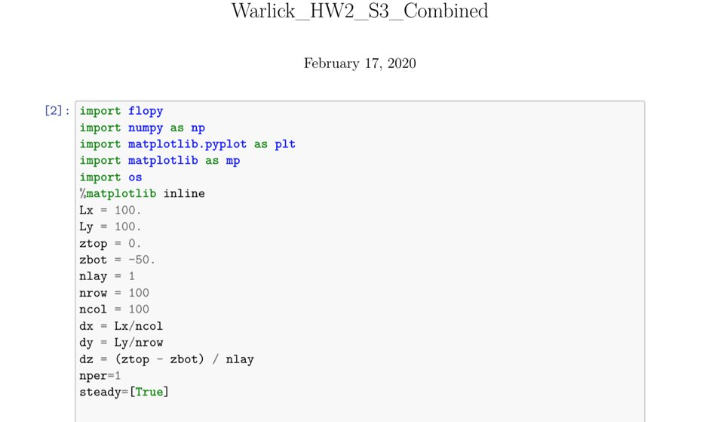
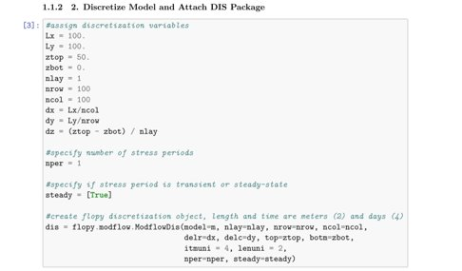
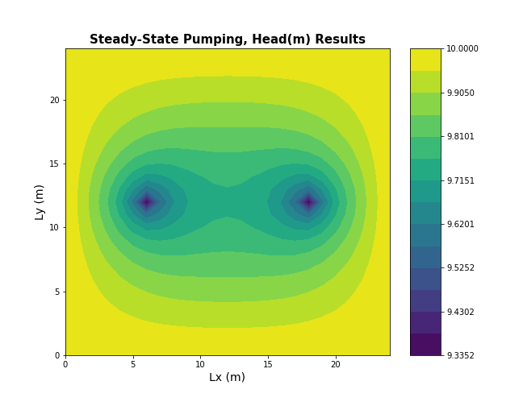
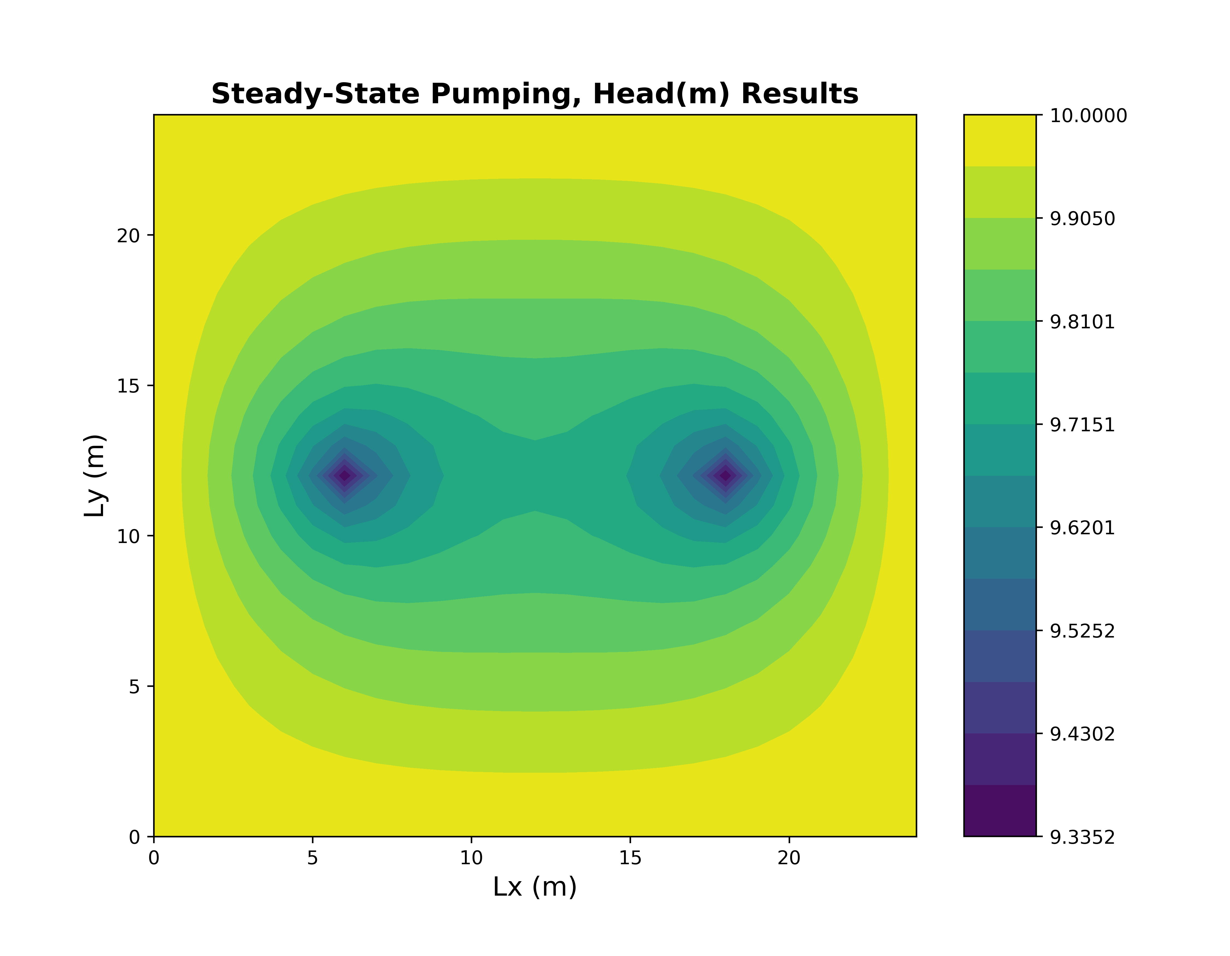

Slide 4
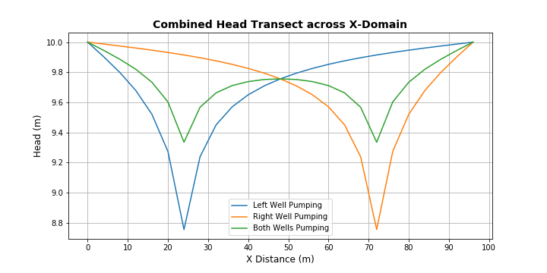
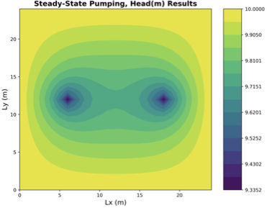
effects of two lower Pumping-rates

Slide 5
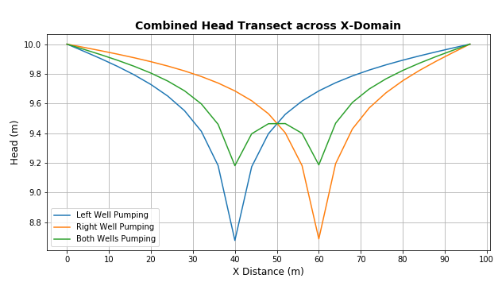
Effect of Well proximity

Slide 6
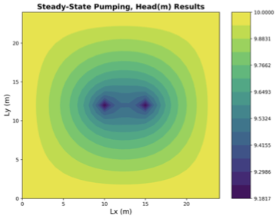
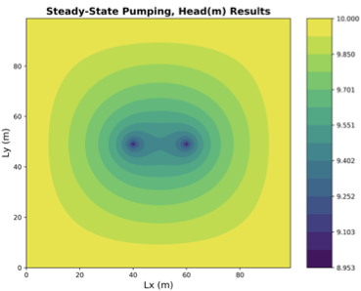
Effect of Resolution

