Slide 1
Homework 3 - Recharge
HWRS 582
2/27/2020
David Murray and Danielle Tadych

Slide 2
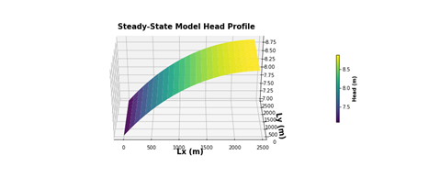
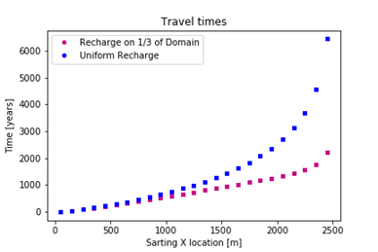
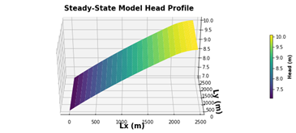
Part 1 - Uniform versus partial recharge
How does the head profile change when the recharge is only applied to the right 1/5 of the domain? Why is this?
How do the ages and the relationship between age and recharge location change? Explain why this makes sense?

Slide 3
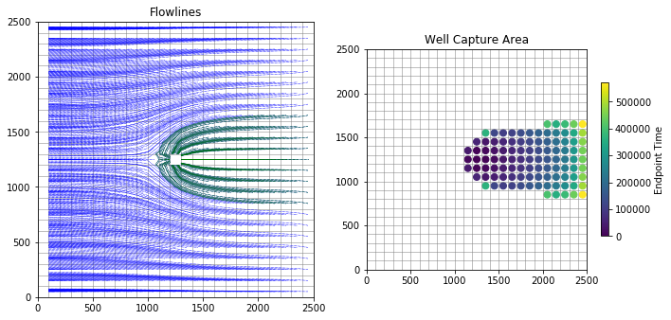
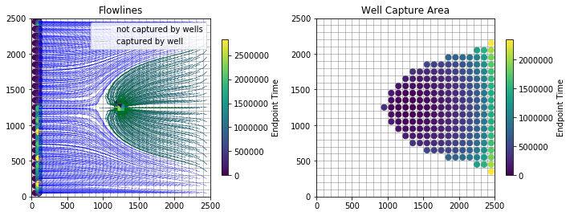
Part 2 - Well that’s nice
Uniform Recharge
Recharge on ⅕ of the domain

Slide 4
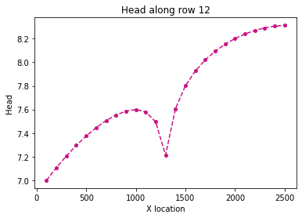
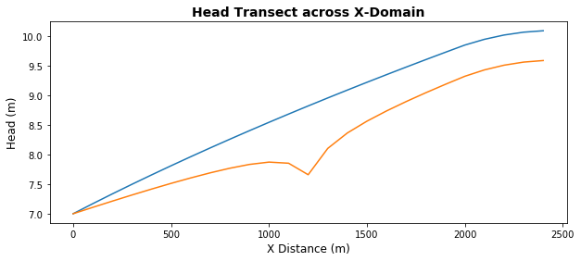
Part 2 - Gradient Change
Recharge on ⅕ of the domain
Uniform Recharge

Slide 5
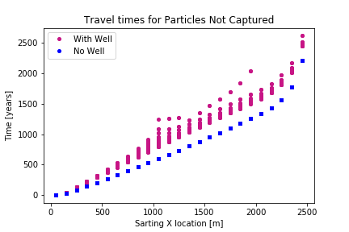
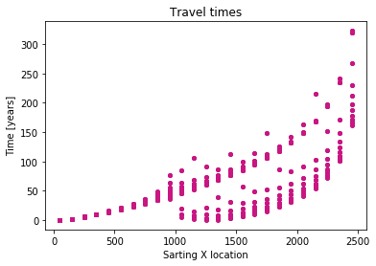
Part 2 - Travel Times
With Well - Uniform Recharge

Slide 6
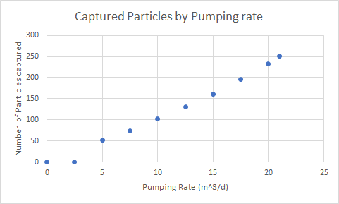
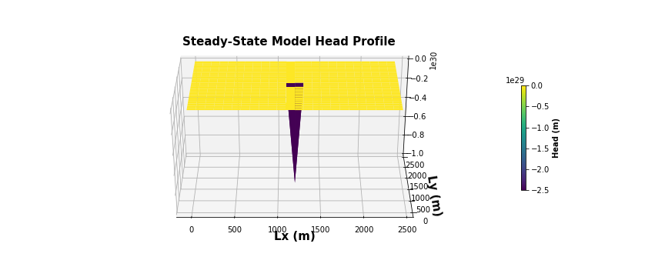
Optional Part 3
Total recharge = 30 m^3/d

