Slide 1
River Package vs. Constant Head
Group 2: Ben Mitchell, Jacob Ridlinghafer, Danielle Tadych

Slide 2
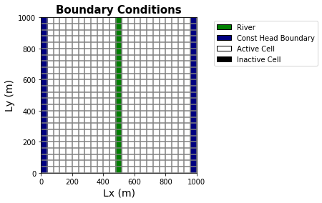
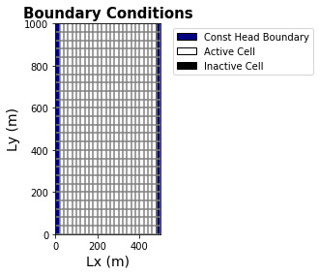
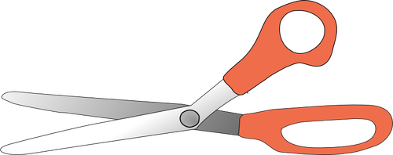
Assignment
Convert the river to a time varying constant head boundary

Slide 3
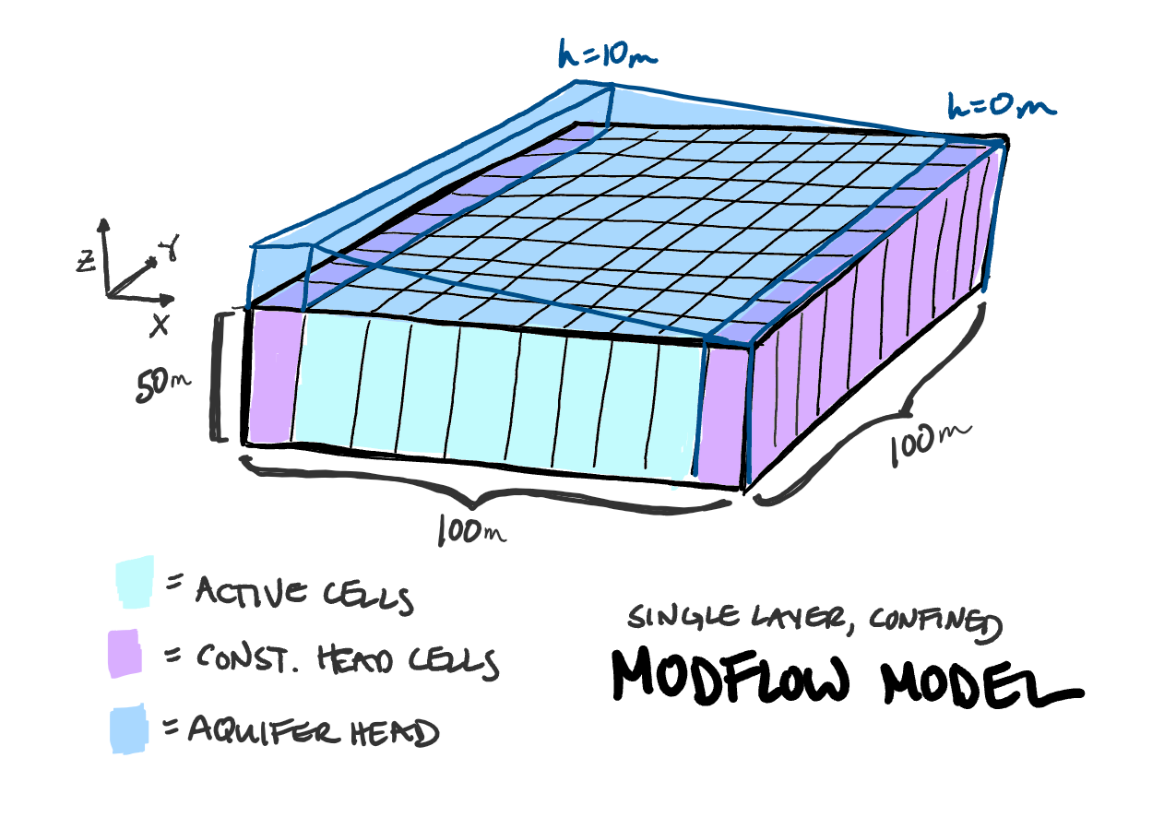
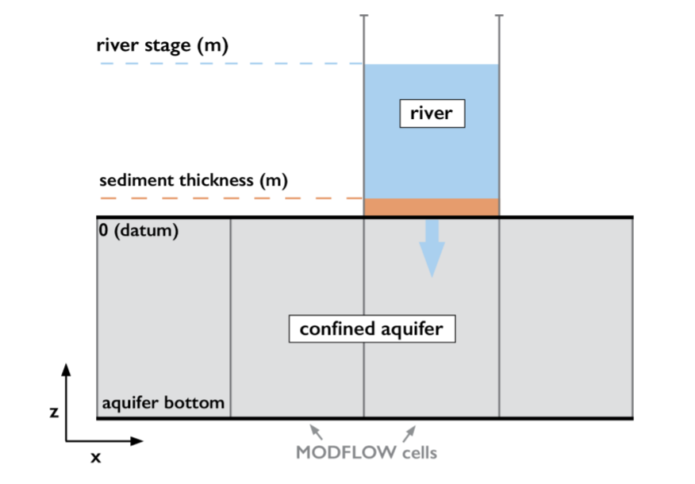
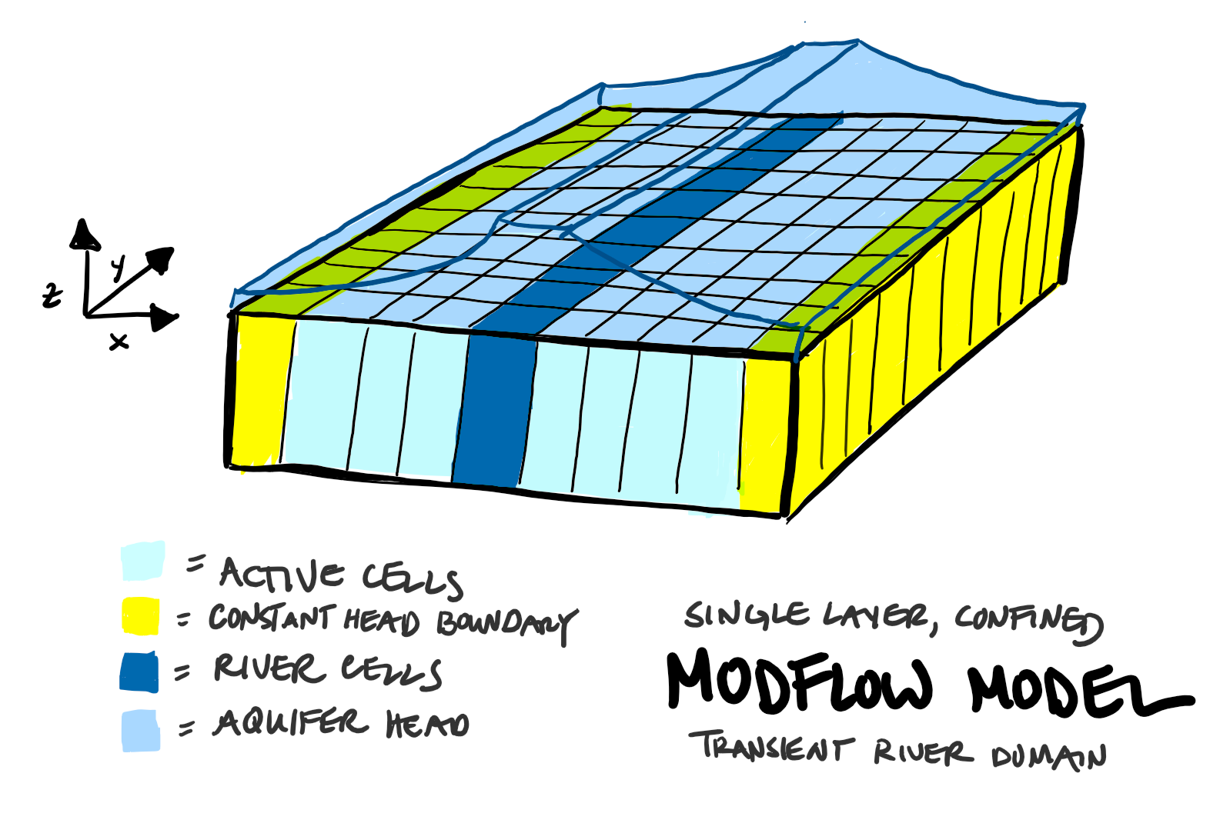
Concept

Slide 4
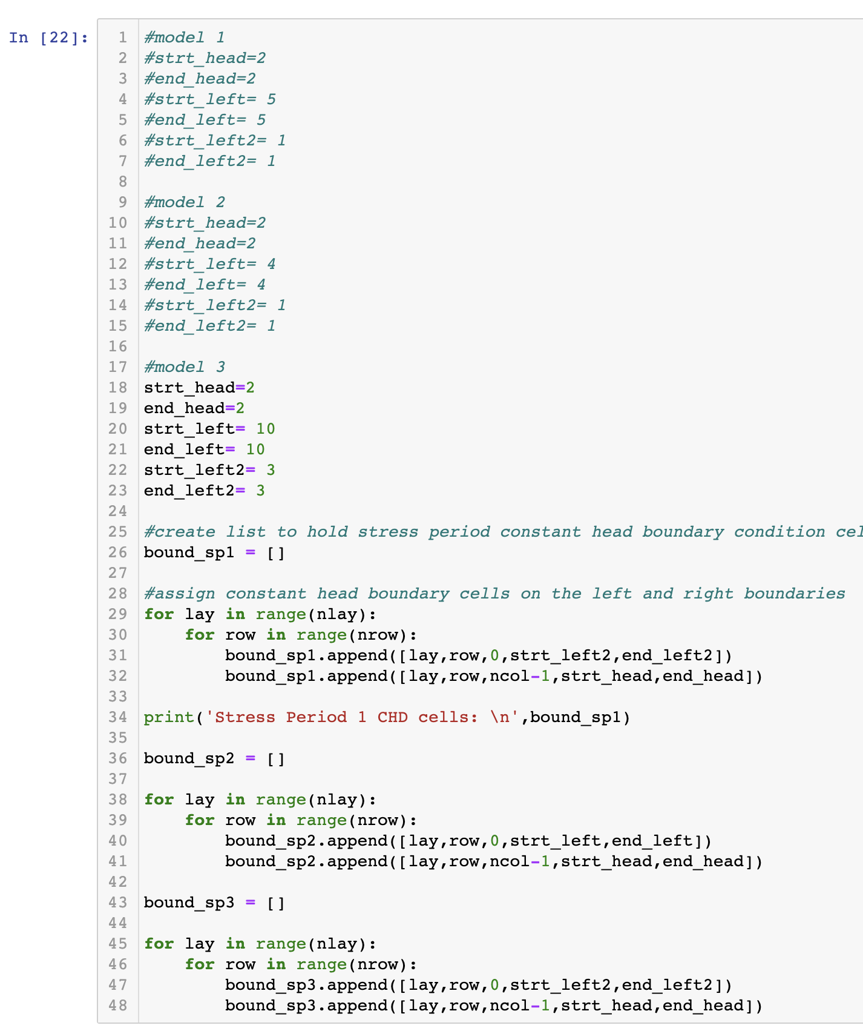
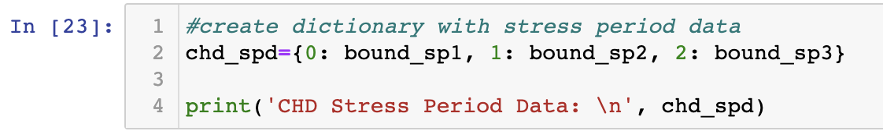
Code for Days
Changed Lx = 500
Commented out the river package information
Changed the value of the left constant head

Slide 5
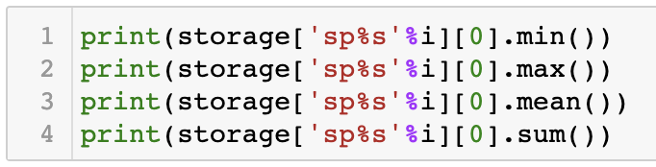
Storage Change
Key
Model | Stage/Start Head | Stage/End Head
River Package | 5 | 1
1 | 5 | 1
2 | 4 | 1
3 | 10 | 3
Model: | Min: | Max: | Mean: | Total:
River Package | 0 | 0.536 | 0.327 | 205
1 | 0 | 0.402 | 0.246 | 204
2 | 0 | 0.938 | 0.573 | 153
3 | 0 | 1.073 | 0.657 | 357

Slide 6
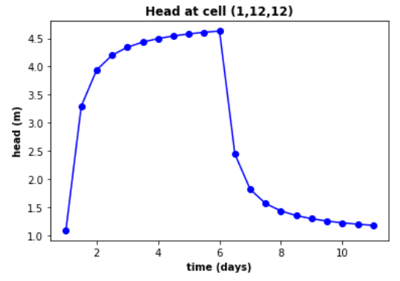
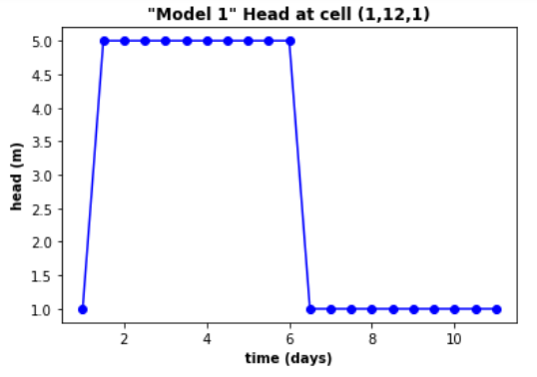
Head at river location
The primary difference was the time series
River Package allows for actual flow in the cells
River Package
Constant head

Slide 7
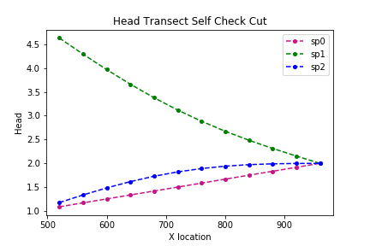
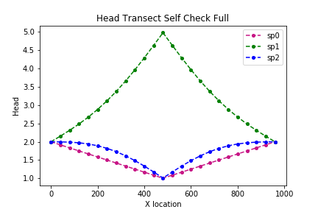
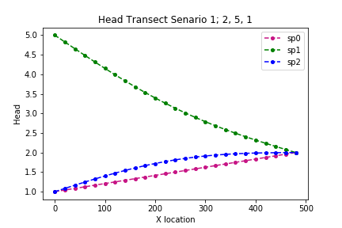
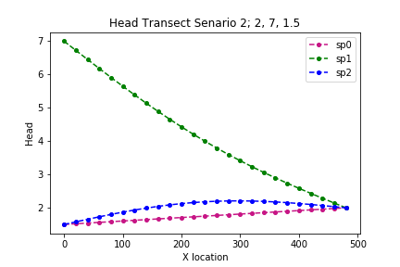
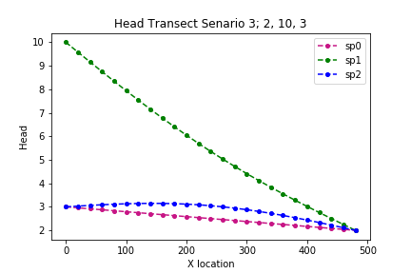
Head Transects
Top two graphs are the Self Check with the river still in place
The bottom 3 graphs represent our cut in half models with different boundary heads Scenarios
Do you notice any patterns among these graphs?
How similar does the Self Check W/ the River compare to our Half Model W/O the River using similar head boundaries?

Slide 8
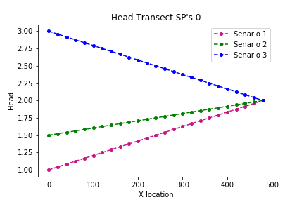
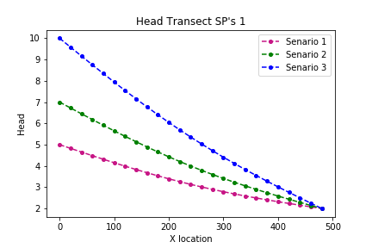
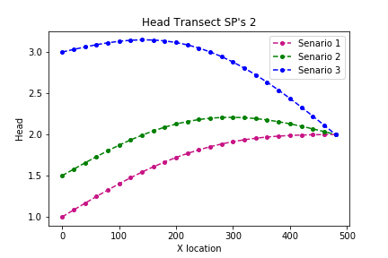
Stress Period Head Transects
These charts are the different stress periods (sp0, sp1, sp2) graphed with one another for comparison
What patterns are present here?
What do you notice going from one Stress Period to another?
Do these graphs make sense?

