Slide 1
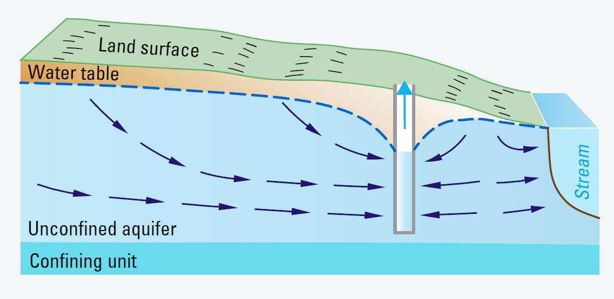
HW 8 Streams
Group 1
Amanda, Justin, Tesfa, Vivek

Slide 2
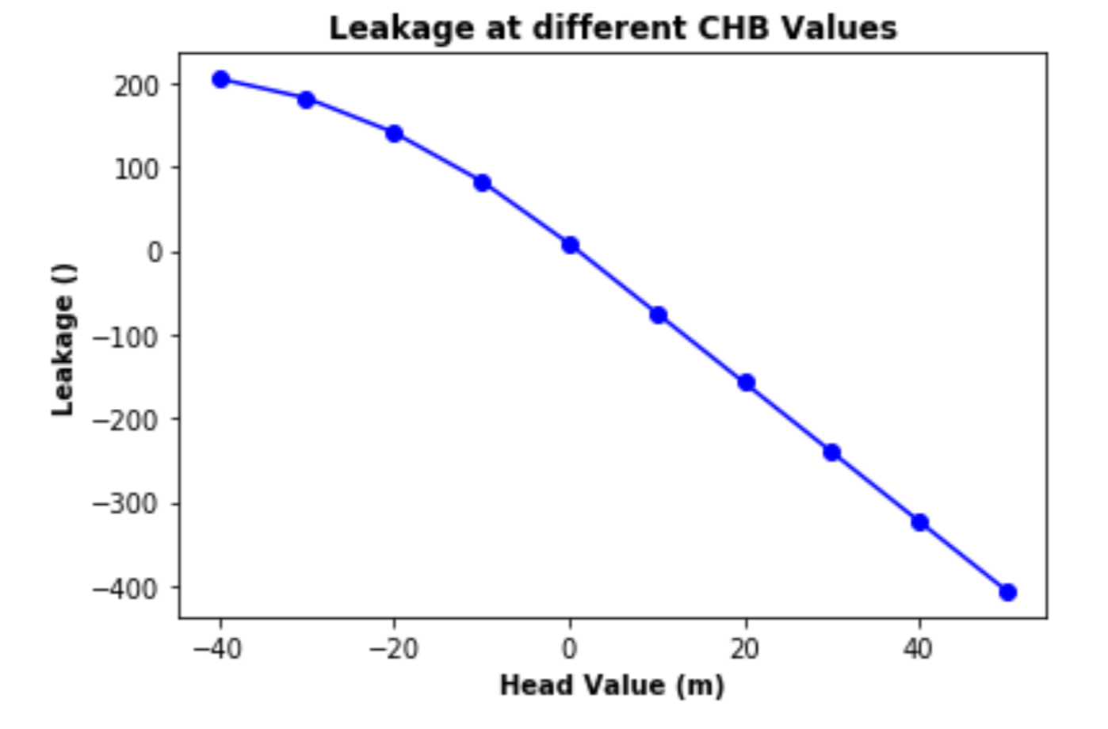
Changing Both Constant Head Boundaries Together
Model 1 - Building steady state models to explore the sensitivity of the model to the boundary condition heads and the heads in the river
Positive Leakage = “Leaking” or “Losing Stream”
Negative Leakage = “Gaining Stream”
Units of leakage are length cubed

Slide 3
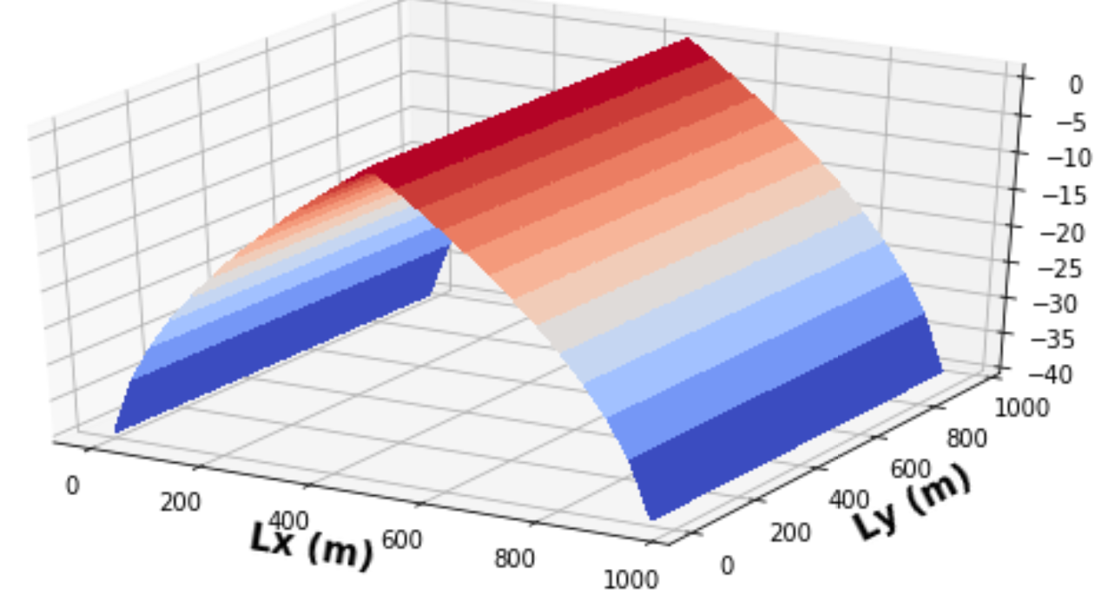
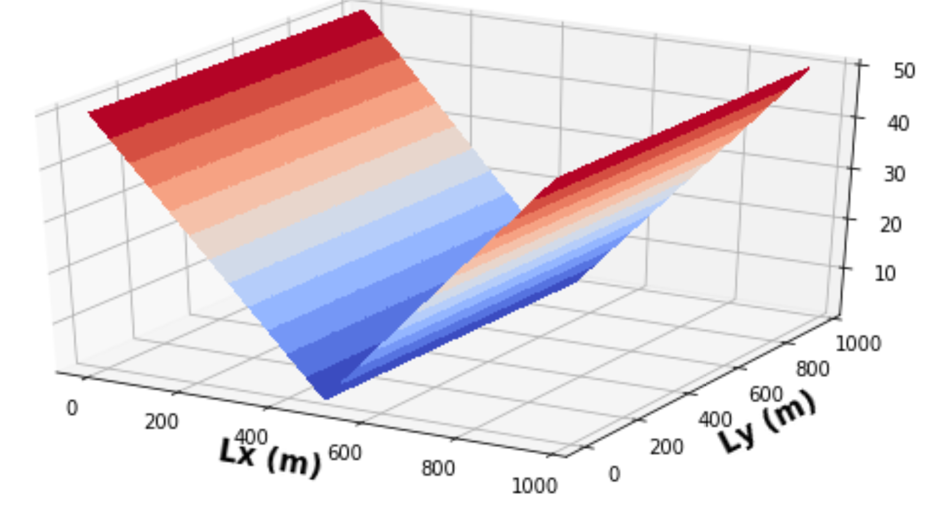
Changing Both Constant Head Boundaries Together
Head at CBH = - 40 Head at CBH = 50

Slide 4
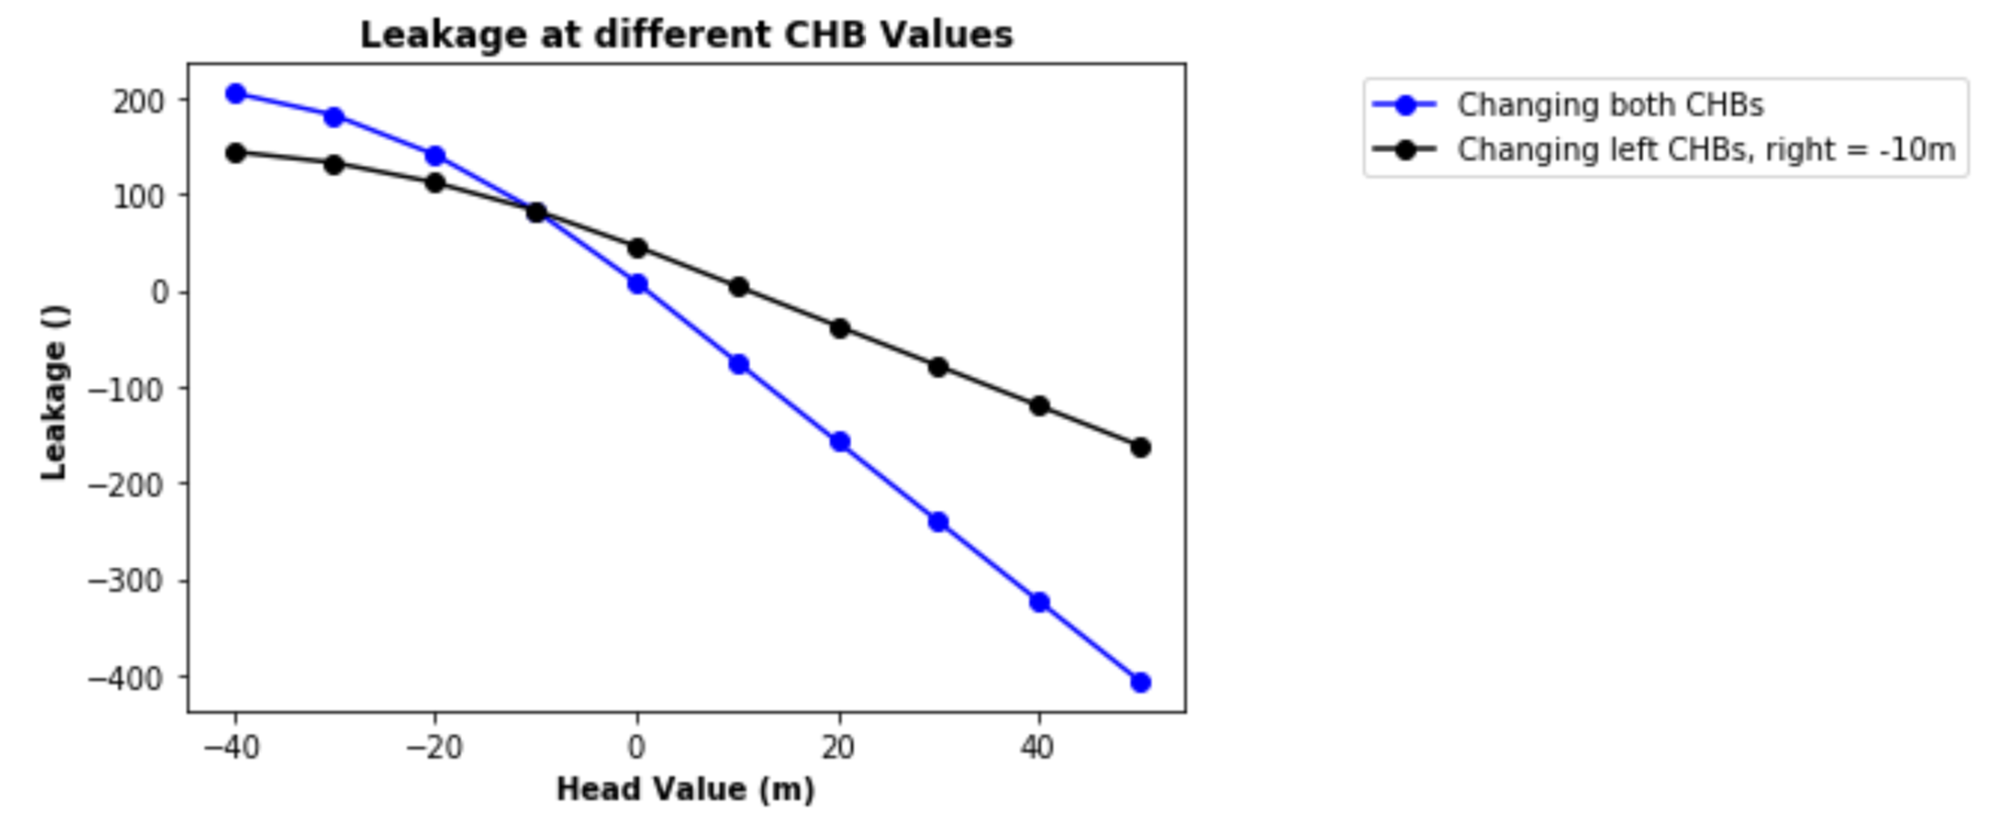
Changing One Constant Head Boundary

Slide 5
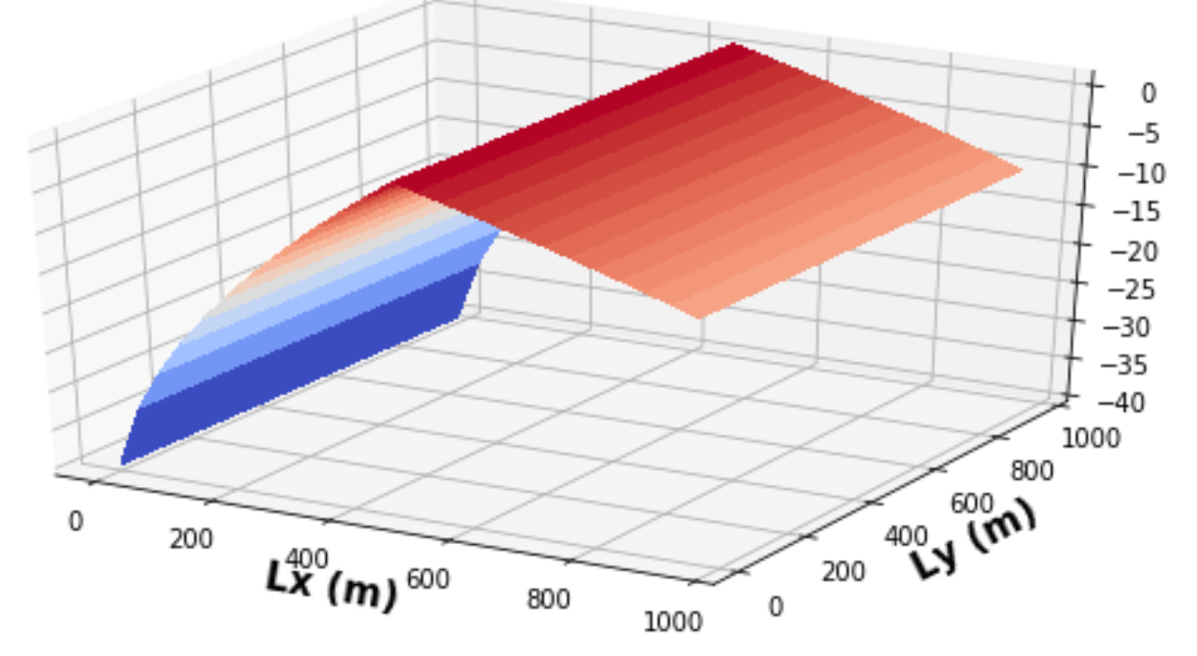
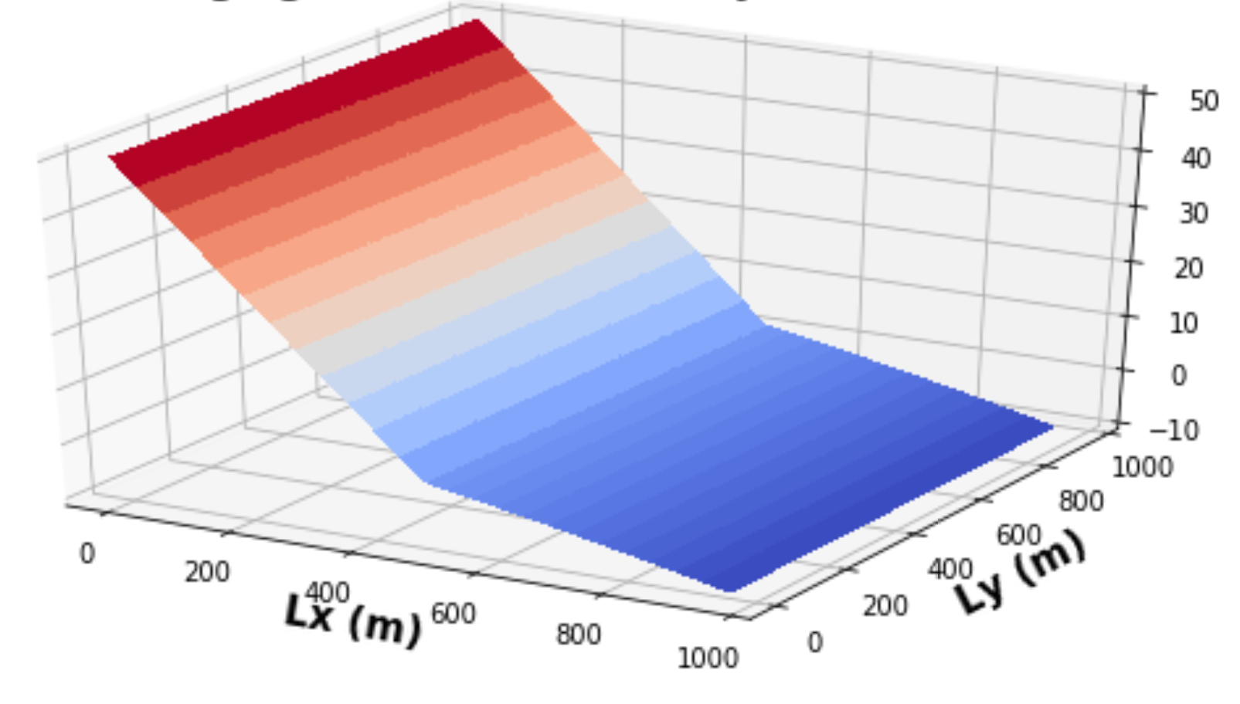
Changing One Constant Head Boundary
Heads at Left Boundary Head = - 40 Heads at Left Boundary Head = 50

Slide 6
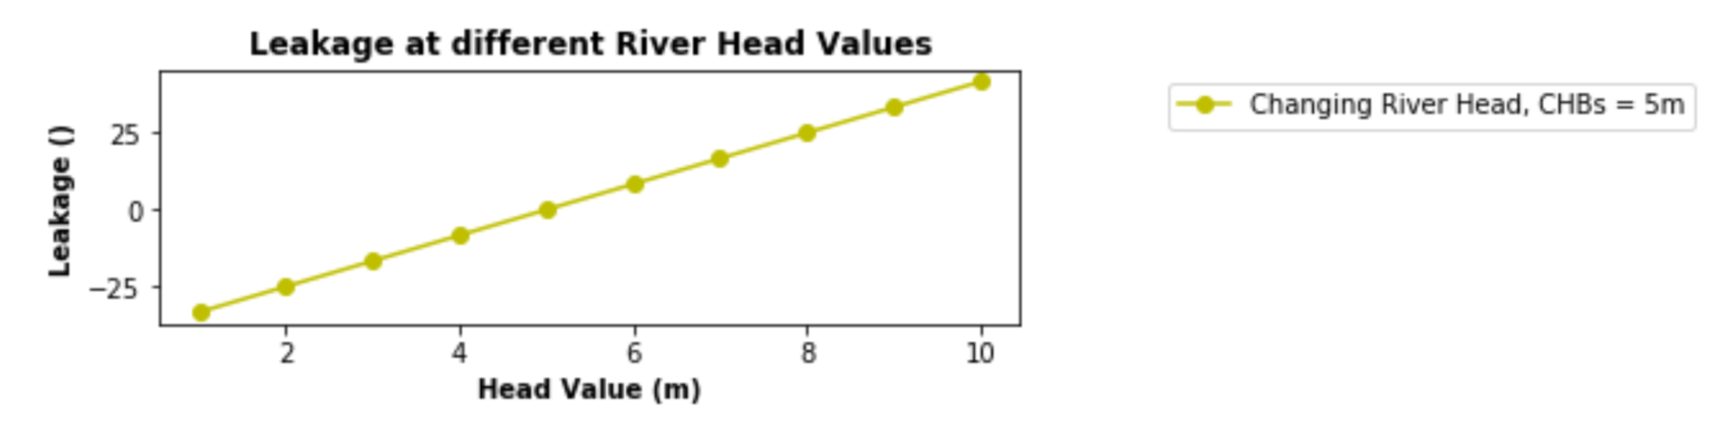
Only Changing the Head in the River (CBH = 5)

Slide 7
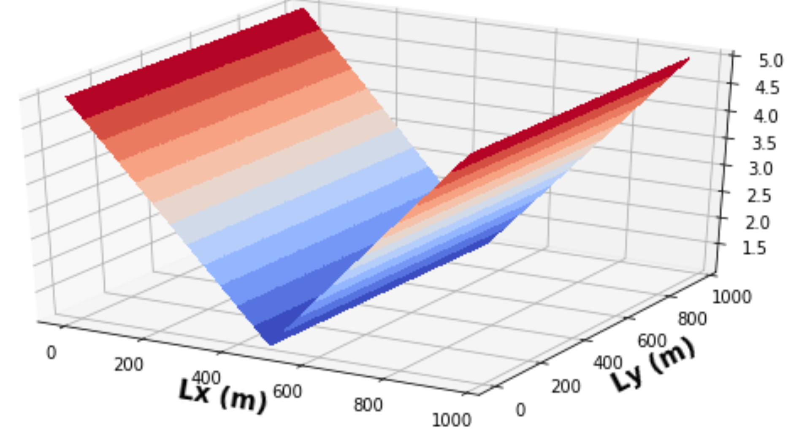
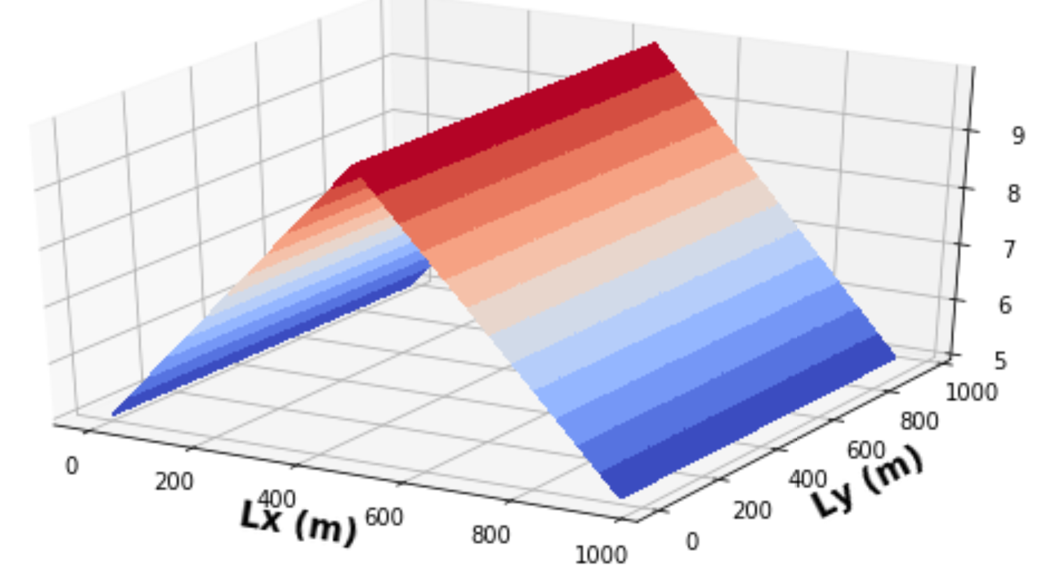
Only Changing the Head in the River (CBH = 5)
Heads at River Stage = 1 Heads at Left Boundary Head = 10

Slide 8
Heads at Column 12 [m]
 | Both Heads | Left Head | Right Head | River Stage
Run 1 | 0.871827 | 0.871827 | 0.871827 | 0.02590674
Run 2 | 0.8862784 | 0.87905306 | 0.87905306 | 1.0207254
Run 3 | 0.91198623 | 0.891908 | 0.891908 | 2.015544
Run 4 | 0.94819593 | 0.9100132 | 0.9100132 | 3.0103626
Run 5 | 0.9948186 | 0.93332654 | 0.93332654 | 4.0051813
Run 6 | 1.0466322 | 0.9592348 | 0.9592348 | 5
Run 7 | 1.0984457 | 0.985143 | 0.985143 | 5.9948187
Run 8 | 1.150259 | 1.0110512 | 1.0110512 | 6.9896374
Run 9 | 1.2020725 | 1.0369594 | 1.0369594 | 7.984456
Run 10 | 1.253886 | 1.0628675 | 1.0628675 | 8.979275
For columns 1-3 in the table to the right head was adjusted in 10 m intervals from -40 m to 50 m.
For columns 2 and 3 the CHB was kept at -40 m
The river stage was increased in 1 m intervals from 0 m to 9 m.
Once the head becomes greater 0 m you can see the river stage increases
Increasing Head

Slide 9
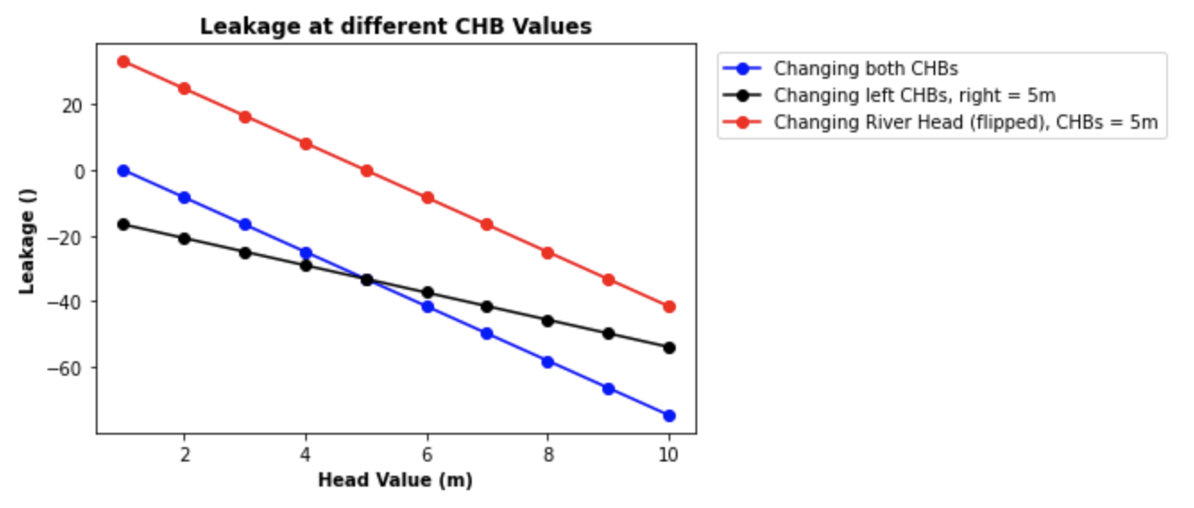
Comparing the Sensitivities of all Scenarios Together
River scenario is flipped for ease of comparison (multiplied by negative one)
All changes in head were uniform (1-10)
Same slope for changing both heads and changing the river head, so we conclude they have the same sensitivity
Shifted because of starting CHBs
Leakage slope is shallower when there is a gradient

