Slide 1


Platform for Improving Searchability and Interactivity of Recorded Lectures
Group 19-087

Slide 2

Background
Increasing adoption of E-Learning in the past few years
Students are more satisfied with web enhanced learning and are more likely to watch videos as opposed to reading text.
reaches students with a variety of learning styles. Be it visual, aural, physical or verbal
Many Universities provide the facility to view pre-recorded lectures online
Notes:
https://www2.le.ac.uk/services/reflect/how-can-reflect-help-learning-and-teaching/recording-lectures/advice-for-students-on-how-to-use-recordings

Slide 3

Recorded Lectures
Benefits
Allows teachers to save hours of repetitive teaching.
Re-watch videos anytime and anywhere
Students can learn at their own pace
However…

Slide 4
Research Problem
When viewing online lecture videos students come across a few problems.
Video lectures are usually lengthy and tedious to watch.
Poor searchability through the video
Less interaction with the student
Not directly connected to other supporting material such as Lecture slides and Tutorials
Many of the existing tools to improve lecture quality require human intervention which is time consuming

Slide 5





Existing Systems

Slide 6
Feature Comparison
Features | echo360 | TechSmith Relay | Camtasia | LearnWorlds | Hippo Video | Proposed System
Automatically matching code samples to occurrence in recorded lecture | ✗ | ✗ | ✗ | ✗ | ✗ | ✔
Automatically divide video into topic units | ✗* | ✗ | ✗ | ✗ | ✗ | ✔
Automatically match lecture slides with the recorded video | ✗** | ✗** | ✗** | ✗ | ✗** | ✔
Automatic question generation | ✗ | ✗ | ✗ | ✗ | ✗ | ✔
* Only if integrated with LMS or with provided topics
** Only if recorded using their proprietary recording tools or editing tools

Slide 7
Objectives
Automated platform for interactive lecture video generation
Matching lines of codes to occurrences in live-coding videos
Content-based Lecture Video Segmentation into topic units
Automatic question generation from lecture and reference materials
Synchronization of slides with the lecture video and denoising

Slide 8







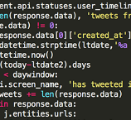
Proposed Solution

Slide 9
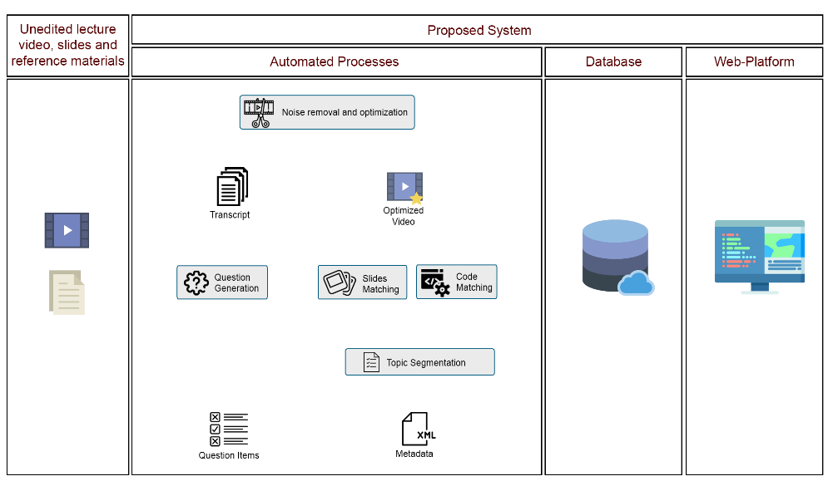
System Architecture

Slide 10
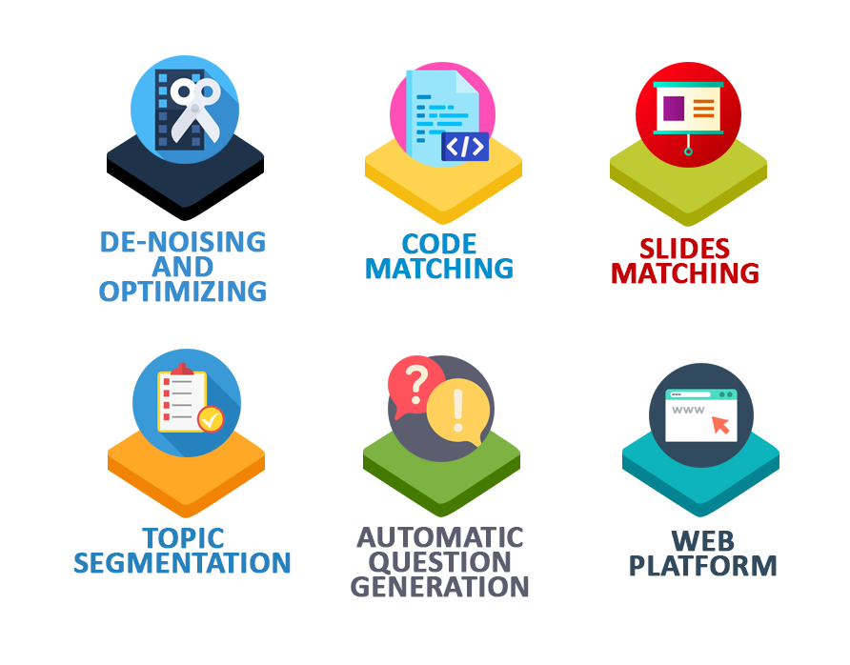
Core Modules

Slide 11






Source Code Matching
Frames Containing Code
Video Frames
Neural network
Extracted Audio
Line Matching Algorithm
<output>
<line/>
<timestamp/>
</output >
Source Code File

Slide 12
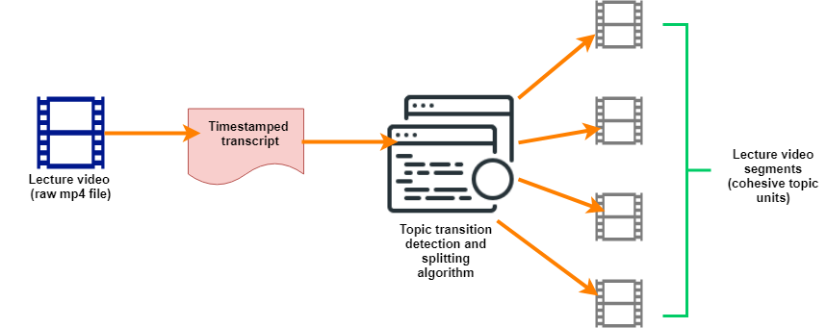
Topic Generation and Video Segmentation
Extracts timestamped transcripts.
Identifies topic transitions and segment the videos into cohesive topic units
Enables easier information searching and reduce learning time

Slide 13




Automatic Question Generation
Transcript
Ontology
Extracted Sentences and Words
Question generation and distractor selection
Reference materials
Question Items

Slide 14
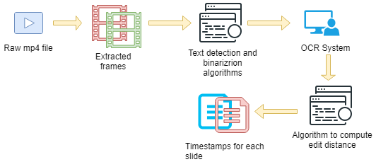
Synchronization of lecture video and slides

Slide 15
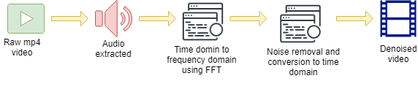
Noise Removal

Slide 16
Work Breakdown Structure
System
Code Matcher
Trained Neural Network
Slide Matcher
Video Segmenter
Question Generator
Audio Enhancer
Domain Specific Ontology
Question Generation Algorithm
Distractor Generation Algorithm
Code timestamp Identification algorithm
Text Detection Algorithm
Algorithm to Enhance Frame Resolution
Transcription Extractor
Topic Segmentation Algorithm
Labeled Training and Test Datasets
Text Binarization algorithm
Web Application
Algorithm to compute noise and noisy speech spectrums

Slide 17
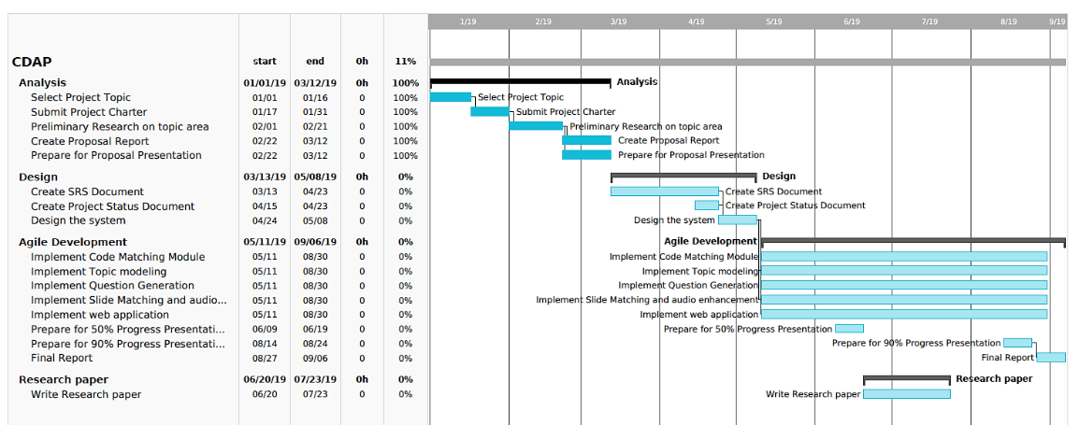
Gantt Chart

Slide 18
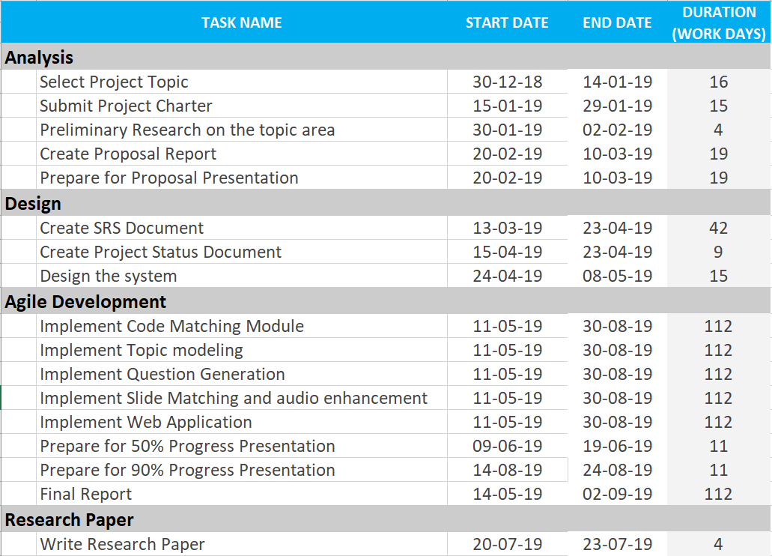
Task Duration

Slide 19







Tools which will be used

Slide 20

Users
Lecturers / content creators
Students

Slide 21


Business Potential
Potential Business Models
Plugin for several existing MOOCs and LMSs
Software as a Service (SaaS) product, where the customer will pay a one-time fee or monthly subscription or as a freemium model
advertisements can be incorporated into a web application.
Achievable user benefits
The system will fully automate otherwise tedious manual processes involved in creating lectures.
Enhanced online lectures which are tied in seamlessly with supporting content.

Slide 22
THANK YOU!

