Slide 1
Platform for Improving Searchability and Interactivity of Recorded Lectures
Group 19-087
SRS Presentation

Slide 2
Introduction
Overview of the presentation:
Knowledge gap & comparison with existing products
Addressing key pillars of e-learning
System design
Requirements
Interfaces – (Software, hardware, UI)
Limitations

Slide 3
Introduction
Objectives :
Recorded Lecture videos can be improved by,
Linking them with other course material such as lecture slides and source code samples.
Segmenting them into smaller, more manageable videos instead of a single long video.
Removing unwanted background noise and long pauses.
Generating and embedding quiz questions which are relevant to the content in the video.
Although some platforms available on the market today offer similar functionality, the process of enhancing the video has to be carried out manually.
Main focus of the project is, adding interactivity and accessibility to recorded lecture videos automatically.

Slide 4
Knowledge Gap
Feature | Learn Worlds | Echo360 | Techsmith Relay | TechsmithCamstasia | Shotcut | Our Solution
Matching lines in code samples to occurrence in recorded lectures | ✗ | ✗ | ✗ | ✗ | ✗ | ✔
Automated segmentation of lecture video into topic units | ✗ | ✗ | ✗ | ✗ | ✗ | ✔
Matching slides with the lecture video | ✗ | ✔ | ✗ | ✔ | ✗ | ✔✔
Automated noise removal from the video | ✗ | ✗ | ✗ | ✗ | ✗ | ✔
Automatic question generation | ✗ | ✗ | ✗ | ✗ | ✗ | ✔
Embedding questions in video playback | ✔ | ✔ | ✔ | ✔ | ✗ | ✔✔
Automated question embedding in video playback | ✗ | ✗ | ✗ | ✗ | ✗ | ✔

Slide 5
Key Pillars Addressed
Knowledge Area : e-Society (e-Learning)
High quality content
Keep information straightforward and useful by cutting out long silences and background noise from the lecture video.
Relevance
Tap into emotions like intrigue and motivation by making the lecture videos interactive, thereby increasing learner engagement.
Staying friendly to learners
Make the lectures easier to navigate.
Do not have screens which are complicated and overwhelming.
Include milestones and self assessment activities in the lecture video.

Slide 6
Technologies and architecture
Cloud computing - AWS
Having a cloud architecture will allow the system to be developed with less capital investment
Third party managed cloud infrastructure leads to less operational issues.
Horizontal scaling based on load can be arranged in a few clicks.
Microservices
Independent development of key components of the system.
Can use multiple frameworks to suit different needs. Not restricted to a single technology stack.
Failure of a single service has a reduced effect on the rest of the system.

Slide 7
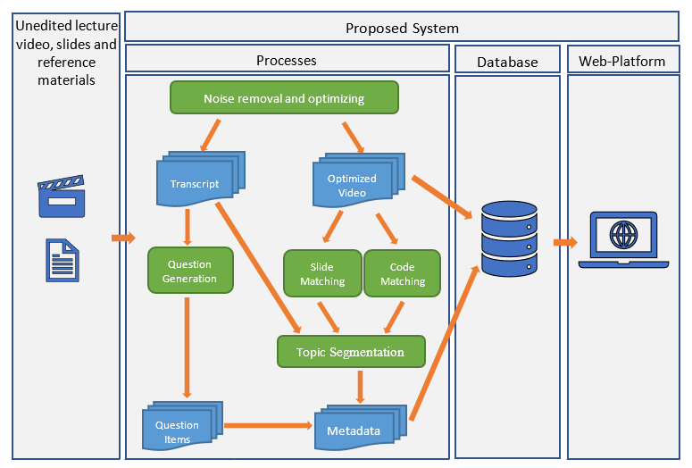
System Design – high level architecture

Slide 8
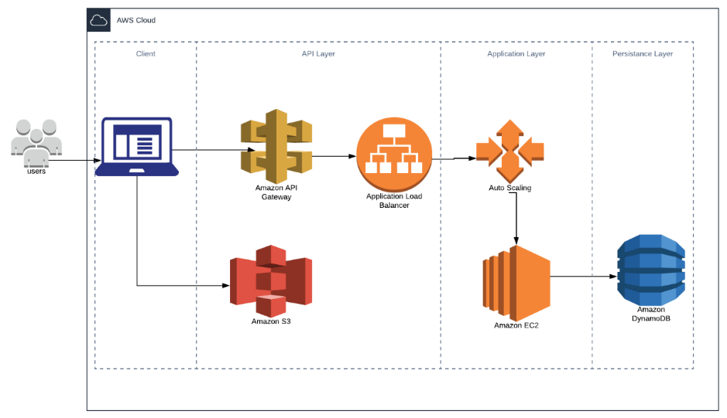
System Design – cloud architecture

Slide 9
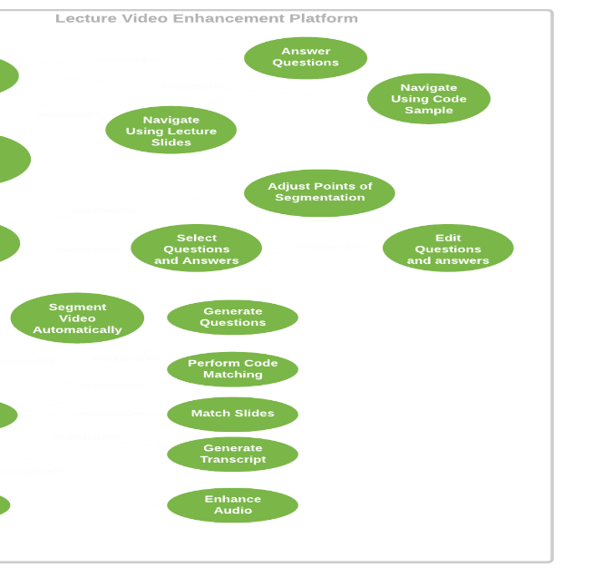
Functional Requirements

Slide 10
Non Functional Requirements
Availability
Maintainability
Reliability
Security

Slide 11
Interfaces
1. Software Interfaces
Node.js runtime
Python 3 SDK
OWL API
Ffmpeg – video and audio manipulation
Keras machine learning library
OpenCV computer vision library
Amazon Web Services (AWS)
WebStorm
Protégé

Slide 12
2. Communication Interfaces
Stable high speed internet connection
E.g. ADSL, 4GLTE, FTTH
3. Hardware Interfaces
No special hardware required
4. Memory constraints
Min : 4GB of RAM

Slide 13
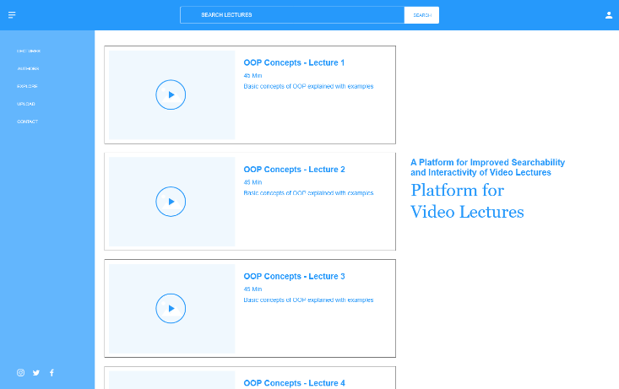
5. User Interfaces
Home page

Slide 14
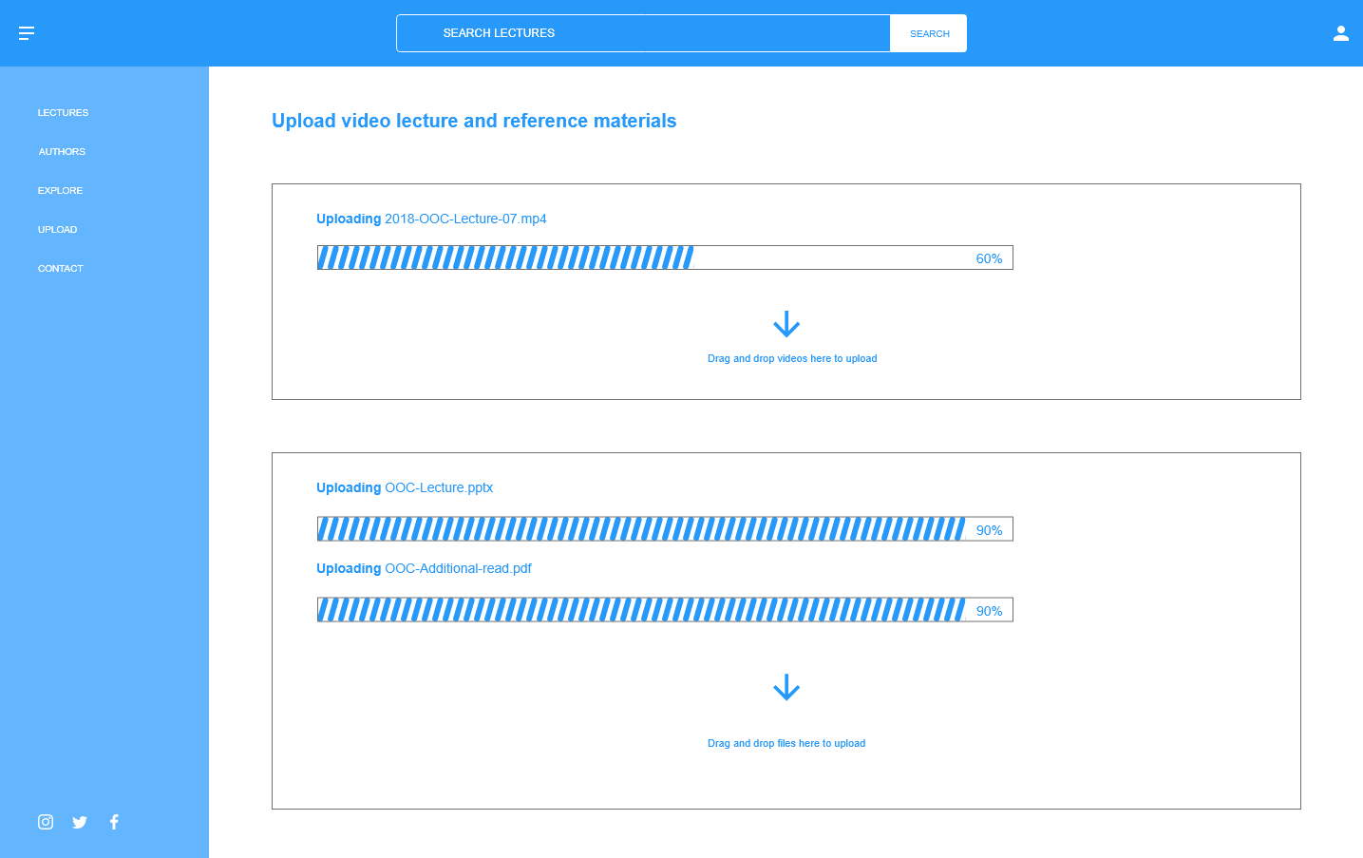
Upload content

Slide 15
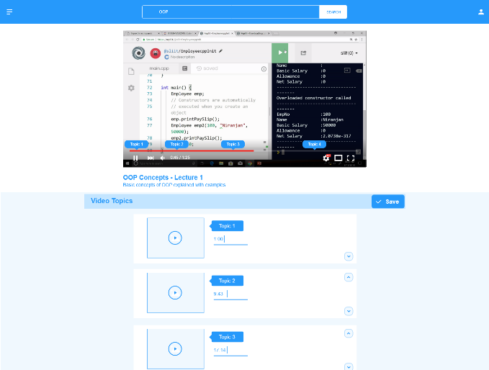
Topic Segment Adjusting

Slide 16
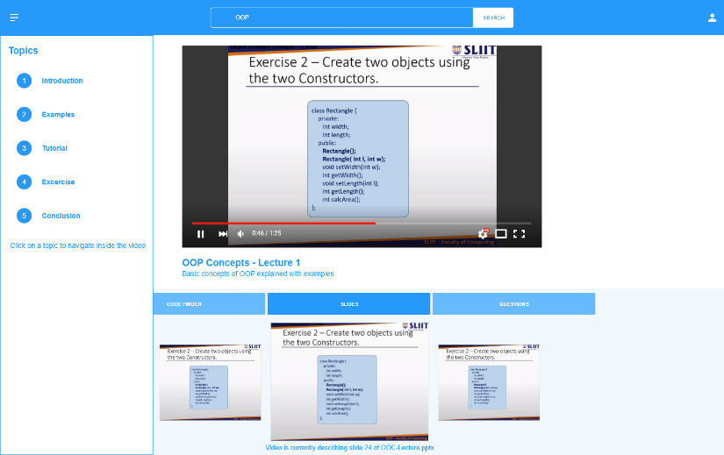
Video Player

Slide 17
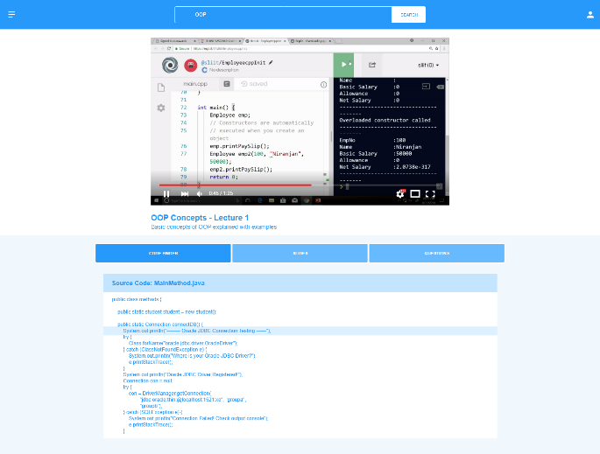
Navigate Video Using Code Samples

Slide 18
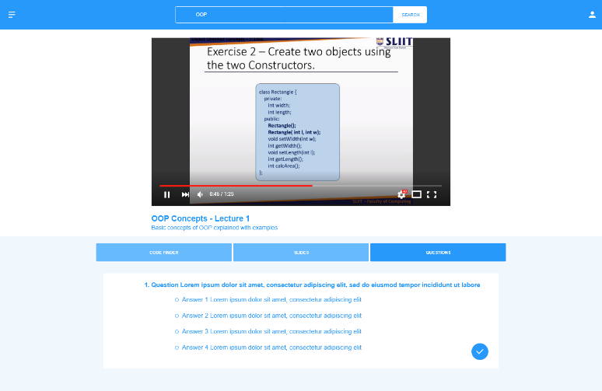
Answer Questions in Video Playback

Slide 19
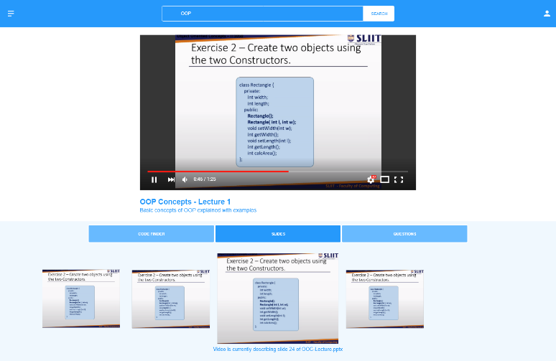
Navigate Using Slides

Slide 20
Limitations
Initial release will be targeted at audiences with desktop web browsers.
Only screen recordings with voice-over presentations will be supported for the initial release.
Users cannot search through lecture videos using keywords.
Users must have a continuous internet connection.

