Slide 1
Potable Water Usage By SectoR In CANADA
DAB 103- Analytics Tools & Decision Making Project

Slide 2
Contents
Team Introduction
Background
/motivation
Problem Statement
Project Proposal
Analysis Questions
Dataset Description and EDA

Slide 3





DAB 103- Analytics Tools & Decision Making Project
GROUP - 007
1) Mohammed Anan Mansuri
2) Miloni Patel
3) Kush Patel
5) Mohammed Ahtesham Uddin
4) Priyal Patel

Slide 4

BackgroUNd/Motivation
Despite being one of the most water-rich nations in the world, for generations Canada has failed to guarantee access to clean water for Indigenous peoples. The water in dozens of communities has been considered unsafe to drink for at least a year – and the government admits it has failed. In 2016, there were 105 communities with long-term drinking water advisories in place –meaning the water had been unsafe to use or consume for at least a year. As of late April 2021, that number is down to 52 advisories in 33 communities.
Notes:
Consider talking about:
Case Studies

Slide 5
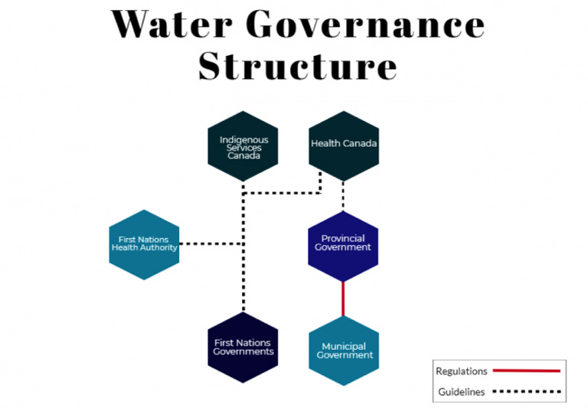


Slide 6
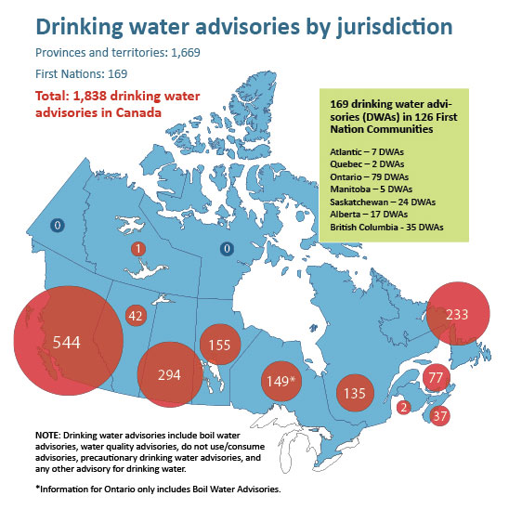

Drinking water advisories are issued to warn people to not drink water that may be unsafe or is known to not be safe based on water quality test results.

Slide 7
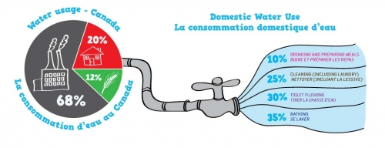

Water Usage In CANADA
10% | Drinking and preparing meals
25% | Cleaning (including laundry)
30% | Toilet flushing
35% | Bathing

Slide 8

Problem Statement
Better insights on the supply and demand of drinkable water by different sectors is needed by the Government of Canada and First Nations authorities. Our water supplies are becoming increasingly vulnerable to contaminants, urbanization, shifting land uses, climate change, and we are facing a water-insecure future as Canada's population grew by 156,503 year over year due to international migration. Setting up water treatment infrastructure is a logistical problem due to Canada's large territory and the varied locations of 630 First Nations communities, some of which are only accessible by plane.

Slide 9
Project Proposal
Our project team will create a descriptive analytics product which shows potable water usage in Canada by different sectors, the amount of water loss and how the potable water usage has increased over past few years and how can we prepare for future as the population in the country is on rise. Canadians know the importance of our freshwater supply, but by understanding how we use it and where it goes, we can use our supply even more responsibly.
Notes:
Consider talking about:
Improving access
Reclaimed water
Purification
Global programs

Slide 10
Analysis Questions
Which province in Canada has the highest water usage?
Which province supplies water to other Jurisdictions?
Which province is best in managing potable water distribution?
Which province in Canada has the highest residential water usage?
Which province has highest and lowest water loss during distribution in Canada?
Which months have the highest water usage?
Which province has highest and lowest unknown usage of water in Canada?
Notes:
Consider talking about:
Contaminant Reduction through Policy & Market Improvements
Water treatment options

Slide 11
DATAset DEscription
The analysis is based on potable(drinking) water use by sector and average daily use dataset obtained from statistics Canada source.
We are using four datasets for this analysis.
First one is potable water usage by province, second is population in Canada yearly, third is water availability from different sources and the last one is water usage by month.
The first dataset consists year wise data of water usage from 2011 to 2019 for various provinces of Canada, the second one has data from 1950-2021 and the third, fourth have data from 2005-2019 respectively.
The analysis we are going to perform on includes sectors namely:
Residential, Industrial, commercial, institutional, other non-residential sectors and Responding population served for the average daily residential use.

Slide 12




DATAset DEscription
Total Volume of water supply and demand Canada had from 2011-2019.
Yearly Surface and ground water levels in various Canadian provinces.
Monthly water consumption in various Canadian provinces from 2006-2020.
All the values described in datasets are in cubic meters.
QR codes are provided for the dataset 1,2,3 and 4 respectively.

Slide 13
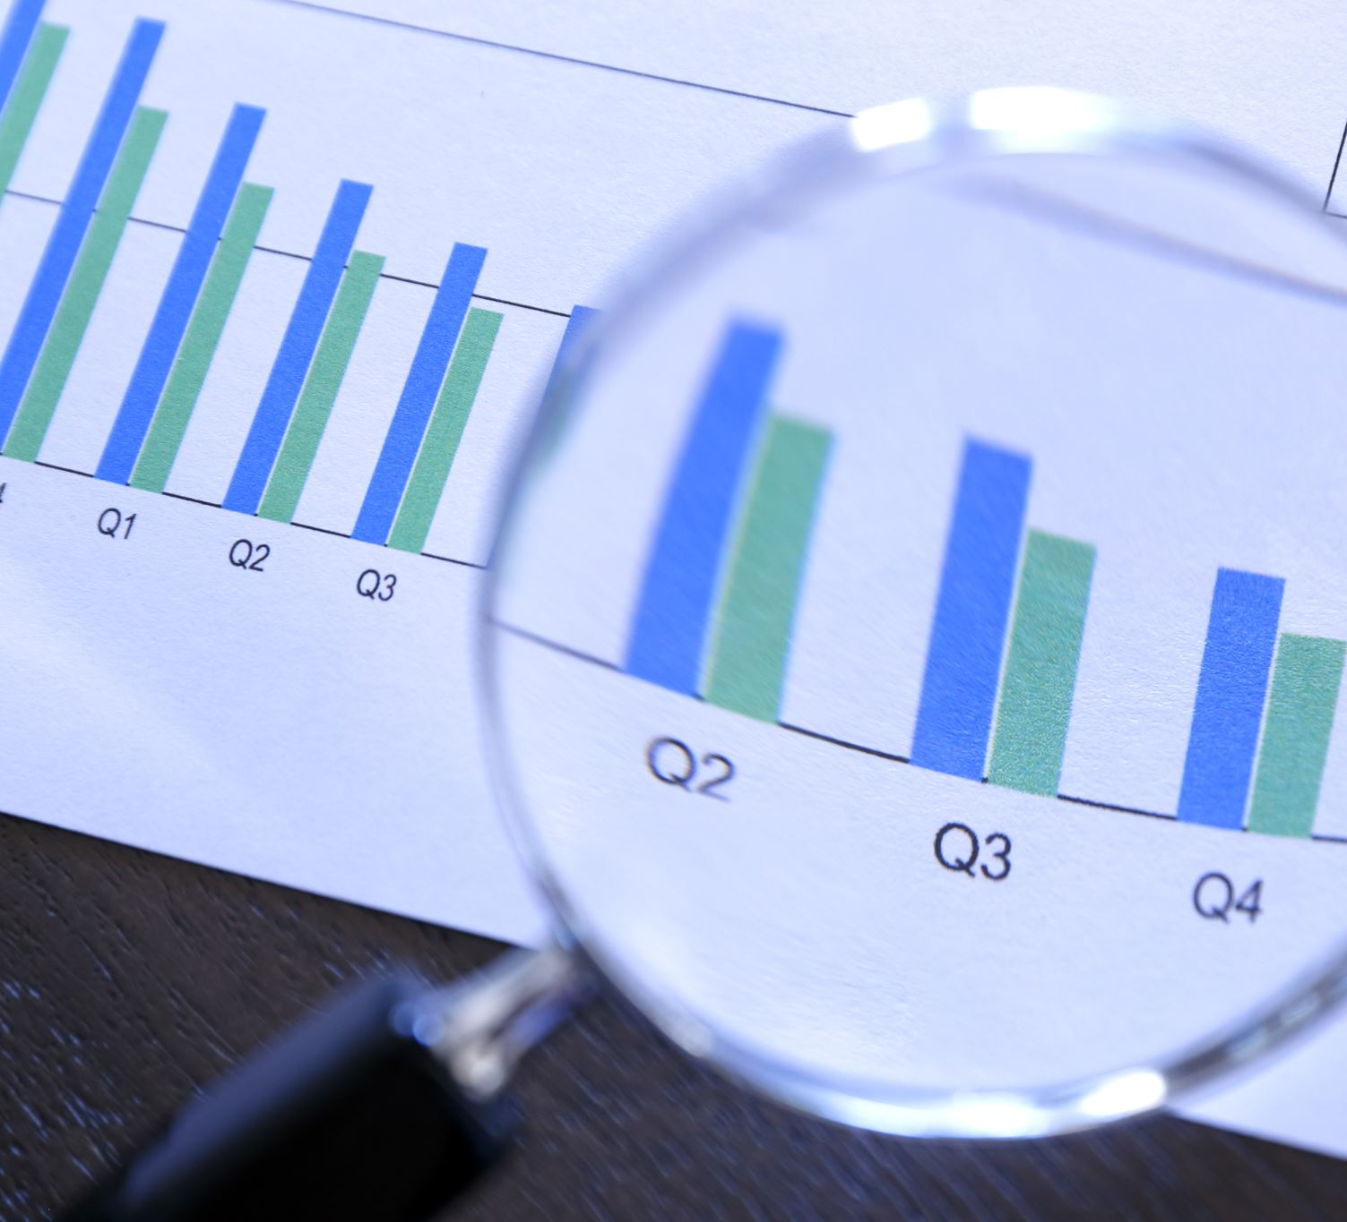
Data Analysis

Slide 14
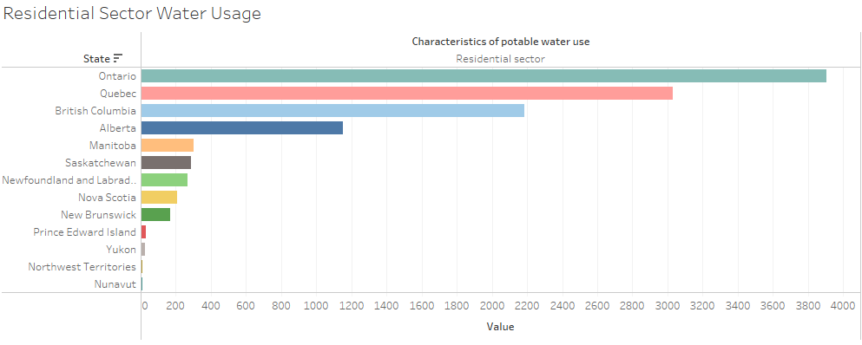
1) Which province in Canada has the highest residential water usage?
As we can see from the visualization that Ontario has the highest water usage from past 10 years followed by Quebec and British Columbia.

Slide 15
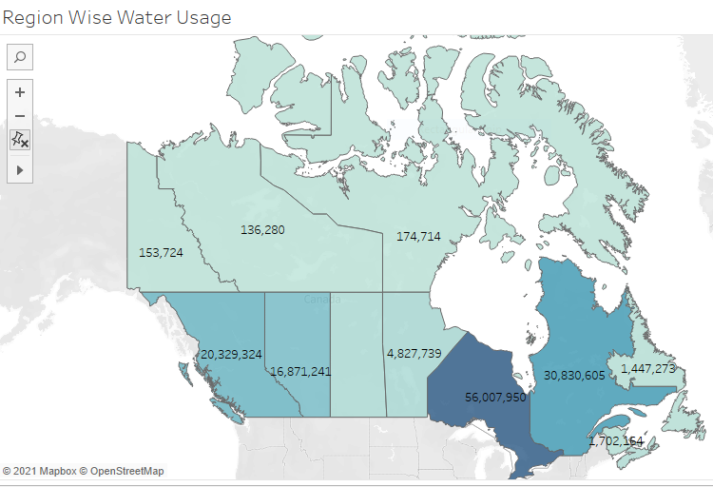
2) Which province in Canada has the highest water usage?
As we can see from the visualization that Ontario has the highest water usage from past 10 years followed by Quebec and British Columbia.

Slide 16
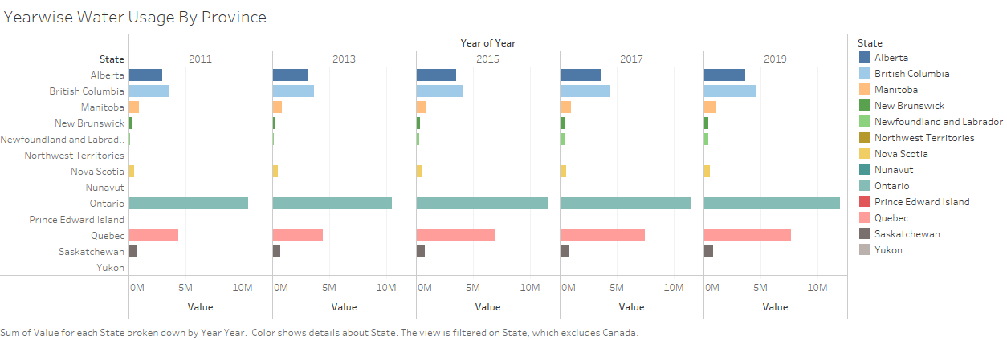
3) Year-wise water usage in various provinces of Canada.
We can see from the visualization that all provinces have observed a gradually increasing trend in water usage, especially in Newfoundland and Quebec province.

Slide 17
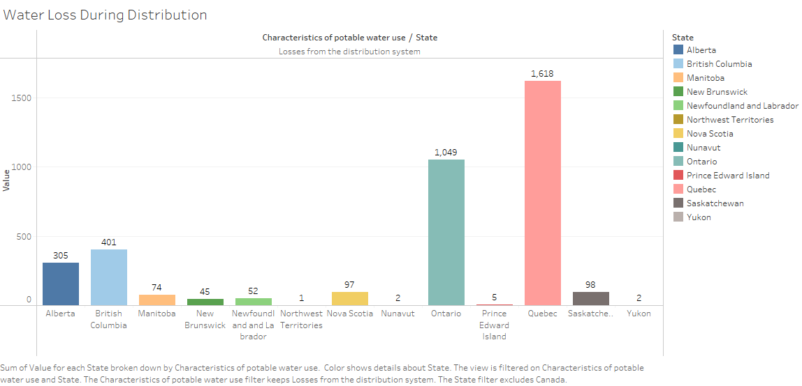
4) Which province has highest and lowest water loss during distribution in Canada?
We can see from the visualization that Quebec province has the highest and northwest territories have lowest water loss from distribution system.

Slide 18
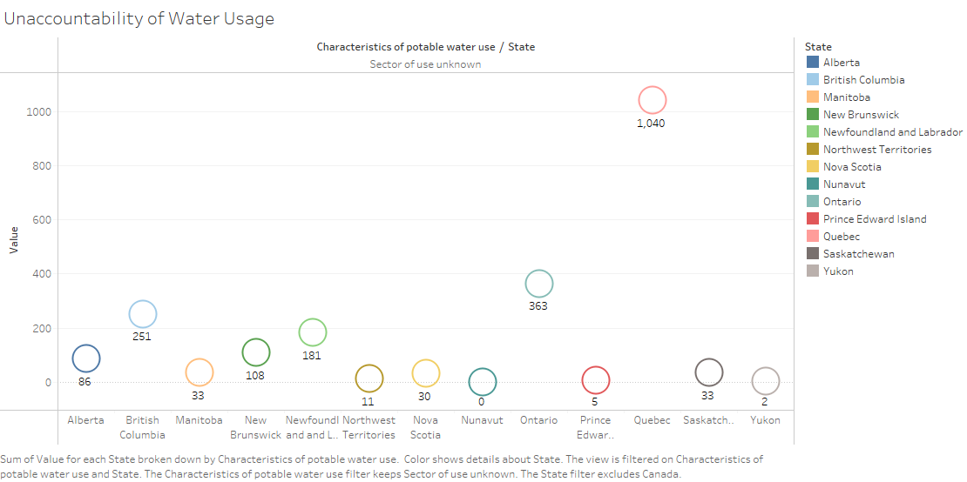
5) Which province has highest and lowest unknown usage of water in Canada?
As per the data Quebec province has the highest unaccountability of water usage and Yukon have lowest unaccountability of water.

Slide 19
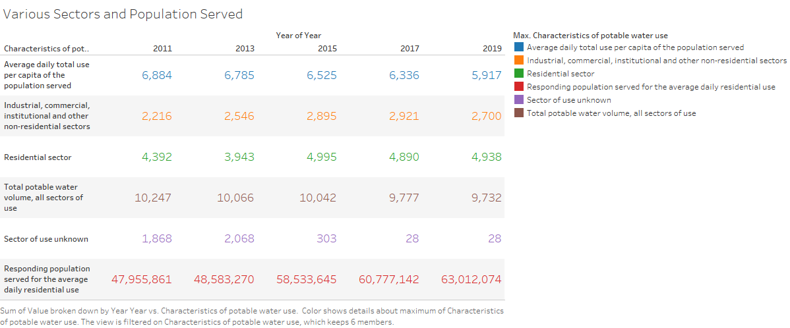
6) Depiction of potable water distribution in several areas and the amount of population served over past few years.

Slide 20
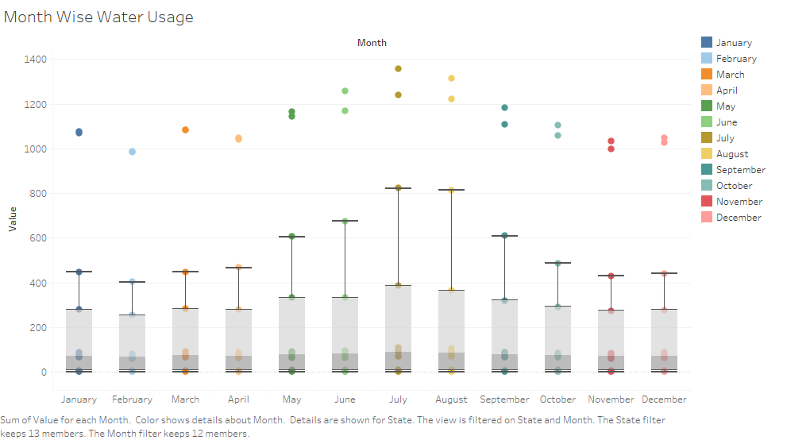
7) Which months have the highest water usage?
As we observed, the usage of potable water is usually high during summertime(May-Aug).

Slide 21
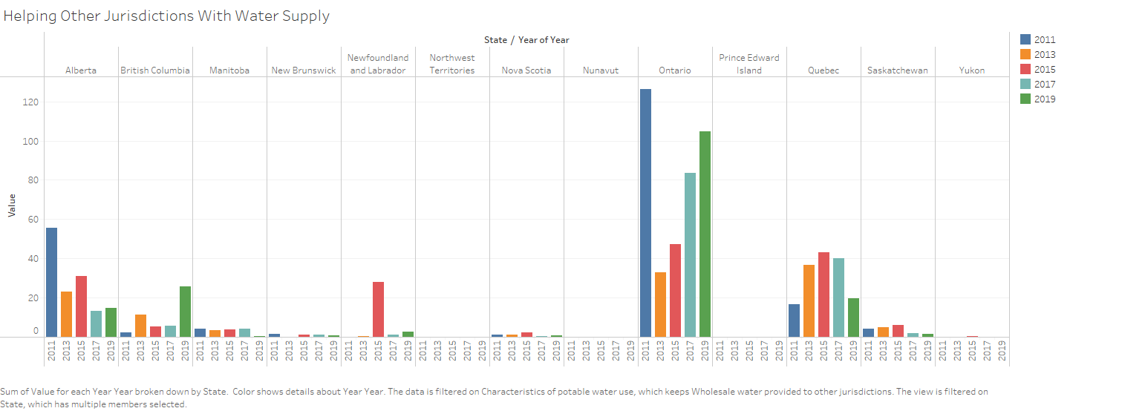
8) Which province supplies water to other Jurisdictions?
The above graph depicts that Ontario tops in the list of supplying water to other provinces followed by Quebec and Alberta.

Slide 22
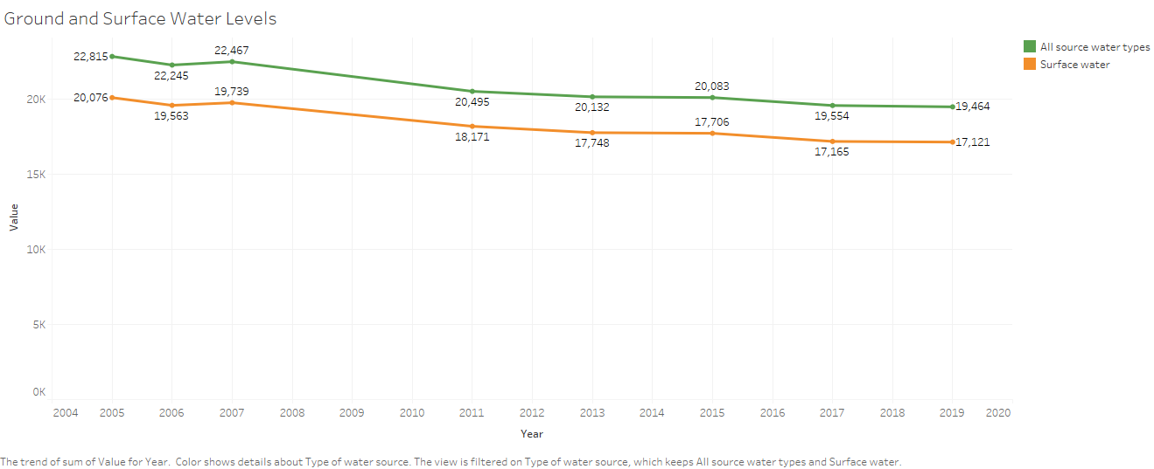
9) Ground and surface water levels in Canada over past few years.
As per the visualization above ground and surface water level is steadily decreasing.

Slide 23
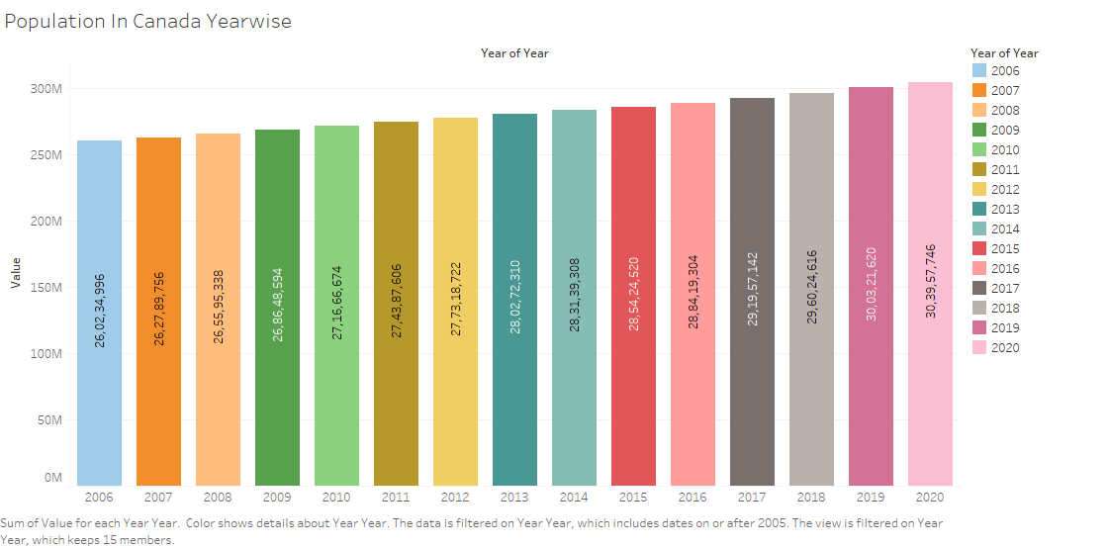
10) Population in Canada is rising constantly and as we have seen in the previous slide, ground and surface water levels are decreasing.

Slide 24
Conclusion
According to the findings, Quebec has a poor water management system that needs to be upgraded. Even being the most populous province, Ontario excels at water management and assists other jurisdictions with water delivery. Among all water-using sectors, the residential sector uses the most, followed by the industrial sector. When compared to other seasons, summer water demand is significantly higher. Every year, Canada's population grows at a rapid rate, but ground and surface water levels continue to decrease.

Slide 25
Recommendations
Canada can lead by example
As responsible water stewards, we can take further action to show the rest of the world how to conserve and sustainably use water. The major takeaways from these analysis are Non-revenue water(NRW),unaccountability of water and steadily decreasing Groundwater.
As per the data, Quebec is the top-most province for Non-revenue water. The NRW is basically produced, cleaned water which is lost somewhere in the water distribution system, never reaching its final destination. This means water not used or paid for, affecting local economies as well as local resources available. The govt should aim for efficient leakage recovery. Leaking pipes and equipment, due to bursts or breaks, is one of the primary causes to water loss. There should be quick assessment and repair tactics to resolve this kinds of causes.

Slide 26

Recommendations
Canada can lead by example
As per findings above, Quebec province has the highest unaccountability of water usage. There should be a proper mechanism to measure water usage. In Vancouver, commercial, industrial, and institutional customers are billed according to the water they consume. For residential customers, all homes on property over half an acre in size have water meters installed, while smaller properties pay a flat rate for water usage. There are currently no plans in Montreal to install water meters in every home.
As observed from analysis, Ground and surface water levels are steadily decreasing in Canada over past few years. Even where we might not use it directly as drinking water supply, we must still protect groundwater. The nation should apply possible measures to increase and protect the groundwater, since it will carry contaminants and pollutants from the land into the lakes and rivers from which other people get a large percentage of their freshwater supply. All levels of government in Canada are starting to take some of the actions necessary to protect our groundwater.

Slide 27

Thank You. Any questions?

