Slide 1
Potable Water Usage By SectoR In CANADA
DAB 103- Analytics Tools & Decision Making Project

Slide 2
Contents
Team Introduction
Background
/motivation
Problem Statement
Project Proposal
Analysis Questions
Dataset Description and EDA

Slide 3
DAB 103- Analytics Tools & Decision Making Project
GROUP - 007
1) Mohammed Anan Mansuri
2) Miloni Patel
3) Kush Patel
5) Mohammed Ahtesham Uddin
4) Priyal Patel

Slide 4
BackgroUNd/Motivation
Despite being one of the most water-rich nations in the world, for generations Canada has been unwilling to guarantee access to clean water for Indigenous peoples. The water in dozens of communities has been considered unsafe to drink for at least a year – and the government admits it has failed. In 2016, there were 105 communities with long-term drinking water advisories in place –meaning the water had been unsafe to use or consume for at least a year. As of late April 2021, that number is down to 52 advisories in 33 communities.
Ref: https://www.sac-isc.gc.ca/eng/1506514143353/1533317130660
Notes:
Consider talking about:
Case Studies

Slide 5
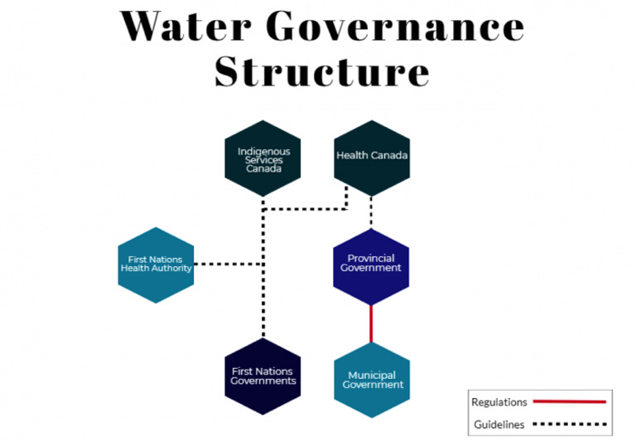
Ref: https://globalreportingcentre.org/lytton-water/img/water-governance.jpg

Slide 6
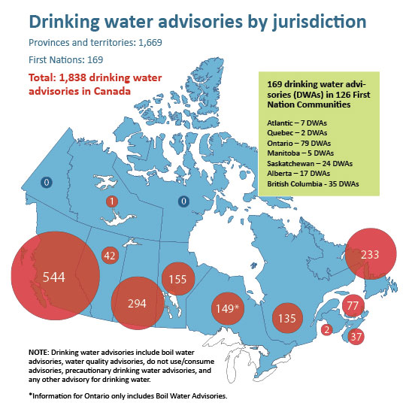
Drinking water advisories are issued to warn people to not drink water that may be unsafe or is known to not be safe based on water quality test results.
Ref: https://canadians.org/sites/default/files/inline-images/DrinkingWater-Report-map.jpg

Slide 7
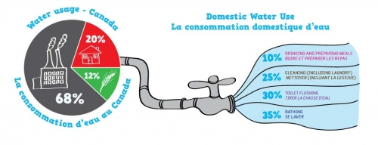
Water Usage In CANADA
10% | Drinking and preparing meals
25% | Cleaning (including laundry)
30% | Toilet flushing
35% | Bathing
Ref: https://www.mcgill.ca/waterislife/waterathome/how-much-are-we-using

Slide 8
Problem Statement
Better insights on the supply and demand of drinkable water by different sectors is needed by the Government of Canada and First Nations authorities. Our water supplies are becoming increasingly vulnerable to contaminants, urbanization, shifting land uses, climate change, and we are facing a water-insecure future as Canada's population grew by 156,503 year over year due to international migration. Setting up water treatment infrastructure is a logistical problem due to Canada's large territory and the varied locations of 630 First Nations communities, some of which are only accessible by plane.
Ref: https://www.theguardian.com/world/2021/apr/30/canada-first-nations-justin-trudeau-drinking-water

Slide 9
Project Proposal
Our project team will create a descriptive analytics product which shows potable water usage in Canada by different sectors, the amount of water loss and how the potable water usage has increased over past few years and how can we prepare for future as the population in the country is on rise. Canadians know the importance of our freshwater supply, but by understanding how we use it and where it goes, we can use our supply even more responsibly.
Notes:
Consider talking about:
Improving access
Reclaimed water
Purification
Global programs

Slide 10
Analysis Questions
Which province has the highest and lowest water loss?
Which province has most unaccountable water usage?
Which province provides water to other Jurisdictions?
Which province is best in managing potable water distribution?
Industries and non-residential sectors are provided with potable water.
Households are not provided with grey water for cleaning purpose.
Loss of water during distribution is the major problem.
Large proportion of water usage is unknown.
The government does not track waterborne illnesses in First Nations communities, or potential deaths that could be related to water quality.
Ref: https://storymaps.arcgis.com/stories/cbdc979bf27642bfba51689ca3c180e8
Notes:
Consider talking about:
Contaminant Reduction through Policy & Market Improvements
Water treatment options

Slide 11
DATAset DEscription
The analysis is based on potable(drinking) water use by sector and average daily use dataset obtained from statistics Canada source.
We are using four datasets for this analysis.
First one is potable water usage by province, second is population in Canada yearly, third is water availability from different sources and the last one is water usage by month.
The first dataset consists year wise data of water usage from 2011 to 2019 for various provinces of Canada, the second one has data from 1950-2021 and the third, fourth have data from 2005-2019 respectively.
The analysis we are going to perform on includes sectors namely:
Residential, Industrial, commercial, institutional, other non-residential sectors and Responding population served for the average daily residential use.

Slide 12
DATAset DEscription
Total Volume of water supply and demand Canada had from 2011-2019.
Yearly Surface and ground water levels in various Canadian provinces.
Monthly water consumption in various Canadian provinces from 2006-2020.
All the values described in datasets are in cubic meters.
Links to the dataset used: https://www150.statcan.gc.ca/t1/tbl1/en/tv.action?pid=3810027101
https://www150.statcan.gc.ca/t1/tbl1/en/tv.action?pid=1710000901
https://www150.statcan.gc.ca/t1/tbl1/en/tv.action?pid=3810009201
https://www150.statcan.gc.ca/t1/tbl1/en/tv.action?pid=3810027201

Slide 13
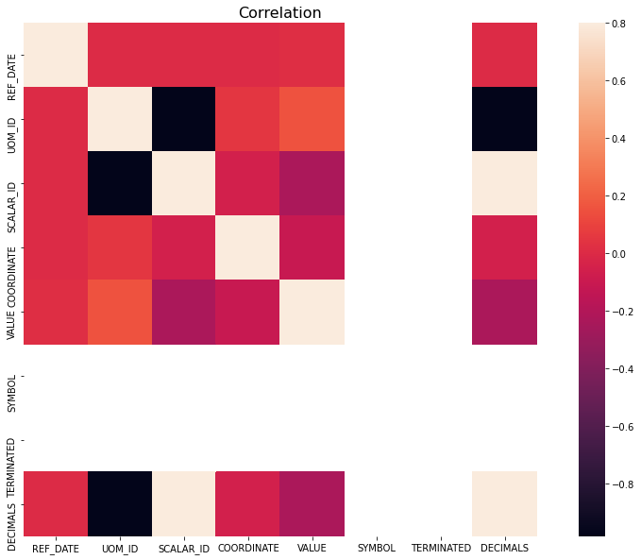
preliminary VISUALIZATIONS
Heatmap for the correlation coefficients which quantify the association between variables and features of a dataset.

Slide 14
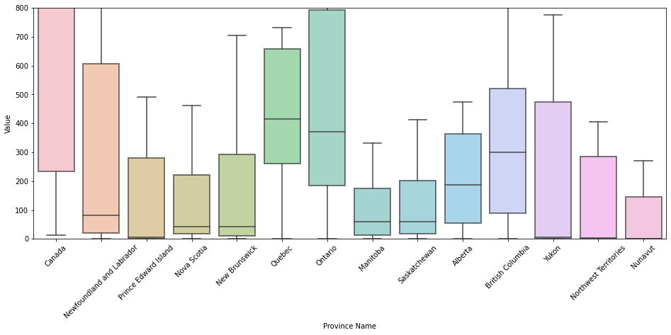
preliminary VISUALIZATIONS
Boxplot for various provinces of Canada and their associated values in the dataset

Slide 15
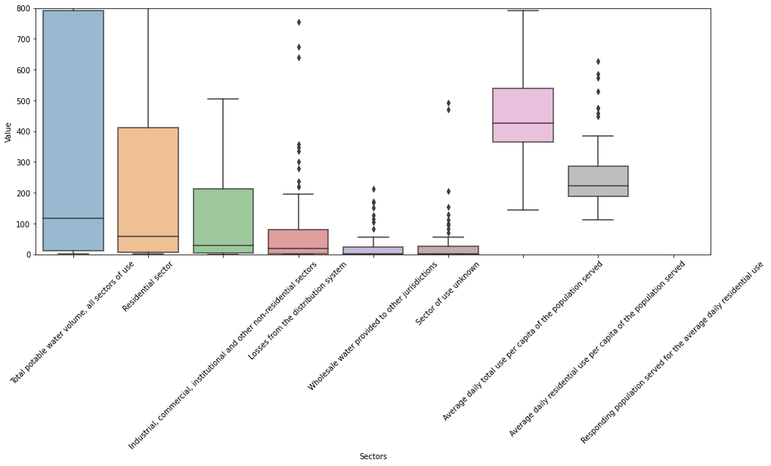
preliminary VISUALIZATIONS
Boxplot for various sectors of water usage in Canada and their associated values in the dataset.

Slide 16
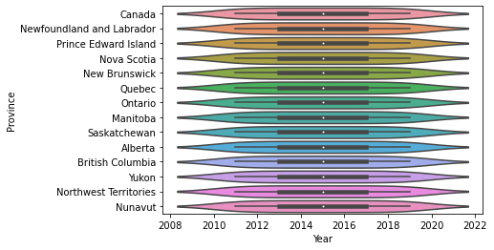
preliminary VISUALIZATIONS
Violin plot for various provinces of water usage in Canada and their associated years in the dataset.

Slide 17
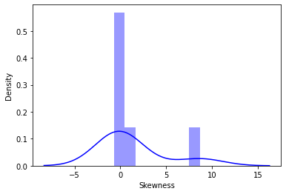
preliminary VISUALIZATIONS
Dist plot for measuring skewness of the data.

Slide 18

Second Submission

Slide 19
DATA Cleaning and tranformation
In the potable water usage dataset added country column and removed columns named: DGUID,UOM_ID,SCALAR_ID,VECTOR,COORDINATE,STATUS,DECIMAL,
SYMBOL,TERMINATED.
In the year wise population dataset sliced the data from the 2006-2021 and added country column.
Removed rows which have invalid or incomplete records.
Changed the datatype of year to date from string and other variables as per the use.
Renamed the columns in an easy understandable format.
Did not remove the outliers.
Used python for data cleaning and transformation before feeding the data to tableau.
Made sure the data is in consistent state.

Slide 20
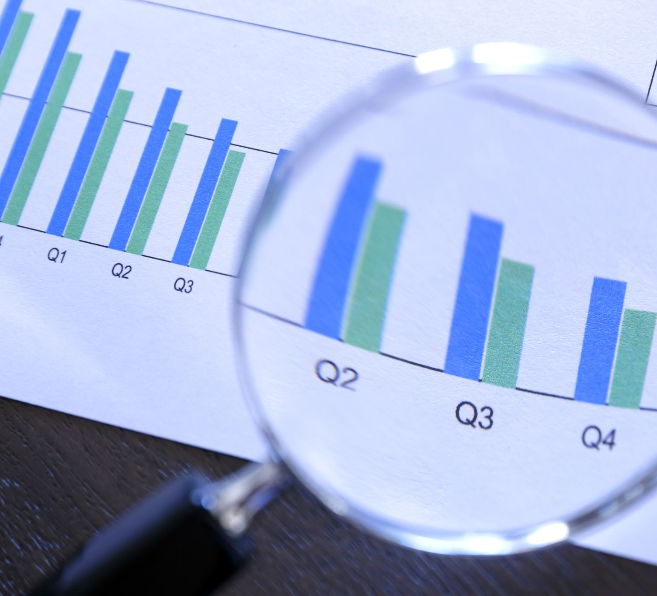
Data Analysis

Slide 21
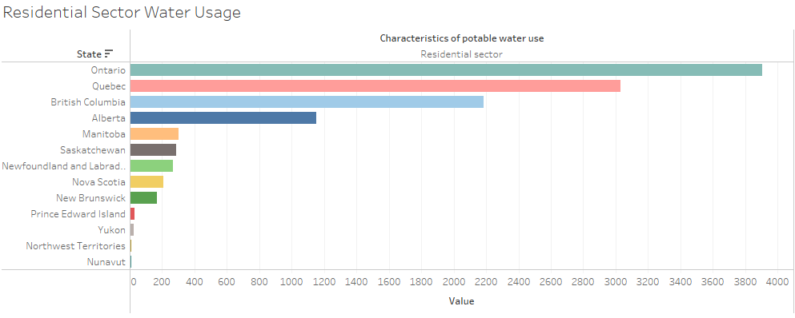
1) Which province in Canada has the highest residential water usage?
As we can see from the visualization that Ontario has the highest water usage from past 10 years followed by Quebec and British Columbia.

Slide 22
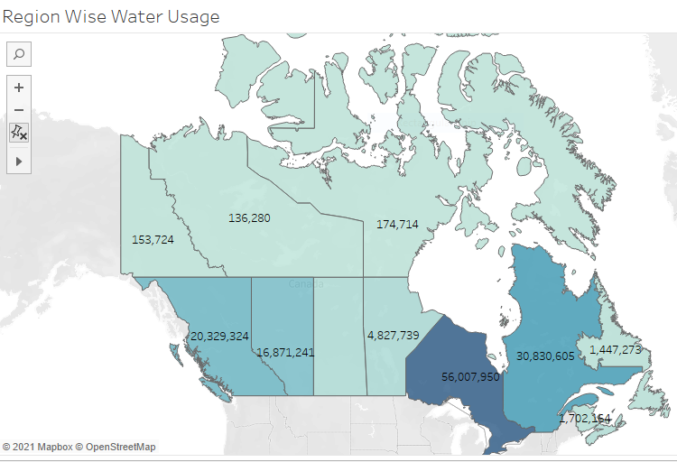
2) Which province in Canada has the highest water usage?
As we can see from the visualization that Ontario has the highest water usage from past 10 years followed by Quebec and British Columbia.

Slide 23
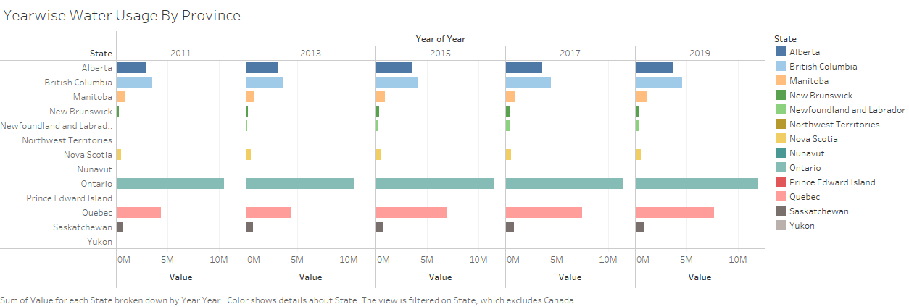
3) Year-wise water usage in various provinces of Canada.
We can see from the visualization that all provinces have observed a gradually increasing trend in water usage, especially in Newfoundland and Quebec province.

Slide 24
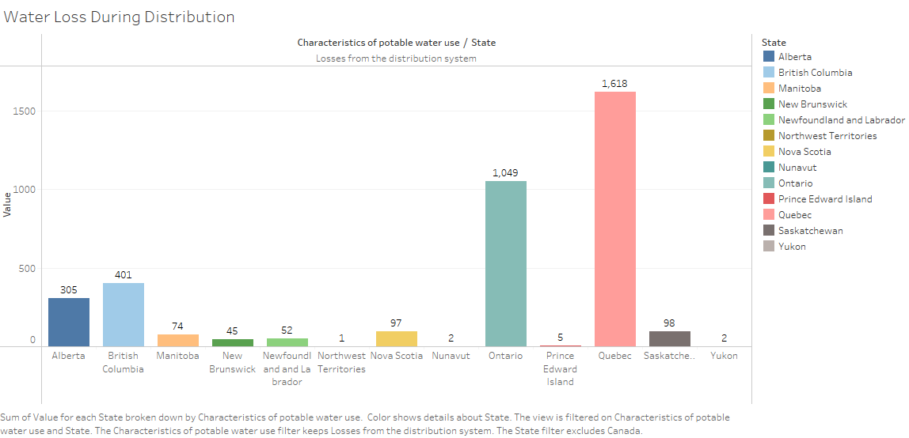
4) Which province has highest and lowest water loss during distribution in Canada?
We can see from the visualization that Quebec province has the highest and northwest territories have lowest water loss from distribution system.

Slide 25
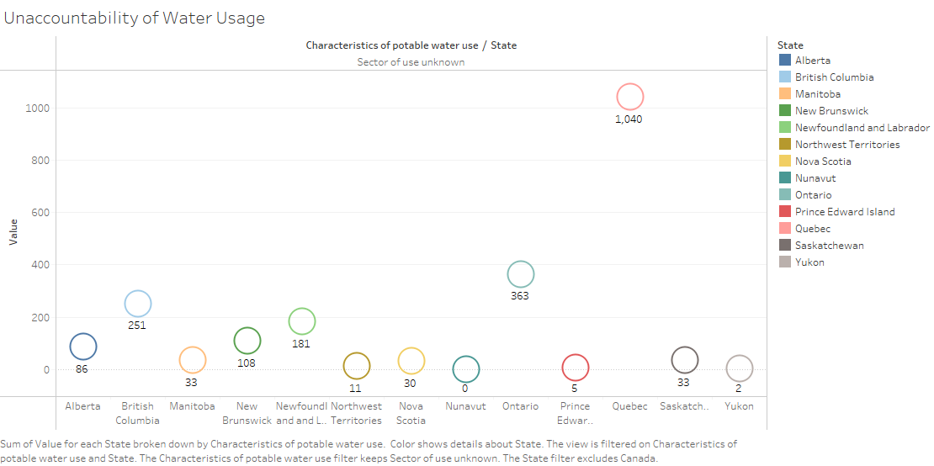
5) Which province has highest and lowest unknown usage of water in Canada?
As per the data Quebec province has the highest unaccountability of water usage and Yukon have lowest water loss from distribution system.

Slide 26
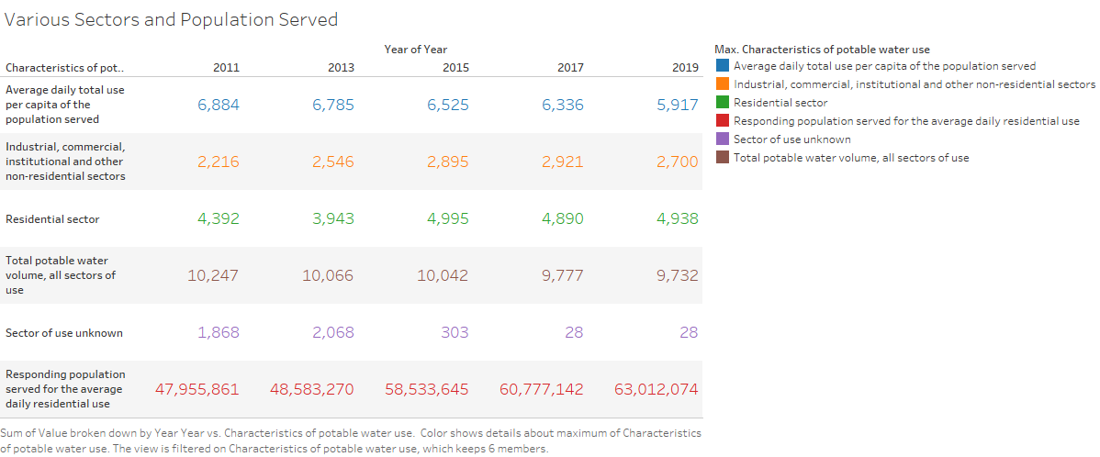
6) Depiction of potable water distribution in several areas and the amount of population served over past few years.

Slide 27
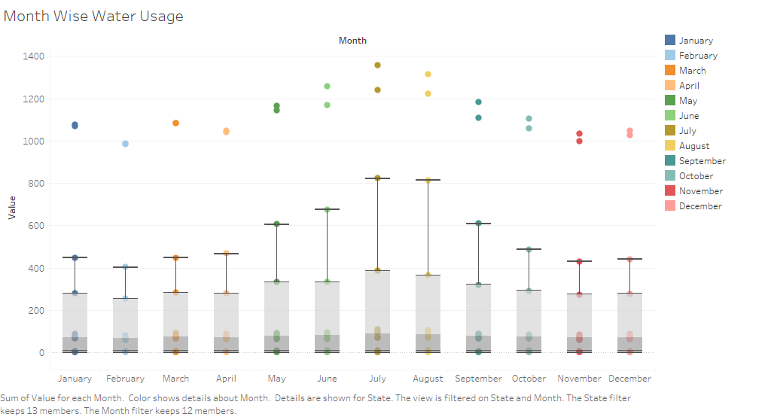
7) Which months have the highest water usage?
As we observed, the usage of potable water is usually high during summertime(May-Aug).

Slide 28
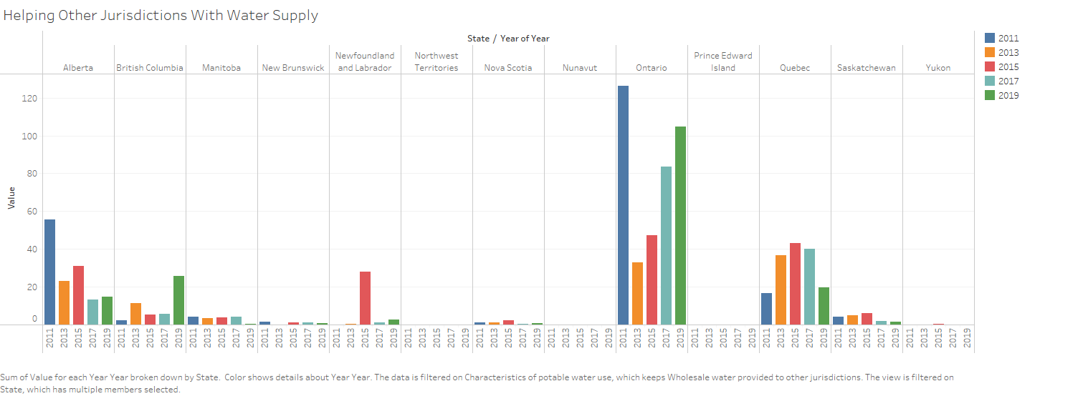
8) Which province supplies water to other Jurisdictions?
The above graph depicts that Ontario tops in the list of supplying water to other provinces followed by Quebec and Alberta.

Slide 29
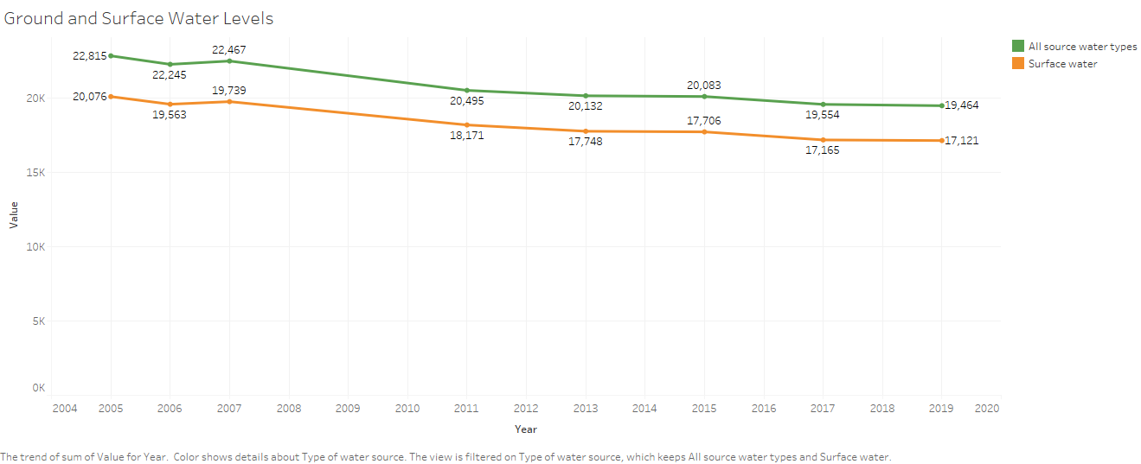
9) Ground and surface water levels in Canada over past few years.
As per the visualization above ground and surface water level is steadily decreasing.

Slide 30
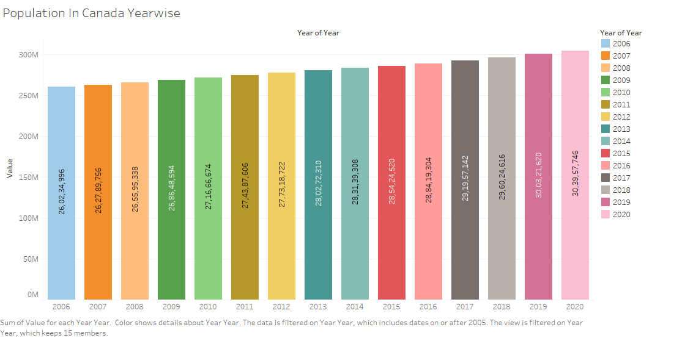
10) Population in Canada is rising constantly and as we have seen in the previous slide, ground and surface water levels are decreasing.

Slide 31
Conclusion
According to the findings, Quebec has a poor water management system that needs to be upgraded. Even being the most populous province, Ontario excels at water management and assists other jurisdictions with water delivery. Among all water-using sectors, the residential sector uses the most, followed by the industrial sector. When compared to other seasons, summer water demand is significantly higher. Every year, Canada's population grows at a rapid rate, but ground and surface water levels continue to decrease.

Slide 32
Recommendations
Canada can lead by example
As responsible water stewards, we can take further action to show the rest of the world how to conserve and sustainably use water. Fitting faucets with aerators and installing modern, dual-flush toilets help to achieve the same results with much less water, while simple habit changes like only washing full loads of clothes and turning the tap off while brushing teeth also result in substantial savings. And it all adds up—just reducing time spent showering by two minutes can save around 2,600 liters of water per month, and not pre-rinsing dishes before loading the dishwasher saves up to 75 liters per load.
These are small, water-conscious choices that each of us can make every single day. And, if a water-rich country like Canada continues to reduce its consumption, the rest of the world will likely agree that they should, too.
Ref: https://www.nationalgeographic.com/science/article/partner-content-where-our-water-goes-canada

Slide 33

Thank You. Any questions?

