Slide 1
GROUP 13
GAME THEORY

Slide 2
GROUP 13
NAME | REGISTRATION NO. | STUDENT NO.
TIMOTHY MASIKO | 16/U/6880/PS | 216004877
ANTHONY ISINGOMA MBAHE | 16/U/7002/PS | 216004870
JASON KIGOZI | 16/U/5972/EVE | 216013407
MARGARET NJOGEDDE NASSIWA | 16/U/10024/PS | 216002556

Slide 3
GAME THEORY
Game theory is the study of mathematical models of conflict and cooperation between intelligent rational decision-makers.
Game theory is mainly used in economics, political science, and psychology, as well as in logic and computer science.
It is a tool used to analyze strategic behavior by taking into account how participants expect others to behave.

Slide 4
GAMES
A game is a system wherein adaptive agents are interdependent in affecting each other and the overall outcome.
A game is an interaction between multiple people in which each person’s payoff is affected by the decisions made by others. A game within game theory is any situation involving interdependency between adaptive agents.
A game has three major components: players, strategies, and payoffs.
A player is a decision maker in a game.
A strategy is a specification of a decision for each possible situation in which a player may find themselves.
A payoff is a reward or loss that players experience when all the players follow their respective strategies.

Slide 5
Types of games
Cooperative and Non cooperatives games
Zero-sum and Non zero-sum games
Symmetric and Asymmetric games
Perfect information and imperfect information
Combinatorial games

Slide 6
Types of games…
Cooperative Games
A cooperative game is one in which there can be cooperation between the players and they have the same cost. Players are able to form binding commitments externally enforced for example through contract law. In cooperative games, every player loses or wins.
Non Cooperative Games
A non-cooperative game is one where an element of competition exists and there are limited mechanisms for creating institutions for cooperation. Players cannot form alliances.

Slide 7
Types of games…
Zero-sum games
Zero-sum games are a special case of constant-sum games, in which choices by players can neither increase nor decrease the available resources. In zero-sum games the total benefit to all players in the game, for every combination of strategies, always adds to zero (more informally, a player benefits only at the equal expense of others)
In zero-sum games, the relationship between the agents' payoffs are negatively correlated, which is called negative interdependence meaning individuals can only achieve their goal via the failure of another agent and this creates an attractor towards competition, there is no incentive to cooperate and thus these games are called strictly competitive.

Slide 8
Types of games…
Non zero-sum games
Non-zero sum games are those in which the total value to be distributed can increase or decrease depending on the degree of cooperation between actors.
With non-zero sum games, we can get positive interdependence between the agents, meaning members of a group come to share common goals and perceive that working together is individually and collectively beneficial, and success depends on the participation of all the members leading to cooperation.

Slide 9
Types of games…
Symmetric games
A symmetric game is a game where the payoffs for playing a particular strategy depend only on the other strategies employed, not on who is playing them. If the identities of the players can be changed without changing the payoff to the strategies, then a game is symmetric.
Asymmetric games
In asymmetric games, the payoffs to individuals for the different possible actions may not be the same.

Slide 10
Types of games…
Combinatorial games
Combinatorial games are games in which the difficulty of finding an optimal strategy stems from the multiplicity of possible moves.
Other types of games; Perfect information and imperfect information, Simultaneous / Sequential, Infinitely long games, Differential games, Many player and many population games, Stochastic games, Meta games, Pooling games.

Slide 11
REPRESENTATION OF GAMES
Extensive Form Games
These are the ones in which the description of the game is done in the form of a decision tree.
Representation of events that can occur by chance.
Suppose A wants to enter a new market, while B is the existing item in that marked.
A has 2 strategies:
One is to enter the market and the challenge to survive
Or do not enter the market and remain deprived of the profit that it can earn.

Slide 12
Extensive form games…
B has its two strategies.
To fight for its existence or
To cooperate with A
If A doesn’t enter, payoffs would be zero. If it enters, the situation would be dependent on B.
If they both get into war, they suffer a loss of 3.
If B cooperates, the both would earn equal profits.

Slide 13
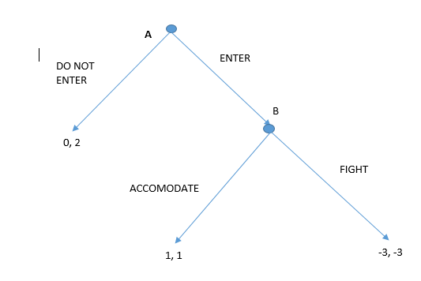

Slide 14
Normal form games
Representations are not graphical. They are by matrix.
Used in identifying strictly dominated strategies and Nash Equilibria, some information is lost as compared to extensive form representations.
The matrix to the right is a normal form representation of a game in which players move simultaneously(or at least do not observe the other player’s move before they make their own) and receive payoffs as specified for the combinations of actions played
For example;
If player 1 plays top and player 2 plays left, player 1 receives 4 and player 2 gets 3.
In each cell, the first number represents the payoff to the row player(in this case player 1). And the second payoff represents the payoff to the column player(player 2).

Slide 15
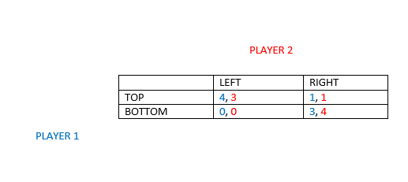

Slide 16
The Game theory as used in decision making
The Nash Equilibrium and Pareto Optimal
The Nash Equilibrium is a fundamental concept in the theory of games and the most widely used method of predicting the outcome of a strategic interaction in the social sciences.
We should be able to make certain predictions about how games will play out. Both players should search for a strategy that optimizes their payoff, and where those strategies of the players interact we should have a stable outcome, that we should be able to predict will occur. This stable outcome is what we call an equilibrium.
Because actors in a game are trying to optimize their payoff, they will both naturally gravitate towards the strategy that gives them the highest payoff.

Slide 17
The Nash Equilibrium
But because their payoff is dependent on what strategy the other chooses and because they can not depend upon cooperation between them, they have to choose the best strategy assuming that the other will work to optimize their payoff without cooperating.
A set of strategies one for each player, such that no player has the incentive to change his or her strategy given what other players are doing
A pure strategy in Nash equilibrium is when players do not randomize between 2 or more strategies
A good way of demonstrating the Nash Equilibrium is by using the Prisoner’s Dilemma
The prisoner's dilemma game is a classic two player game that is often used to present the concept of Nash equilibrium in a payoff matrix form.

Slide 18
The Prisoner’s Dilemma
“Two suspects, A and B, are arrested by the police. The police does not have sufficient evidence to find the culprit and, having locked up the two prisoners in two different cells, questioned both by offering them the following prospects: if one confesses (C) and the other does not confess (NC) he has not confessed will serve 10 years in prison while the other will be free; if both do not confess, then the police will condemn them to one year in prison; if, however, confess both worth to be served will be equal to 5 years in prison. each prisoner can reflect on the strategy to choose from, in fact, confess or not to confess. in any case, neither of the two prisoners may know the choice made on the other prisoner”.
MATRIX FOR PRISONER’S RESPONSE
Basing on the Nash Equilibrium, it is best for both prisoners to confess in order to optimize their pay off.
prisoner A/ prisoner B | confesses | Not confesses
confesses | -5, -5 | 0, 10
Not confesses | -10, 0 | -1, -1

Slide 19
Pareto Optimal
Whereas Nash Equilibrium is a solution concept of non-cooperative games, Pareto optimality in game theory answers a very specific question of whether an outcome can be better than the other?
Pareto optimality is a notion of efficiency or optimality for all the members involved. An outcome of a game is Pareto optimal if there is no other outcome that makes every player at least as well off and at least one player strictly better off. That is to say, a Pareto optimal outcome cannot be improved upon without hurting at least one player. Pareto optimality is not a solution concept, but it can be an important attribute in determining what solution the players should play, or learn to play over time.

Slide 20
Use case example of game theory in R
The Monty Hall Game
You are a contestant in a game show in which a prize is hidden behind one of three doors. You will win the prize if you select the correct door. After you have picked one door but before the door is opened, the emcee lifts one of the other doors, revealing a goat, and asks if you would like to switch from your current selection to the remaining door. How will your chances change if you switch?

Slide 21
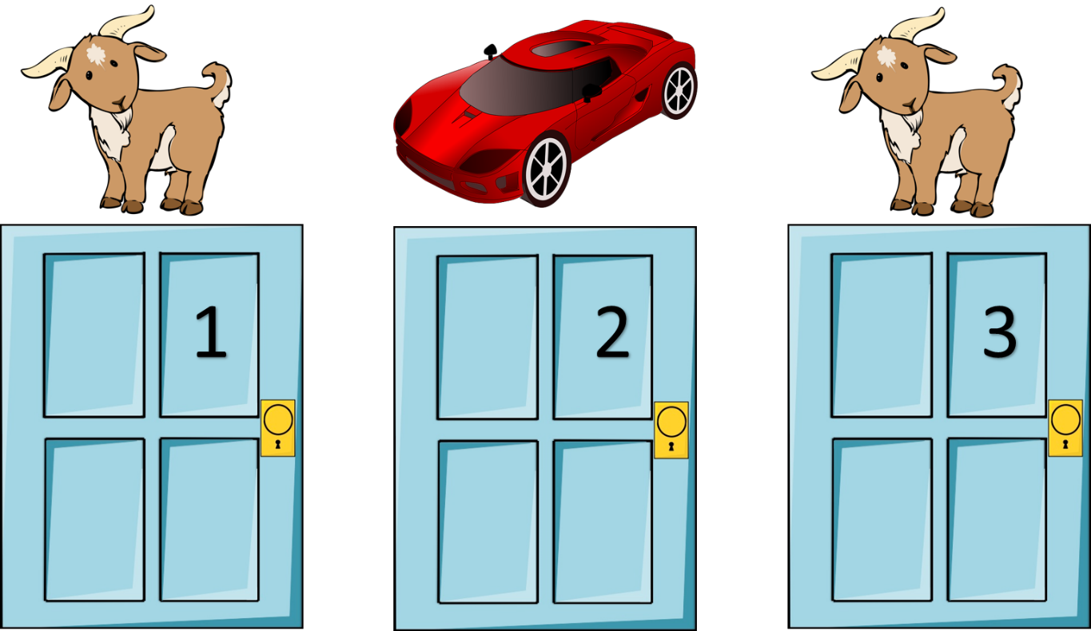
Monty Hall…

Slide 22
Monty Hall…
The best thing to do is to switch as it increases the probability of you winning. It is not guaranteed that you will when you switch but in the long run as you continue playing the game, the number of wins will be more than the number of losses.

Slide 23
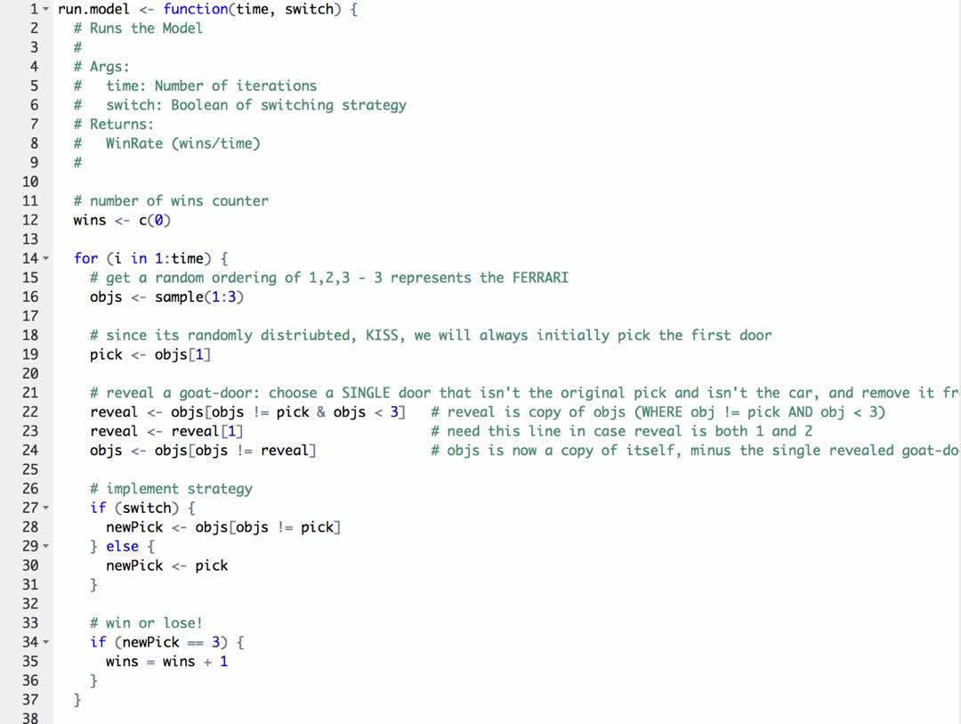
CODE SNIPPETS

